Slide 1
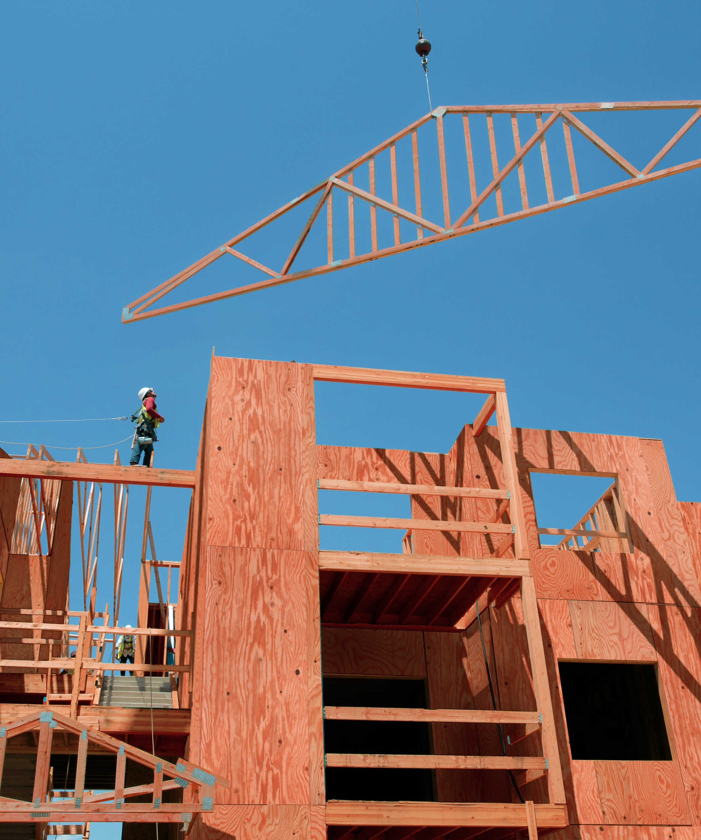
FIRE-RETARDANT WOOD PROVIDES SAFETY, RELIABILITY & VALUE
Course #PWFR-101
UFP Retail, LLC | AIA Provider #404109561

Slide 2
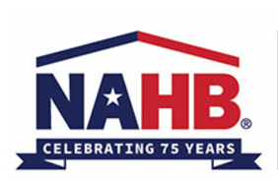
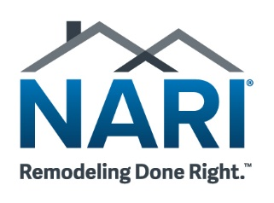
CEU CERTIFICATION
UFP Retail Solutions, the parent company of ProWood®, is a registered provider with The American Institute of Architects Continuing Education Systems (AIA CES). Credit earned on completion of this program will be reported to CES Records for AIA members. Certificates of Completion for non-AIA members are available on request.
This program is registered with AIA, NARI, and NAHB for continuing professional education. As such, it does not include content that may be deemed or construed to be an approval or endorsement by the AIA/NARI/NAHB of any material of construction or any method or manner of handling, using, distributing or dealing in any material or product. Questions related to specific methods, and services will be addressed at the end of this presentation.

Slide 3
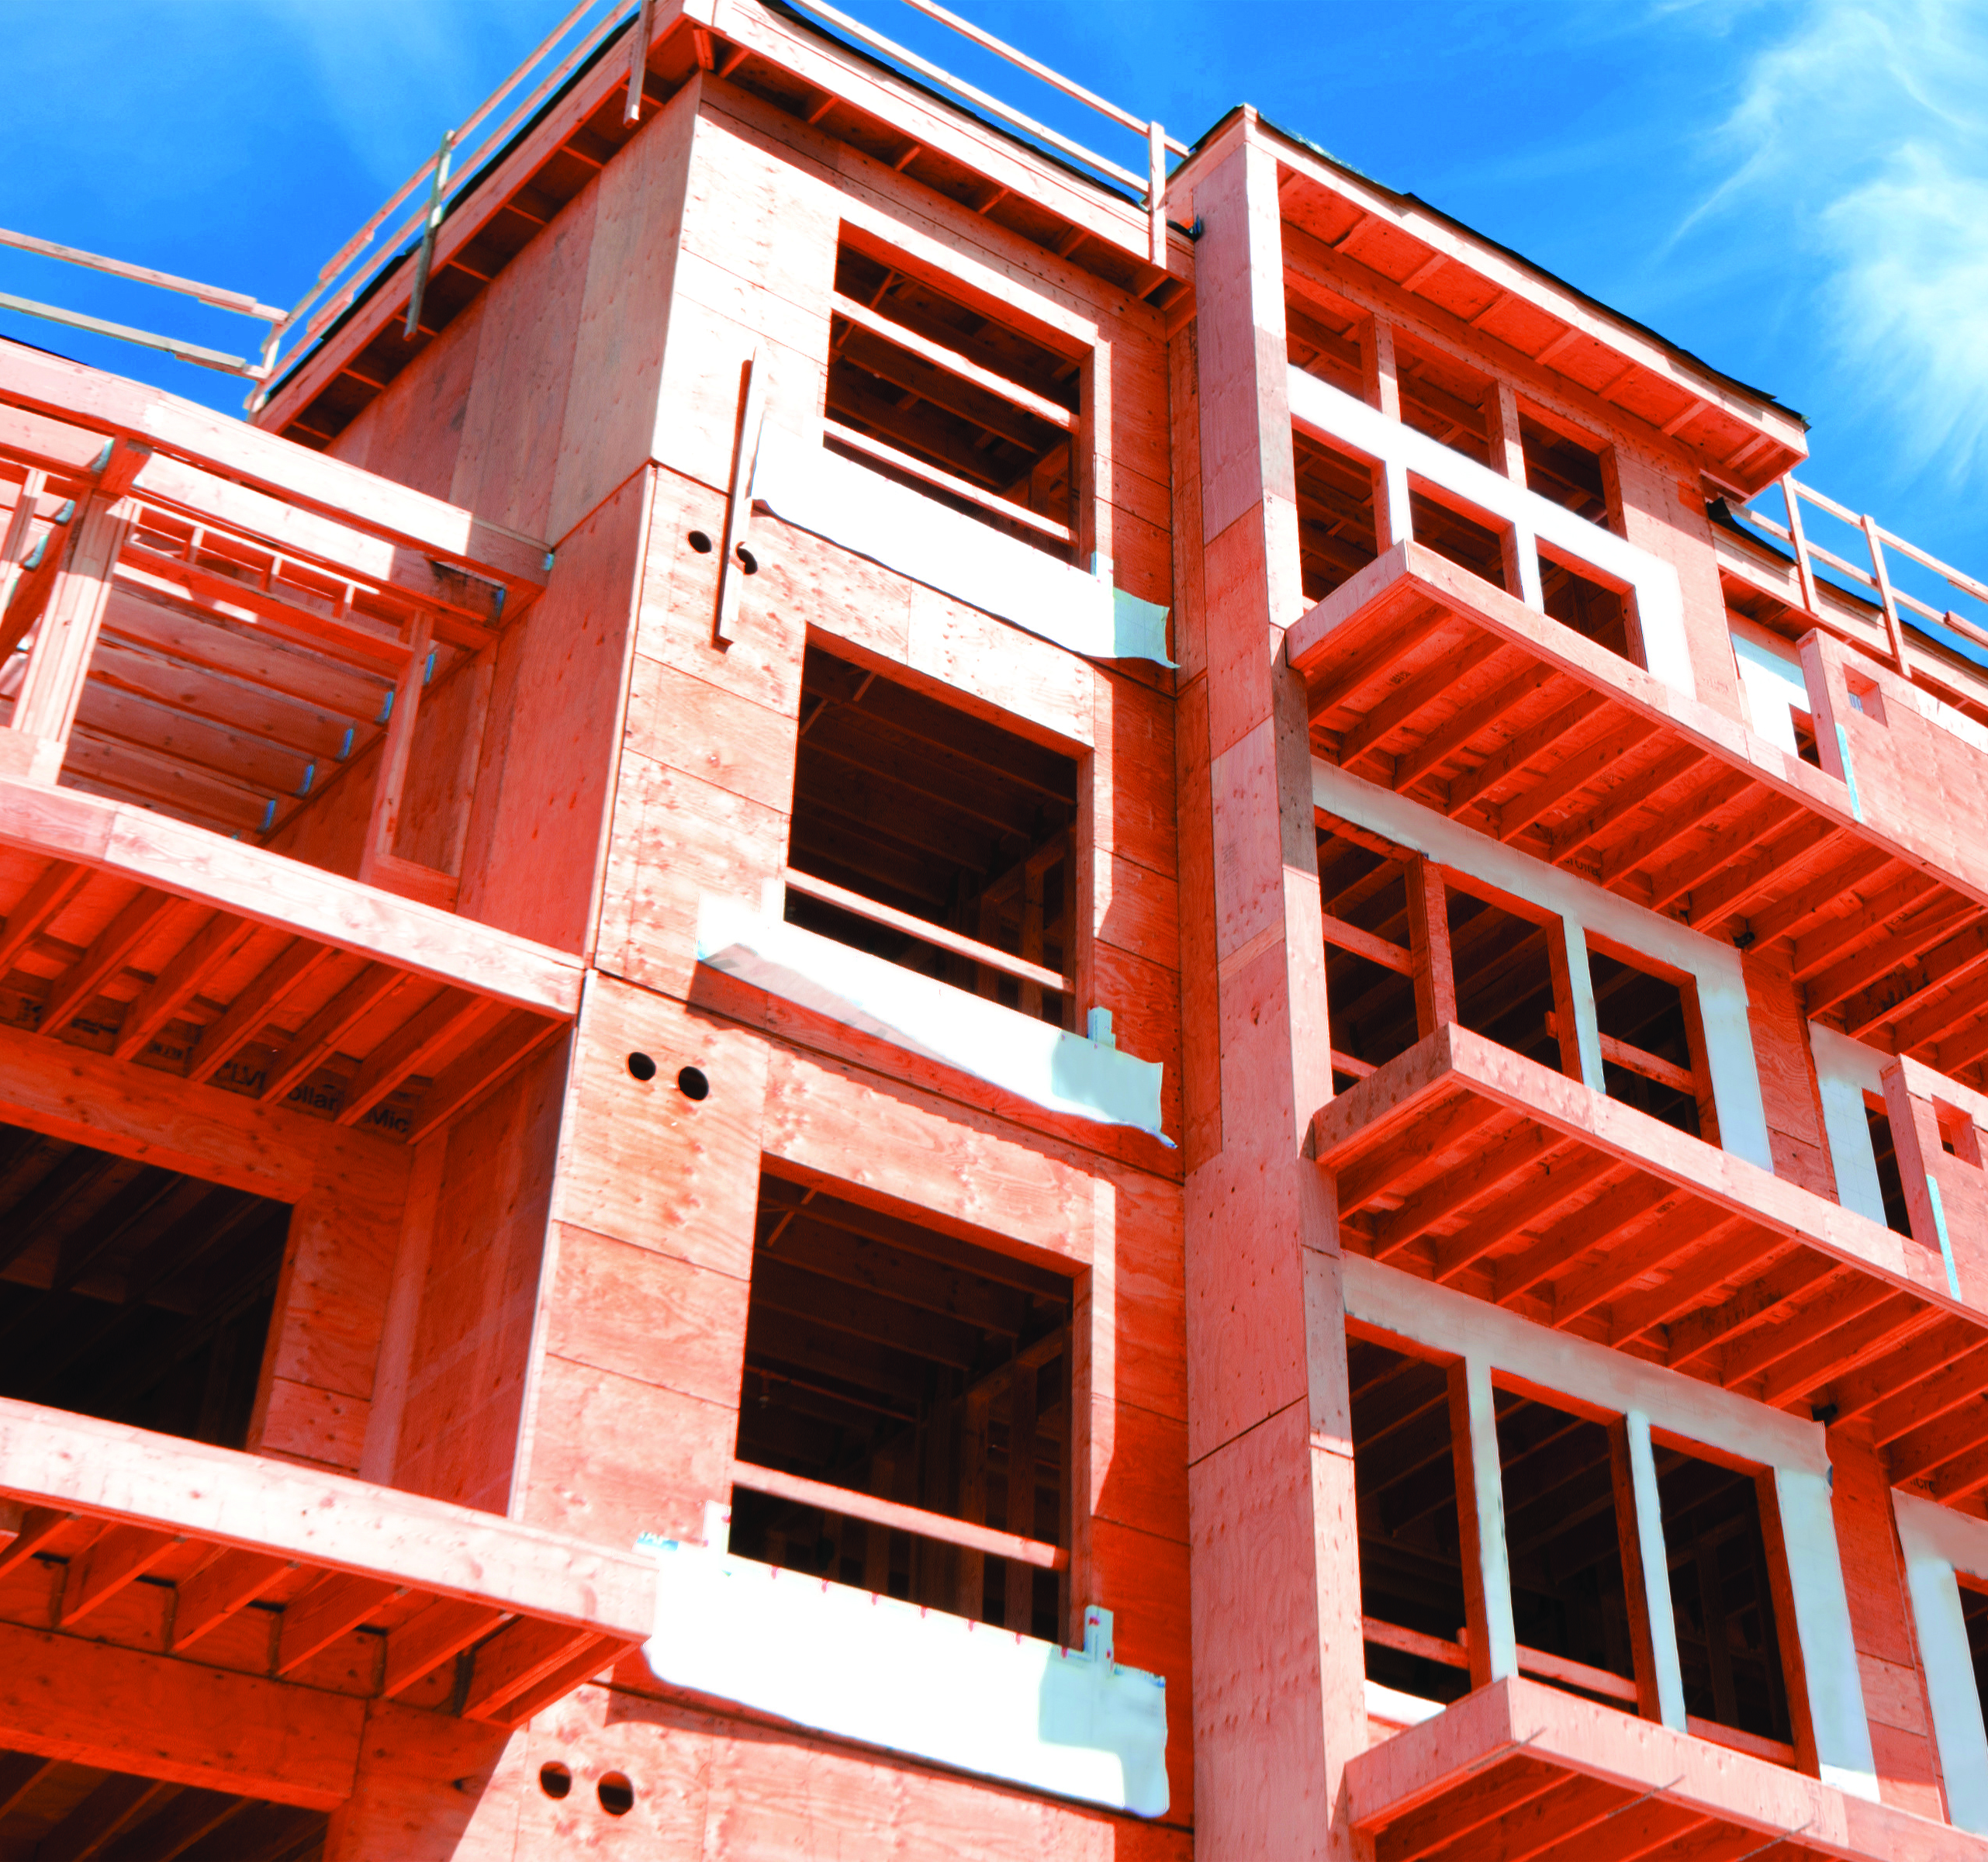
COPYRIGHT MATERIALS
This presentation is protected by U.S. and international copyright laws. Reproduction, distribution, display and use of the presentation without written permission of ProWood or UFP Retail Solutions is strictly prohibited.
© ProWood 2022
© UFP Retail, LLC

Slide 4
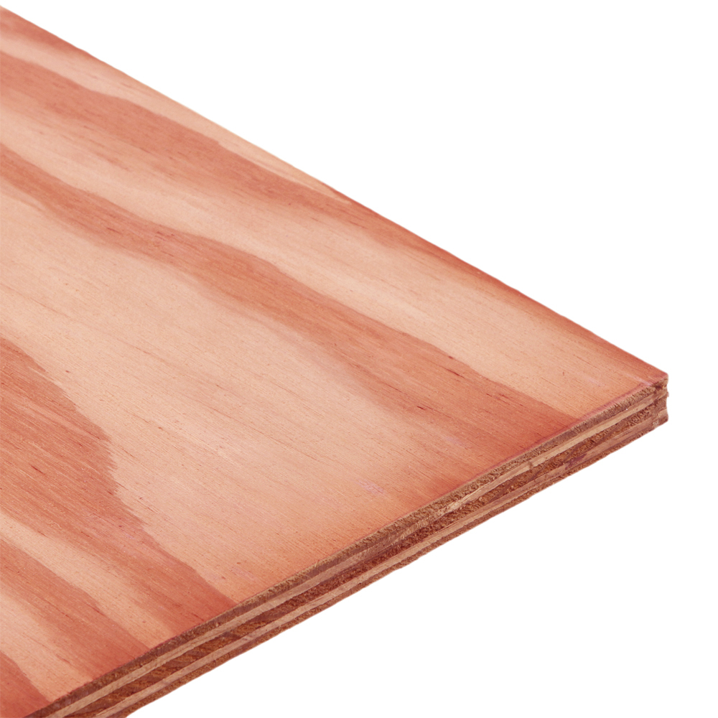
COURSE OVERVIEW
Fire-retardant wood is a common and increasingly required building construction material
In this course, you will learn about fire-retardant wood attributes, manufacturing, code compliance and testing
We will also cover common applications as well as proper storage and handling

Slide 5
WHY FIRE-RETARDANT WOOD?
The probability of wildfire in the US continues to increase geographically as well as in frequency and size
WUI (Wildland-Urban Interface) codes continue to be adopted by more municipalities
In 2021, US fire departments responded to approximately 340,000 fires occurring in home properties, including one- or two-family homes and apartments or other multifamily housing**
Represents 25% of all fire responses**
However, these fires caused 75% of civilian fire deaths and 76% of injuries**
Ultimately, fire-retardant wood is a strong, reliable building material consideration providing safety and protection against the real threat of fire
*Wildfire Today, 2022.
**National Fire Protection Association (NFPA), 2022.

Slide 6
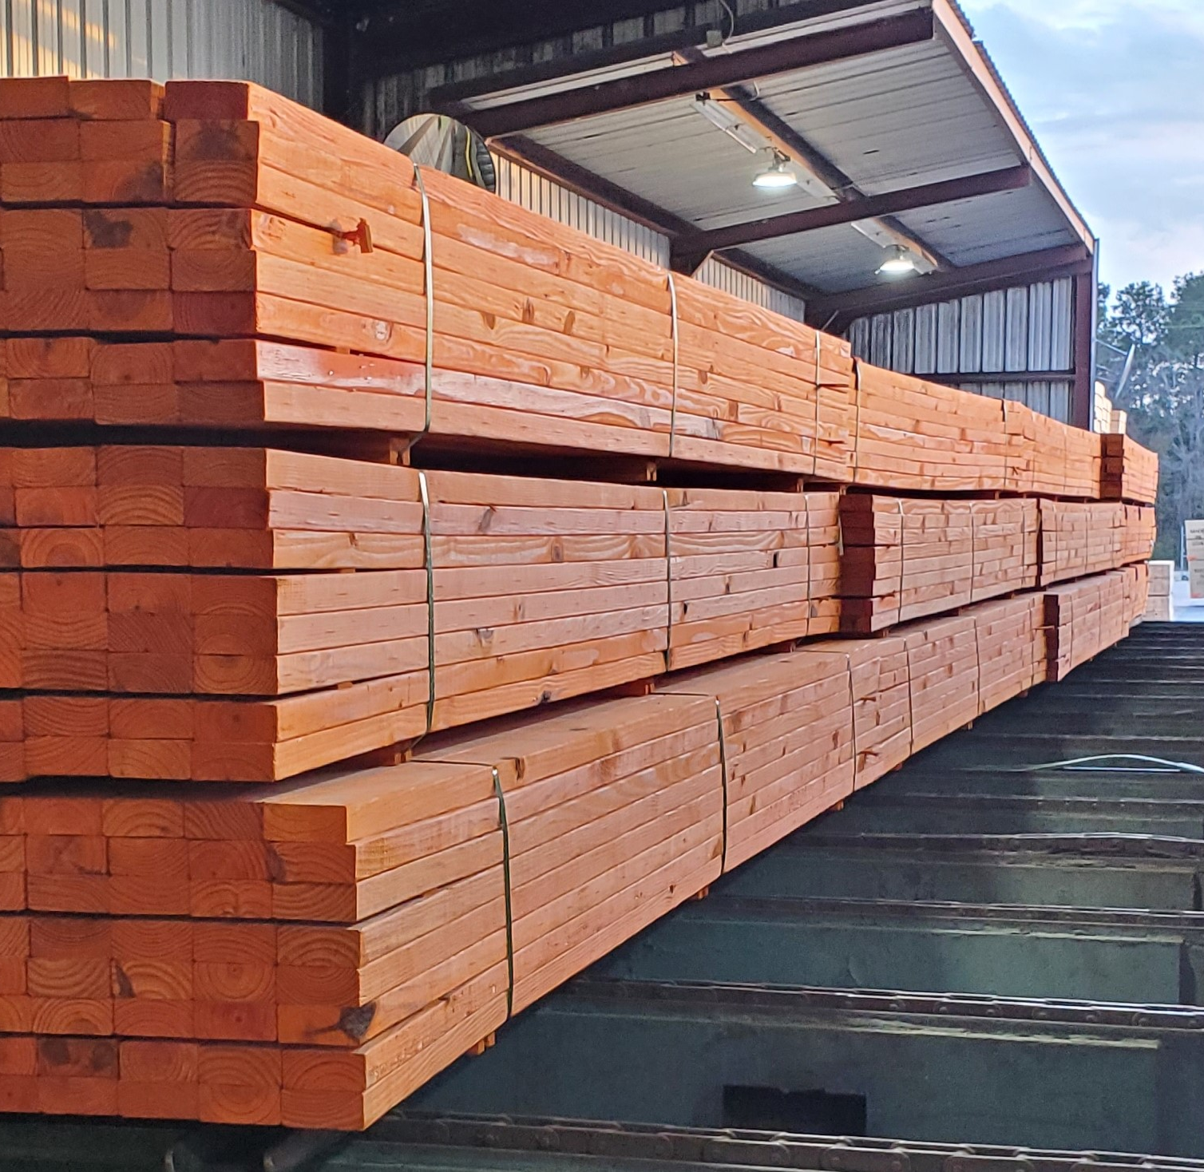
LEARNING OBJECTIVES
1
Product Attributes
Manufacturing Process
Building Code Acceptance
Common Product Uses
Storage and Handling Requirements
2
3
4
5

Slide 7
LEARNING OBJECTIVES
At the completion of this course, you should be able to:
List the product attributes of fire-retardant wood.
Describe the stages of the manufacturing process of fire-retardant lumber, including the pressure treatment process as noted in the International Building Code (IBC).
Explain the importance of building code compliance for the safe and proper usage of fire-retardant wood, including minimizing issues related to flame spread.
Identify common uses of fire-retardant wood products.
Discuss the various storage and handling requirements of fire-retardant lumber.
1
2
3
4
5

Slide 8
Learning Objective #1
PRODUCT ATTRIBUTES
FIRE-RETARDANT WOOD PROVIDES SAFETY, RELIABILITY & VALUE

Slide 9
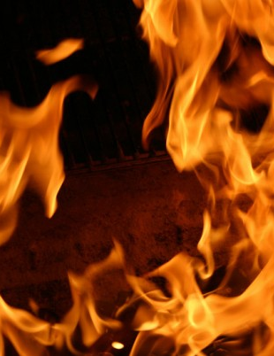
PRODUCT ATRRIBUTES
WHAT IS IN
FIRE-RETARDANT WOOD?
The fire-retardant elements within most fire-retardant wood products include:
A blend of phosphate powder (the salt of phosphorus)
Boric acid powder
Water for dilution
The Carbon Dioxide reaction of these elements creates a char around the wood, insulating and suppressing the spread of fire
In addition to suppressing fire, this also suppresses the development of smoke
Typically, the species of wood used is a variety of Spruce, Pine or Fir
Phosphorus is a common additive in fire retardants
For example, Ammonium Polyphosphate – the common compound applied to wildfires – contains 70-72% Phosphorus
Notes:
Phosphorus is a common ingredient in fire-retardant. For example, Phos-Chek is a compound dropped from planes onto wildfires. This compound contains 70-72% phosphorus.

Slide 10
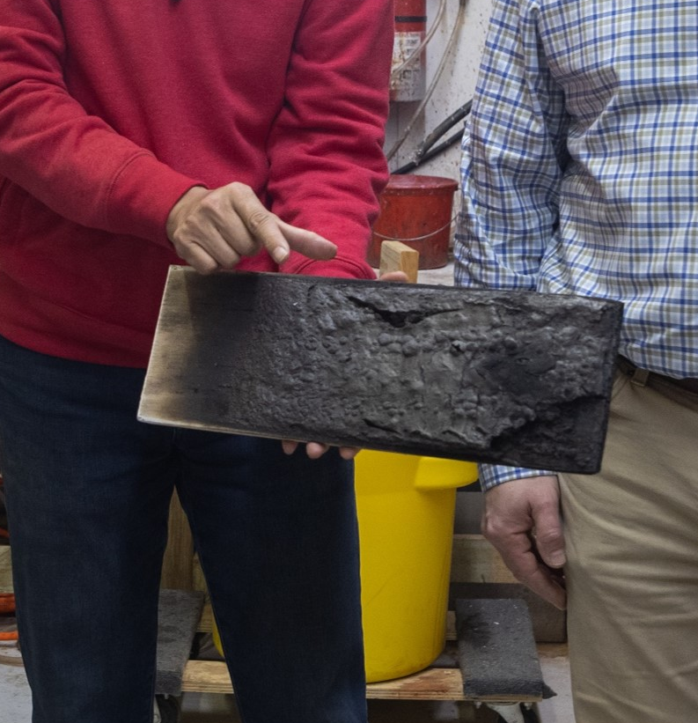
PRODUCT ATRRIBUTES
FIRE-RETARDANT WOOD FEATURES
Forms a char layer to insulate the wood, and to reduce flame spread and smoke development
Features interior pressure treated fire retardant as required in building code
Kiln-dried after treatment (KDAT) to 19% or lower for lumber and 15% or lower for plywood
When used as recommended, fastener corrosion is not increased when in contact with fire retardant lumber
Notes:
Reduces flame spread and smoke development when exposed to fire while releasing CO2 and a water vapor
Forms a char layer to slow the spread of fire and help insulate the wood
Features interior pressure-treated fire retardant as required in building code
The treatment goes beyond the surface of the wood
Kiln-dried after treatment (KDAT) to 19% or lower for lumber and 15% or lower for plywood
Building code requires product to be dry when put into service
Fastener corrosion is not increased when in contact with fire retardant lumber when product is used as recommended

Slide 11
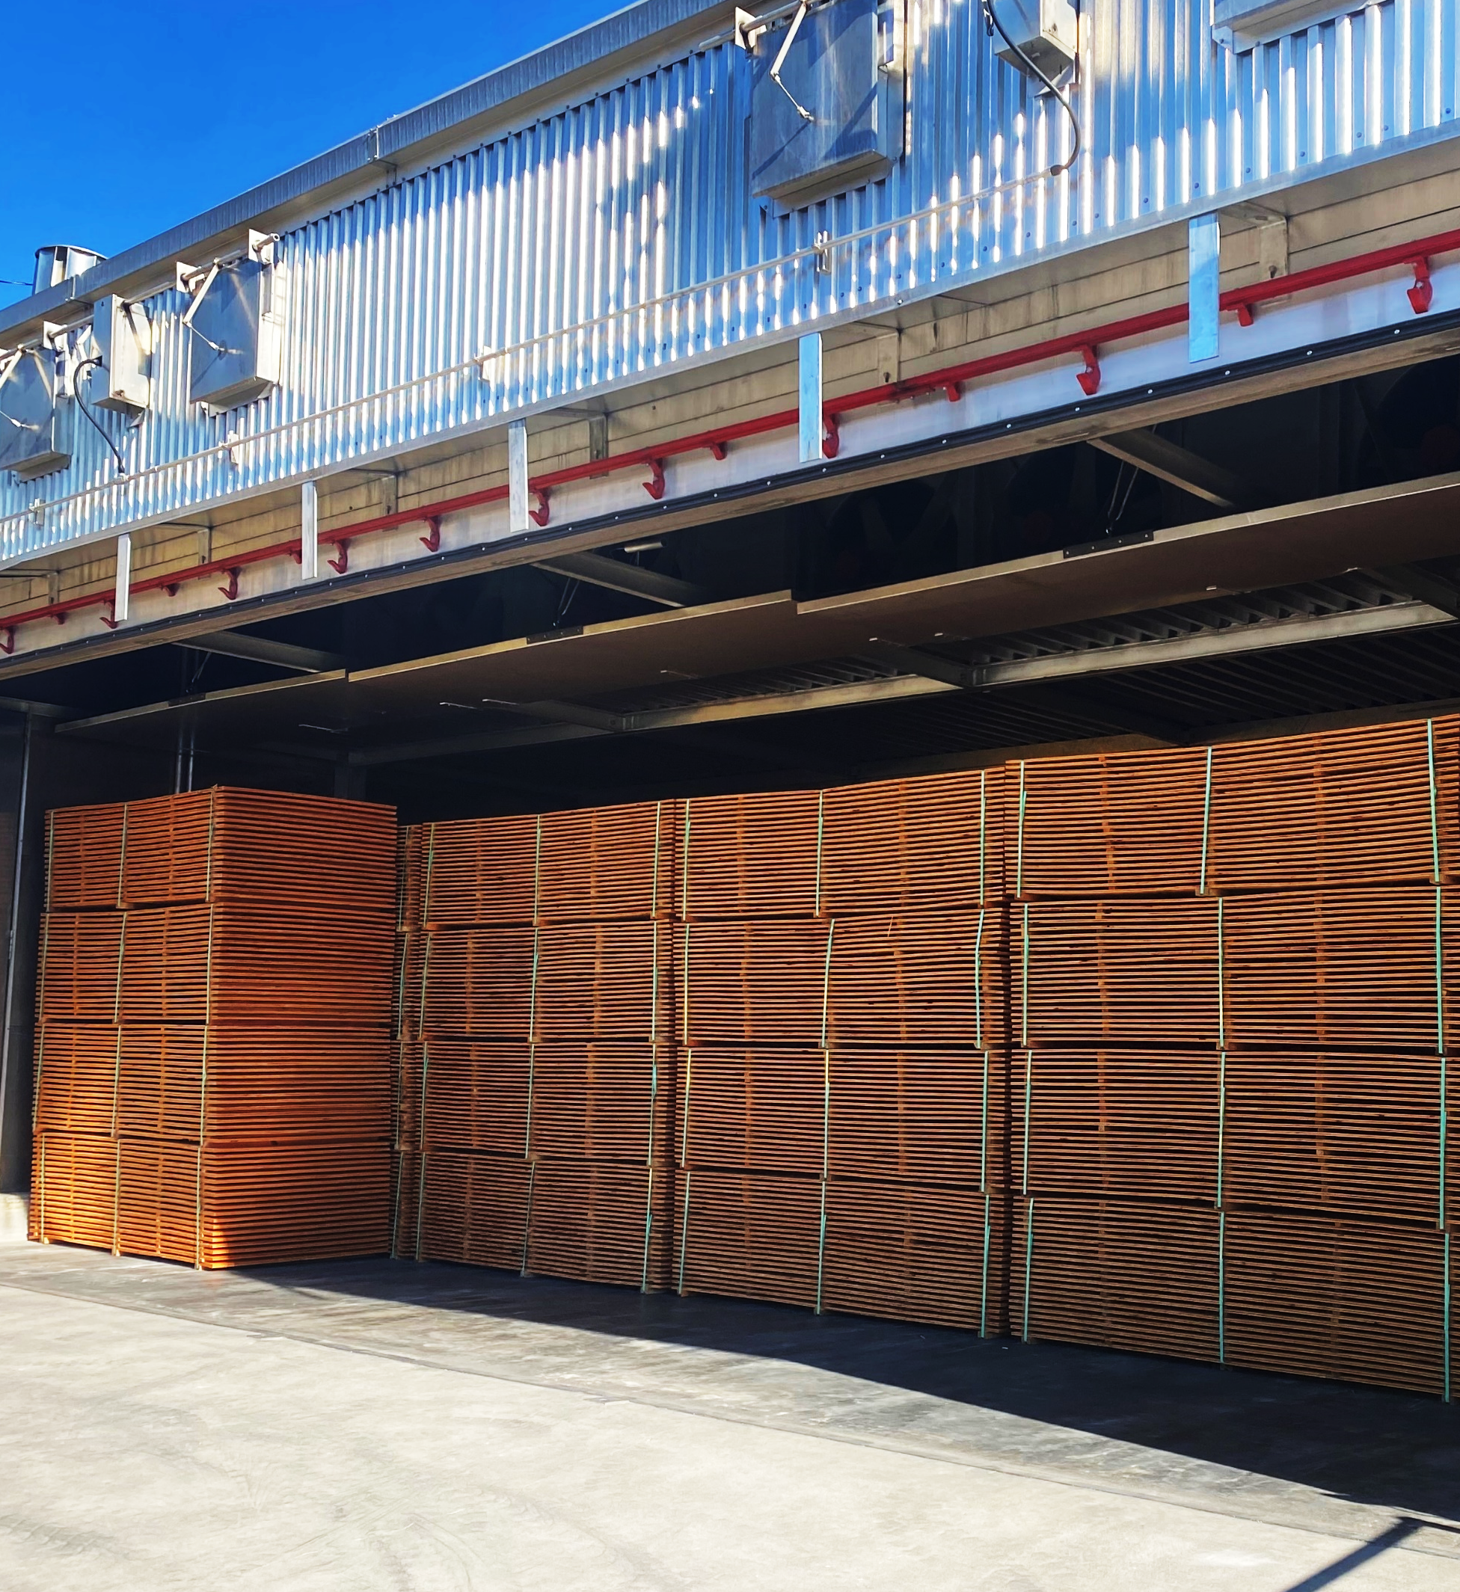
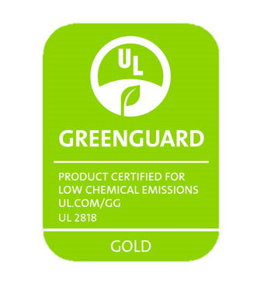
PRODUCT ATRRIBUTES
ADDITIONAL CONSIDERATIONS
May contain a red/orange dye to distinguish it on jobsites
Stains or paint can be used as a finish on the product once it is in service, if desired
Look for certifications such as UL Greenguard Gold for low chemical emissions
Certificates of Treatment are often issued for specific lots of material upon request
Consider the manufacturer testing and warranty details
Fire-retardant plywood dried in a kiln
Notes:
Greenguard certification involves testing for emission of VOCs – Volatile Organic Compounds – and modeled indoor concentrations
Greenguard GOLD means the product achieves a total (low) emission rate of 220/μg/m³
μg/m³ means micrograms per cubic meter. VOC can also be measured in ppb – parts per billion.
Some warranties are through the chemical company, some through the manufacturer. The typical warranty range is 20-50 years and covers manufacturing defects.

Slide 12
Learning Objective #2
MANUFACTURING PROCESS
FIRE-RETARDANT WOOD PROVIDES SAFETY, RELIABILITY & VALUE

Slide 13
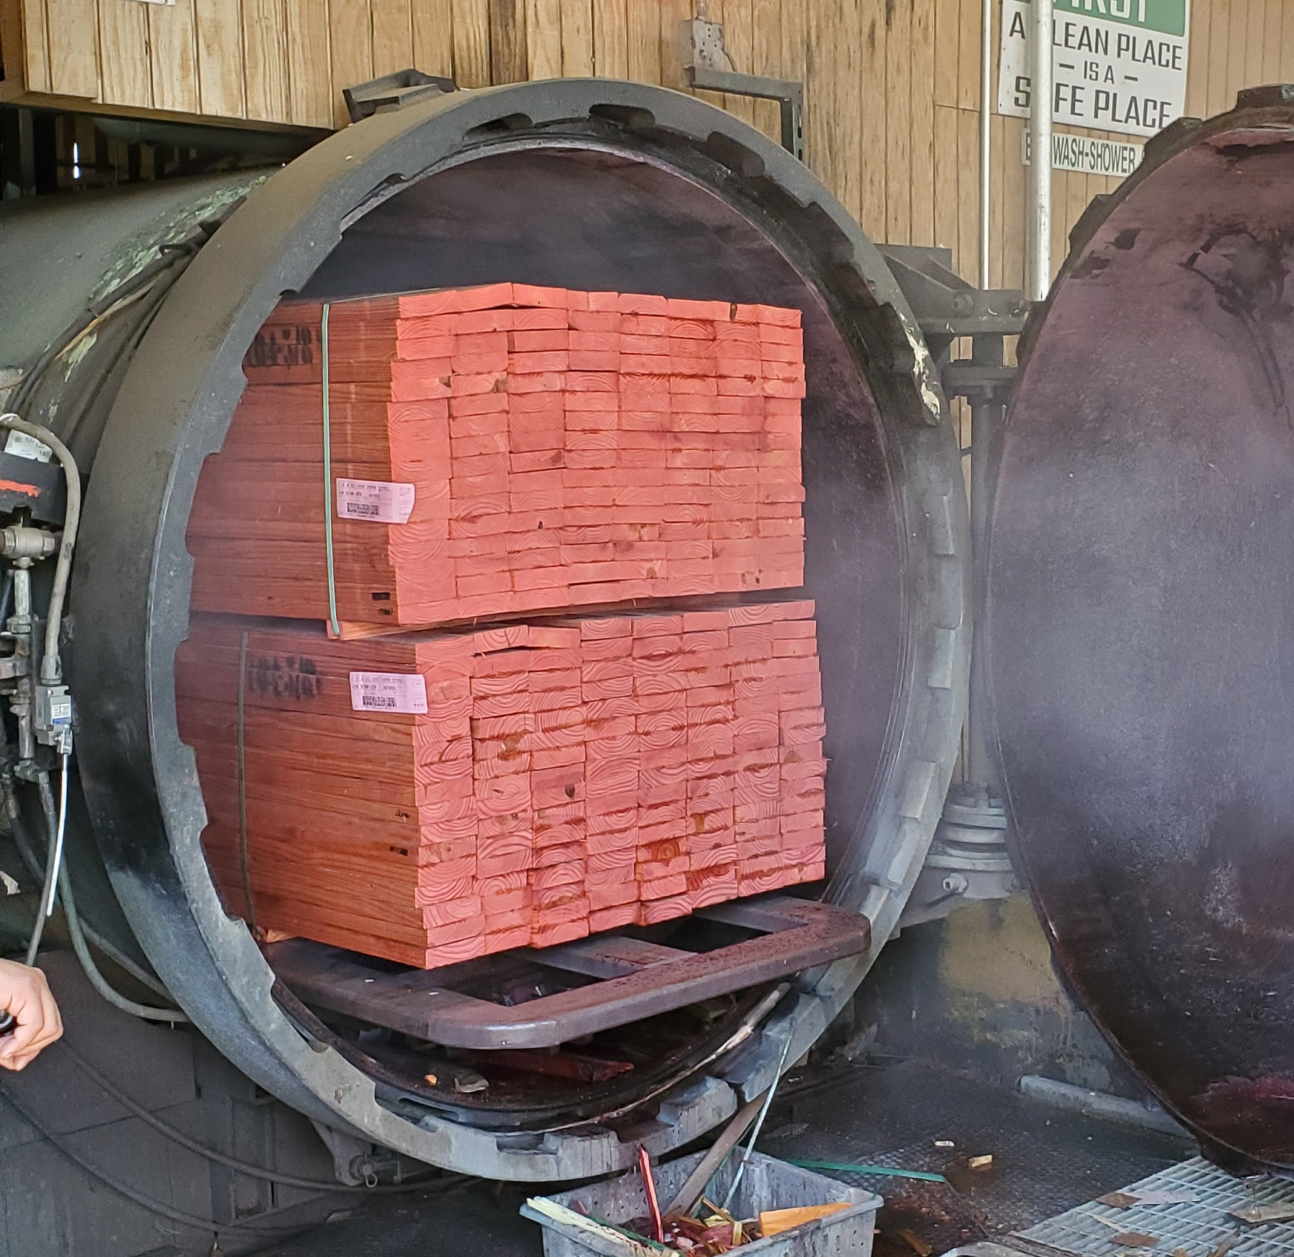
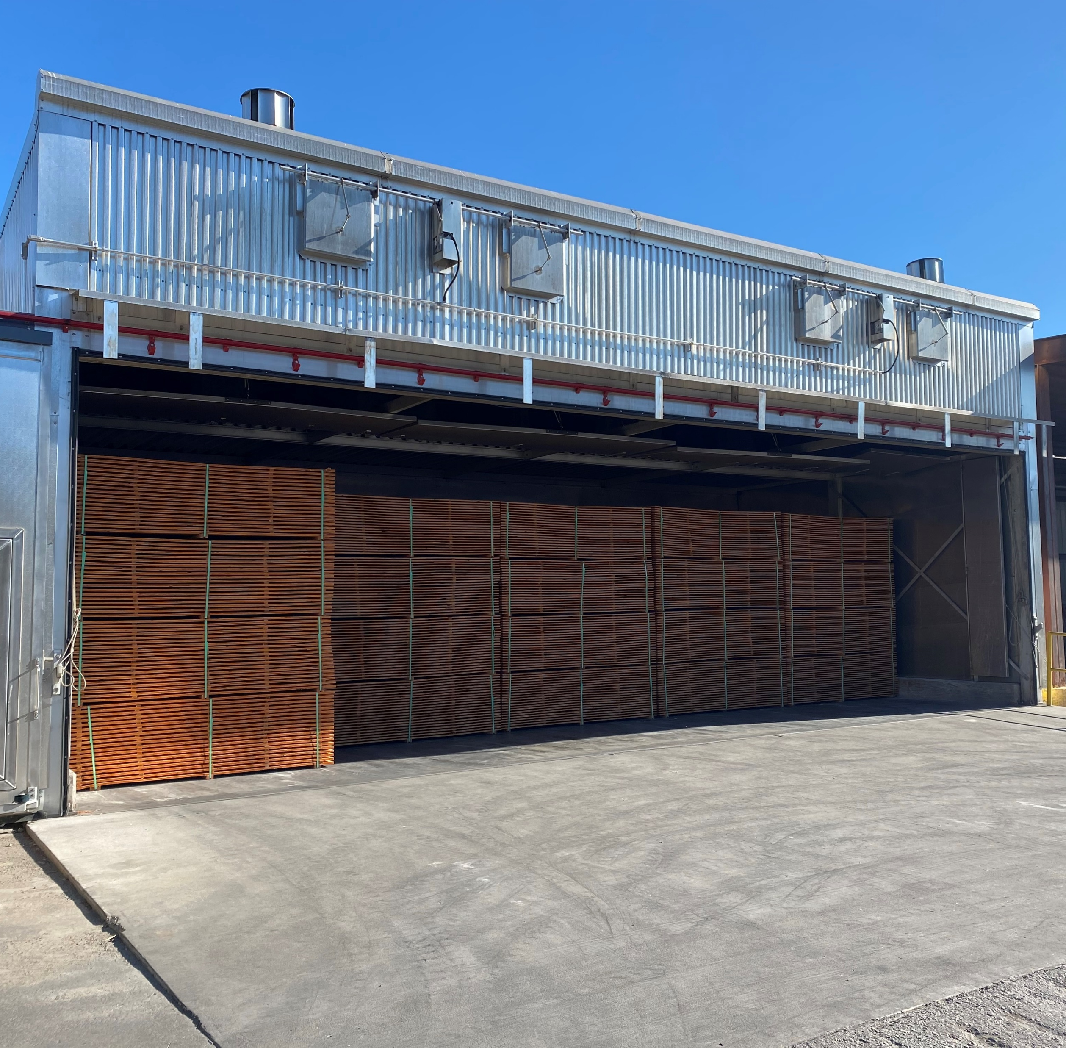
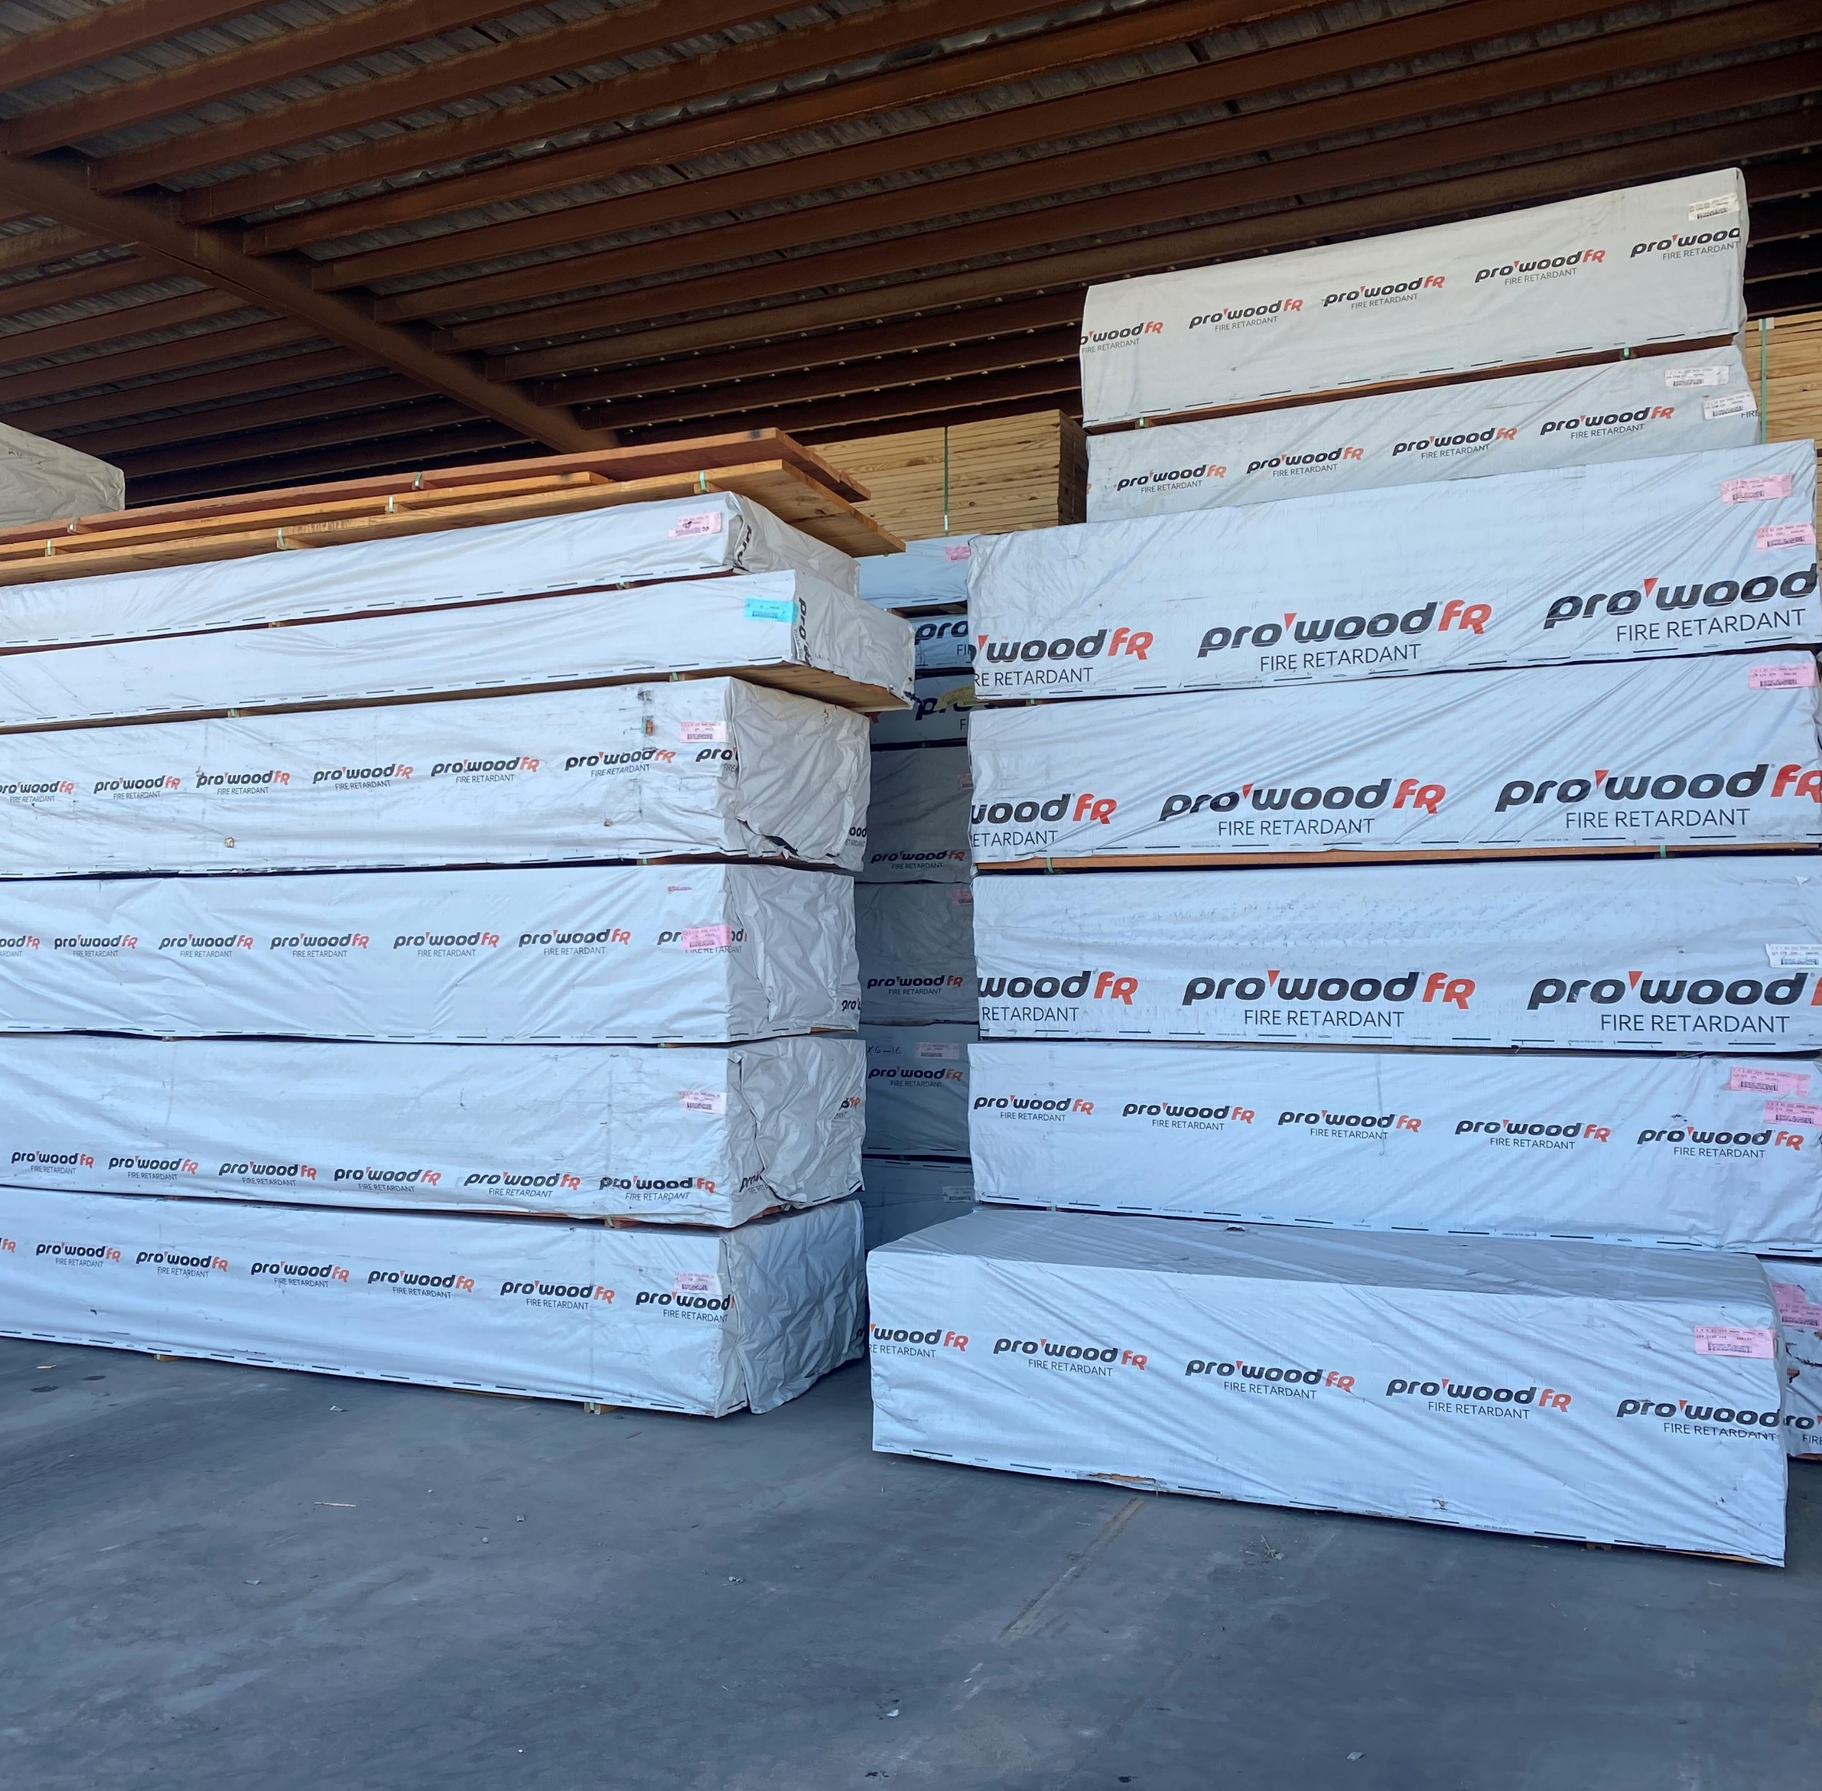
TREAT, DRY, PROTECT.
MANUFACTURING PROCESS
Treatment of Product
Wood is impregnated with fire-retardant chemical during pressure treatment
Fire-treated wood often contains a red tint for easy identification
Product is available in a variety of Spruce, Pine and Fir species
Kiln-Dried After Treatment
After treatment, the wood is moved from the cylinder to the kiln to be dried
Spacers are placed between to wood to maximize airflow and proper drying
Fire-treated wood remains in the kiln until moisture content is achieved
Storage & Handling
Finished product units are wrapped for protection
It is best practice to store in a dry, covered space
Fire-treated wood is not intended for exterior applications

Slide 14
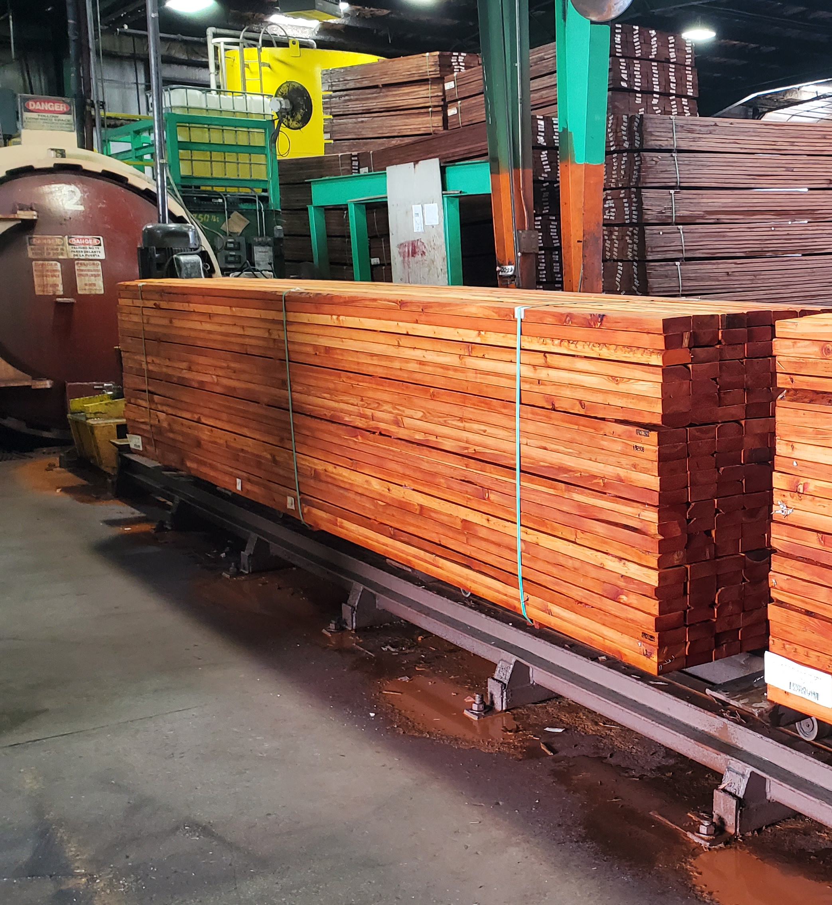
MANUFACTURING PROCESS
PRESSURE TREATMENT
Fire-retardant lumber must be pressure treated as required by code
For wood products impregnated with chemicals by a pressure process, the process must be performed in closed vessels under pressures not less than 50 pounds per square inch gauge (psig) (345 kPa)
Reference
International Building Code (IBC)
2303.2.1
Fire-retardant lumber outside treating cylinder
Notes:
KEY: Fire-retardant lumber must be pressure treated as required by code

Slide 15
Learning Objective #3
BUILDING CODE ACCEPTANCE
FIRE-RETARDANT WOOD PROVIDES SAFETY, RELIABILITY & VALUE

Slide 16
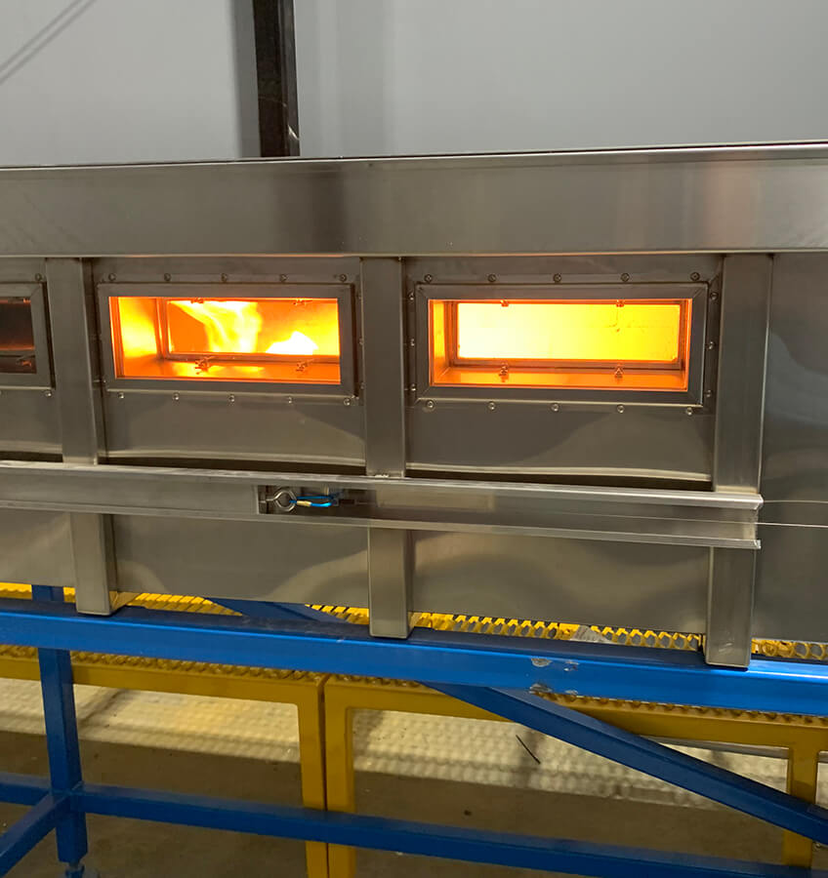
BUILDING CODE ACCEPTANCE
FLAME SPREAD
ASTM E84 Steiner Tunnel test
Tested in accordance with ASTM E84 or UL 723 to achieve a listed flame spread index of 25 or less
10 minutes is Class A
For fire-retardant wood used in construction, passing a 30-minute test is required
The initial 10 minutes, plus an additional 20 minutes
Flame spread rating is found using Steiner Tunnel test
Extended ASTM E84 test - flame front does not progress more than 10-1/2 ft beyond the centerline of the burners during a 30-minute test
Reference:
International Building Code (IBC) 2303.2 Fire-Retardant Treated Wood
Notes:
ASTM 84 also tests for smoke development. Must be below 450.
Many topical fire retardants will pass the 10-minute test and claim Class A. However, for FR wood used in construction, this is not enough.
For FR wood in construction, the 10-minute test AND the extended 20-minute test are required. (30 minutes total).

Slide 17
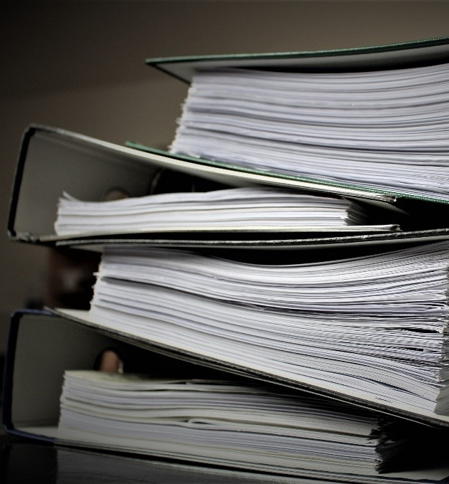
BUILDING CODE ACCEPTANCE
CODE COMPLIANCE
Fire-retardant lumber must meet IBC code requirements for fire retardant treated wood as defined in IBC 2303.2 for wood used as a construction material
Must be labeled according to requirements in IBC 2303.2.4 Labeling
There are several organizations involved in the development of codes as well as evaluation

Slide 18
BUILDING CODE ACCEPTANCE
ICC, IBC & IRC
International Code Council (ICC) – www.iccsafe.org
The International Code Council is the leading global source of model codes and standards and building safety solutions that include product evaluation, accreditation, technology, training, and certification
The Code Council's codes, standards, and solutions are used to ensure safe, affordable, and sustainable communities and buildings worldwide
International Building Code (IBC) – www.iccsafe.org/ibc
Developed and published by the ICC
The International Building Code (IBC) is the foundation of the complete Family of International Codes®
It addresses design and installation of innovative materials that meet or exceed public health and safety goals
International Residential Code (IRC) – website
The IRC is a comprehensive collection of rules that apply to residential construction
It is the model building code for one- and two-family dwellings throughout most of the US
Notes:
The International Code Council is an association focused on developing model codes and standards “used in the design, build and compliance process to construct safe, sustainable, affordable and resilient structures.” According to the ICC, 50 states and the District of Columbia have adopted the I-Codes at the state or jurisdictional level.
The ICC also administers the International Residential Code (IRC).
The IRC is a comprehensive collection of rules that apply to residential construction. Most U.S. states have adopted, to some extent, the IRC as the model building code for one- and two-family dwellings.

Slide 19
BUILDING CODE ACCEPTANCE
ASTM & ESR
American Society for Testing & Materials (ASTM) – www.astm.org
ASTM International is a globally recognized leader in the development and delivery of voluntary consensus standards. Today, over 12,000 ASTM standards are used around the world to improve product quality, enhance health and safety, strengthen market access and trade, and build consumer confidence
Example ASTM: ASTM E84 – Standard Test Method for Surface Burning Characteristics of Building Materials
Evaluation Service Report (ESR) - website
An ESR, or evaluation service report, is a compilation of all the tests conducted on a specific product showing the approvals, testing and effective applications of a specific product based on code requirements
ESR is not part of the building code – the code resides in publications by the International Code Council (ICC), this includes the IRC, the IBC and the ICC depending on the project
ICC ES ESR-4373 is a code compliant document that shows conformance to appropriate standards and codes
Example: ESR 4373

Slide 20
BUILDING CODE ACCEPTANCE
UNDERSTANDING LABELING
2302.2.4 Labeling
In addition to the labels required in Section 2303.1.1 for sawn lumber and Section 2303.1.5 for wood structural panels, each piece of fire-retardant treated lumber and wood structural panels shall be labeled
The label shall contain the following items:
The identification mark of an approved agency in accordance with Section 1703.5
Identification of treating manufacturer
The name of the fire-retardant treatment
The species of wood treated
Flame spread and smoke-developed index
Method of drying after treatment
Conformance with appropriate standards in accordance with Sections 2302.2.5 through 2303.2.8
3
3
[ BRAND NAME ]
1
1
1
6
6
7
2
7
3
[ TREATING MANUFACTURER]
4
5
2
2
5
4
5
6
4
7

Slide 21
Learning Objective #4
COMMON PRODUCT
USES
FIRE-RETARDANT WOOD PROVIDES SAFETY, RELIABILITY & VALUE

Slide 22
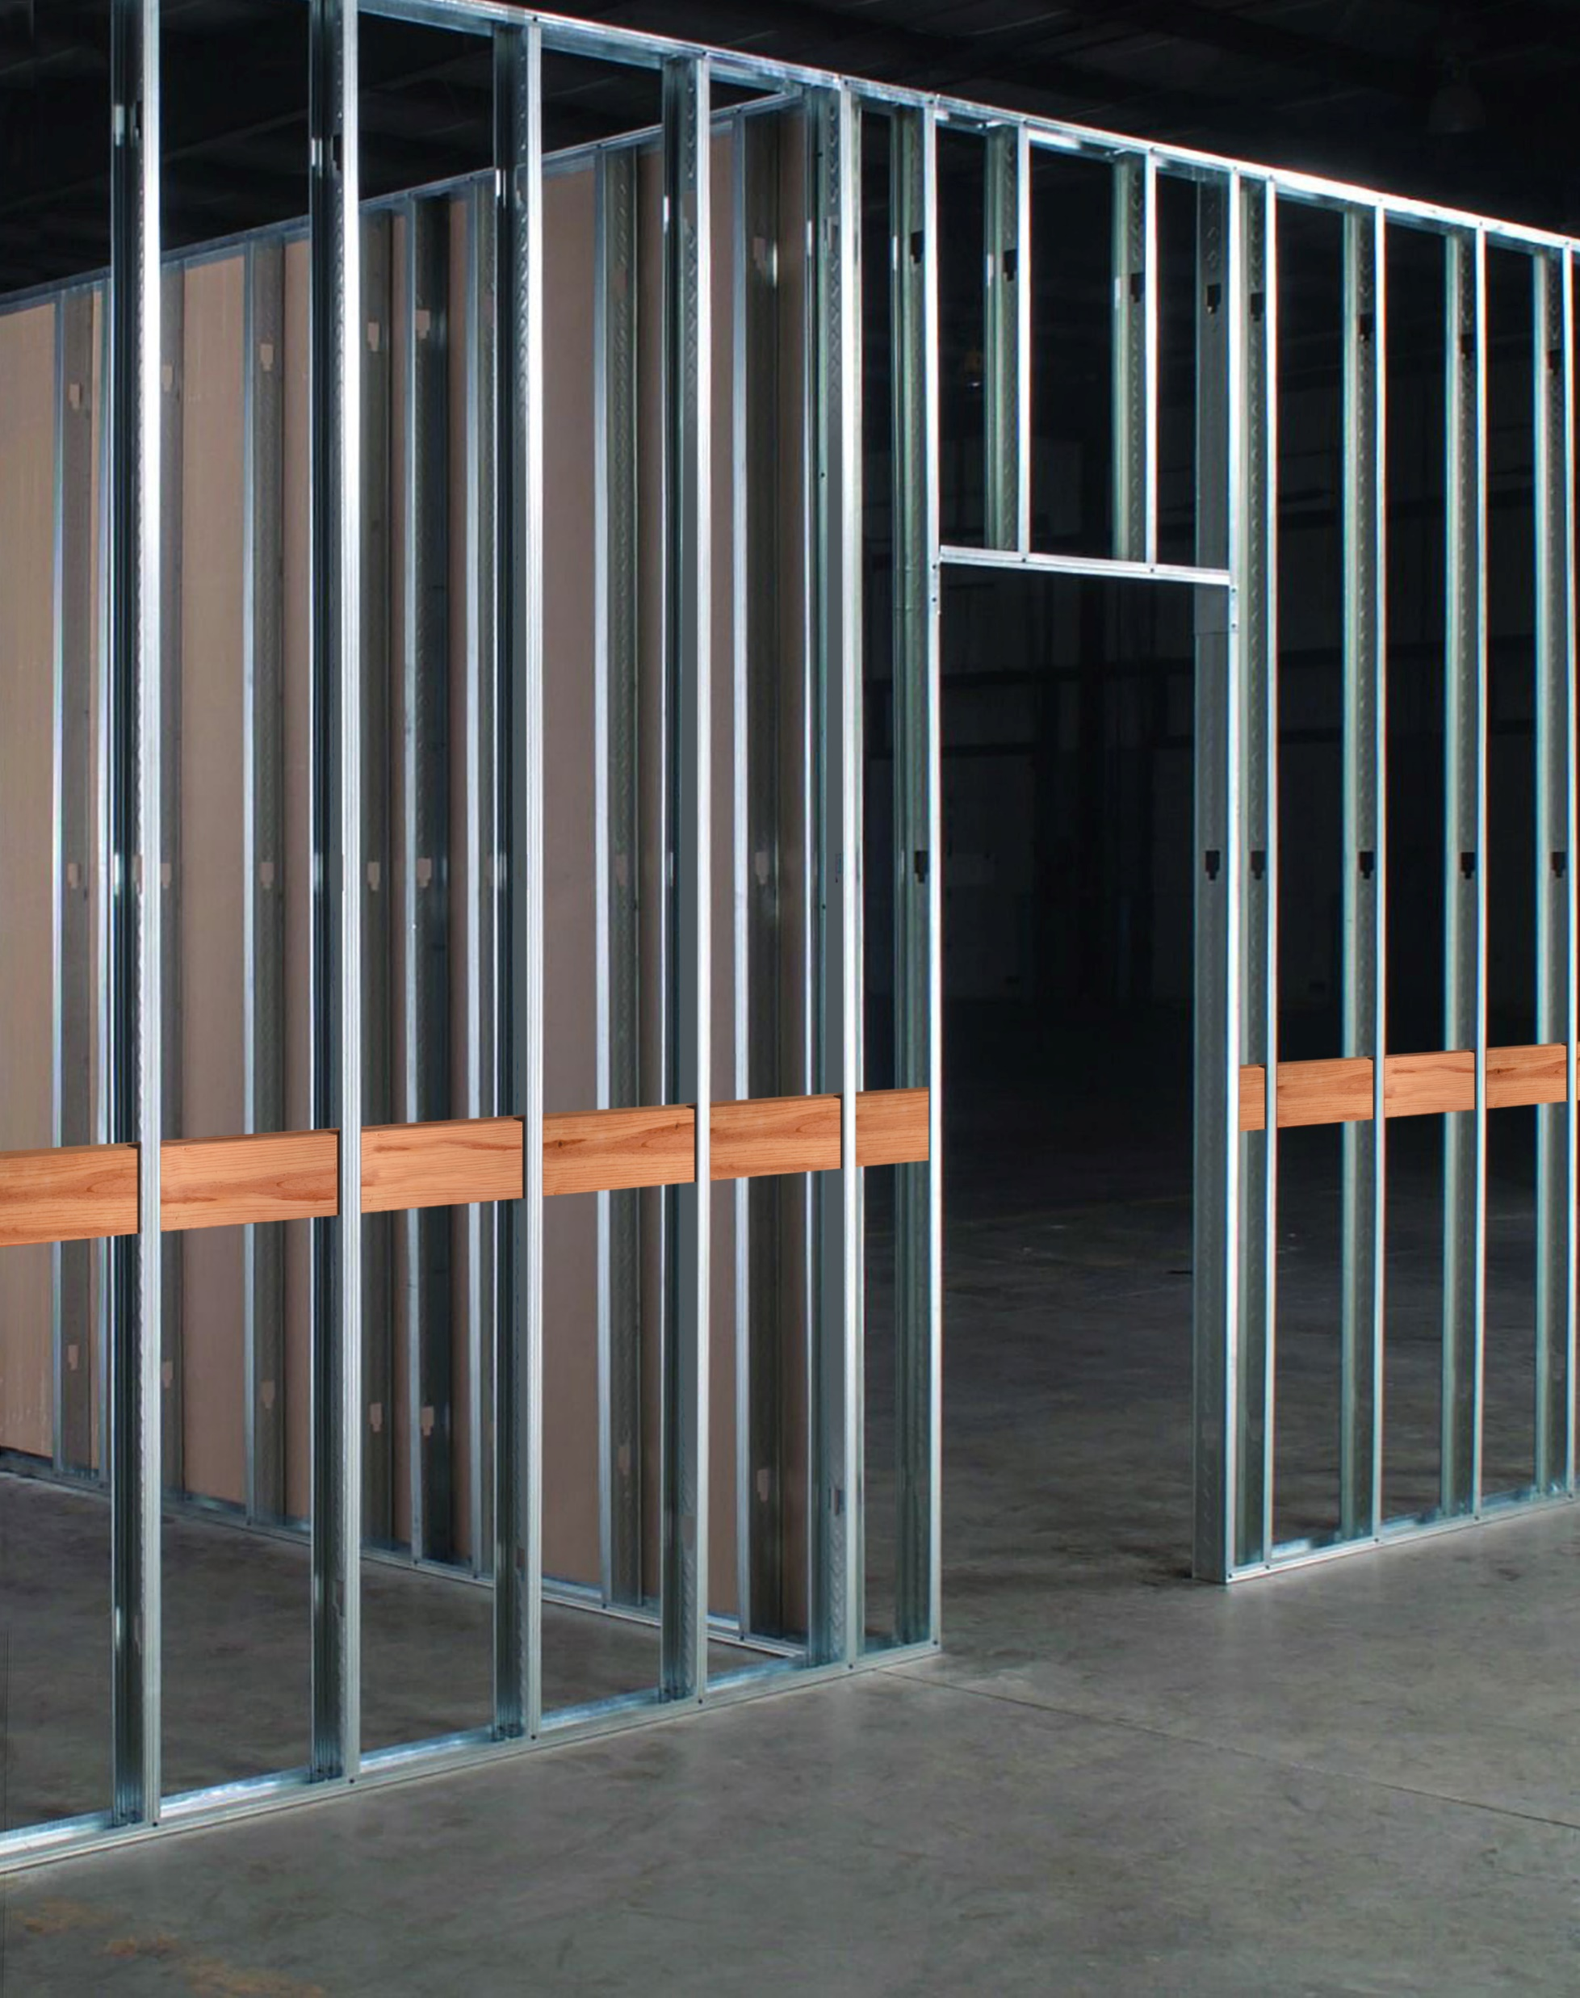
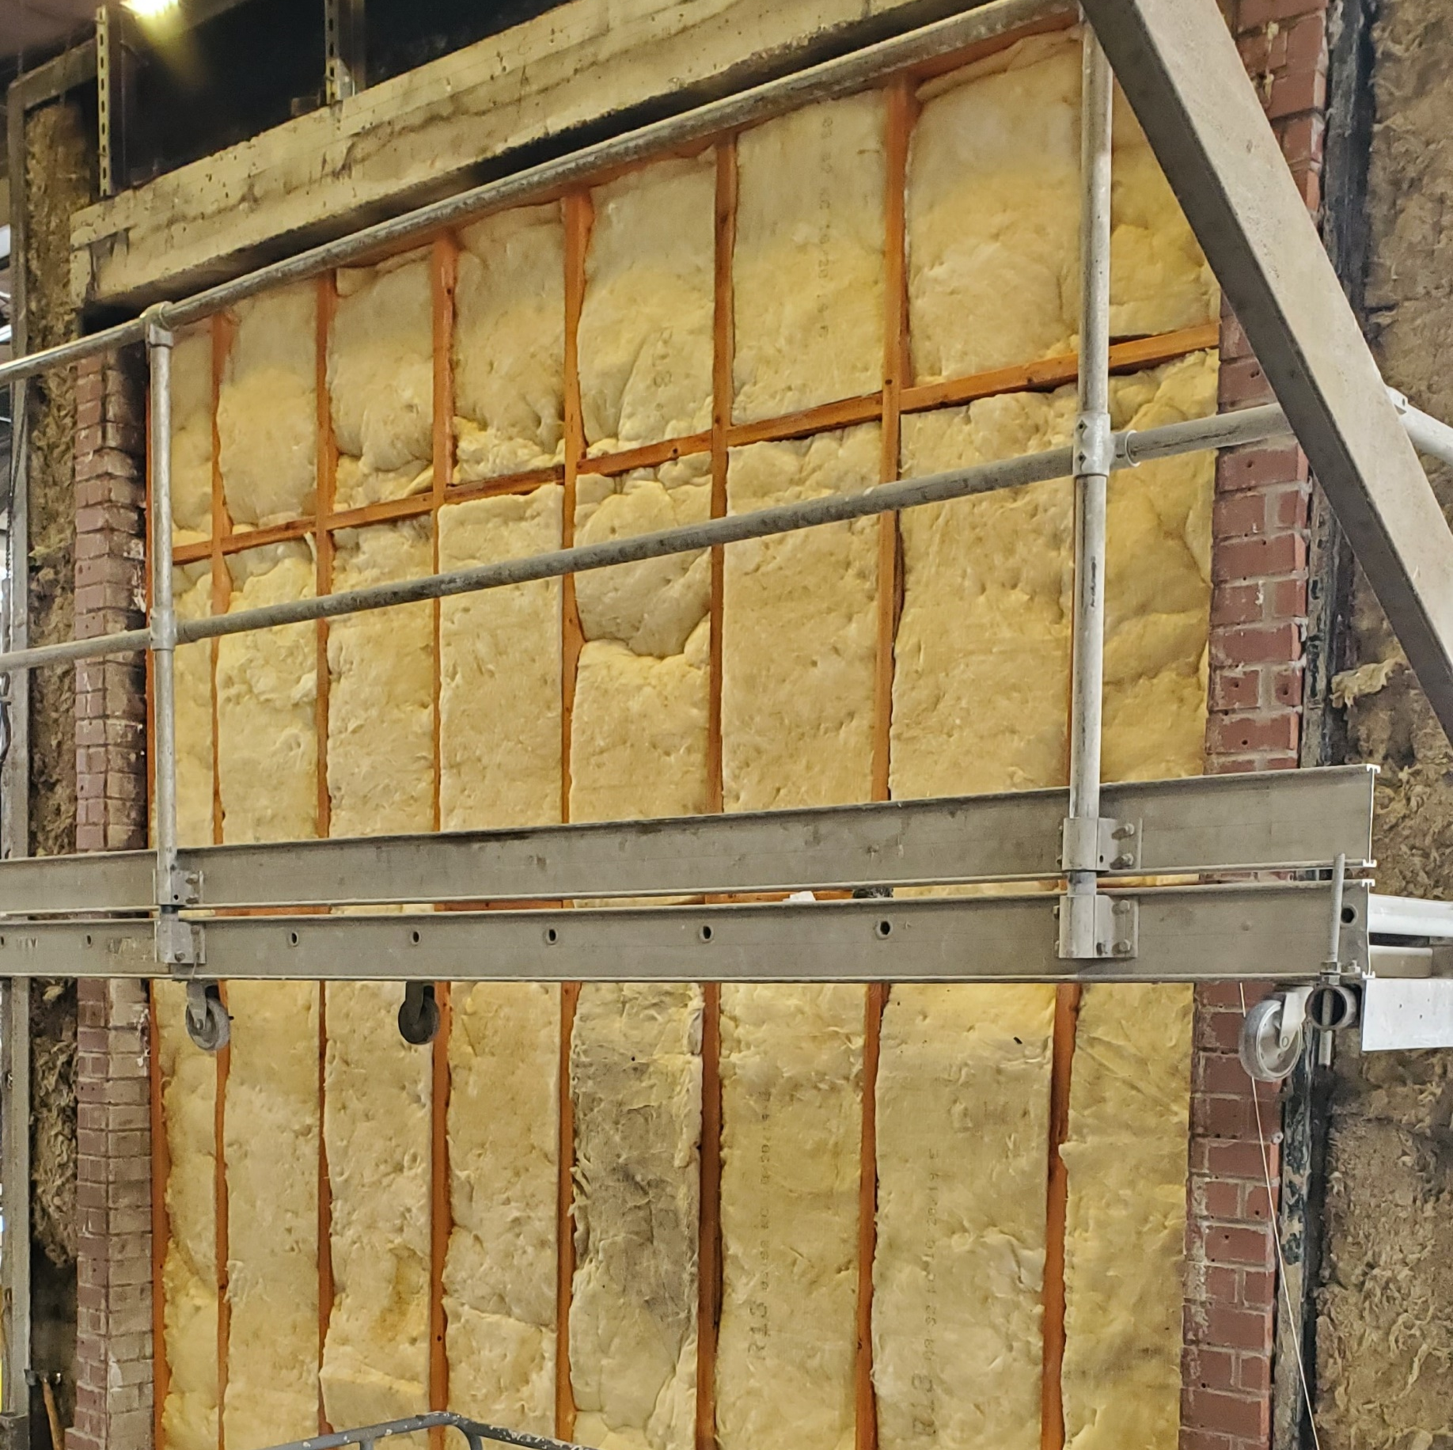
COMMON PRODUCT USES
WALL BLOCKING, BACKERS & ASSEMBLIES

Slide 23
COMMON PRODUCT USES
1-HOUR WALL ASSEMBLY
(Example: ASTM E119)
2-HOUR WALL ASSEMBLY
(Example: UL V343 / UL 263 Listed)
Drywall
Fire-Retardant Lumber
Insulation
4) Fire-Retardant Plywood
5) House Wrap (optional)
6) Exterior Facings (optional)
Drywall
Fire-Retardant Lumber
Insulation
4) Fire-Retardant Plywood
5) House Wrap (optional)
6) Exterior Facings (optional)
Notes:
Exterior Load Bearing Walls

Slide 24
COMMON PRODUCT USES
ROOF TRUSSES, BEAMS & PURLINS

Slide 25
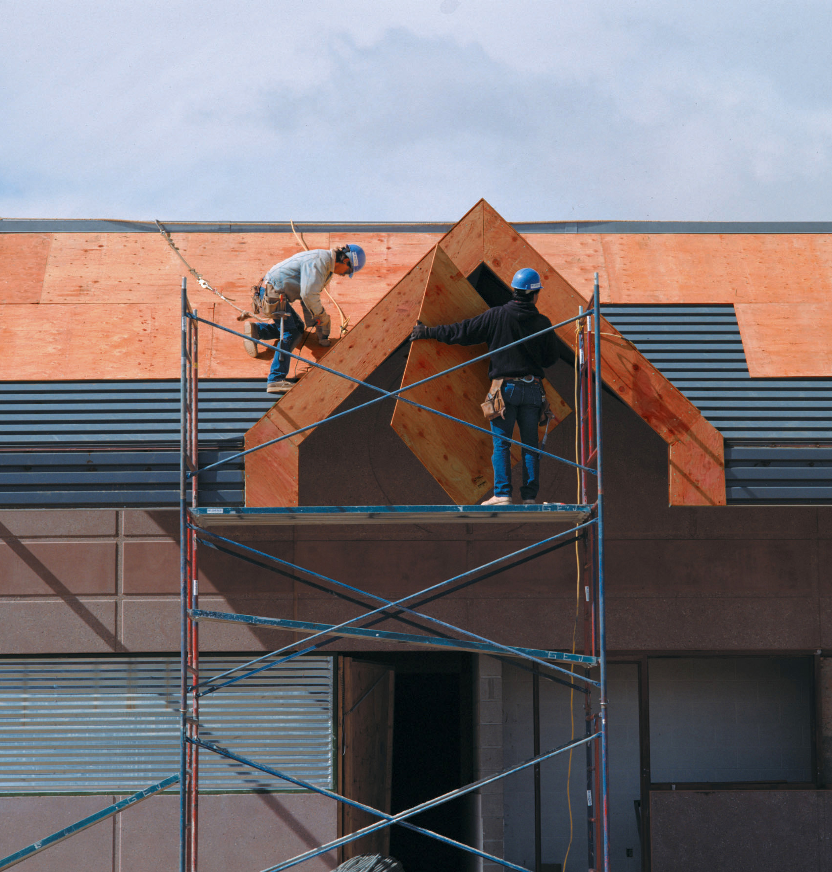
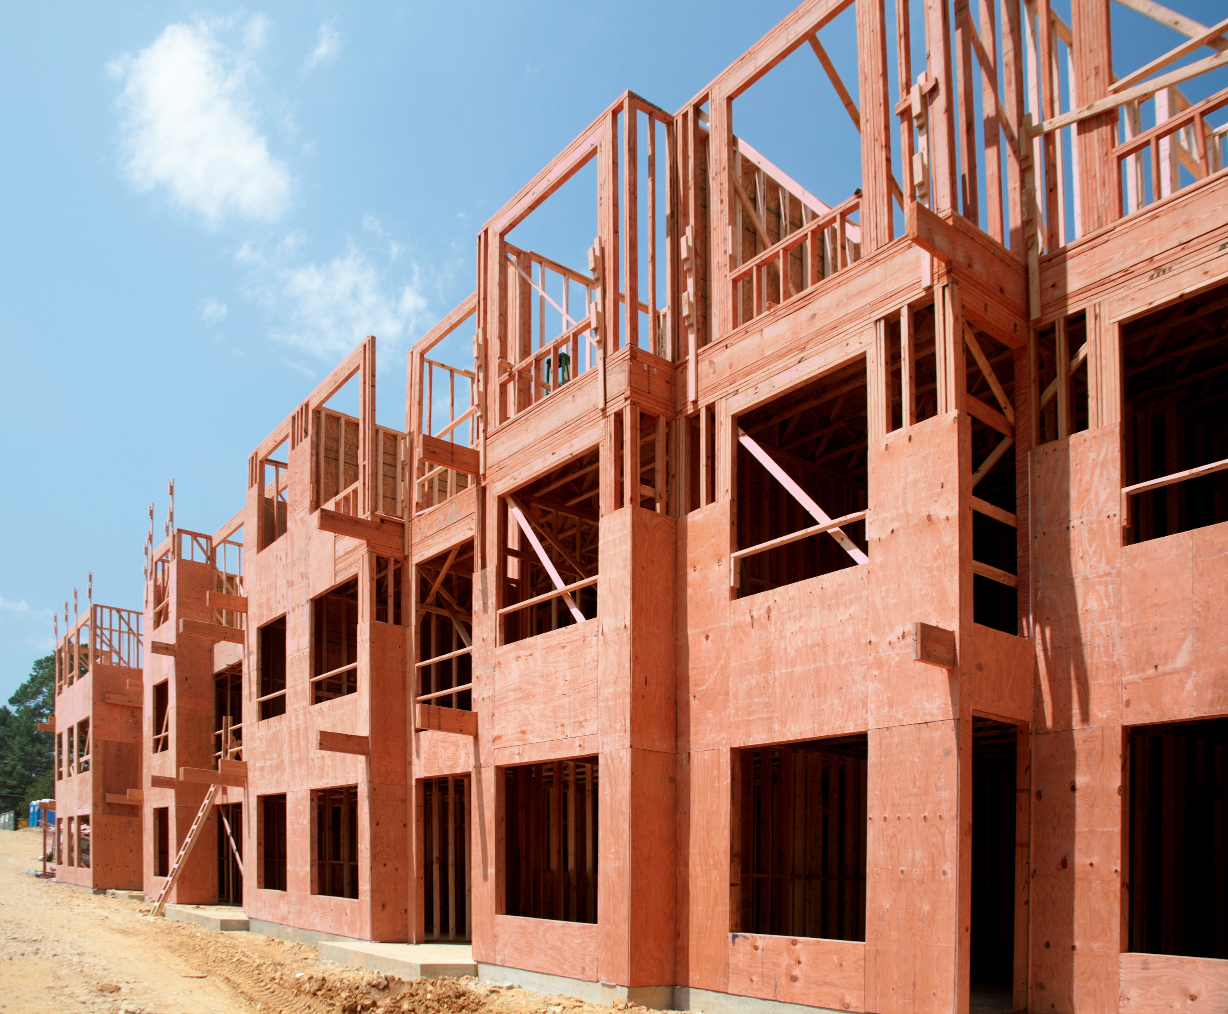
COMMON PRODUCT USES
ROOF, WALL & FLOOR SHEATHING

Slide 26
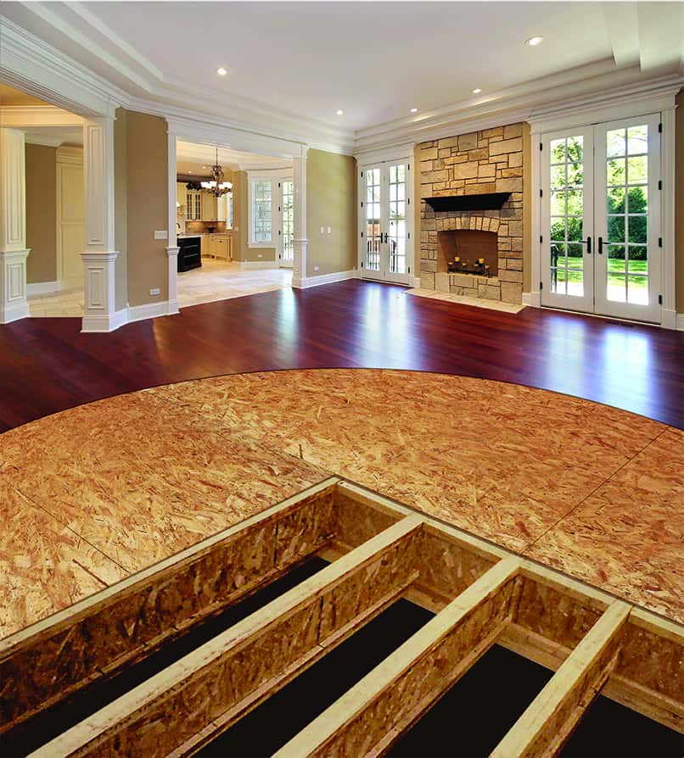
COMMON PRODUCT USES
SUBFLOORING, PLATFORMS & STAGES

Slide 27
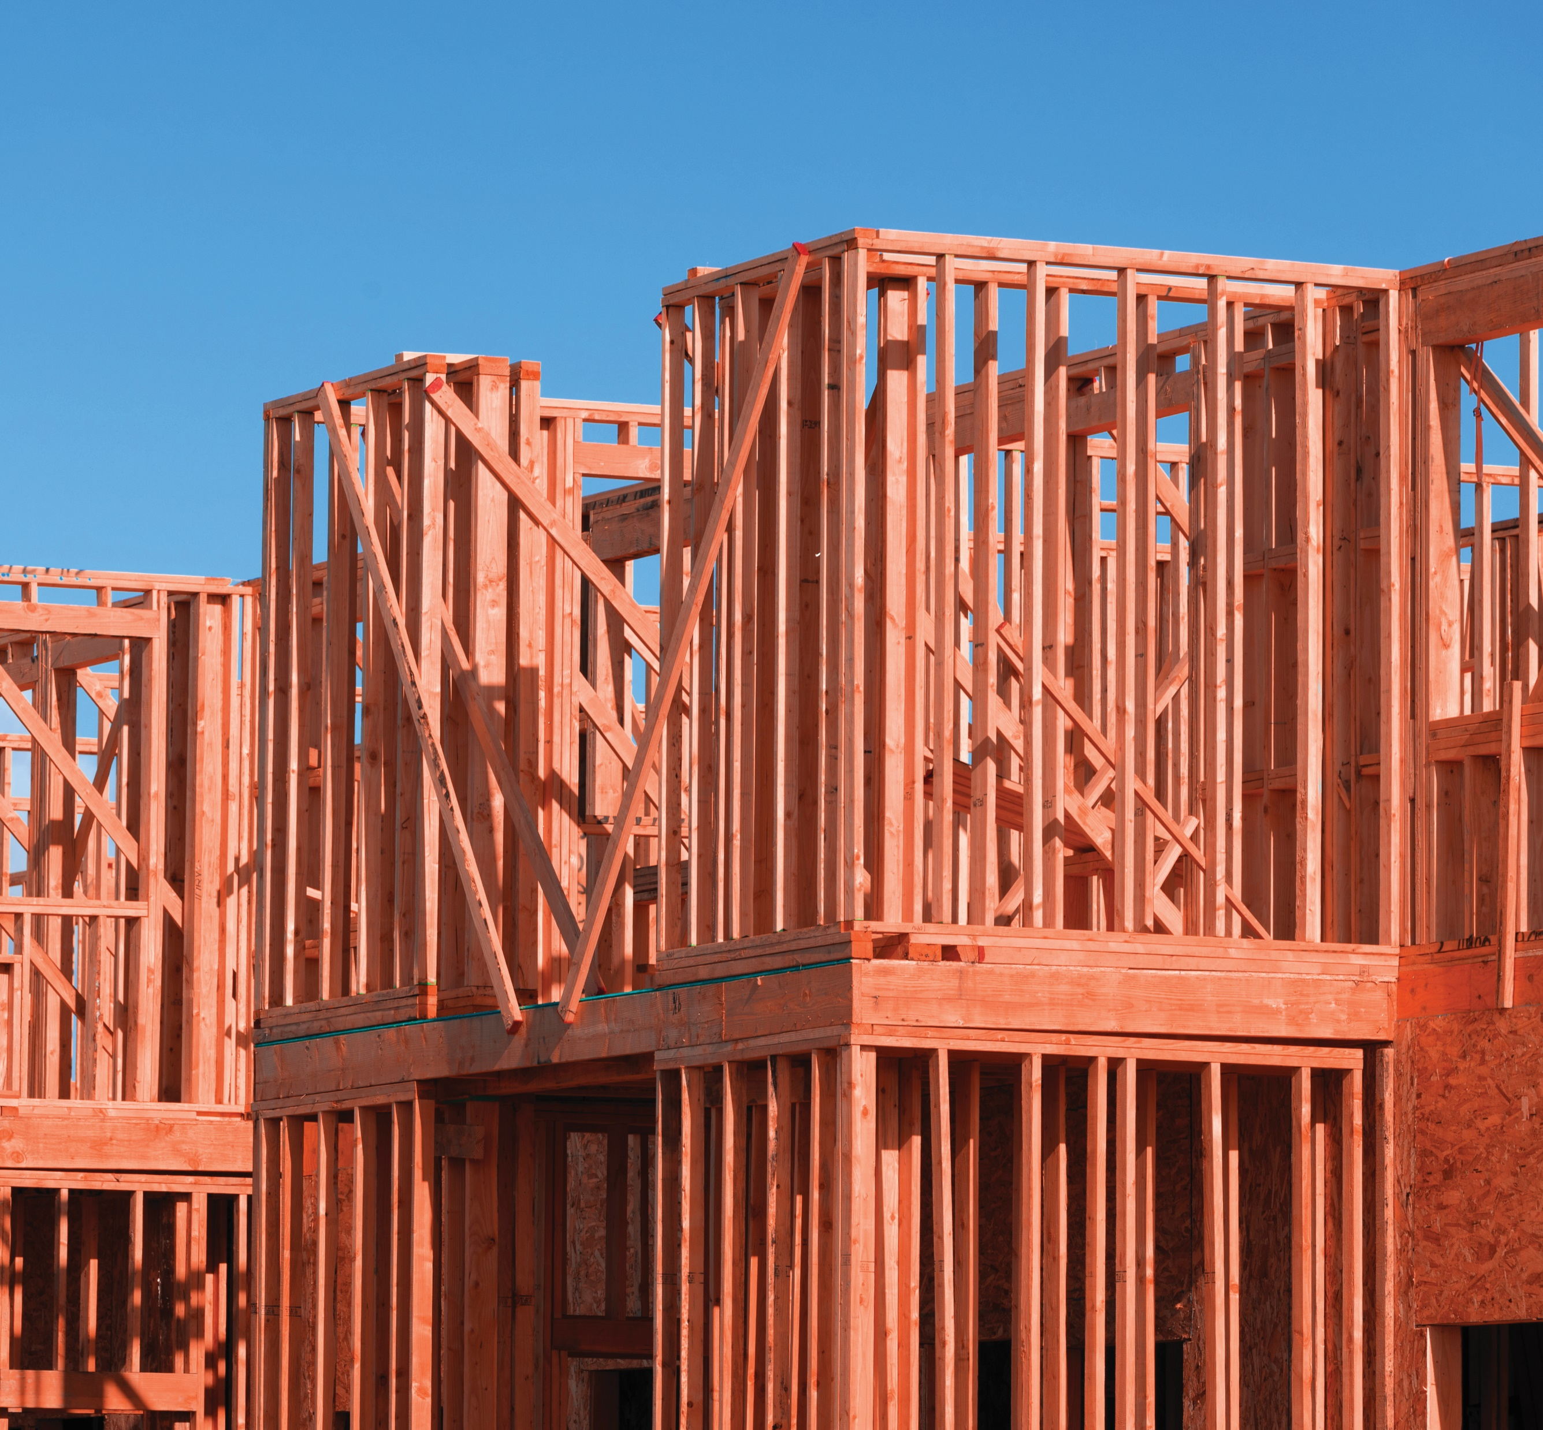
COMMON PRODUCT USES
STUDS & PARTITION WALLS

Slide 28
Learning Objective #5
STORAGE
& HANDLING
FIRE-RETARDANT WOOD PROVIDES SAFETY, RELIABILITY & VALUE

Slide 29
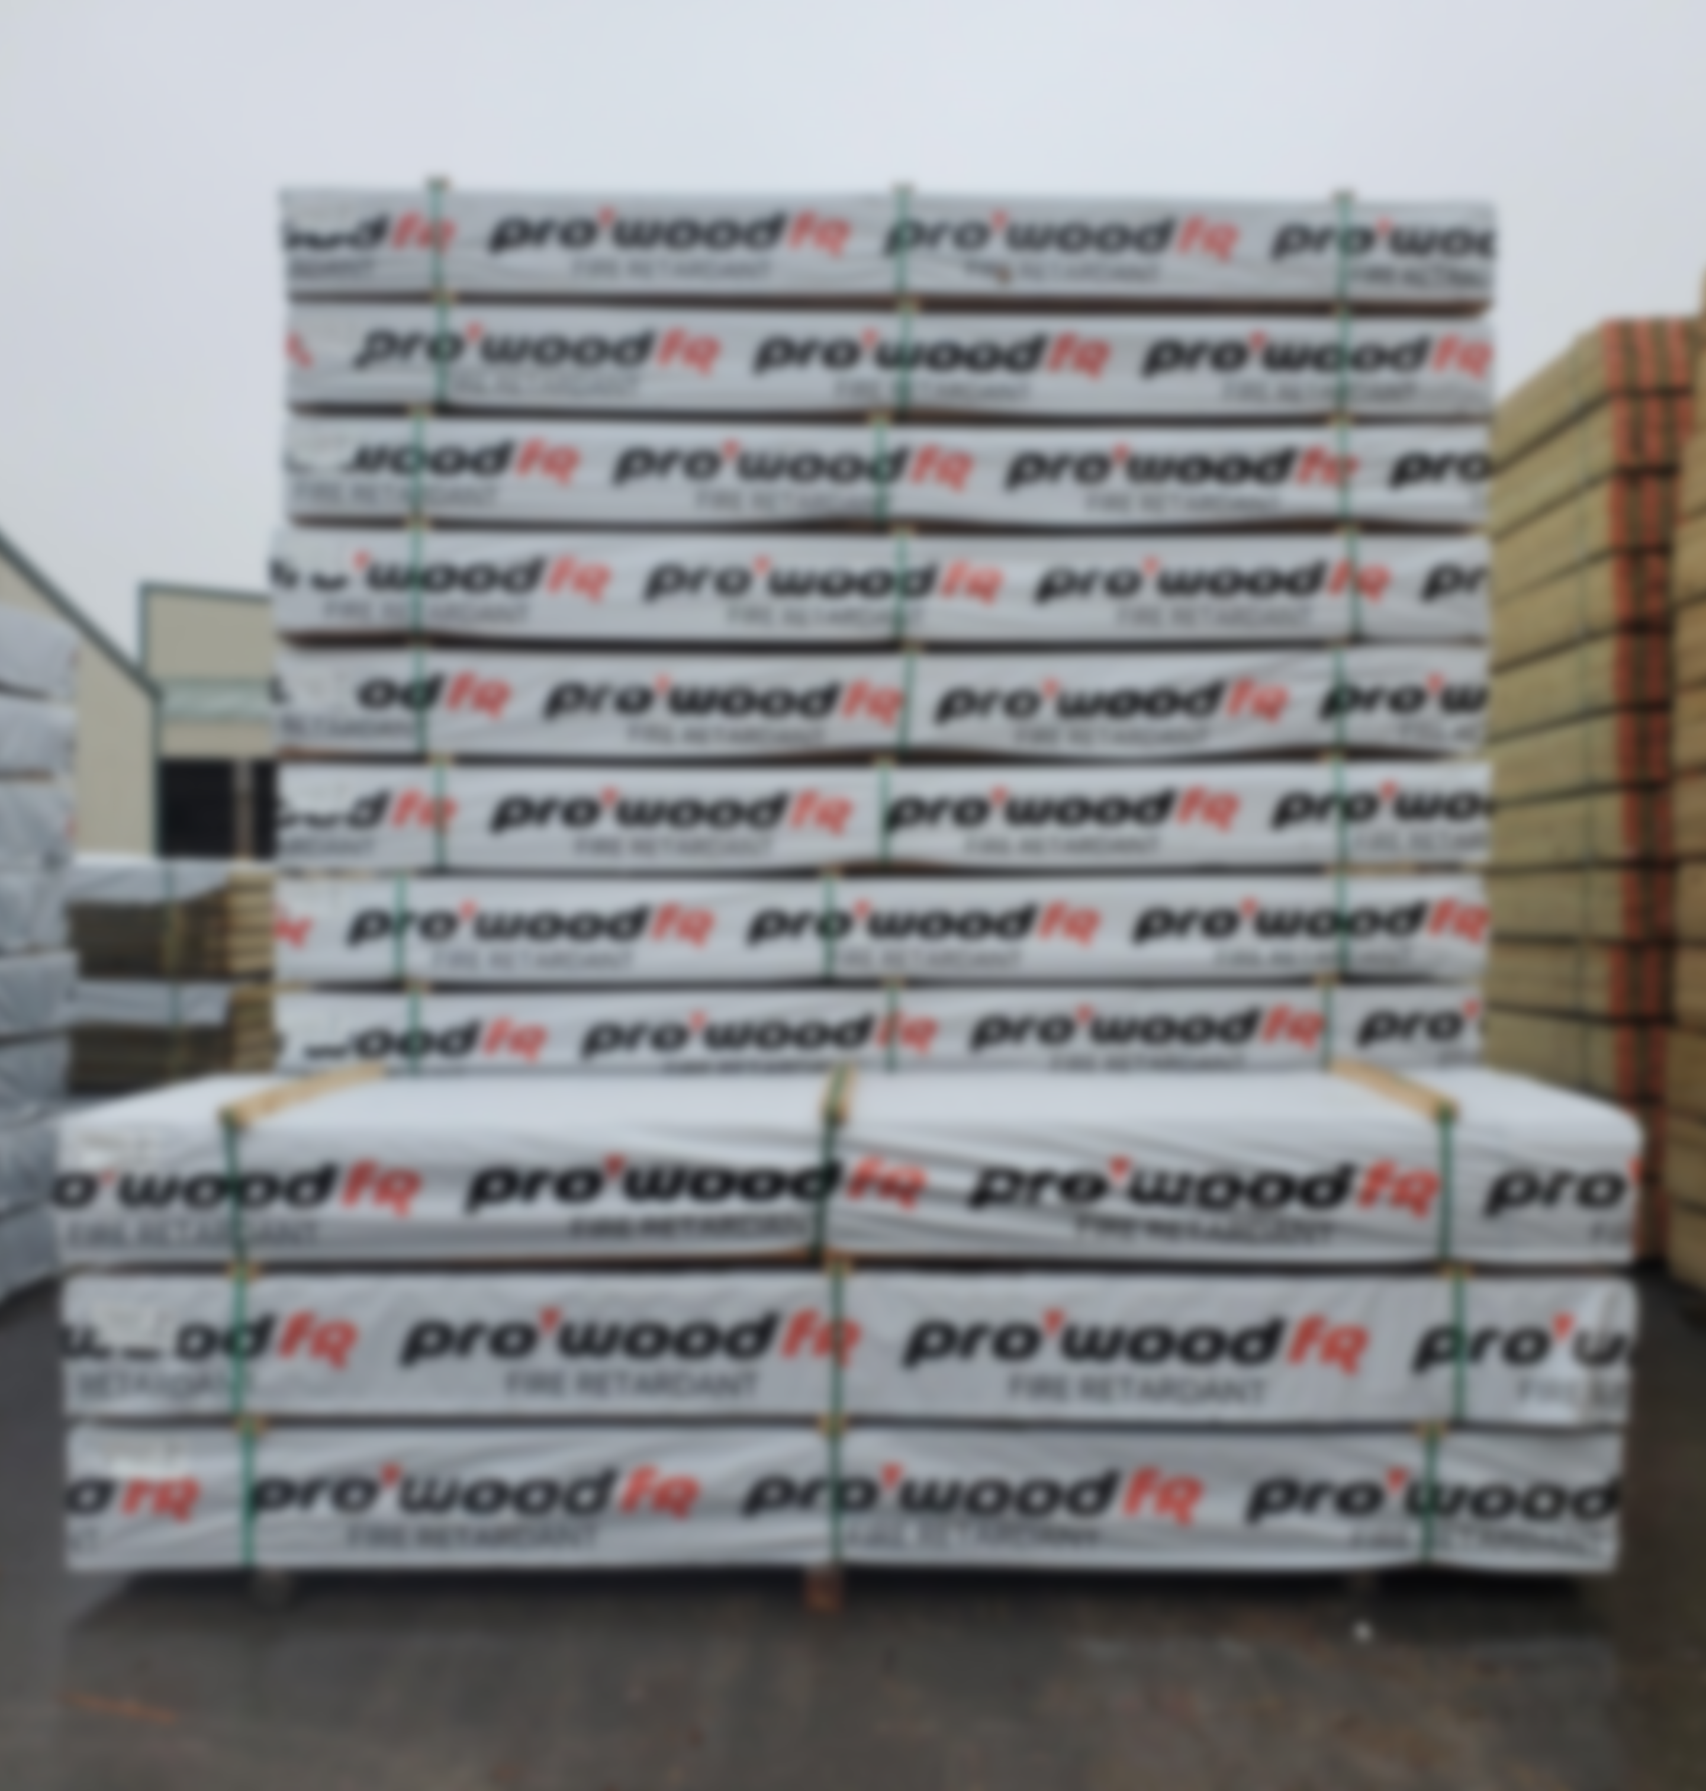
STORAGE & HANDLING
STORAGE & HANDLING
Exposure to precipitation during storage and installation must be avoided
If product becomes wet, allow to dry before enclosing
Finished products are wrapped or bagged and stored 6” off ground and under cover whenever possible
29
Notes:
KEY – raise product and keep it covered

Slide 30
STORAGE & HANDLING
INSTALLATION CONSIDERATIONS
Cannot be installed where end use application will be exposed to precipitation, either directly or through regular condensation
Lumber cannot be ripped post treatment lengthwise while plywood can
End cuts are permitted on lumber

Slide 31
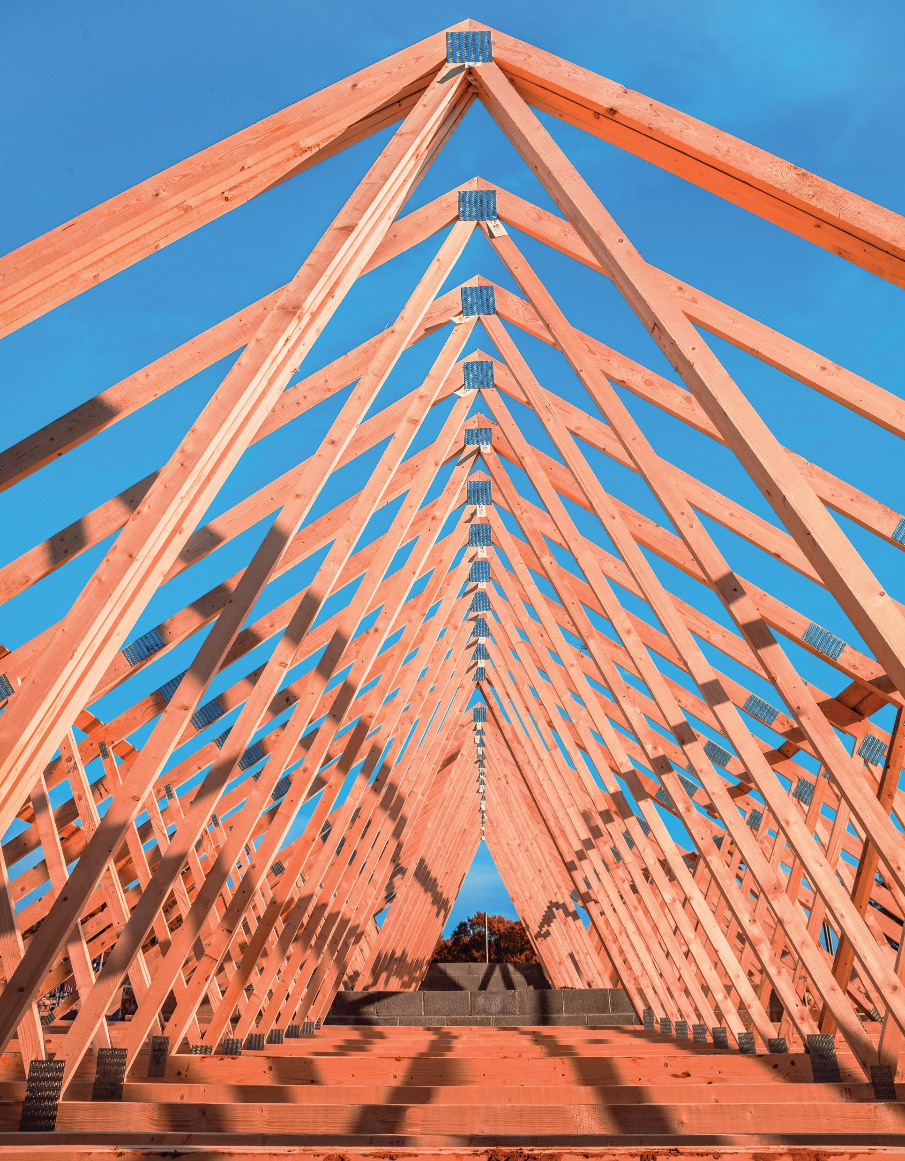
SUMMARY
Fire-retardant wood is a great building material option to prevent damage or harm from fire and smoke development
Fire-retardant wood is available in plywood, dimensional lumber, and can be use in a variety of applications
There are several requirements by code and tests to evaluate performance to standards – ask about codes and test results
Not all fire-retardant wood products are the same – ask about pressure-treatment, testing, certifications and warranty

Slide 32
THANK YOU
This concludes the continuing education unit.
Thank you for your time.
For more information, go to:
www.prowoodlumber.com/FR

