Slide 1
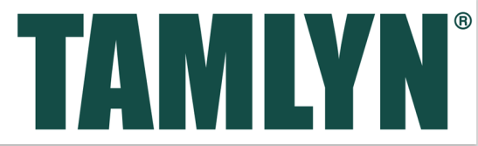
Moisture Management Fundamentals
Design considerations for robust wall assemblies in residential, multi-family, mix-use and light commercial buildings
This seminar is available through a professional courtesy provided by:
Notes:
Hello everyone, my name is Lais Simon, also known as Lasey so call me whichever one you prefer. I’m the Building Envelope Specialist at Tamlyn.

Slide 2
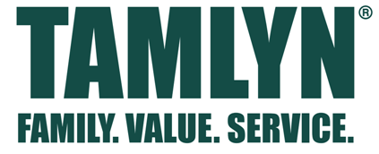
Copyright Materials
This presentation is protected by US and International Copyright laws. Reproduction, distribution, display and use of the presentation without written permission of the speaker is prohibited.
© Tamlyn® 2021
Notes:
We would like to thank y’all on behalf of Tamlyn for giving us a chance to present to you our Continuing Education course on Moisture Management and the value of properly flashed wall assembly systems.
If you guys have any specific issues that you wish to have addressed, let’s get a list together now and we can review them at the end of the presentation to see which ones we still need to cover.

Slide 3
Tamlyn is a Registered Provider with The American Institute of Architects Continuing Education Systems (AIA/CES), Provider 40117877.
Credit(s) earned on completion of this course will be reported to AIA CES for AIA members. Certificates of Completion for both AIA members and non-AIA members are available upon request.
This course is registered with AIA CES for continuing professional education. As such, it does not include content that may be deemed or construed to be an approval or endorsement by the AIA of any material of construction or any method or manner of
handling, using, distributing, or dealing in any material or product.
_______________________________
Questions related to specific materials, methods, and services will be addressed at the conclusion of this presentation.
Notes:
This course is AIA accredited and you should have included your AIA number on the registration, but if you didn’t for any reason, I’ll have my email address at the end of the presentation for you to send me that information and I’ll be able to give you credit for today’s course.

Slide 4
Learning Objectives
Describe how moisture impacts building durability
Define the various mechanisms of moisture movement and their relative severity
Identify common issues that lead to moisture problems and appropriate design remedies
Understand the integration of moisture control layer components as a system for proper moisture management
Notes:
Our objectives for this presentation are:
To provide you with a better understanding of the impact moisture can have on building durability and how that moisture moves within a building.
To identify some common design and installation defects and the steps that you can take to alleviate some of these via details and specification.

Slide 5
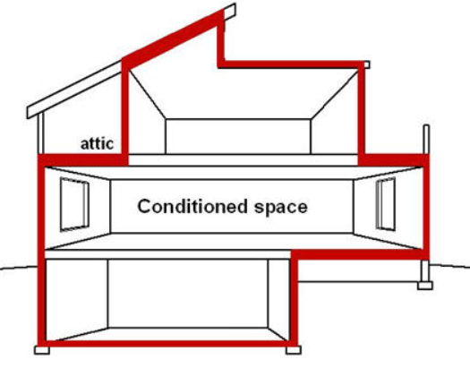

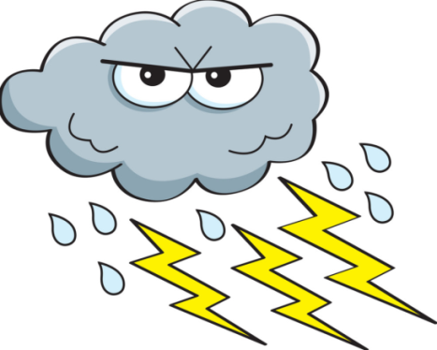
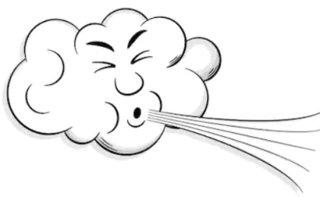
What is Building Envelope
Building envelope- the physical separator between the conditioned and unconditioned environment of a building including the resistance to water, air, heat, light, and noise transfer
Notes:
So what is the Building Envelope?
It is what physically separates the conditioned space from outside elements including heat, wind, water, UV rays and noise.
In this seminar, we will be focusing on the water resistance requirement.

Slide 6
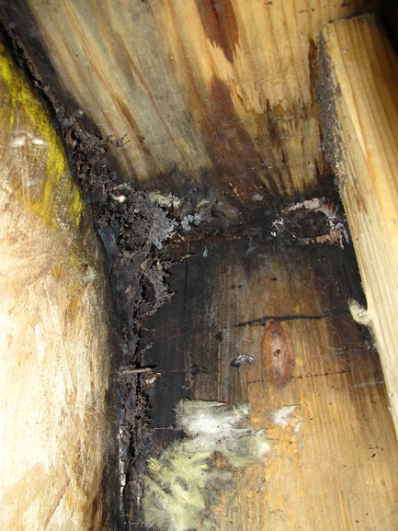
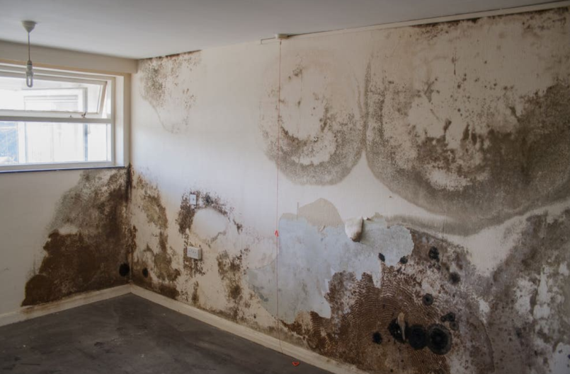
Design Goals for Buildings
Durable and Long Lasting
Energy Efficient
Comfortable to Work and Live In
Healthy and Safe to Work and Live In
Managing Moisture is a key component for achieving these goals
Notes:
All building designs have the goals of being durable, energy efficient, comfortable and safe to live or work in.
The greatest threat to achieving these goals is moisture.

Slide 7
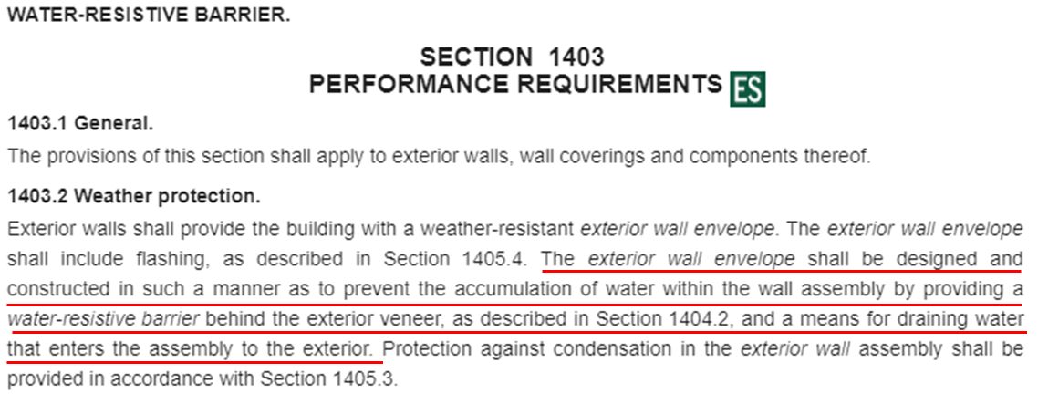
Building Codes and Standards Require Water Management Performance: IBC 2015
https://codes.iccsafe.org/content/IBC2015/chapter-14-exterior-walls?site_type=public
Notes:
The ICC has added a requirement in chapter 14 for Water Resistive Barriers to be included as part of the wall assembly.
This is to provide weather protection and means for draining any water that may enter behind to the exterior cladding.

Slide 8
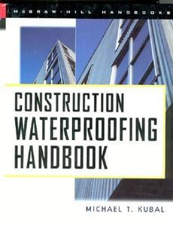
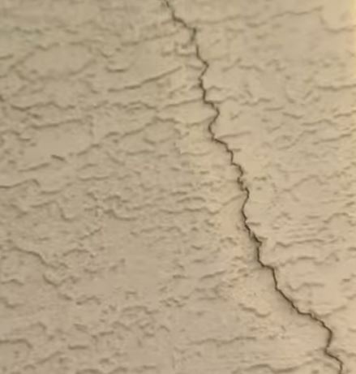
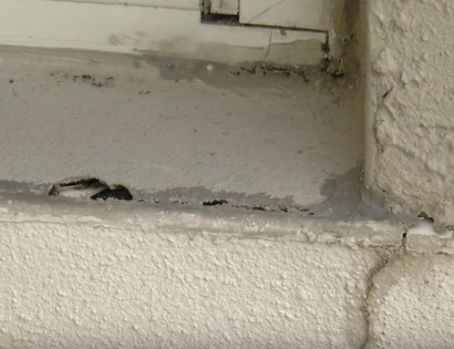
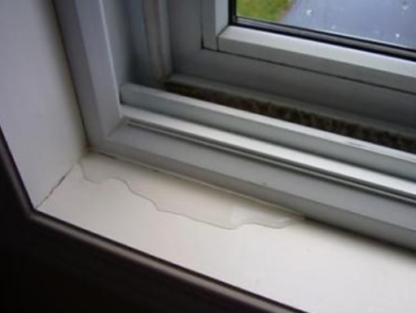
Significant Problem!
Kubal: 90%-1% principle
Up to 90% of all water intrusion problems occur with 1% of the total building envelope (Kubal)
Notes:
According to Kubal in the Construction Waterproofing Handbook, most issues start in a very small area but can spread to cause significant damage over time, which he refers to as the “90%-1% Principle”.
This means that small deficiencies in execution can actually result in significant and costly problems down the line.

Slide 9
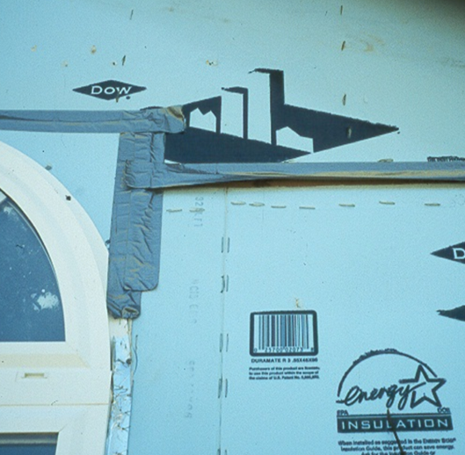
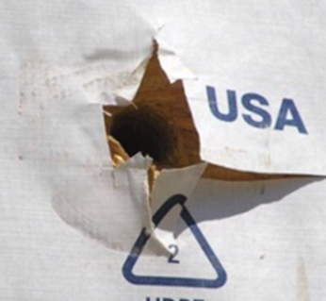
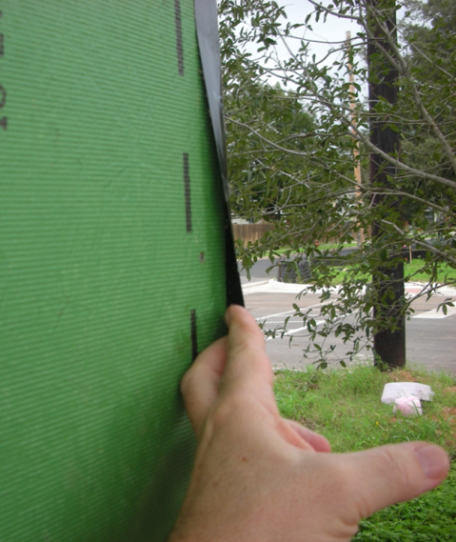
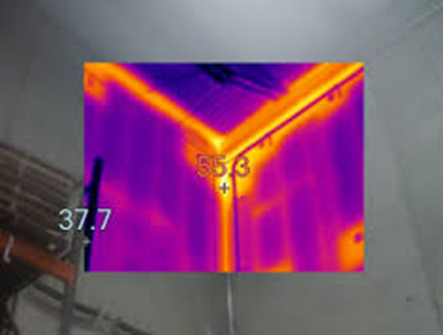
Common Building Envelope Deficiencies
The US Construction Industry spends over $9 billion per year on construction defects that are due to water intrusion.
Notes:
These failures are a significant contributor to the staggering $9 billion spent by the Construction Industry every single year on construction defects related to water intrusion alone. This data was actually compiled by the ASTM.

Slide 10
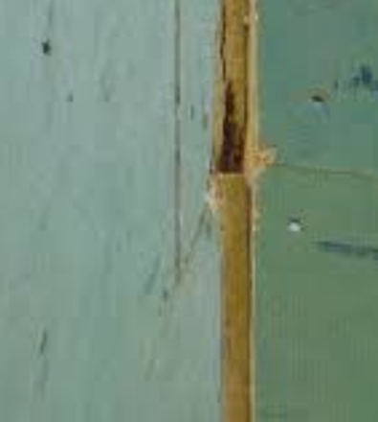
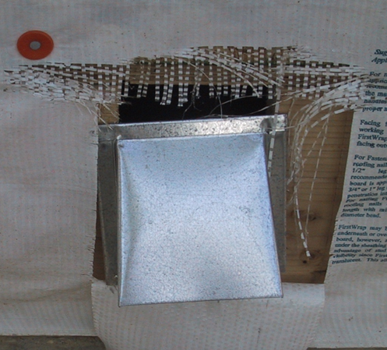
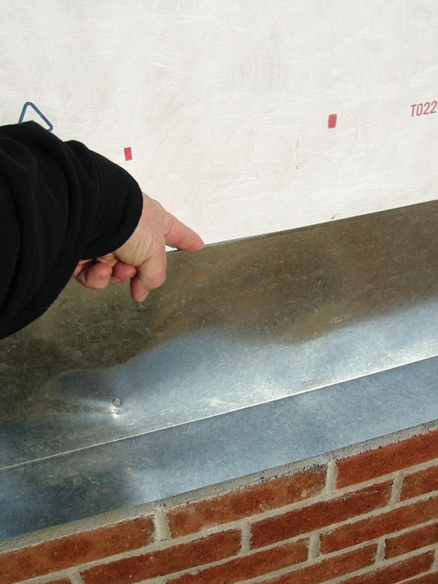
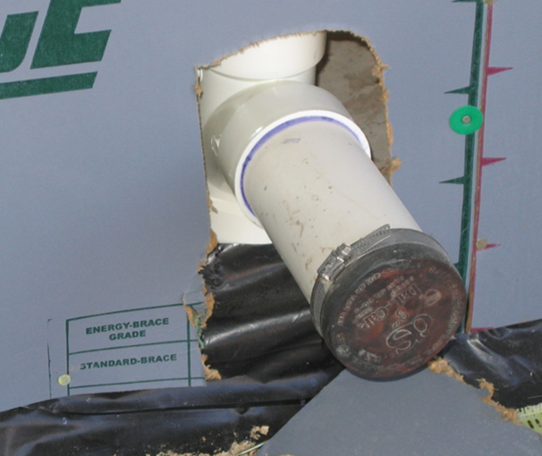
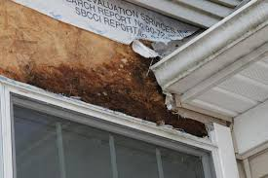
Common Building Envelope Deficiencies
Notes:
So designing robust systems that can be easily executed, managed and communicated are essential components for the proper execution by the trades in the field.

Slide 11
Building Science Fundamentals
Heat moves from warmer areas to colder areas
Moisture moves from wetter areas to dryer areas
Pressure moves from high to low
All of the above impact the wetting and drying rates of building assemblies
Energy and Water Management work hand in hand
Notes:
How the wetting and drying takes place within a building is based on some building science fundamentals that state:
Heat always moves from warm to cold
Moisture always moves from wet to dry
And Pressure always moves from high to low

Slide 12
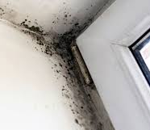
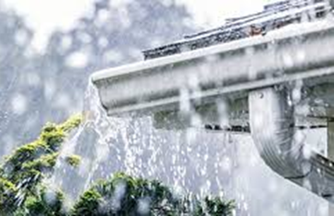
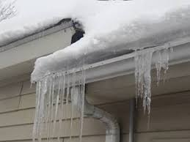
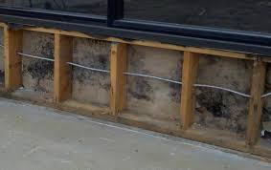
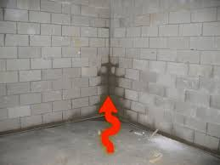
Building Science Fundamentals
Moisture Flow Mechanisms
  Bulk water movement
    Capillary action
  Air transported moisture
  Vapor diffusion
Notes:
Bulk water intrusion is typically a source of weather and site conditions.
It can enter through cladding deficiencies, and then it’s absorbed by materials through capillary action.
Also, both air-transported and diffused moisture can contribute to moisture related issues as well.

Slide 13
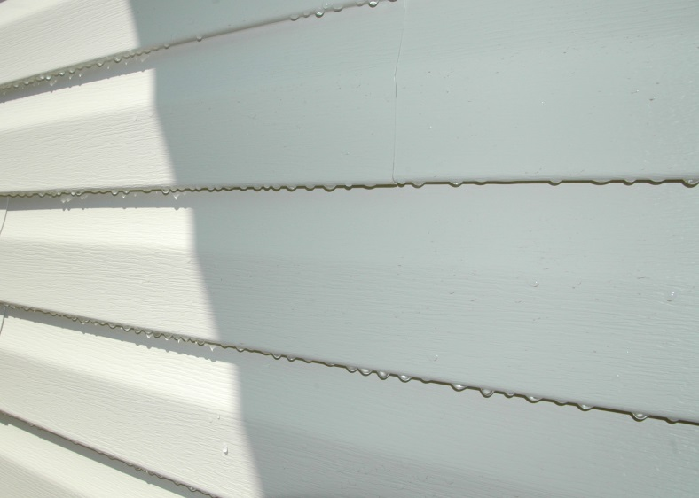
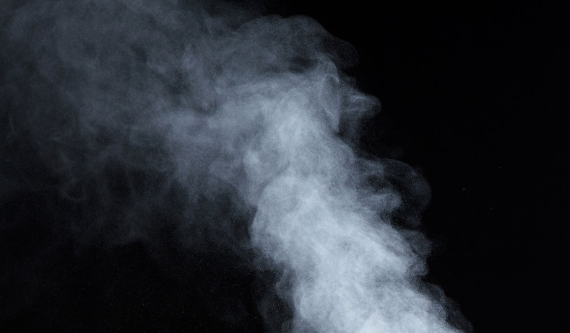
Moisture Movement in Buildings
Liquid water moves via
Gravity
Wind Driven Rain
Capillary Action
Pressure Differentials
Water vapor moves via
Air currents, infiltration and exfiltration
Diffusion
Notes:
Bulk water can move by various forces and it’s definitely the most severe.
Water vapor can move through air currents and diffusion, which we will discuss later in the presentation…

Slide 14
Priorities
Protect against bulk water FIRST
  Water control layer, flashing, drainage, capillary breaks
Protect against air entrained moisture SECOND
  Continuous air barrier, internal air seals
Protect against diffused moisture LAST
  Vapor permeability of materials, location
Notes:
You should always manage Bulk Water first,
Air Entrained Moisture second
and Diffused Moisture third, taking material selection and climate requirements into consideration.

Slide 15
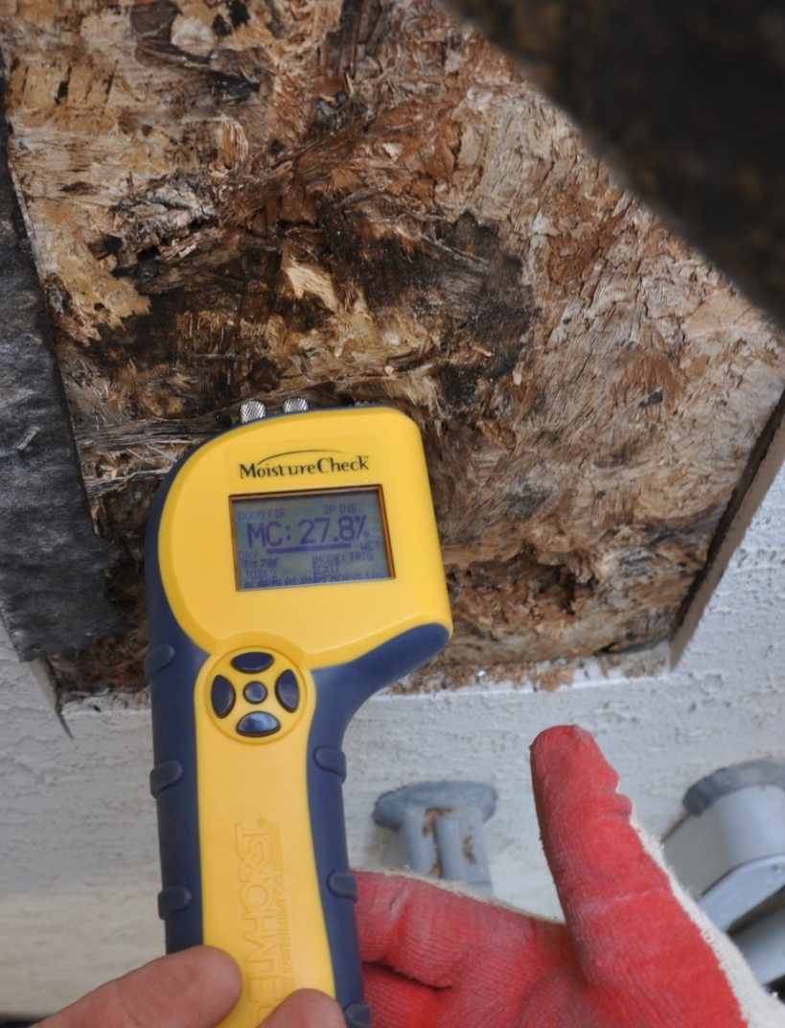
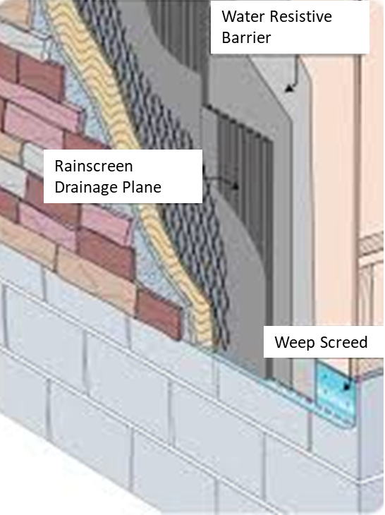
Preventing Problems Starts With Good Design
Notes:
Good designs include WRBs, flashing, drainage, redundancy and compatible materials.
Here you can see a section of stucco that was removed to expose the OSB sheathing that has a moisture content of almost 28%. Moisture issues can start at ~15% moisture content and that can cause corrosion of metal fasteners. At 16% it may lead to fungal growth.
The issues found here could have been avoided by simply having a properly designed water management and drainage system capable of managing the typical moisture that penetrates behind stucco cladding systems. Stucco, along with other absorptive claddings like brick and fiber cement, require enhanced drainage protection to avoid moisture related issues.

Slide 16
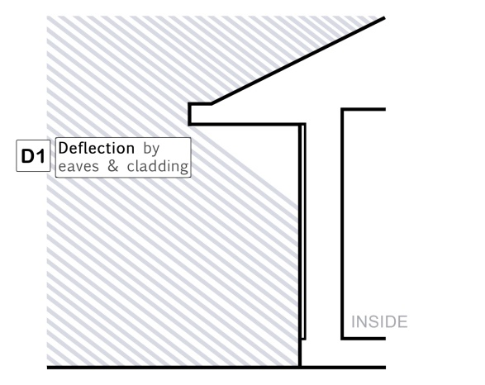
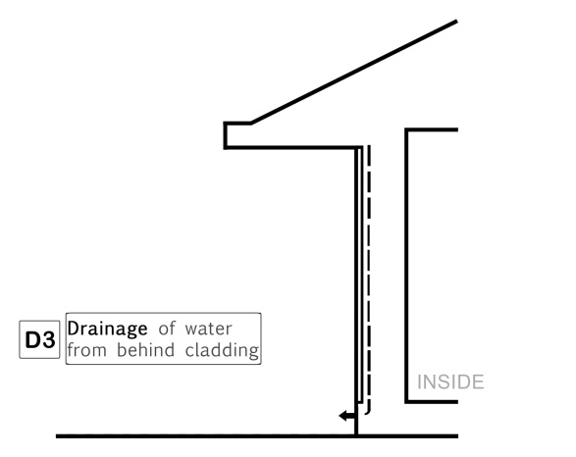

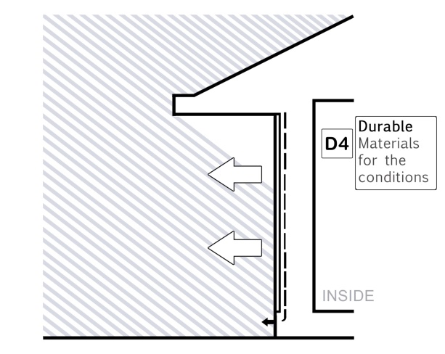
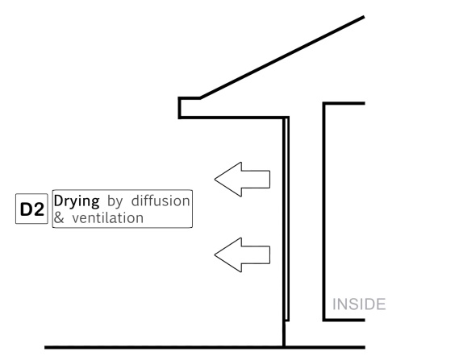

Moisture Management the 4 D’s in Design
Deflection
Drainage
Drying
Durable Materials
Notes:
In Moisture Management, we always organize our thinking around the four D’s
Deflection- which is your exterior cladding and roofing systems, deflects ~80% of the water away from the building
Drainage- since claddings allow ~20% of moisture to penetrate, it’s important to find a way to make it drain out as quickly as possible.
Drying- it’s important to always include provisions for proper drying of components so moisture doesn’t sit on the wall for long. You should have a ventilated wall system in at least one direction, but having it in two directions is actually much better and recommended.
Durable Materials- finally it’s crucial we always include materials that are compatible with one another and that are resistant to UV rays in order to have a robust system.

Slide 17
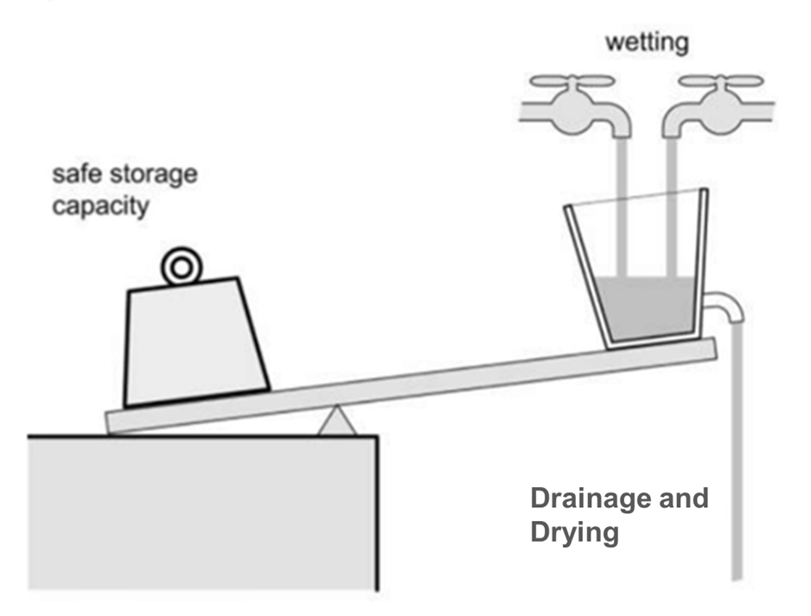
Moisture Balance
Balance is Design, Climate and Material Dependent
Notes:
Cladding systems can handle a specific amount of water depending on the materials selected and the climate.
But when the wetting rate exceeds the material capacity, problems, such as fungal growth and decay can begin to occur.
The best way to avoid this is by designing a robust water managed system with the proper drainage and drying that ensures a safe balance of wetting and drying potentials.

Slide 18
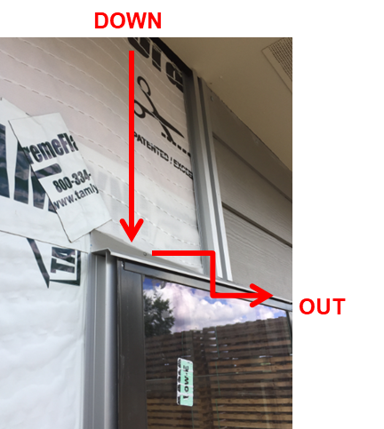
Building Science Fundamentals
  Bulk water movement (rain, snow, or groundwater)
  A gap or deficiency in the cladding system (80/20)
  A driving force such as:
    Gravity
    Air pressure
    Capillary action
Solution: Install a robust water control layer
  Water resistant barrier (WRB)
  Continuous
  Drainage
  Flashing systems
Considerations:
  Climate
  Material compatibility
  Redundancy
Notes:
Most cladding systems allow moisture to penetrate and can often represent 20% or more of the moisture exposure.
This moisture is best addressed by protecting sensitive materials from wetting, redundancy where it’s feasible, ensuring proper drainage, and a means for that water to escape.
This is achieved with a comprehensive plan and good moisture management system.

Slide 19
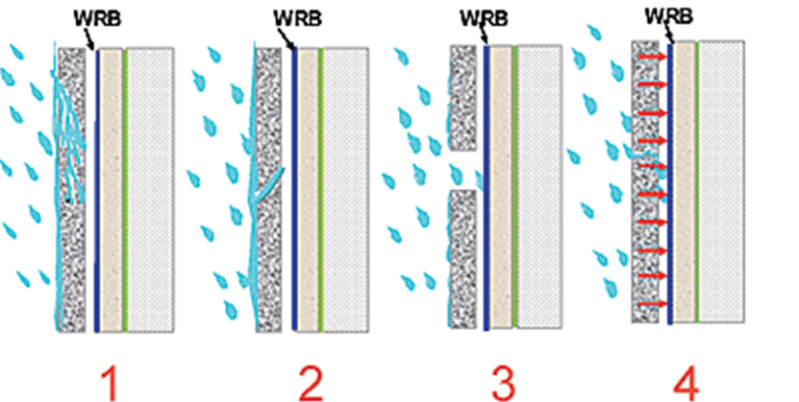
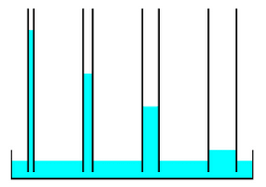
Building Science Fundamentals
  Capillary action (capillarity)
  Water being absorbed from surrounding wet materials or conditions.
Solutions:
  Avoid materials in direct contact
  Utilize a space for effective capillary break (1/4”+)*
  Capillary barriers
*- Material and design specific
Notes:
Capillary action is dependent on the materials selected and how close they are to each other. It’s often compared to how a tree delivers water to its branches.
The image on the left depicts how a more narrow tube shows a higher level of capillarity relative to a wider tube. To avoid capillary action on vertical surfaces, a 1/4” minimum gap is typically needed. This is particularly important behind absorptive claddings like stucco, brick, etc.
The gap facilitates drainage and enhanced drying of properly designed wall systems.

Slide 20

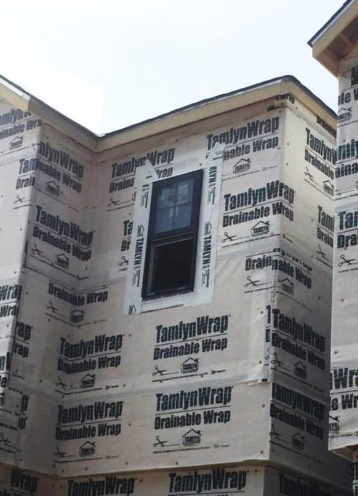
Building Science Fundamentals
  Air transported moisture
    Air-transported moisture can leak into, or out of, buildings
    Moisture in it will condense on any surface temperature that is below the dew point
    Typical building has miles of cracks and gaps
  Solutions:
    Install a continuous air barrier system
      Air barrier material (High Performance WRB)
      Air barrier detailing
    Additional air sealing from the interior, around all penetrations, plate lines, band joists …
Notes:
Air can also move a significant amount of entrained moisture.
This moisture will condense on any cool surface that is below the dew point, and it can be easily shown on the beer mug example, where you don’t see the moisture in the air but it quickly collects and puddles on a cold mug.
In wall systems, we almost always have a cold surface where condensation can occur and accumulate.
It’s best avoided by including a continuous air barrier in the wall system design and details.
Many WRBs can also perform as air barriers if detailed properly, but woven WRBs cannot act as air barriers.

Slide 21
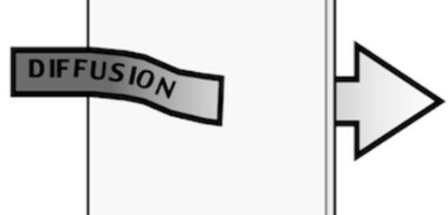
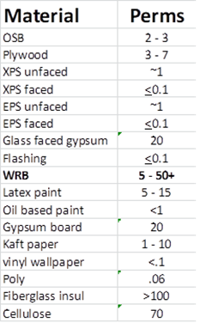
Building Science Fundamentals
  Vapor diffusion
    Even without leaks, small amounts of moisture in the form of water vapor can pass through porous building materials through a process called diffusion.
    Rate is material dependent (perms)
    Temperature and Vapor Pressure dependent
  Solutions:
    Promote drying in wall systems- at least one direction
    Higher perms = higher vapor transmission
    Material selection and location
      Vapor permeable- Promotes drying (>15 perms)
      Vapor barriers- Limit vapor diffusion (cold climates)
      Exterior insulation – shift dew point
Notes:
Vapor diffusion refers to moisture that slowly migrates through materials and is how materials dry. It’s material dependent and referenced in “perms”.
The higher a material perm rating is, the easier water vapor diffuses through it.
Vapor diffusion is an important consideration for wall system drying. Studies have shown that permeability >15 perms is required for proper drying, and a permeability >30 can actually lead to wetting in certain climates and cladding systems.
It’s important to consider this for material selection, climate conditions and the adequate drying potential of a wall system.

Slide 22
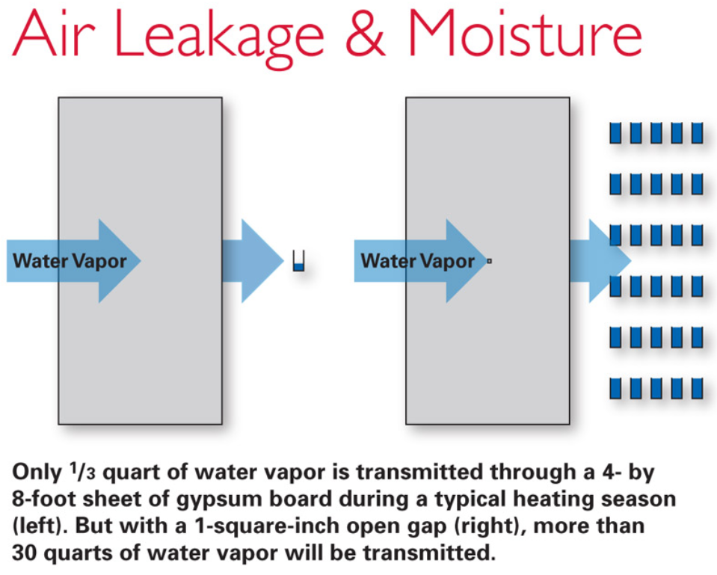
Building Science Fundamentals
Vapor Diffusion vs. Air Leakage
Air leakage moves ~100X the amount of moisture vs. diffusion
Notes:
The above images show that an air leak through just a 1 in² opening in a wall system can move 100X more moisture than diffusion.
This is why air leakage must be controlled with a higher level of priority over diffusion alone in order to avoid wetting.
The truth is that a typical home has over a mile of cracks that have to be addressed and sealed as part of a continuous air barrier system.

Slide 23
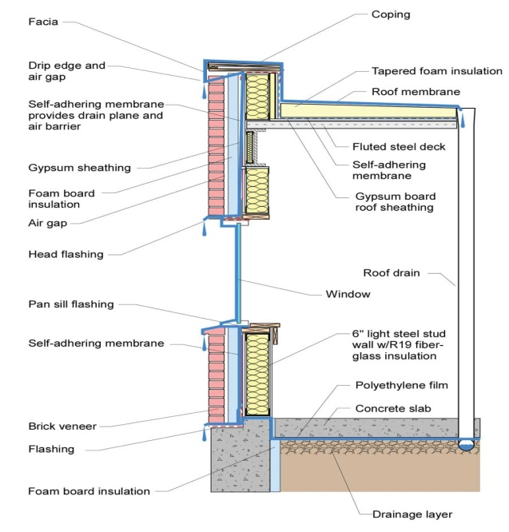
Causes of Moisture Related Building Failures
Poor details
Lack of moisture management plan
Material incompatibility
Poor workmanship and construction practices
No redundancy
Lack of maintenance
Image source: EPA
Notes:
We know that wall assemblies dry slowly, so it is critical that everything is done to avoid complications.
This is accomplished through proper design, material specifications, construction, and maintenance.
Moisture control and management should be a consideration for the lifecycle of a building, and in order to reduce risks:
You should avoid designs that trap or direct water into the building.
You should detail a well thought-out moisture management plan, specifying drainage and compatible materials.
Also, ensure that proper workmanship and standard construction practices are being used.
And plan for the moisture generated from the occupants.

Slide 24
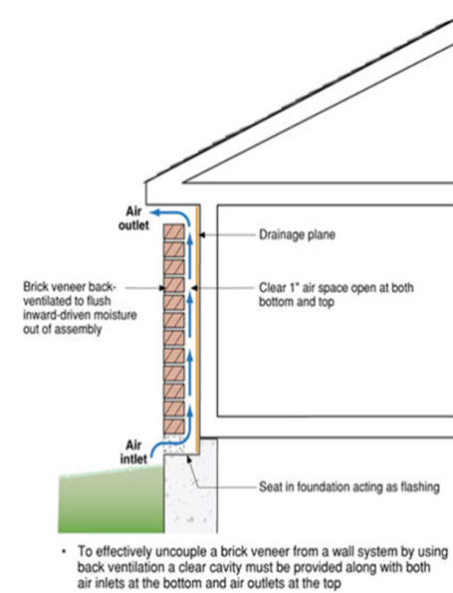
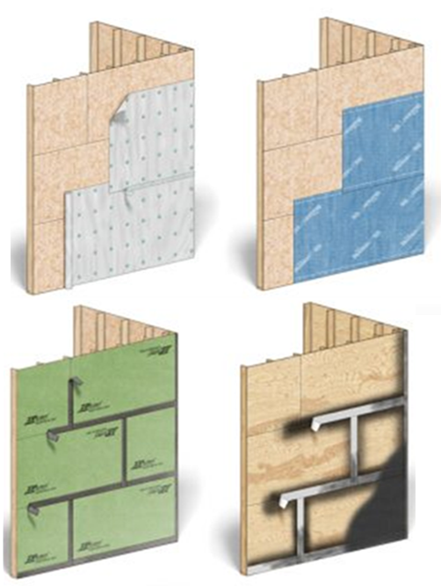
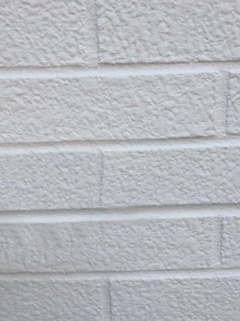
Moisture Management - Types of Wall Systems
Barrier Walls Drainable Walls Rainscreen Walls
Notes:
There are 3 main types of wall systems in moisture management:
The 1st being Barrier Walls – which try to prevent moisture intrusion.
The 2nd type are Drainable Walls – which manage moisture that is inevitable.
And the 3rd type are Rainscreen Walls – which are for climates with severe weather exposure or behind absorptive claddings.

Slide 25
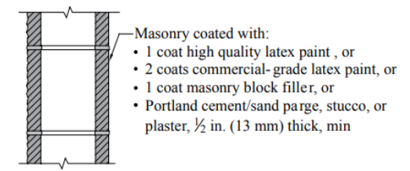
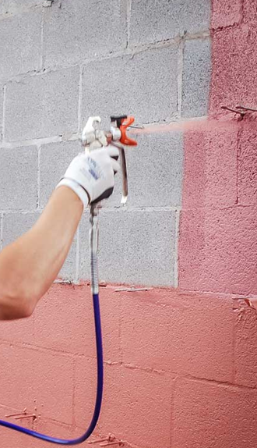
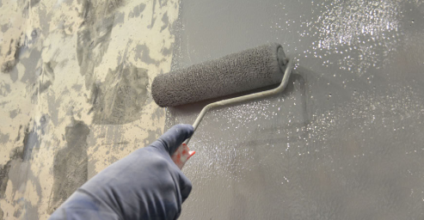
Barrier Walls
Considered Least Effective
Relies on face sealing of everything – biggest weakness being joints
Paints & Coatings (interior or exterior)
Notes:
Barrier Walls
Are Considered Least Effective because
It relies on face sealing,
It provides no path for drainage,
And it’s often used with tilt-up concrete or block construction

Slide 26
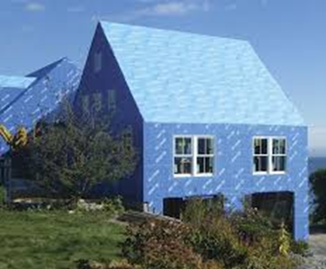



Drainable Walls
Use a water resistive barrier (WRB) to protect the wall assembly from water intrusion
Some claddings have drainage limitations
Most common, cost-effective application
Notes:
Drainable Walls
Most wall systems rely on a WRB to protect the wall assembly from water.
The most common types of membrane systems include:
Mechanically attached membranes
Adhesive membranes
Fluid applied membranes
And Sheathings with an integrated water resistive coating
Mechanically attached membranes are most common in residential applications and offer a cost effective system that has been in use for decades

Slide 27






Enhanced Drainable Walls
Use a Drainable Water Resistive Barrier (WRB)
Enhanced drainage and drying
  >90% drainage efficiency
  Use non-compressive drainage layer
  Non linear drainage pattern
Added protection with minor cost impact
Drainable is sustainable
Notes:
Drainable housewraps provide a cost-effective enhanced drainage by creating a drainage channel behind the cladding system.
For best results, use a non compressive gap material that is non directional to ensure that a drainage gap is present, and that moisture will be able to drain out efficiently.
Enhanced drainage is required behind stucco, fiber cement and other absorptive claddings but can also enhance the sustainability and resilience of other cladding systems.

Slide 28


Rainscreen Walls
Have a physical airspace between WRB and cladding to promote greater drying as well as drainage
Typical air space range from ¼” to 1”
Furring products typically plastic or wood- cost, labor intensive
Mesh products- compressible challenges
New innovative rainscreen products available
Best Practice - Growing in use
Notes:
Rainscreen Walls
Differ from drainable walls because they have an increased airspace between the WRB and the cladding.
Rainscreen systems typically include a minimum gap of 3/16” and can exceed 1”. This increased air space physically decouples the cladding from the wall system to ensure a superior drainage and can be designed as a vented or ventilated system.
These systems are a best practice but are growing in adoption along coastal and high exposure climate regions, and behind absorptive claddings in moist and marine climates. The latest code revisions for 2021 are now requiring rainscreens behind stucco claddings for such regions.

Slide 29

Climate Considerations
Any area receiving more than 20” of annual rainfall should incorporate enhanced drainage techniques (Drainable Housewrap) in the wall system, especially if using an absorptive/reservoir cladding material.
Areas receiving 40” of annual rainfall should utilize a rainscreen design regardless of cladding material.
Notes:
So, how do you decide what is needed?
As buildings become more energy efficient, they have become less moisture tolerant.
For general guidance, the Building Enclosure Moisture Management Institute suggests that any area that experiences more the 20” of annual rainfall should incorporate enhanced drainage such as a drainable housewrap. If annual rainfall reaches 40” a rainscreen system should be incorporated into the wall system.

Slide 30

Components of a Moisture Management System
Water resistive barriers (WRBs)- Required
Drainable WRBs- Enhanced Drainage + Drying
Rainscreens- Best Practice
Essential Details
  Lap all layers shingle fashion
  Step and Kick-Out flashings
  All penetrations sealed
  Thru-wall flashing at cladding transitions, openings and at the wall base
  Self-adhered flashing systems and compatible sealants
  A continuous exterior air barrier and interior air seal - Redundancy
  Material selection- Vapor permeability
Drainable is Sustainable
Notes:
When you are designing a Moisture Management System there are a number of key details to focus on:
At roof to wall intersections, you need to have a step and seamless kick-out flashing.
At a minimum, you should use a well-designed, continuous WRB and air barrier system. Include enhanced drainage and drying by using drainable membranes or rainscreens when applicable. I also like to stress that DRAINABLE is SUSTAINABLE.
Care must also be taken to seal all penetrations and openings.
Carefully select materials that are compatible with each other and all wall system components such as windows, doors, cladding, etc.
Thru-wall flashings should be used at material transitions and at the base of wall assemblies.
A continuous exterior air barrier and interior air seal are also appropriate for all climates.
Last but not least, develop clean, detailed and executable design drawings.

Slide 31






Water Management System Considerations
Flash windows & doors per ASTM 2112
Flash all penetrations
Use drainable systems
Use capped fasteners
Lap layers shingle fashion and use seam tape
Apply flashing with rigid roller or applicator
Notes:
It is important to specify materials and components that work together for proper moisture management which includes:
Properly designed cladding systems for the climate conditions
Install all components shingle fashion
Properly flashed windows and penetrations
Use capped fasteners
Observe proper overlaps
Tape WRB seams
Use a roller application of adhered products
Overall good installation practices

Slide 32








Flashing Roof and Wall Transitions
Notes:
Here on the left, you have a diagram showing proper roof-to-wall flashing using a step and seamless kick-out flashing.
Flashings are a key component of water managed systems and include thru-wall flashings, joint flashings, window flashings and weep screeds. These details can help avoid costly issues down the road, yet they are often overlooked, unfortunately.

Slide 33



Seal All Wall Penetrations BEFORE Cladding
Notes:
Lastly, you should always detail and complete your water managed system before the cladding is installed.

Slide 34










Questions?
Lais (Lasey) Simon
lsimon@tamlyn.com
(832) 798-5873
This concludes The American Institute of Architects Continuing Education Systems Program
Notes:
Now we’ve reached the end of this course and we have about ___ minutes left to answer some of your questions.
If you have any questions, you can just drop them in the chat room below and I can answer your them as they come.

