Slide 1
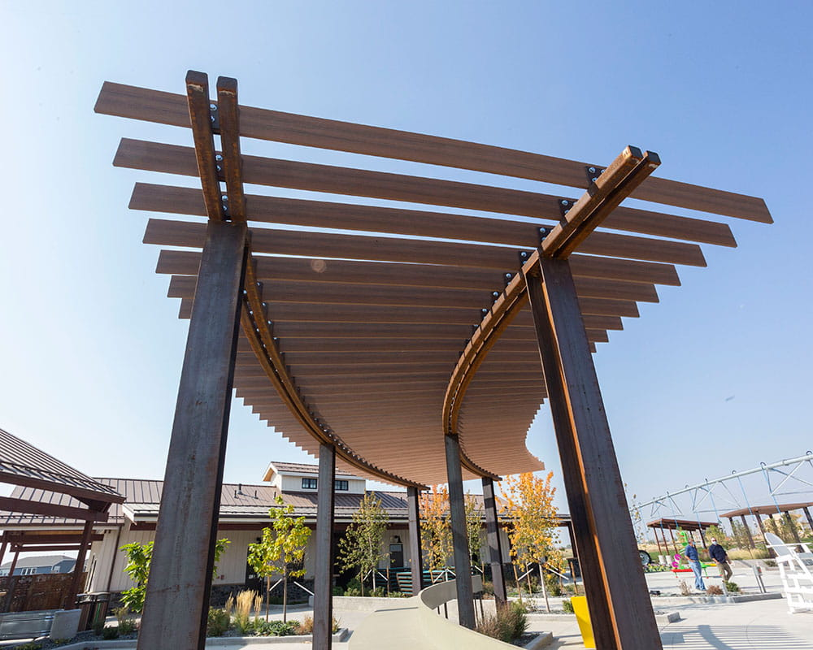
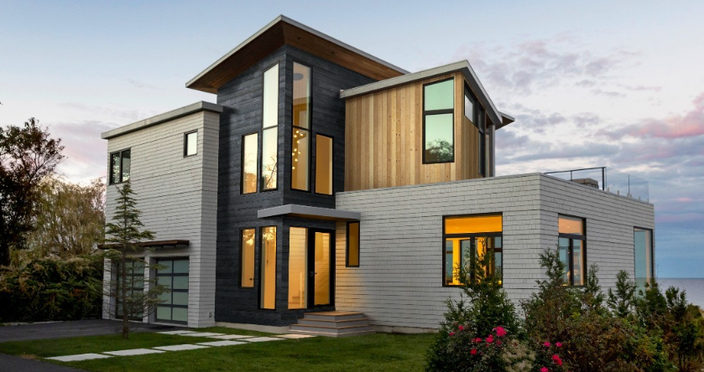
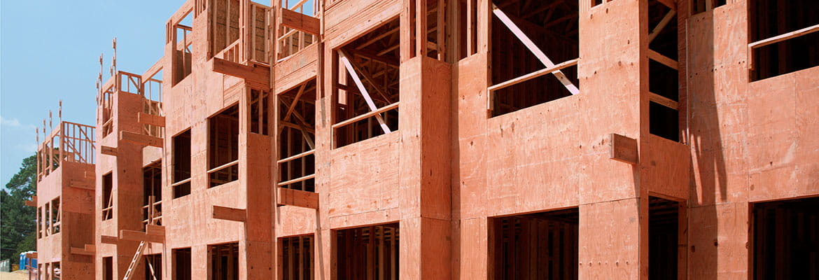


Slide 2
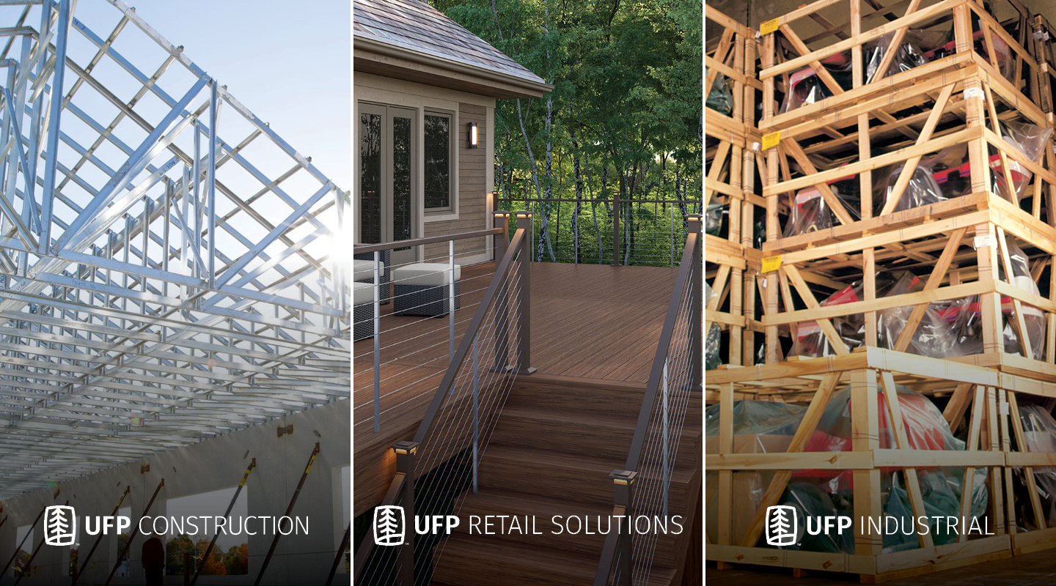

ABOUT US
Founded in 1955
211 Locations Worldwide
15,000+ Employees
2021 Sales: $8.6 Billion
Based in Grand Rapids, MI

Slide 3
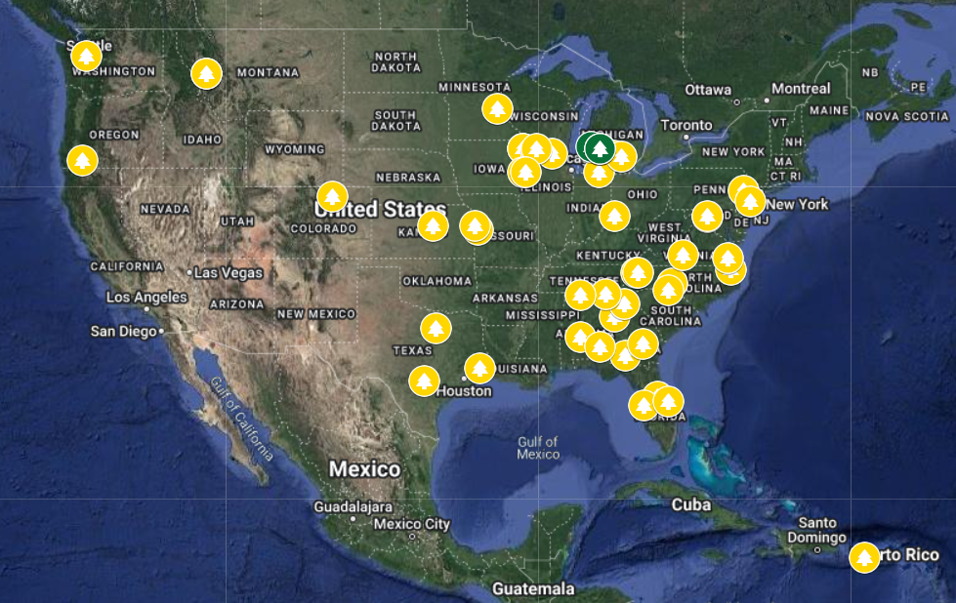

UFP RETAIL SOLUTIONS FACILITIES
Over 40 locations strategically located across the US
Capabilities include treatment, manufacturing, assembly and distribution

Slide 4





UFP RETAIL SOLUTIONS BRANDS

Slide 5


INNOVATIVE PRODUCTS. UNMATCHED PERFORMANCE.
Mineral Based Composite (MBC) Decking
Wood Plastic Composite (WPC) Decking
Aluminum & Cable Railing
Exterior Wood Siding
Interior Wood Shiplap & Pattern
Trim & Fascia
Structural Posts
Fire Retardant Wood
Pressure-Treated Wood
Color-Treated Wood
Kiln-Dried (KDAT) Wood

Slide 6
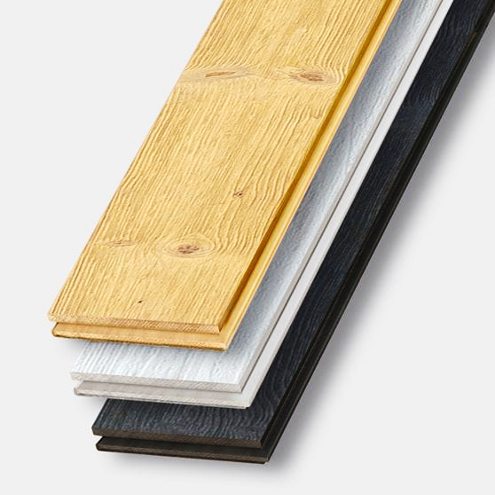
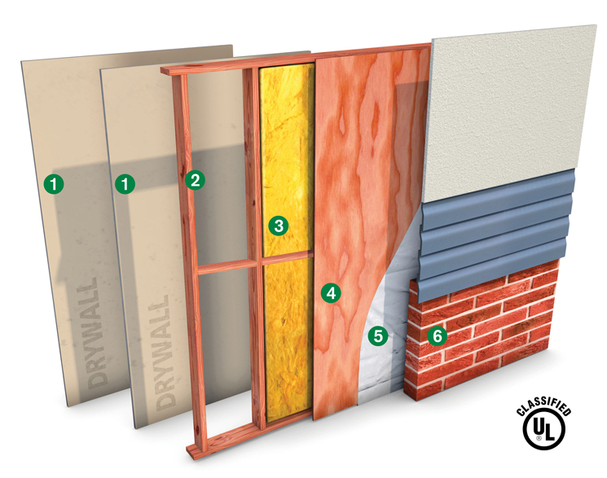
SIGNATURE PRODUCTS
Voyage MBC Decking
Thermally Modified Wood Siding
Fire Retardant Wall Assemblies

Slide 7
Composite Decking Delivers Performance, Safety & Value
Course #DKR-101
UFP Retail, LLC | AIA Provider #404109561

Slide 8



CEU CERTIFICATION
UFP Retail Solutions, the parent company of Deckorators, is a registered provider with The American Institute of Architects Continuing Education Systems (AIA CES). Credit earned on completion of this program will be reported to CES Records for AIA members. Certificates of Completion for non-AIA members are available on request.
This program is registered with AIA, NARI, and NAHB for continuing professional education. As such, it does not include content that may be deemed or construed to be an approval or endorsement by the AIA/NARI/NAHB of any material of construction or any method or manner of handling, using, distributing or dealing in any material or product. Questions related to specific methods, and services will be addressed at the end of this presentation.

Slide 9
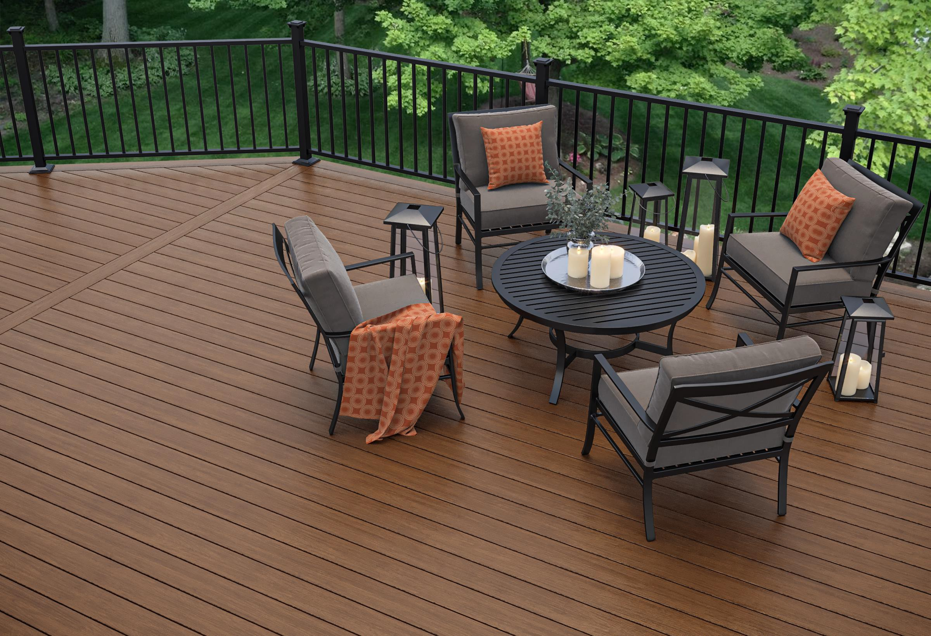
COPYRIGHT
MATERIALS
This presentation is protected by U.S. and international copyright laws. Reproduction, distribution, display and use of the presentation without written permission of Deckorators is strictly prohibited.
© Deckorators 2021

Slide 10
COURSE DESCRIPTION
Long lasting, hassle free, and environmentally friendly, the newer composite decking options are a high-performance alternative to traditional wood and traditional WPC decking.
By the end of this course, contractors/builders and architects will understand how composite decking outperforms traditional decking, why it is sustainable and eco-friendly, and how to select composite decking that meets stringent codes and standards.
This CEU will also explore the components of a decking project and installation best practices for successful project outcomes that deliver value and satisfaction.

Slide 11
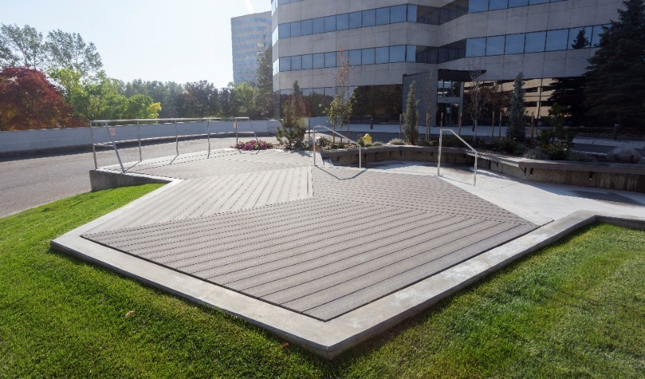
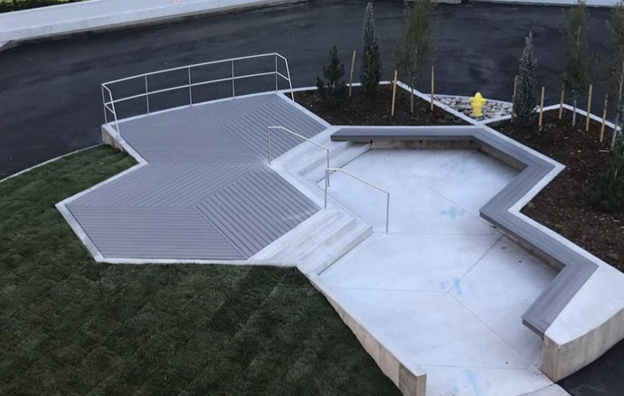
OVERALL LEARNING OBJECTIVES
By completion of this learning unit, you should be able to:
Outline the benefits of composite versus wood decking
Examine installation processes and identify appropriate accessories for composite decking projects
Describe best practices for the selection of composite decking systems
Discuss current composite decking codes and standards and identify best practices for meeting relevant performance and safety criteria
Notes:
Deckorators Voyage
Ground level / on concreate
Denver Tech Center

Slide 12
Learning Objective #1
Outline the benefits of composite decking compared to wood decking

Slide 13
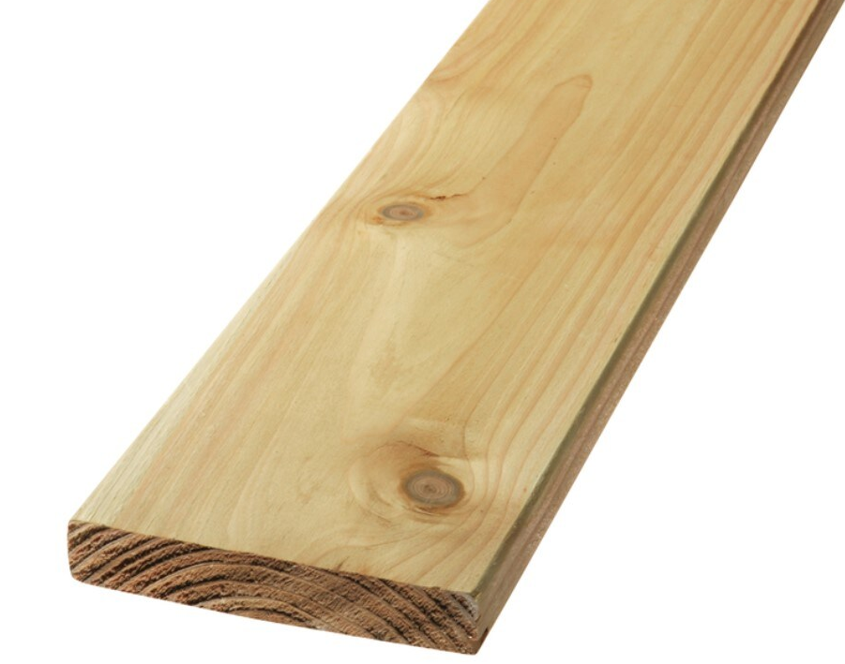
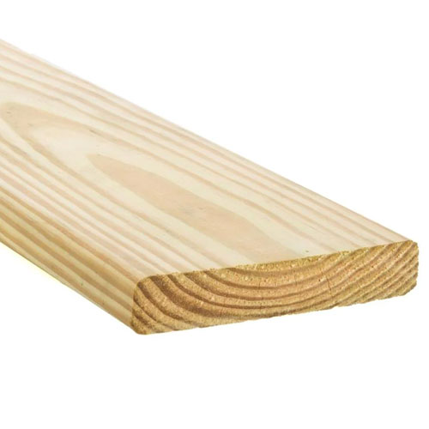
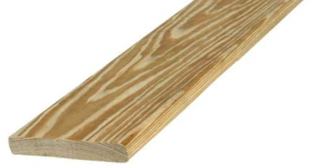
EVOLUTION OF DECKING
Redwood & Cedar
Pressure-Treated Wood
Kiln Dried After Treatment
(KDAT)
Naturally resistant to rot and insect infestation
Wood receives copper-based treatment to resist rot and insect infestation*
Same as pressure-treated wood but dried in a kiln after treatment for stability*
*Commonly Southern Yellow Pine (SYP)
*Treater series is KDAT that has been scanned for defects that may cause twisting or warping

Slide 14
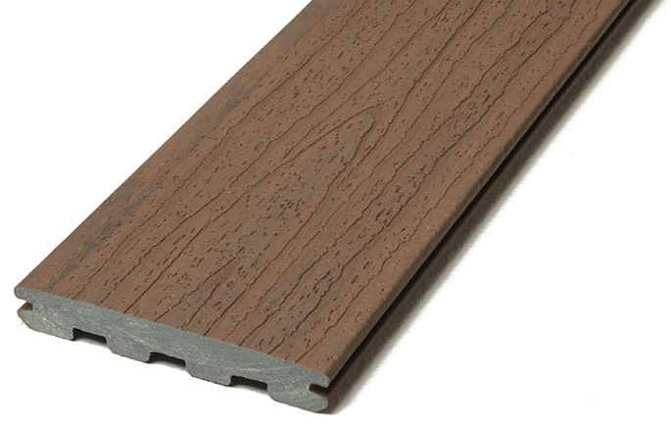
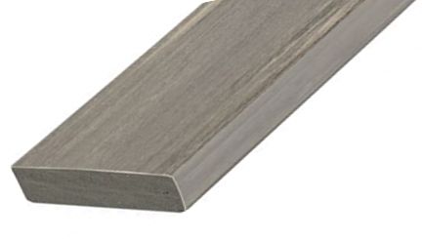
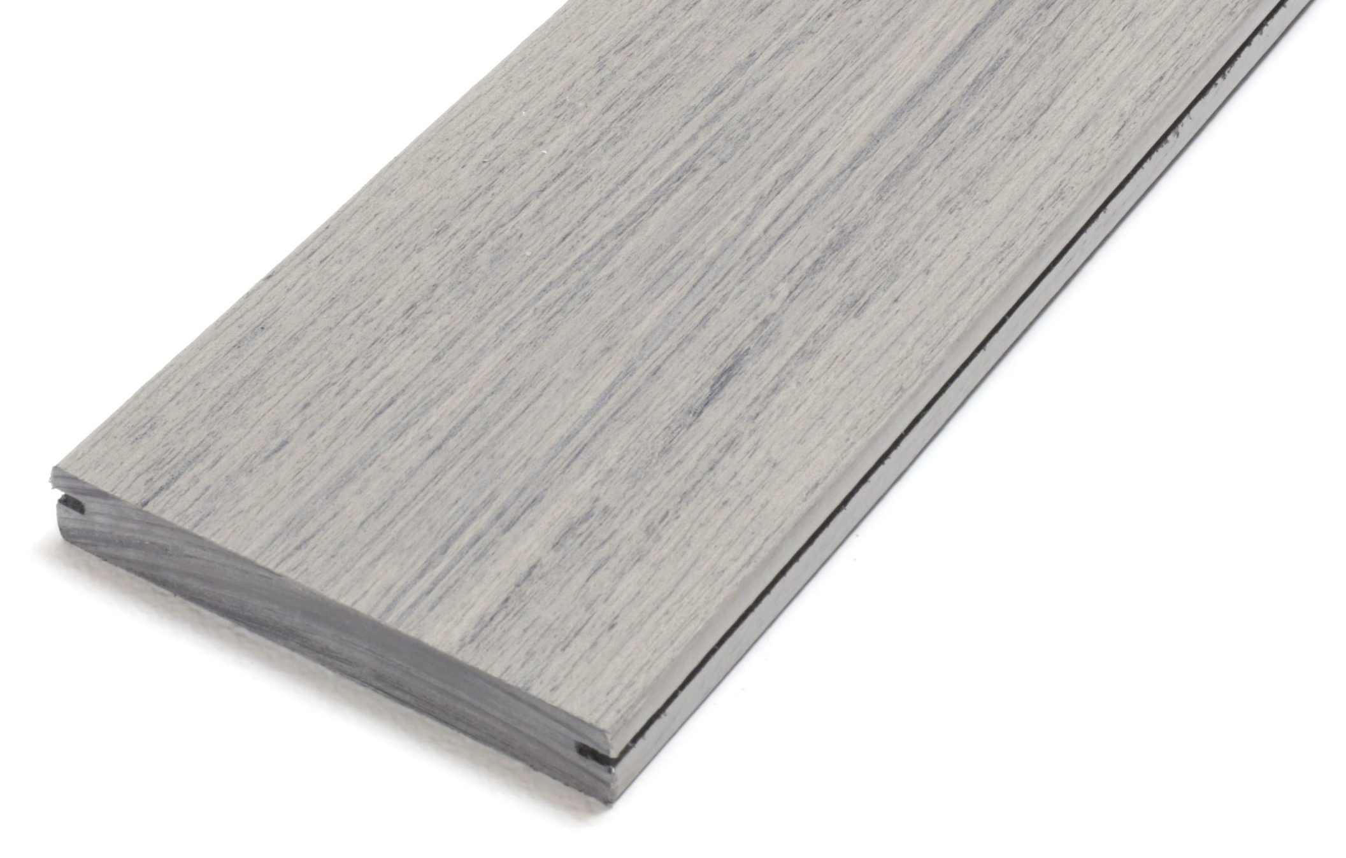
EVOLUTION OF DECKING
Wood Plastic Composite
(WPC)
Poly Vinyl Chloride
(PVC)
Mineral-Based Composite
(MBC)
A combination of wood fiber & HDPE plastic*
Two liquids that create a foam when combined
A composite of ground minerals and polypropylene*
*HDPE used is commonly post-consumer or pos-industrial recycled content
*Sometimes referred to as “open cell”
*HDPE used is commonly post-consumer or pos-industrial recycled content
Notes:
Composite decking, also known as wood-plastic composite (WPC) or mineral-based composite (MBC), is made up of a mixture of wood fiber and plastic. This mixture is further enhanced with pigments, IR and UV filtering agents.

Slide 15
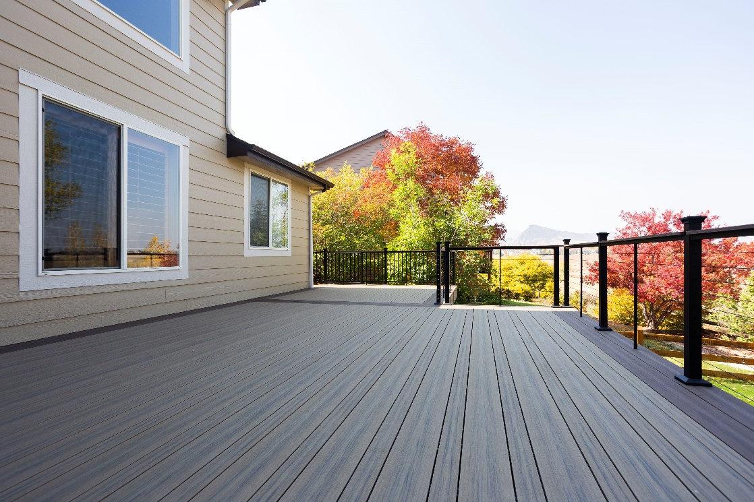
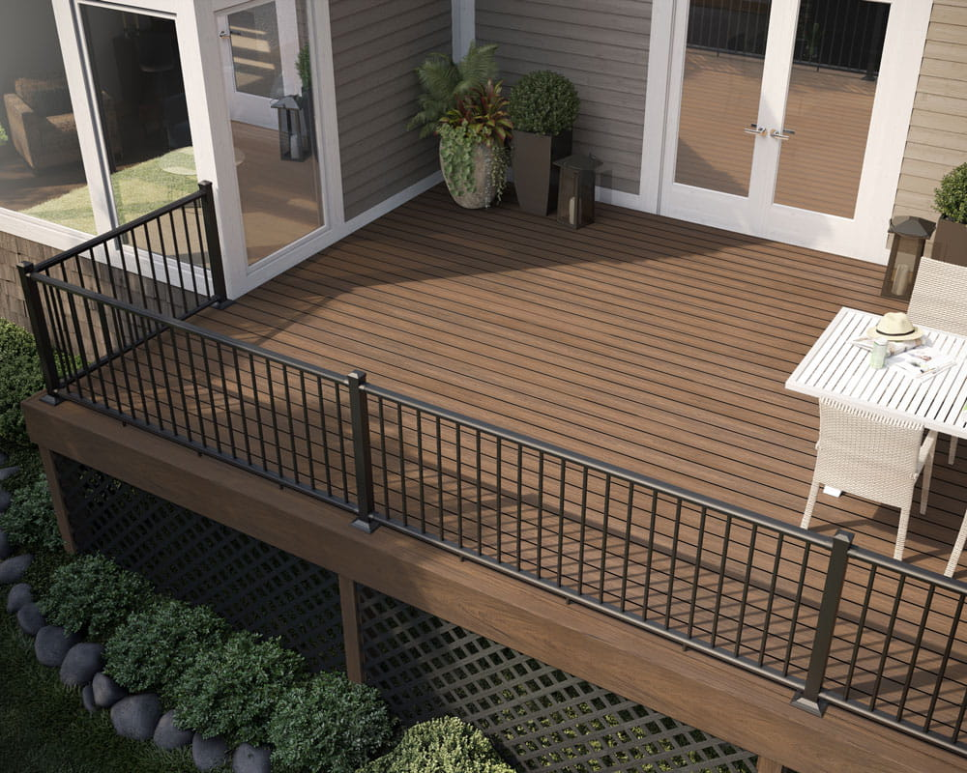
COMPOSITE VS. WOOD BOARDS
Composite decking outperforms traditional wood boards on many fronts, including:
Durability
Return on investment
Ease of maintenance
Lightweight
Strong
Available in an array of colors
Notes:
However, not all decking products are created equal. When it comes to durability, lasting return on investment, and ease of maintenance, composite decking outperforms traditional wood boards on many fronts.

Slide 16
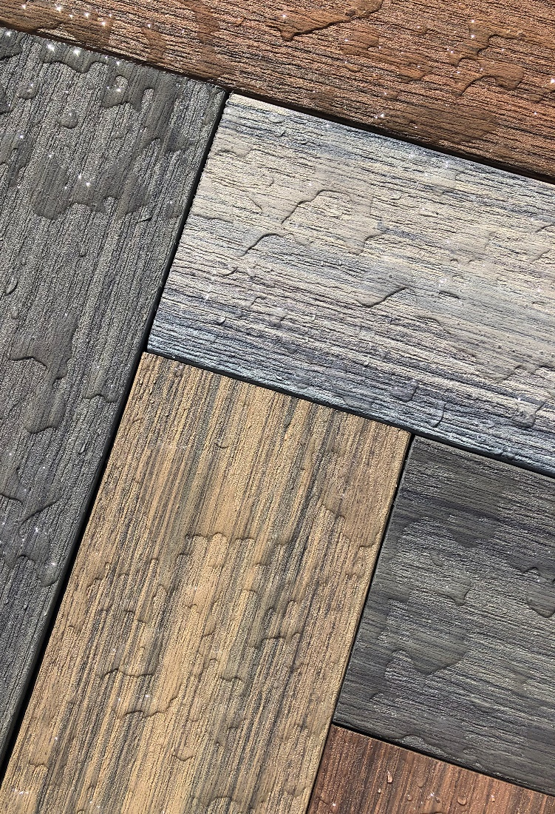
COMPOSITE DECKING VS.
WEATHER, WATER & PESTS
Unlike wood, composite decking is resistant to the following:
Splitting and delamination
Mold, mildew and rot
Insect infestations
UV Damage
Stains and scratches
Water absorption
Notes:
Unlike wood, composite decking is resistant to the following:
Splitting and delamination
Mold, mildew, and rot
Insect infestations
UV damage
Stains and scratches
Water absorption
And where wood requires annual maintenance and costly repairs, composite decking can go for years with just periodic use of soap and water to eliminate dirt and debris buildup.

Slide 17
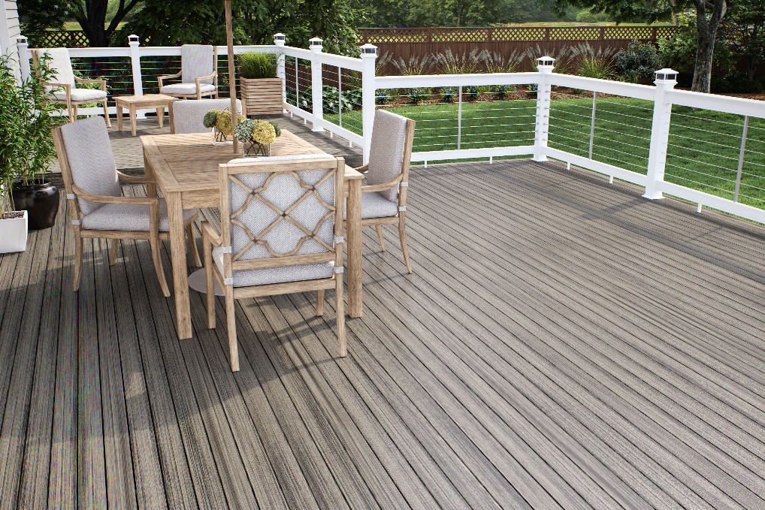
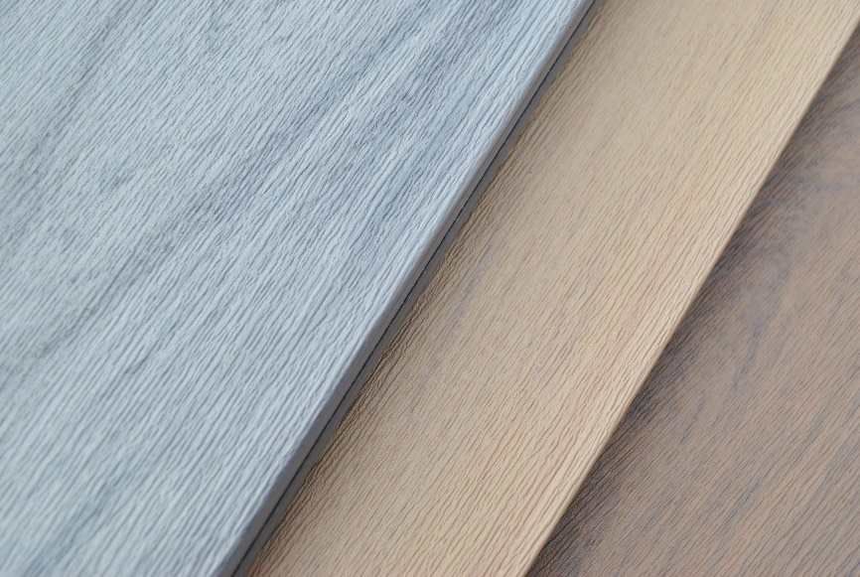
SUSTAINABLE & ECO-FRIENDLY
Recycled materials
Reduced waste
Non-toxic
Notes:
Composite decking is considered sustainable and eco-friendly because of its use of recycled materials.
For example, the wood can be made from ground-up wood leftover from mills and manufacturing processes, wood chips, and wood fiber pieces. The plastic component can also include recycled materials such as plastic bottles and bags.
In addition, composite decking does not need to be stained and sealed, is free of formaldehyde, and thus is non-toxic.
The sustainable appeal of composite decking makes it a popular choice for owners who seek to reduce any negative impact to the environment.

Slide 18
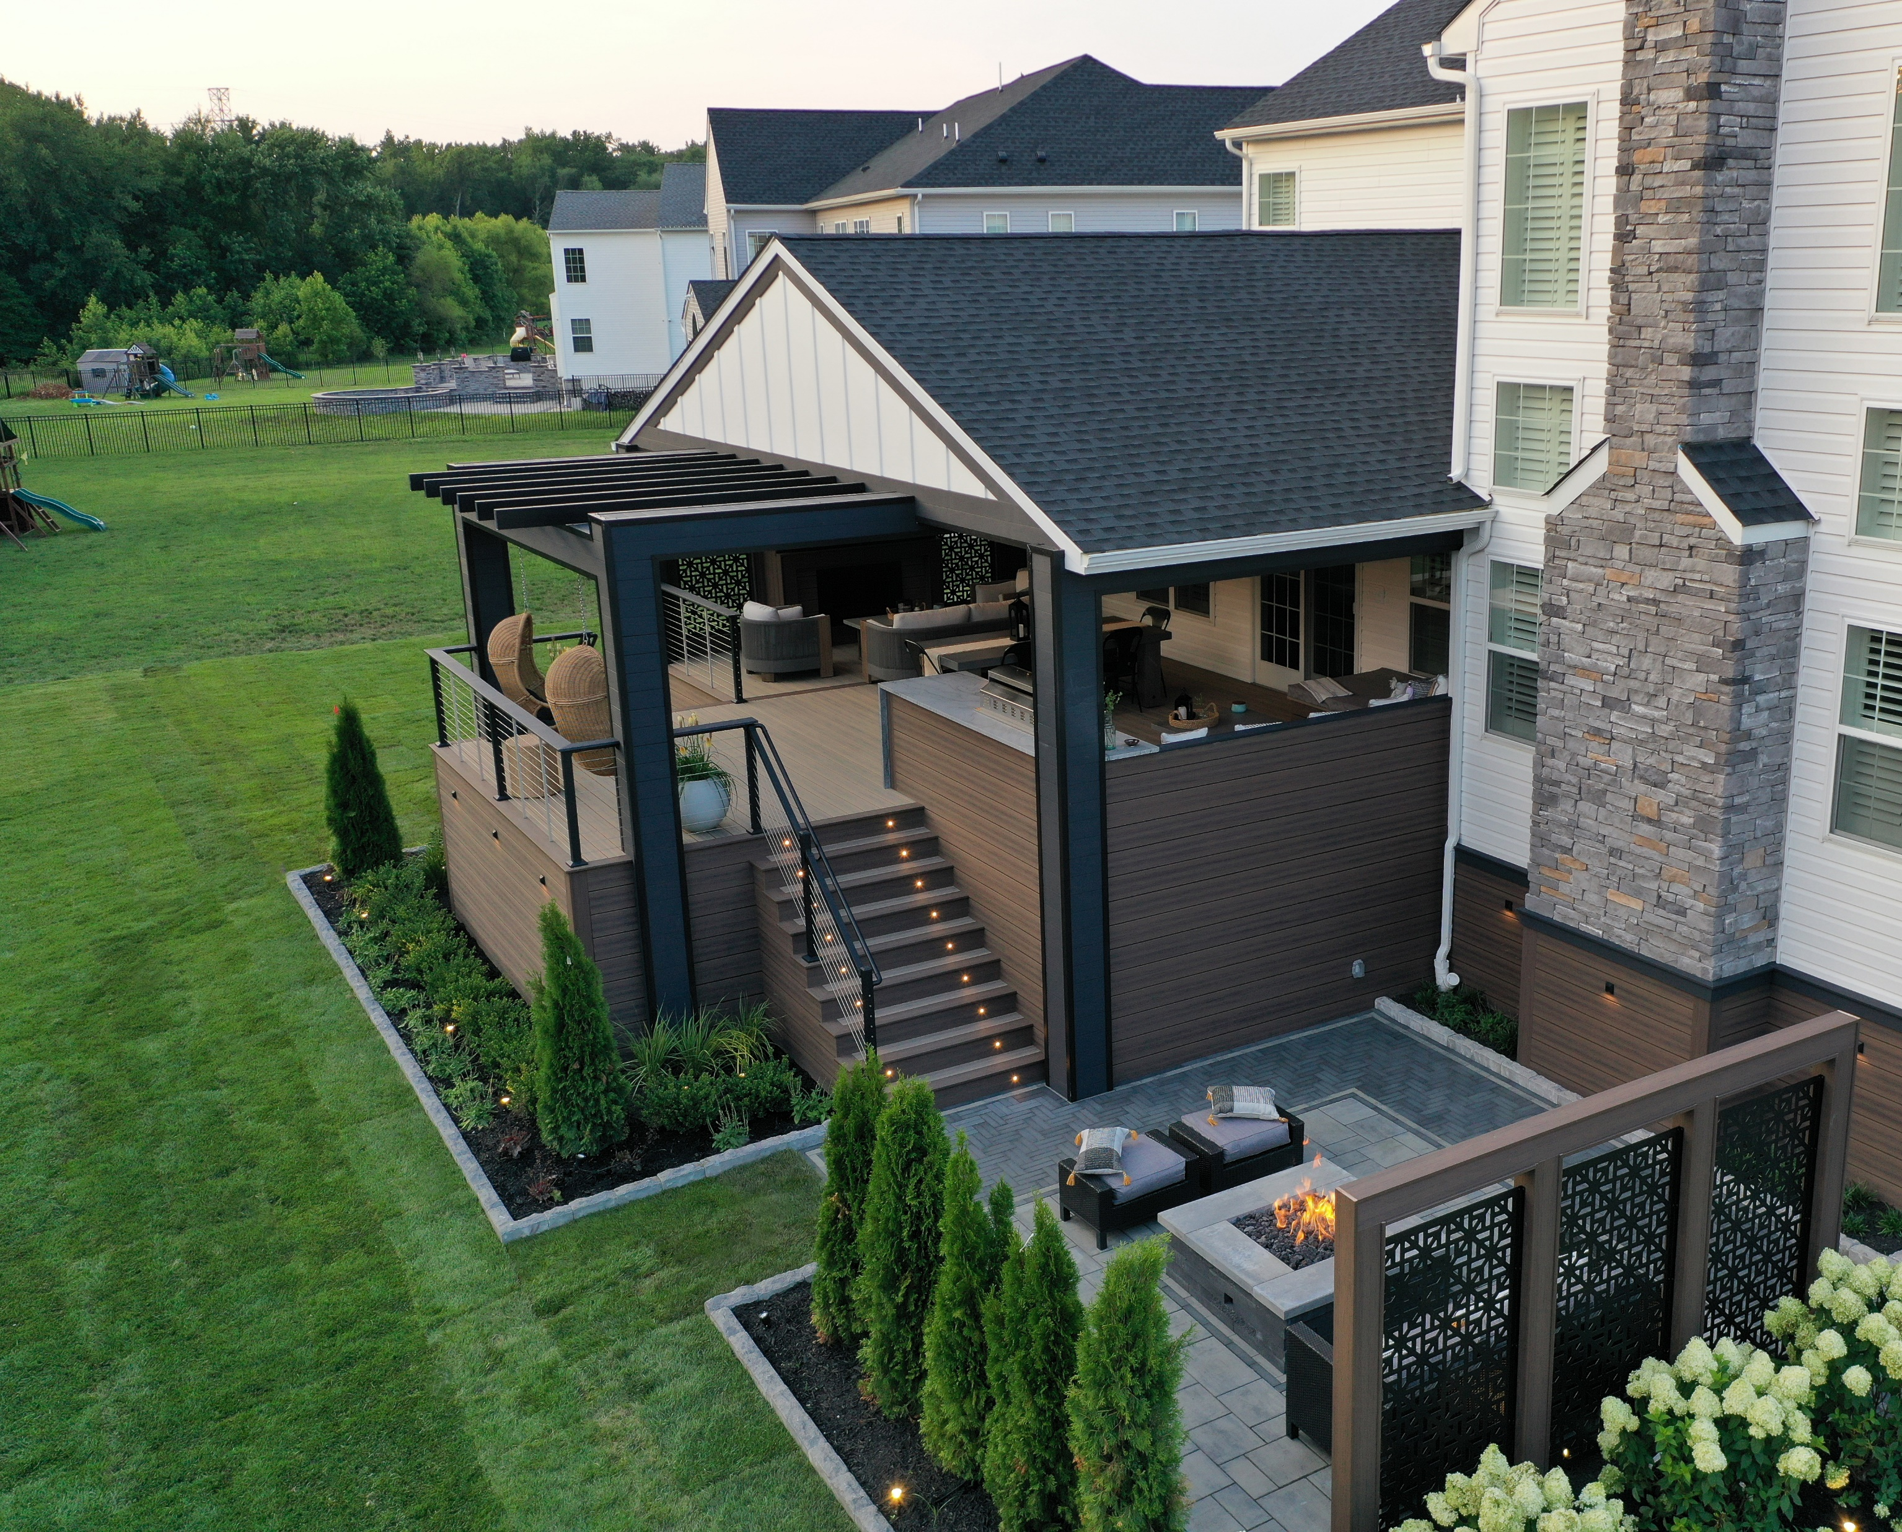
LONG TERM VALUE & SAVINGS
Composite decking provides long-term performance, efficiencies and savings that benefit different types of owners:
Single-home residential
Multi-family
Government
Commercial
Docks and Marinas
Notes:
When you weigh the benefits of composite against wood decking, you find that although composite may cost a bit more up front—more along the lines of upscale wood decking—it offers long-term performance and savings.
Because composite decking lasts longer and does not require the sometimes dramatic and often costly upkeep and replacement of traditional wood, owners can achieve significant savings over the entire lifecycle of a deck installation.
These savings are beneficial not just for residential owners, but also for government and commercial organizations that depend on durability and efficiencies to provide safe and appealing environments for their clients and the public.
Finally, composite decking is typically backed by warranties of 25 to 50 years, further protecting an owner’s investment.

Slide 19
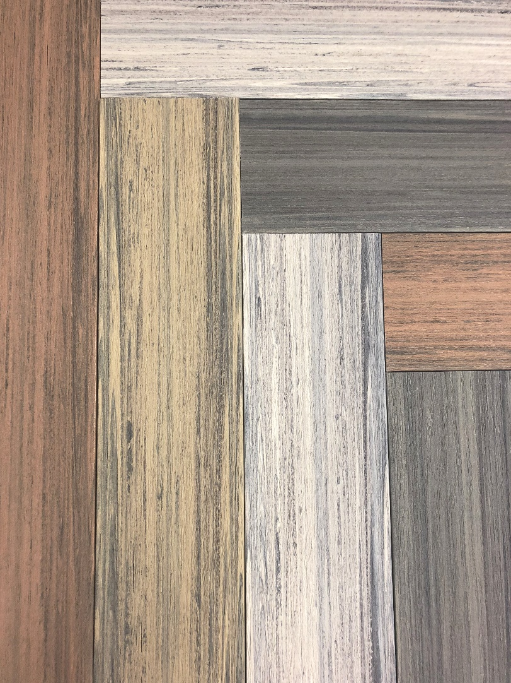
ENGINEERED FOR
PERFORMANCE
Strong
Stable
Available in an array of colors
Notes:
Because composite decking takes advantage of recycled and reused material, it helps reduce construction waste and use of non-renewable resources. Also, wood, a component of composite decking, is one of the most renewable resources on the planet.
As an engineered material, composite decking is lightweight, yet strong. It is also available in an array of colors, so it does not require painting after installation.

Slide 20
Learning Objective #2
Examine installation processes and identify appropriate accessories for composite decking projects

Slide 21
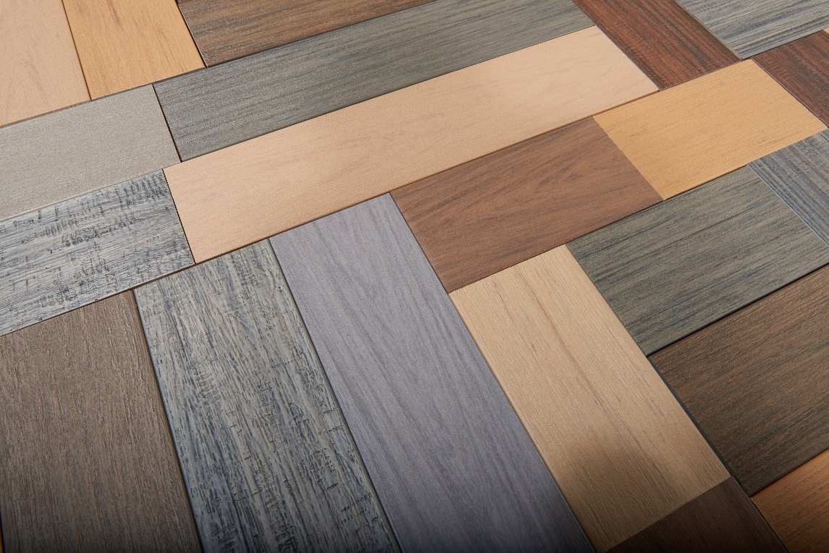
CHOICES IN COMPOSITES
Composite decking is available in a broad array of styles:
Embossed Grain
Plastic Wrapped
Textured
Weathered
Flat Grain
Vertical Grain
Notes:
The composite decking industry is continually evolving, and manufacturers are developing high-performance products and technologies for boards that deliver increasing strength-to-weight ratios, stability, and durability that transcends that of traditional wood board products.
The wood grain finish of composite mimics that of wood but is available in a wider array of styles and colors, maintaining its color and integrity over time.
Manufacturers offer broad arrays of style options ranging from modern and sleek to traditional, to weathered, rustic, and tropical.
Decking board typically comes in lengths of 12, 16, and 20 feet.

Slide 22
CHOICES IN COMPOSITES
Standard Lengths:
  12’
  16’
  20’
Standard Width:
  5.5”
Additional widths include:
  3.5”
  7.25”
  9.25”
Standard Profiles:
  Slotted-edge profile provides a seamless appearance with hidden fasteners
  Solid-edged board is ideal in cases where board edges are visible
Notes:
Decking boards typically comes in lengths of 12-, 16-, and 20-feet x 5.5” wide. Newer manufacturing technology is allowing the addition of variable widths.

Slide 23
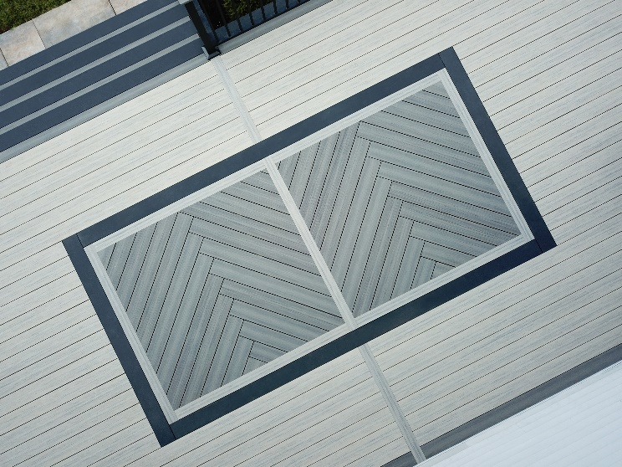
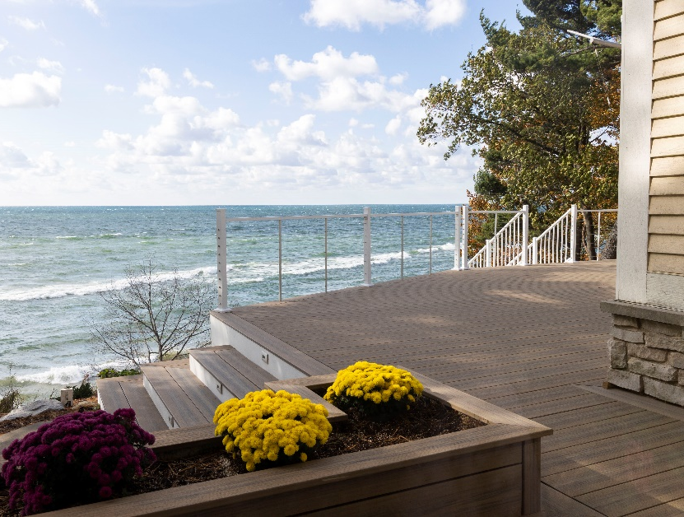
DECKING DESIGN TRENDS
Variable width Decking
Picture Frame & Double Picture Frame
Herringbone pattern
Inlays
Planter Boxes and Benches
Multi-Level Decks
Ground Contact Decks
Notes:
The variable widths allows the designer to create unique patterns and inlays as well as add features that up until now, have not been possible.

Slide 24
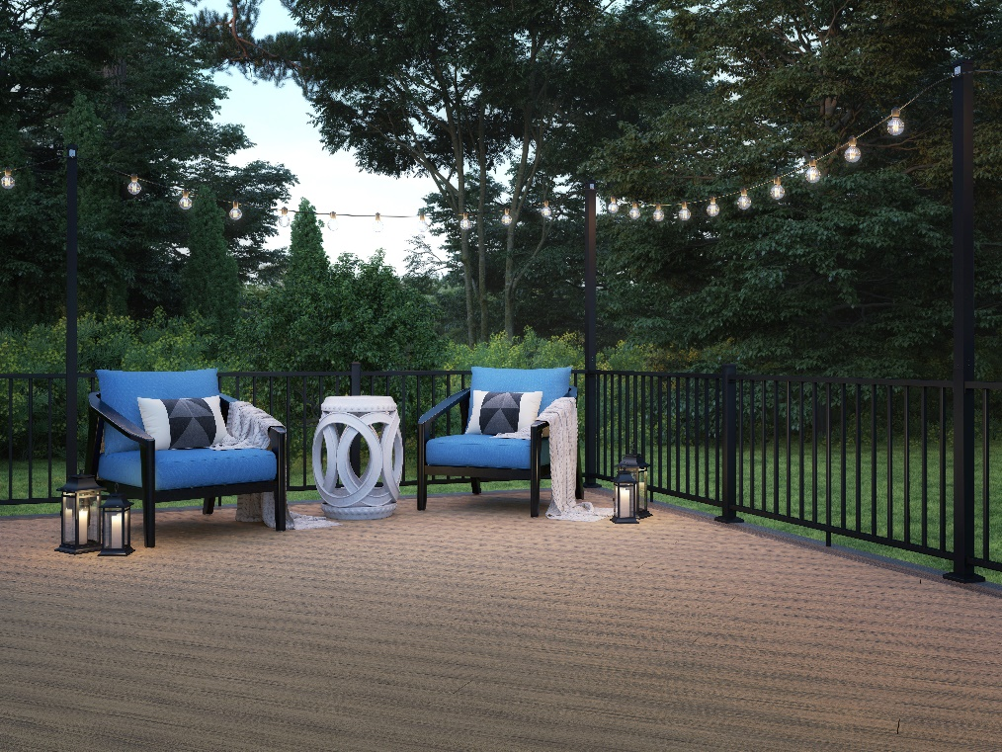
COMPOSITE DECKING BEST PRACTICES
Follow manufacturer instructions for a specific product
Allow deck boards to acclimate to jobsite conditions for 24-48 hours prior to application
Additional products to consider:
    Fasteners
    Outdoor Lighting
    Railing
    Balusters
    Post Caps
    Lattice
Notes:
When installing composite decking, it’s important to follow manufacturer instructions for a specific product. For example, you need to be aware of the effects of temperatures on the boards. In cold weather the boards contract, and in hot weather the boards expand. However, a well-manufactured product will experience only minimal fluctuations due to weather.
Ideally, deck boards should be allowed to acclimate to the jobsite conditions for 24 to 48 hours prior to application.
Ongoing industry improvement encompasses not just the deck boards, but also all the components and accessories that go into a deck system because performance comes down to the details. These details include everything from the lighting systems to railings and baluster connectors, to fasteners and screen systems.

Slide 25
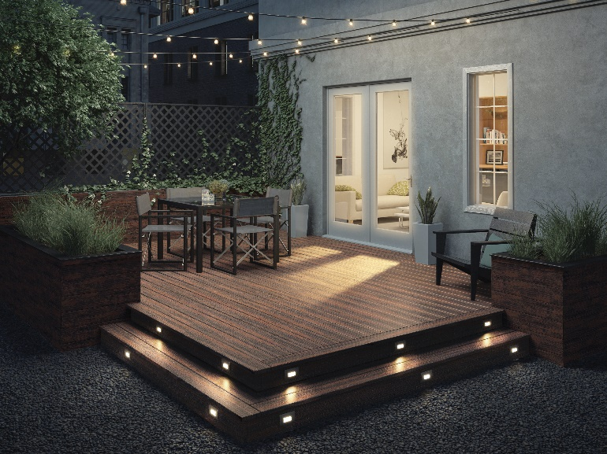
FASTENERS & OUTDOOR LIGHTING
Fasteners
Fasteners for composite decking are designed to reduce predrilling and countersinking.
Lighting
Outdoor lighting installation options:
System components plug into a junction box
System connects to a standard 12-volt power supply
Notes:
Let’s start with fasteners, which are crucial to deck assembly.
Fasteners for composite decking systems are designed to be seamless, durable, and discreet. Major fastener manufacturers make screws specifically for composite decking to reduce predrilling and countersinking.
Also, a best practice for easier installation is use of 2 ½-inch corrosion-resistant, composite wood deck screws. These screws reduce the common mushroom effect that is more common with standard fasteners.
Selecting compatible fasteners also ensures that a deck will perform as designed and meet the conditions of product warranties.
Outdoor lighting improves night-time visibility and safety. Often, it is also required by code.
Low-voltage LED systems encompass assemblies for tops and sides of posts, rails, and decks.
Depending on project needs, lighting systems come in several installation options:
System components plug into a junction box
System connects to a standard 12-volt power supply

Slide 26
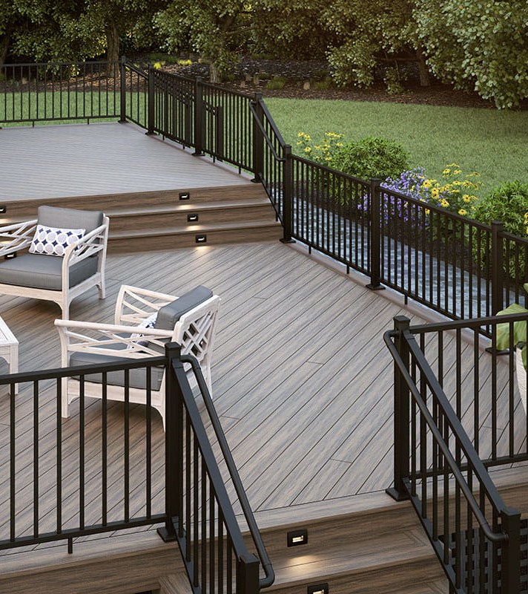
RAILING &
BALUSTERS
Emphasize view
Create drama or subtlety
Coordinate with deck accessories
Ensure security
Notes:
Railings should be selected based on function and style preference. If you are building a deck with emphasis on a view, choose either glass, cable or dark balusters (which disappear in background). For example, you can choose white or copper for accent or choose arcs and other statement pieces to create drama.
Ultimately, deck railing is integral to the safety and style of a deck project and is often designed to coordinate with other deck accessories, including balusters—which must be compatible with your chosen railing system.
When planning a deck with stairs, consider adding a graspable ADA-compliant secondary rail. If you’re constructing a residential deck, most jurisdictions will require you to install a graspable secondary handrail on one side of the deck’s stair railing when there are four or more stair risers.

Slide 27
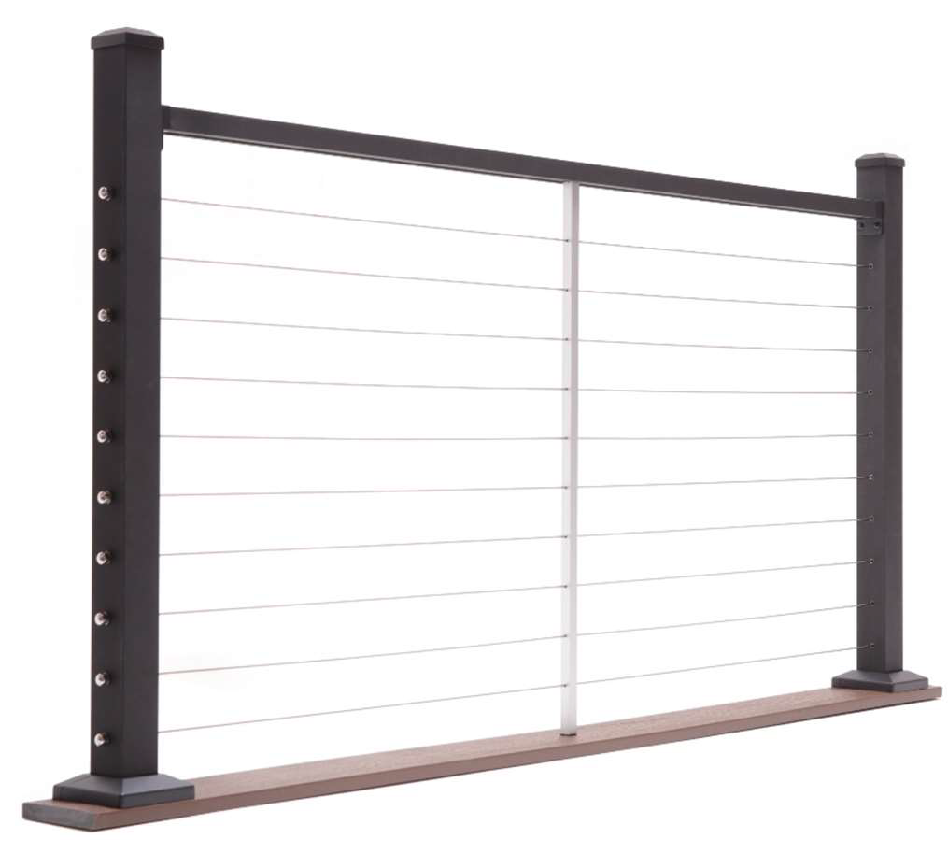
RAILING SAFETY
Mitigate safety issues by paying attention to local codes and following basic industry guidelines.
  Guard rails should be 36” or higher
  Railing should be spaced so that there is no area where a 4-inch sphere can pass through
  Climbing hazards can be eliminated with use of vertical railing systems or solid acrylic or comparable panels
Notes:
A deck railing system—particularly horizontal railing—has potential to be hazardous if not specified and installed properly. For example, you may have encountered the term “ladder effect.” This is where you can climb the railing like a ladder because of improper height and spacing.
These issues are easily mitigated by paying attention to local codes and following basic industry guidelines. Guard rails should by 36” or higher and the railing should be spaced so that there is no area where a 4-inch sphere can pass through.
You can also eliminate climbing hazards by installing vertical railing systems or using solid acrylic or comparable panels that don’t disrupt views from the deck.
But again, there’s no need to avoid horizontal railing systems if you follow the guidelines above.

Slide 28
Learning Objective #3
Describe best practices for the selection of composite decking systems

Slide 29
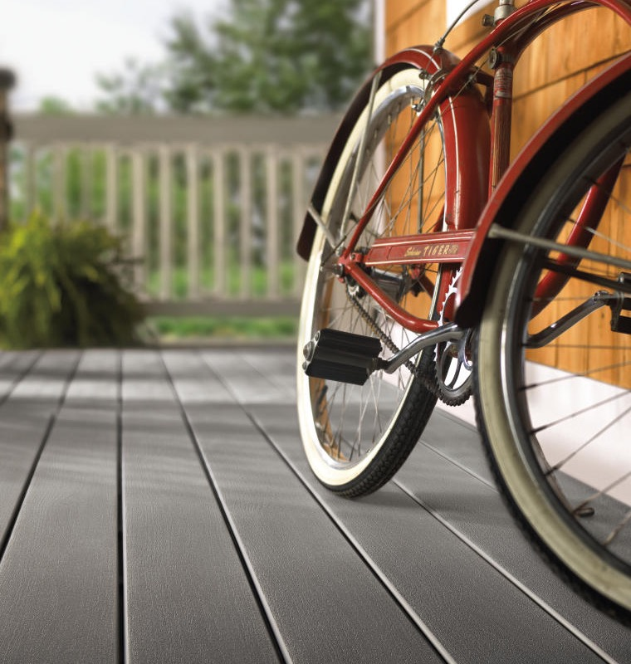
INSTALLATION
Pay attention to gapping, spacing, and fastener requirements
  Gap at ends to allow for expansion and contraction
  Gap between boards to allow for water runoff
  At the ends of the deck boards, for WPC allow a minimum of 1/16-inch gap for every 20° F of difference between the installation temperature and the hottest expected temperature, less is required for MBC
  Between the deck boards and between all decking and any permanent structure or post, allow a ¼-inch gap for water runoff
  Minimize movement by pinning boards at their mid-point
Notes:
As deck building technologies and materials have continued to evolve, so too have construction practices and code requirements. And as with any type of construction, even small mistakes could lead to deck failure.
However, you can ensure successful outcomes by working with a knowledgeable decking vendor and following recommended practices.
Different composite decking boards each have their own requirements, so make sure you follow manufacturer installation instructions, paying attention to gapping, spacing, and fasteners requirements.
It’s recommended that decking be gapped at the ends to allow for expansion and contraction and then gapped between boards to allow for water runoff:
At the ends of the deck boards, allow a minimum of 1/16-inch gap for every 20° F of difference between the installation temperature and the hottest expected temperature.
Between the deck boards and between all decking and any permanent structure or post, allow a ¼-inch gap for water runoff.
Also, you can minimize movement, by fastening boards at their mid-point. (pinning)
Overall deck safety and performance comes down to the details.

Slide 30
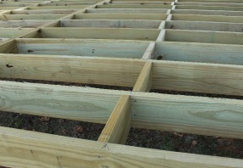
BRACING & CROSS BLOCKING
  Superior support method for getting a tight connection and reducing bounce and squeaking in the supporting joist system.
  Install small pieces of blocking in a zigzag pattern between perimeter joists
  Install cross-blocking throughout the deck frame to increase long-span strength and a more stable structure overall
Notes:
You may also need to consider additional blocking for support. You can either install small pieces of blocking in a zigzag pattern between perimeter joists or you can install cross-blocking throughout the deck frame to increase long-span strength and a more stable structure overall.
Although used more by high-end builders, cross blocking/bridging is a superior support method where it’s much easier to get a tight connection. Overall, cross-blocking helps reduce bounce and squeaking in the supporting joist system. And though you can use scraps of wood or composite decking, you must ensure that the material you use is rot- and decay-resistant.
After you have attached all decking, snap a chalk line (white or yellow chalk recommended) flush with or up to 1-1/2" out from the deck framing and trim with a circular saw.

Slide 31
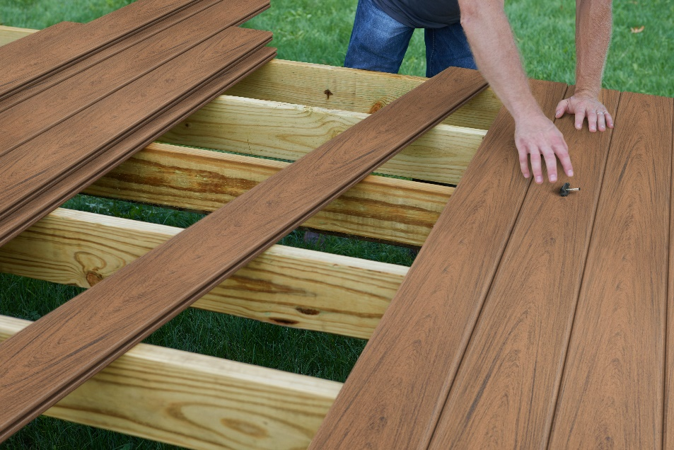
VENTILATION
  When using a minimum 2” x 6” joist standing on edge, with the suggested 1/4" side gap, there should be a 2" clear space between the bottom edge of the joists and grade to allow for proper ventilation.
  Adequate drainage is also needed to prevent water from pooling under the deck.
Notes:
Regardless of material—whether wood, plastic, metal, concrete, and so forth—mold and mildew can be serious problems on any outdoor surface exposed to the elements. Decks are particularly susceptible to mold if they are in consistently wet and shaded areas.
That’s why ventilation is a critical consideration in deck construction. All decking products—whether wood or composite—require proper ventilation and drainage to ensure longevity because the various components breathe and move.
Without gapping to provide ventilation, moisture can build up on the decking underside and lead to mold and mildew. Also, if airflow is restricted on one side (in this case, the underside), the deck boards will buckle and warp from uneven expansion and contraction.
When using a minimum 2” x 6” joist standing on edge, with the suggested 1/4" side gap, there should be a 2" clear space between the bottom edge of the joists and grade to allow for proper ventilation. Adequate drainage is also needed to prevent water from pooling under the deck.
With composite decking, the threat of rusted or popped fasters and damaged boards is reduced significantly.

Slide 32
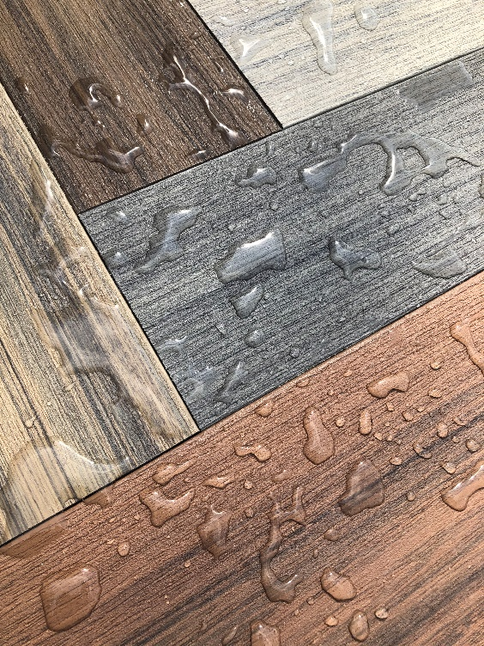
TRACTION & STATIC
CONTROL
  Traction
  Specify decking for texture, including grooves and simulated wood grain
  Composite decking options include enhanced traction
  Consider more traction for decks near water, elevated decks and walkways
Static Control
  Advancements in composite decking have greatly reduced chances of shock
  Weathering further reduces static risk
Notes:
Traction and static control also present safety concerns in decking construction.
Traction
Natural wood decking doesn’t handle water well as it can get extremely slippery and treacherous with even the smallest bits of moisture. Composite decking, on the other hand, can be specified for texture and can have grooves and simulated wood grain.
If a deck will be exposed to water or alongside a pool, consider choosing a texture that provides greater traction and reduces slipping.
Static control
Although composite decking may be prone to some static electricity, advancements in composite decking have greatly reduced any chances of shock. And with the passage of time and associated weathering, the likelihood of static goes down even more.

Slide 33
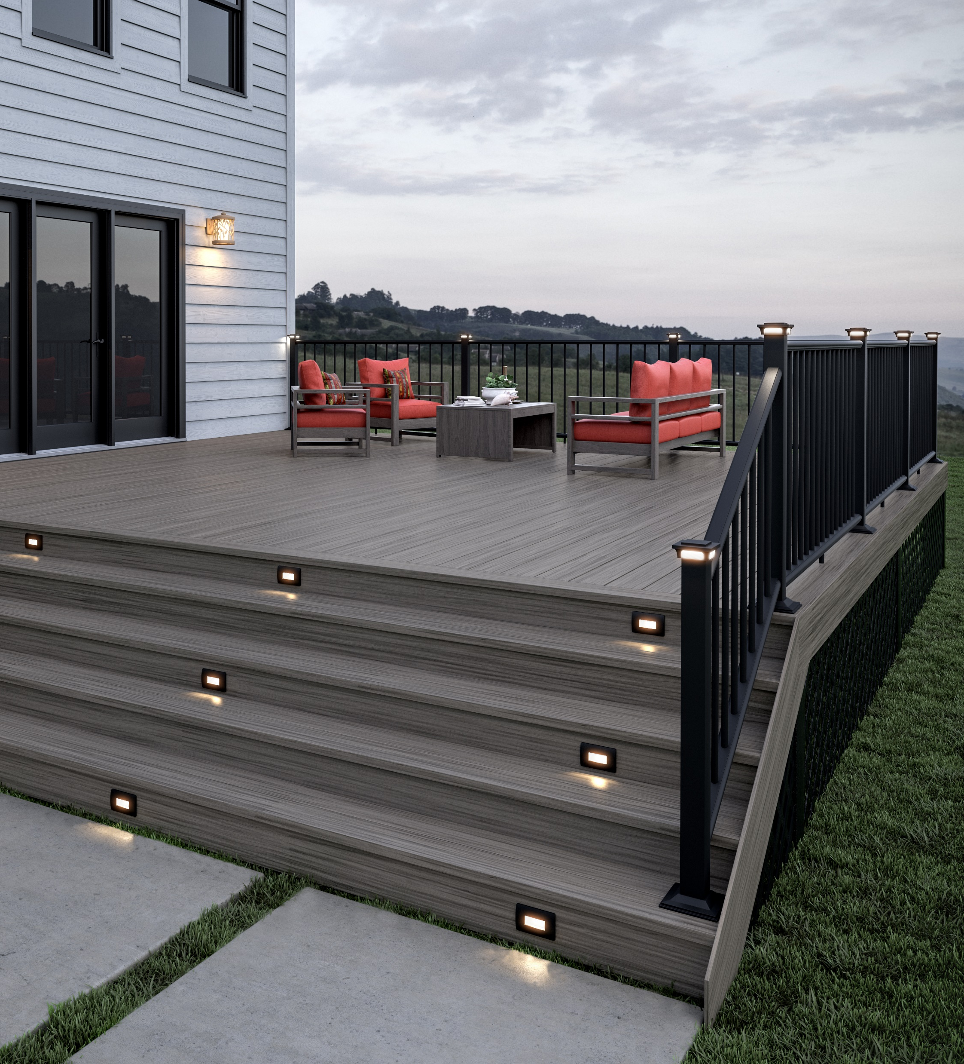
LIGHTING
GUIDELINES
  IRC stipulates that exterior stairways must have an artificial light source located in the immediate vicinity of the top landing of the stairway, including the landings and treads.
  Two common deck lighting options for both ambiance and safety include the following:
    Low-voltage step and stair lighting
    Solar post cap lights
Notes:
Lighting is another key safety consideration for deck systems.
The International Residential Code (IRC) 2000—which we’ll discuss later in more detail—introduced a requirement for illumination of all deck stairways. The IRC stipulates that exterior stairways must have an artificial light source located in the immediate vicinity of the top landing of the stairway, including the landings and treads.
Although the IRC’s deck lighting requirement is a bit vague, it does call for lighting nonetheless. So, check your local building codes and consult your building inspector prior to installation.
Two common deck lighting options for both ambiance and safety include the following:
Low-voltage step and stair lighting
Solar post cap lights

Slide 34
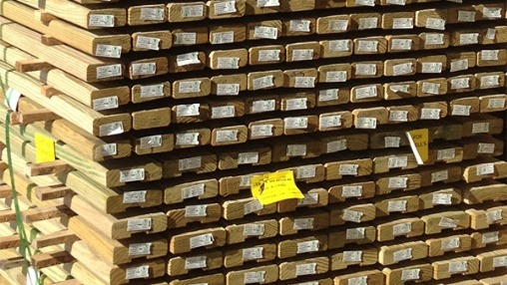
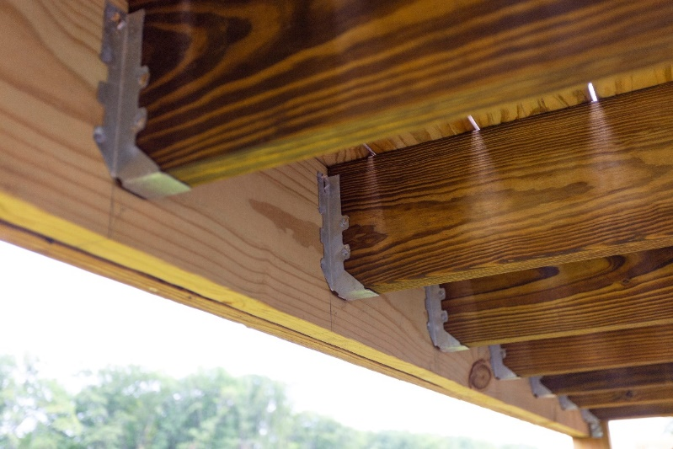
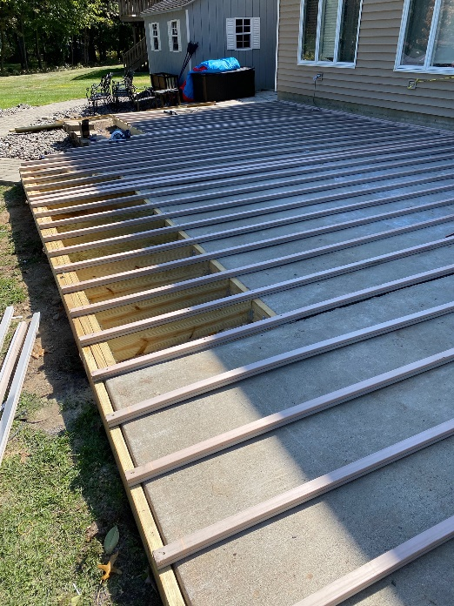
BUILDING A DURABLE FOUNDATION
  Know your options
  Select appropriately treated lumber
  Light Gauge Steel
  Pre-Fab Aluminum
  Sleeper System
Notes:
Ultimately, the safety and performance of a deck rests—literally—on the understructure that supports it. The American Wood Protection Association (AWPA) recently changed its standard on lumber treated for ground-contact use, so know your options and select the appropriate treated lumber for the deck’s supporting structure.

Slide 35
Learning Objective #4
Discuss current composite decking codes and standards and identify best practices for meeting relevant performance and safety criteria

Slide 36
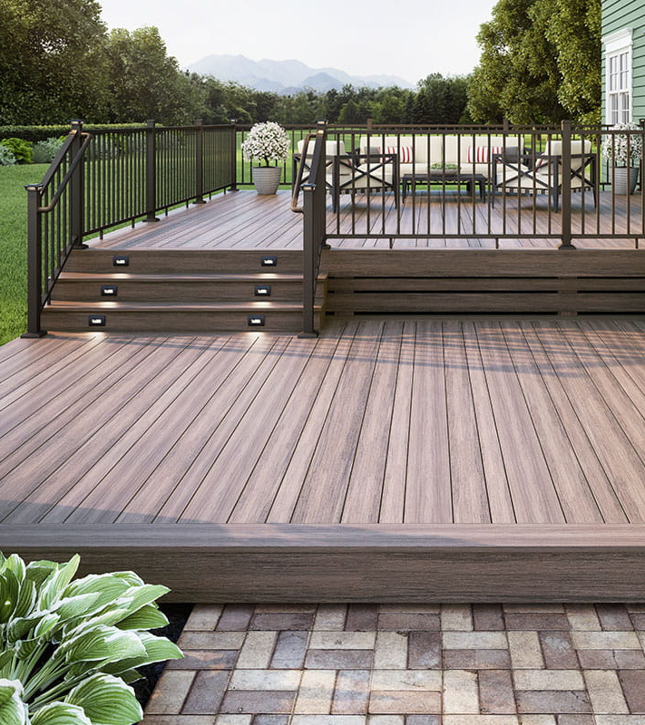
CODES & STANDARDS
ASTM D 7032 Performance Ratings for Wood-Plastic Composite Deck Boards, Guardrails, and Handrails ask for the following:
  Strength and stiffness of a deck board at ambient temperature
  Strength and stiffness of a deck board at high and low temperatures
  UV resistance
  Freeze-thaw resistance
  Creep recovery (duration of a load)
  Surface burning performance (flame spread)
  Slip resistance
  Moisture resistance
  Fungal resistance
  Termite resistance
  Strength and stiffness of a deck board used as a stair tread
  Nail/screw/hidden fastener withdrawal
  Lateral strength
Notes:
You have many resources available to guide you through composite decking and the building code issues. Consider that there are more than 100 products on the market, but not all have evaluation reports or adhere to standards you are looking to meet.
This is where you want to use widely-followed industry standards to ensure you are getting a quality product that meets your performance criteria and local codes.
Composite decking must meet ASTM testing criteria by being tested by an accredited testing agency. ASTM D 7032 Performance Ratings for Wood-Plastic Composite Deck Boards, Guardrails, and Handrails ask for the following:
Strength and stiffness of a deck board at ambient temperature
Strength and stiffness of a deck board at high and low temperatures
UV resistance
Freeze-thaw resistance
Creep recovery (duration of a load)
Surface burning performance (flame spread)
Slip resistance
Moisture resistance
Fungal resistance
Termite resistance
Strength and stiffness of a deck board used as a stair tread
Nail/screw/hidden fastener withdrawal
Lateral strength

Slide 37
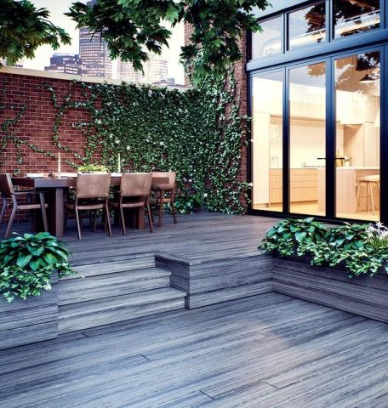
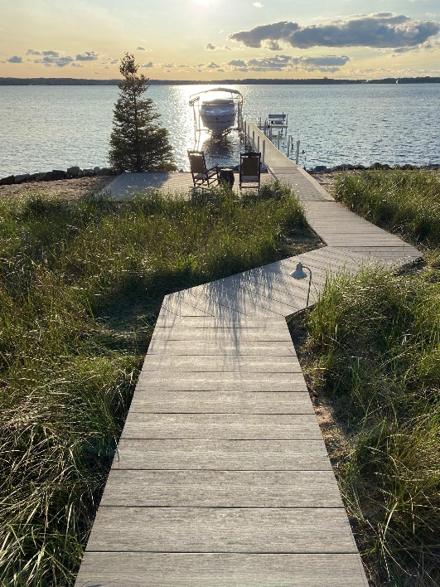
REGULATION RESEARCH
  Do you regulation research and consult with local building authorities
  There is great regional variance due to:
    Climate
    Zoning
    Other factors
Notes:
Considering the cost, time, and effort that goes into any deck project—not to mention the credibility of the construction team—it makes sense to choose products that have been evaluated and tested for safety and overall performance. This holds true even if you’re building a deck in an area where there are no code mandates or restrictions.
Start a project by doing your regulation research and consulting with local building authorities. No two regions are alike when it comes to codes. There is great variance due to climate, zoning, and other factors.

Slide 38
ICC & IRC
  International Code Council – www.iccsafe.org
  ICC-ES encompasses the following:
    Acceptance criteria for decking and guardrail material based on AC174
    Evaluation reports (code compliance reporting)
    Administration of the International Residential Code (IRC)
    The IRC is a comprehensive collection of rules that apply to residential construction.
    It is the model building code for one- and two-family dwellings throughout most of the US.
Notes:
The International Code Council is an association focused on developing model codes and standards “used in the design, build and compliance process to construct safe, sustainable, affordable and resilient structures.” According to the ICC, 50 states and the District of Columbia have adopted the I-Codes at the state or jurisdictional level.
ICC-ES includes acceptance criteria for decking and guardrail material based on AC174.
The ICC also administers the International Residential Code (IRC).
If you are building a deck for a single-family residential home in the U.S., you will likely need to ensure that your plans are compliant with the IRC to apply for a permit.
The IRC is a comprehensive collection of rules that apply to residential construction. Most U.S. states have adopted, to some extent, the IRC as the model building code for one- and two-family dwellings.

Slide 39
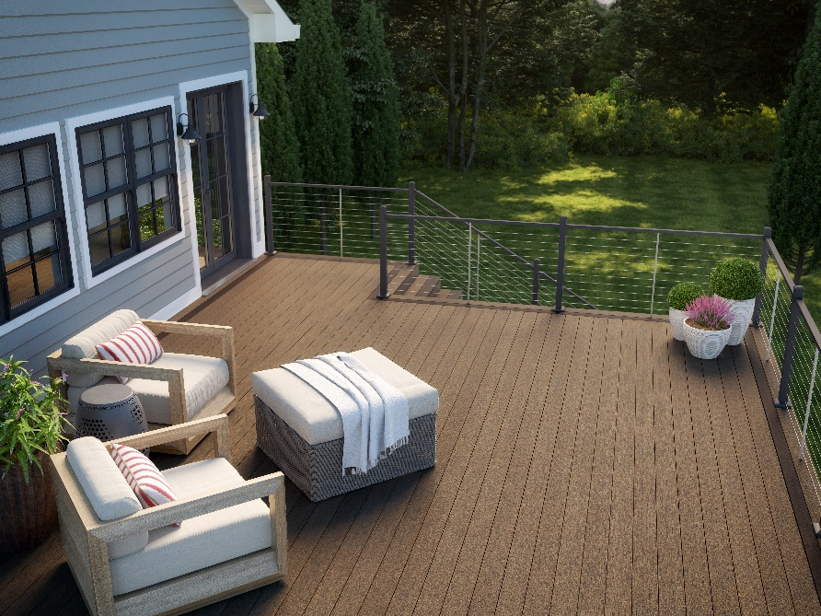
LOCAL CODE LANDSCAPE
  Look to the 2015/2021 IRC for building codes that apply to residential decks.
  The IRC is a baseline code.
  Local building codes may be more stringent in certain cases for specific applications.
  Understand that specific code elements are standard for deck construction:
    Railing and balusters
    Stairs
    Supporting framework
Notes:
Although there is no universal deck building code per se, you can look to the 2015 IRC for building codes that apply to residential decks. And there are specific elements that are standard for deck construction. These elements are railings and balusters, stairs, and supporting framework. Put simply, you can’t build a deck without them.
As outlined earlier, your deck railings must have a height of at least 36 inches and must include stable grasp and support. The railing and balusters must be spaced to prevent any object larger than 4 inches in diameter from passing through, and the bottom rail must not be more than 4 inches above the deck surface.
Keep in mind that the IRC is a baseline code. Local building codes may be more stringent in certain cases and for specific applications.
Let’s dive deeper into some of the pertinent standards and testing/certification organizations…

Slide 40
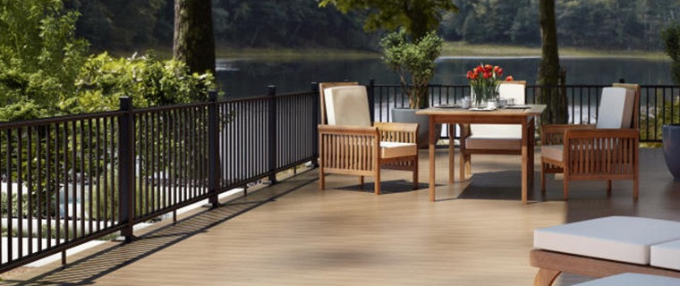
NADRA & CLMA
  North American Deck and Railing Association – www.nadra.org
  Composite Lumber Manufacturers Association – www.compositelumber.org
Notes:
For composite deck systems, you can find guidance from the North American Deck and Railing Association (NADRA) as well as the Composite Lumber Manufacturers Association (CLMA).
NADRA promotes safe building practices and deck safety through proper maintenance, inspection, and evaluation, while CLMA has a codes and standards committee that works on industry issues. With regard to the ICC code development, CLMA has submitted code proposals for the 2018 IBC to align composite lumber decking and guard system requirements its revisions to the 2015 International Residential Code.

Slide 41

INTERTEK
  www.intertek.com/building/deck-fence-rail
  Intertek validates decking and rail system design and material selection:
    Safety testing to the most applicable ICC-ES acceptance criteria and building code requirements
    Performance testing of building materials
    Certification to qualify building products for industry – recognized certification programs
Notes:
Then there’s Intertek, an accredited testing organization. This multinational group focuses on quality and safety assurance for the construction and building products industries—among others.
Intertek conducts deck, fence, and rail safety and performance testing and provides certification services to qualify decking products for industry-recognized certification programs.
Standards test methods include the following:
ASTM
CCMC Technical Guides
ICC-ES
Miami Dade

Slide 42
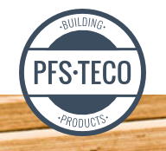
PFS-TECO
  www.pfsteco.com/building-products
  Among issues tested and services provided are:
    Building components
    Engineered wood products
    Formaldehyde certification
    Code compliance testing and reporting
Notes:
PFS-TECO is another organization that provides independent testing and certification to help building products “meet necessary structural requirements and regulations.”
Among the products and issues tested are:
Building components
Engineered wood products
Formaldehyde certification
Research reports (code compliance testing and reporting)

Slide 43
NTA, INC. & ASTM
  NTA (www.ntainc.com) provides the following services:
    Third-Party inspection for commercial and residential construction
    Certification verifying product compliance to standards and conformity to code
    Third-party testing & evaluation of building products
  American Society for Testing & Materials (ASTM) - www.astm.org
    ASTM D 7032-08 establishes performance ratings for wood-plastic composite deck boards and guardrail systems, guards or handrails.
    The industry also looks to AC174 for deck board span ratings and guardrail systems used in exterior residential applications.
Notes:
NTA, Inc. is also an independent, third-party inspection, certification, and testing/evaluation company that is approved per Section 1703 of the IBC. The organization focuses on residential and commercial housing—including decking systems.
ASTM is the world’s largest source of voluntary standards for materials, services, and systems. The organization publishes information that addresses sampling and testing methods to ascertain the health, safety, and performance of materials.
For a decking project, it’s recommended to select composite decking and accessories that have an ASTM rating verifying their safety and performance.
Specifically, ASTM D 7032-08 establishes performance ratings for wood-plastic composite deck boards and guardrail systems, guards or handrails.
The industry also looks to AC174 for deck board span ratings and guardrail systems used in exterior residential applications.
For quality and performance assurance, look for materials that have been evaluated by professional engineers at an independent third-party test laboratory such as NTA, Intertek, and PFS-TECO.

Slide 44
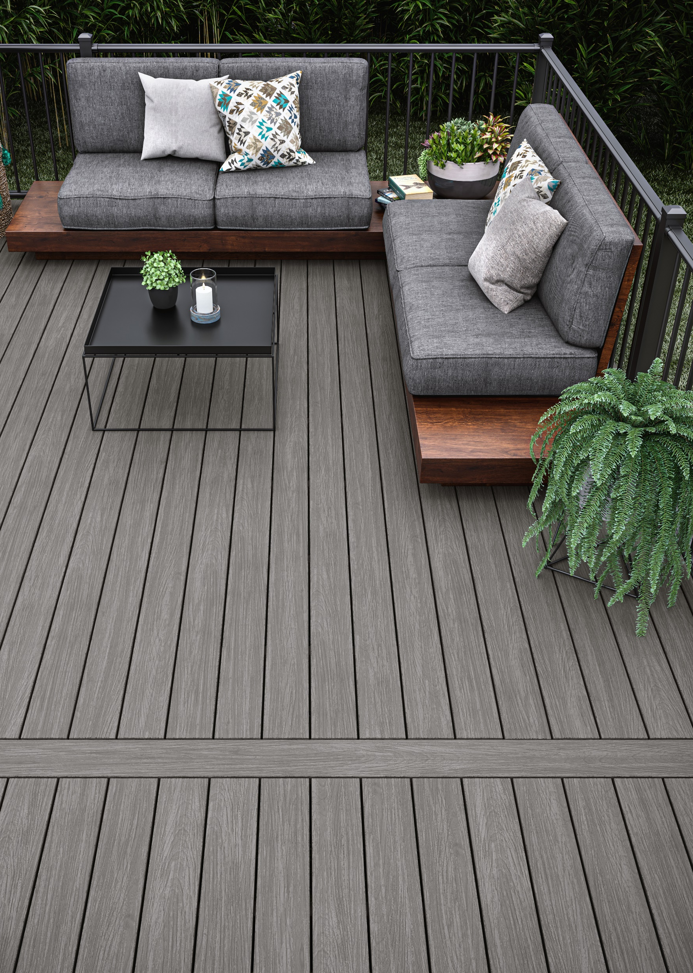
SUMMARY
Relatively new to the marketplace, composite decking is an innovative, continually evolving material that outperforms traditional wood in key areas including sustainability, safety, durability, and broader selection of style options.
Because composite decking is low-maintenance and less prone than alternative materials to fading, splitting, rotting, and replacement requirements, it is ultimately a more cost-effective and high-value choice.
By following best practices in construction and specifying composite deck products that are both code compliant as well as tested and verified for safety and performance, contractors ensure client safety and satisfaction over the life of a project.

Slide 45

THANK YOU
  This concludes the continuing education unit.
Thank you for your time.
For more information, go to:
www.Deckorators.com

