Slide 1
Attractive Accents: The Versatile Appeal of Architectural Metal
Course # MTL102-PAC-23
Learning Units: 1 AIA LU
Notes:
Attractive Accents: The Versatile Appeal of Architectural Metal

Slide 2
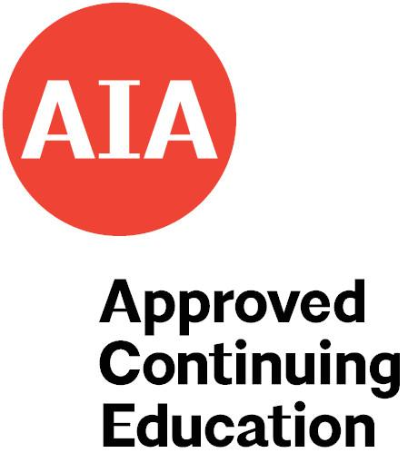
Course registration
Petersen Aluminum is a Registered Provider with The American Institute of Architects Continuing Education Systems (AIA/CES). Credit(s) earned on completion of this program will be reported to AIA/CES for AIA members. Certificates of Completion for both AIA members and non-AIA members are available upon request.
This program is registered with AIA/CES for continuing professional education. As such, it does not include content that may be deemed or construed to be an approval or endorsement by the AIA of any material of construction or any method or manner of handling, using, distributing, or dealing in any material or product.
This presentation is protected by US and International Copyright laws. Reproduction, distribution, display and use of the presentation without written permission is prohibited.
Provider #: K031
© 2023

Slide 3
Learning objectives
Upon completing this course you will be able to:
Describe multiple types of metal cladding, including roofing, wall systems, soffits, perforated panels and tiles, and how they are applied to buildings of all shapes, sizes and purposes.
Explore creative options and applications for perforated metal including hole size, shape, spacing, open space, and how it is applied including for equipment screens, aesthetic accents, acoustics, airflow and more.
Consider simulated finishes, including copper, weathered metal, wood grain, natural ore, as well as the anodized aluminum option.
Discuss examples of architectural metal applications from numerous case studies showing the varied and creative ways metal is specified and applied.

Slide 4
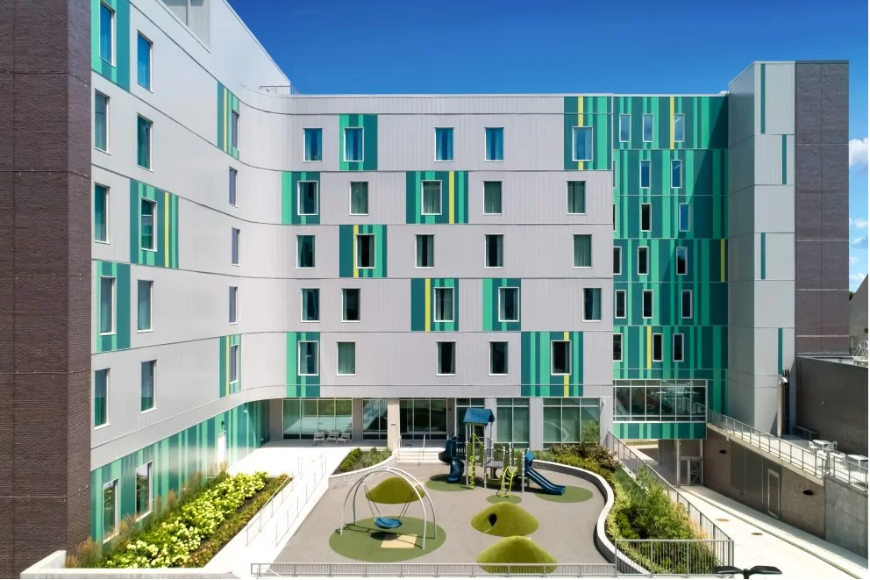
Introduction
Architectural metal panel systems offer numerous benefits
Design versatility and appeal
Variety of applications: roofs, walls, soffits, accents and more
Customization to fit unique project requirements
Various shapes, sizes, finishes
Durable, long-lasting and low-maintenance
Notes:
Ronald McDonald House, Ohio. Flush wall panels in four (4) colors (some custom), snap-seam roof, continuous cleat gold coping.
Architectural metal panels offer unparalleled design versatility and appeal. They can be used for a range of applications, from roofing and wall systems to soffits, accents, and beyond. One of the key advantages of metal panels is their ability to be customized to fit the unique requirements of a project. Metal panels come in a variety of shapes, sizes, and finishes, allowing designers to create unique and visually stunning structures. They can be used to achieve a range of looks, from sleek and modern to rustic and industrial. Additionally, metal panels are durable, long-lasting, and require minimal maintenance, making them an excellent investment for any project. Whether used as a functional component of a building or as a decorative feature, architectural metal panels are a popular choice among architects and designers for their versatility, durability, and aesthetic appeal.

Slide 5
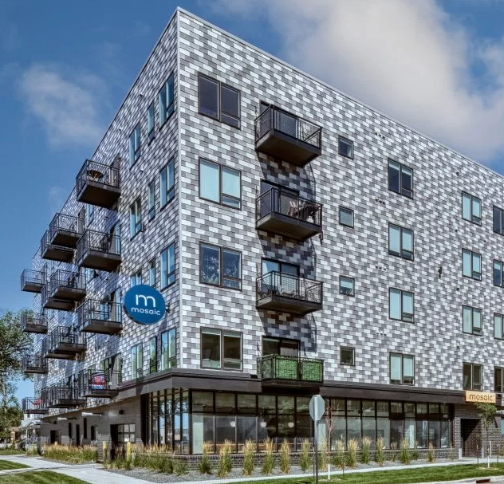
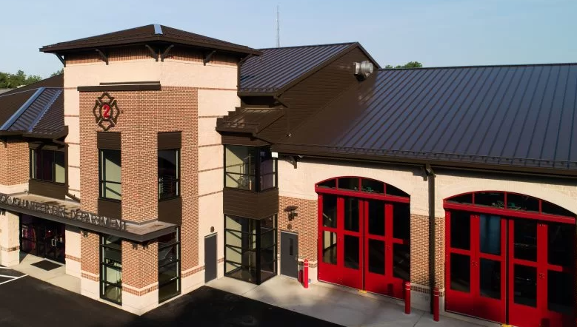
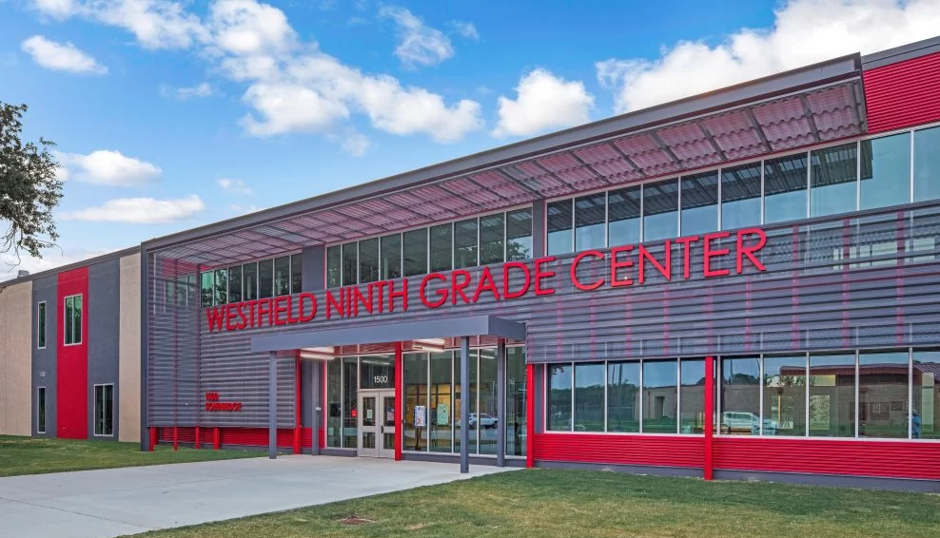
Section 1: Types of architectural metal cladding and how they are applied
Roof systems
Wall systems
Soffits
Tile
Perforation
Notes:
This section will examine various types of metal cladding and the ways in which they are applied to buildings of all shapes, sizes, and purposes.
We will explore roof and wall panel systems, soffits, tiles, and perforated metal options..

Slide 6
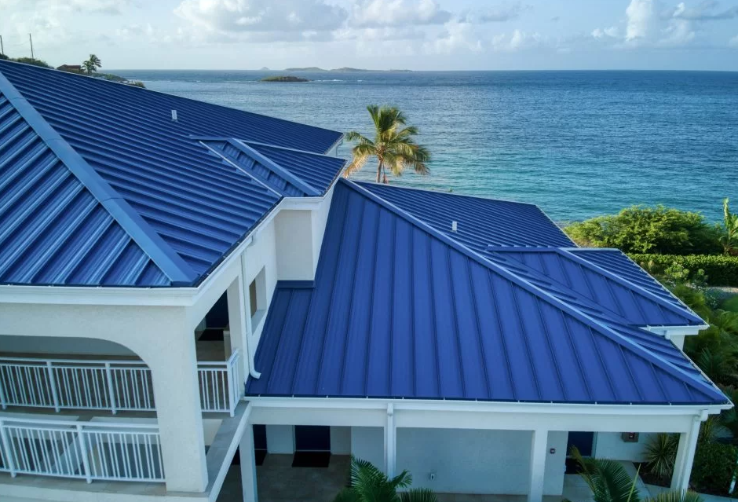
Section 1: Types of architectural metal cladding and how they are applied
Metal roof systems
Standing seam
Steel and aluminum
Snap-seam
Mechanically seamed
Notes:
Limetree Beach Resort, USVI. Blue standing seam panels, .032 aluminum.
Best practice for standing seam metal roofing panels include PVDF coating for prefinished sheet metal, which can be applied to both steel and aluminum roof panels. This finish was originally developed for use in abrasive environments.

Slide 7
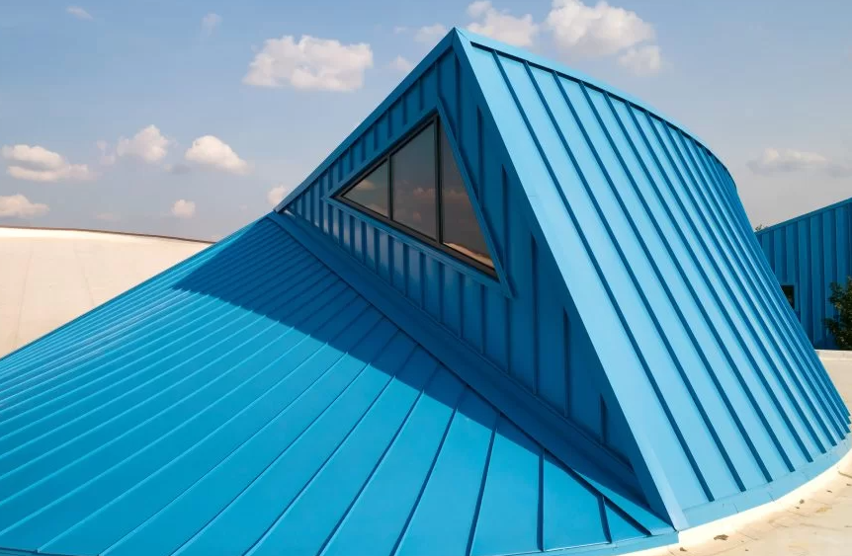
Section 1: Types of architectural metal cladding and how they are applied
Metal roof systems
Produced in factory-formed lengths
Longer lengths if formed on jobsite
Wide color range
Many colors meet LEED requirements and are Cool Roof-rated
Notes:
Altgeld Family Resource Center, Chicago. Snap-seam, custom color.
Architectural panels for standing seam metal roofing systems may be produced in a variety of factory-formed lengths, generally up to 55 feet. They are also available in longer lengths.
There is tremendous color variety in the marketplace for steel and aluminum roofing panels, with many meeting LEED requirements and some that are Cool Roof-rated. Check with manufacturer for special orders and warranty information.

Slide 8
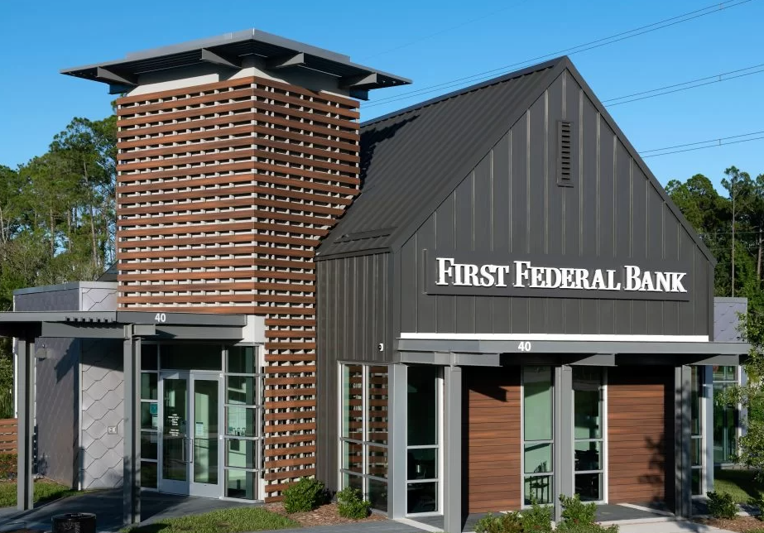
Section 1: Types of architectural metal cladding and how they are applied
Pitch range and applications
Different types of metal roof panels have specific roof pitch ratings ranging from 1/2:12 to 3:12
Pitch affects panel selection
Regions with extreme weather conditions may necessitate a higher roof pitch
Notes:
First Federal Bank, Florida. Snap-seam, graphite gray finish, 24-gauge steel.
Different types of metal roof panels are designed for specific roof pitch requirements from 1/2:12 to 3:12.
It’s important to note that regions with heavy snowfall or extreme climate conditions may necessitate a higher roof pitch.

Slide 9
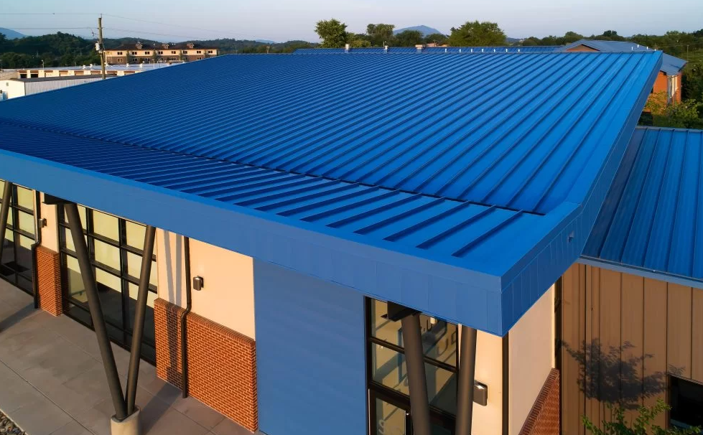
Section 1: Types of architectural metal cladding and how they are applied
Roof project review
Sevier County Utility District
Notes:
Sevier County Utility District, Alabama. Snap-seam in gray, standing seam in blue, flush panel in blue, 24-gauge steel.
Mechanically seamed 90-degree lock, also snap-lock for walls, both 24-gauge steel.

Slide 10
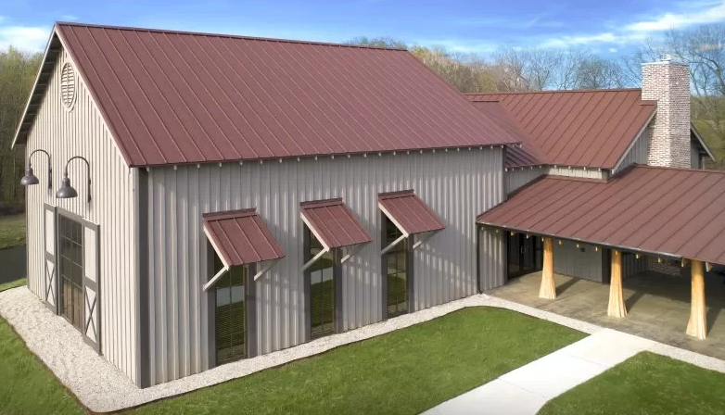
Section 1: Types of architectural metal cladding and how they are applied
Roof project review
Theodore Roosevelt National Wildlife Refuge
Notes:
Theodore Roosevelt National Wildlife Refuge, Mississippi. Mechanically seamed 90-degree roof panels, 24-gauge, simulated weathered steel finish in a 2-coat Kynar paint.

Slide 11
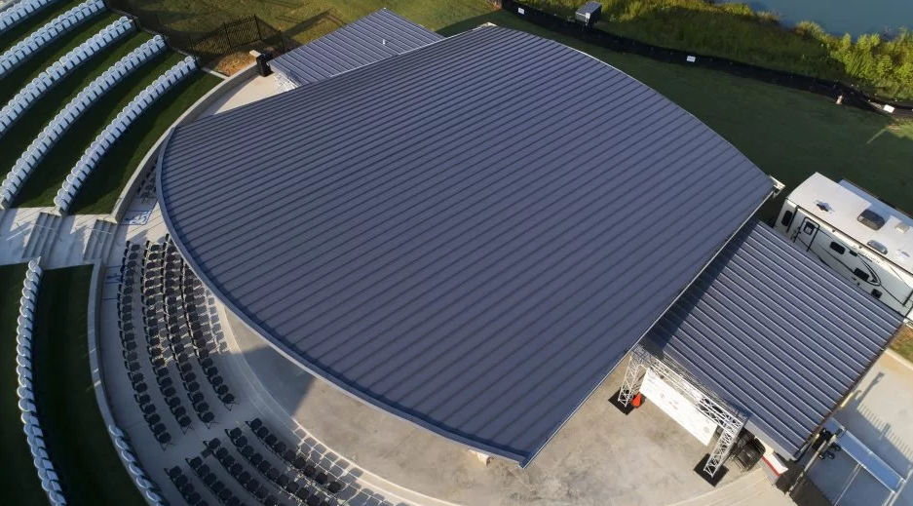
Section 1: Types of architectural metal cladding and how they are applied
Roof project review
Innovation Amphitheater
Notes:
Innovation Amphitheater, Georgia. Mechanically seamed 90 degrees, 24-gauge, charcoal gray finish, field-rolled panels due to panel lengths over 80 feet long.

Slide 12
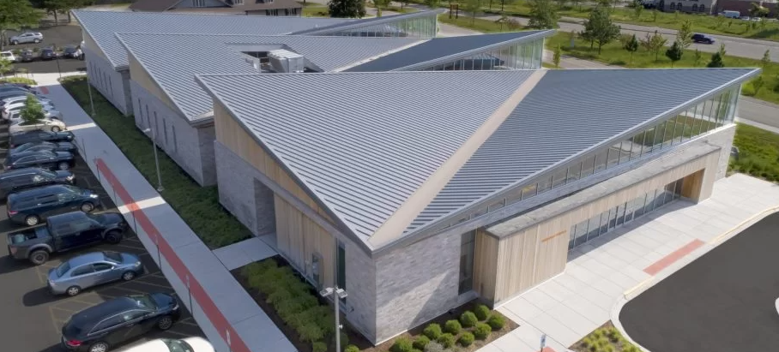
Section 1: Types of architectural metal cladding and how they are applied
Roof project review
Shirley Ryan AbilityLab
Notes:
Shirley Ryan AbilityLab, Illinois. Mechanically seamed 180-degrees, 24-gauge, weathered zinc. Soffit in .032. Example of how to properly flash a “butterfly roof” with this valley. NOTE: Penetrations (vents, etc.) in the valley have been digitally removed.

Slide 13
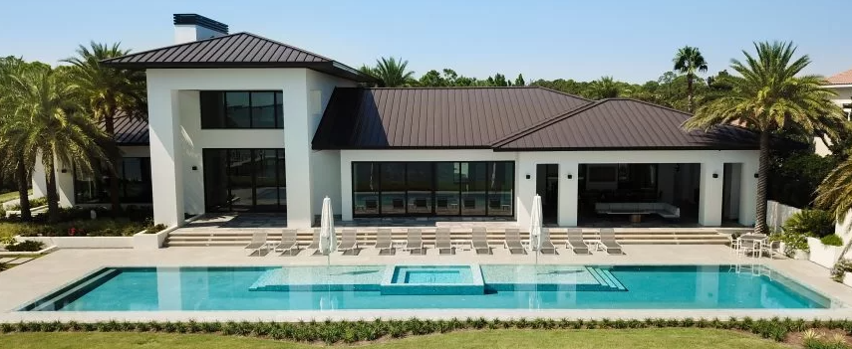
Section 1: Types of architectural metal cladding and how they are applied
Roof project review
Florida Panhandle home
Notes:
Panhandle home, Florida. Snap-seam, dark bronze finish, in .040” aluminum for the salt exposure; this job sits directly on Intercoastal Waterway in Florida.

Slide 14
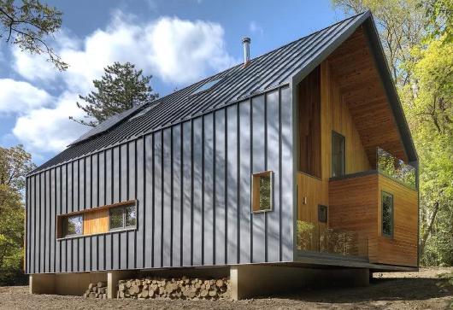
Section 1: Types of architectural metal cladding and how they are applied
Roof project review
Matchbox house
Roof panels applied as wall
Notes:
Matchbox House, Michigan. Snap-seam used as both roof and wall panels. Note how the contractor has matched up the verticals of the roof panels to the wall panels.

Slide 15
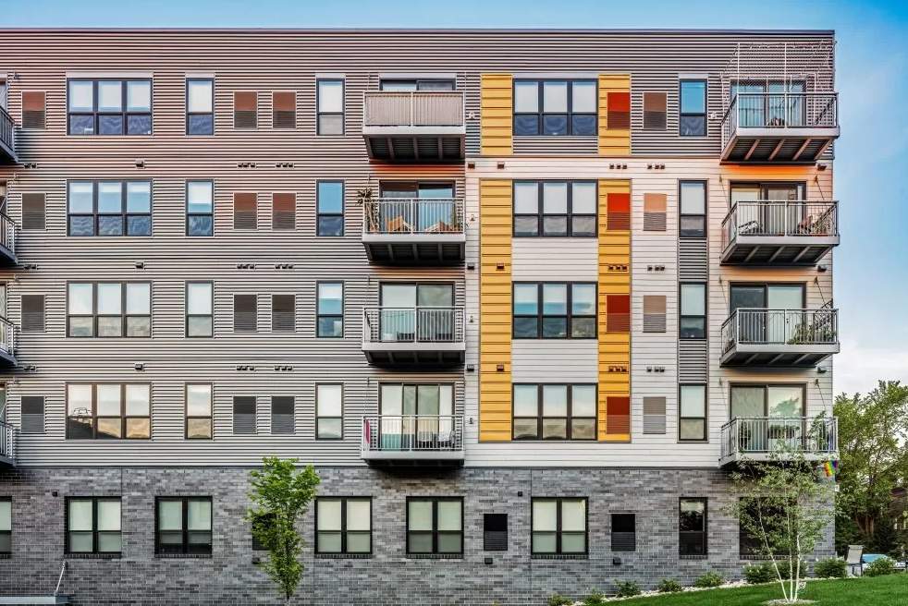
Section 1: Types of architectural metal cladding and how they are applied
Metal wall systems
Single skin, not insulated
Hidden fastener
Exposed fastener
Composite
Notes:
Metric Apartments, Minnesota. Box rib panel in a weathered zinc finish, 22-gauge.

Slide 16
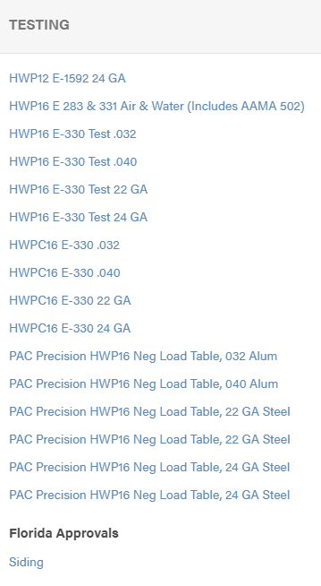
Section 1: Types of architectural metal cladding and how they are applied
Metal wall systems
Testing, approvals
Types, relevance
For example …

Slide 17
Section 1: Types of architectural metal cladding and how they are applied
Metal wall systems
Sustainability
Environmental Product Declaration
Recyclability
Cool Roof ratings
Life Cycle Assessment
LEED points

Slide 18
Section 1: Types of architectural metal cladding and how they are applied
Metal wall systems
Any structure is a candidate
Vertical, horizontal, diagonal
Customization: length, width, color, profile combinations
Ease of installation
Design versatility
Structural integrity, weather resistance, low maintenance, aesthetic appeal
Notes:
Black Diamond Car Wash, Louisiana. Decorative ribbed industrial metal wall panels, 24-gauge steel, weathered zinc finish.
Metal wall panel systems can be customized to match specific design requirements, making them a popular choice in commercial buildings, retail spaces, and even residential structures seeking a modern and sleek appearance.
These panels not only enhance overall aesthetics but also contribute to energy efficiency, noise reduction, and fire resistance.
With their remarkable strength and adaptability, industrial metal wall panel systems provide a reliable and cost-effective solution for a wide range of applications.

Slide 19
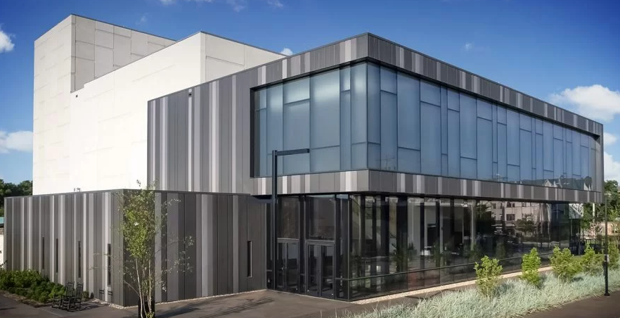
Section 1: Types of architectural metal cladding and how they are applied
Flush and reveal wall panels
Versatile and highly functional architectural solutions
Seamlessly integrate into building exteriors
Create a sleek, streamlined appearance
Durable and resilient
Panels made from materials such as aluminum, steel, or zinc
Durability, strength and resistance to environmental factors
Notes:
Kirkwood Performing Arts Center, Missouri. Flush panel, various gray finishes, 24-gauge steel.
Flush metal panel wall systems are versatile and highly functional architectural solutions that find applications in various construction projects.
These systems consist of metal panels that are seamlessly integrated into building exteriors, creating a sleek, streamlined appearance. The panels are typically made from materials such as aluminum, steel or zinc, which offer durability, strength, and resistance to environmental factors.

Slide 20
Section 1: Types of architectural metal cladding and how they are applied
Wall panel project review
Millennium High School
Notes:
Millennium High School, Arizona. Flush panel, 24-gauge, custom purple, weathered zinc, gray and silver finishes.

Slide 21
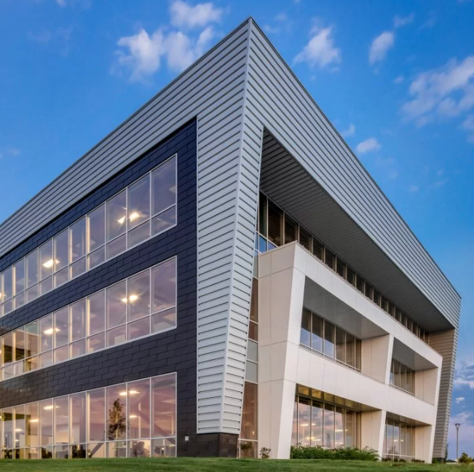
Section 1: Types of architectural metal cladding and how they are applied
Wall panel project review
Wichita State #3
Notes:
Wichita State #3, Kansas. Snap-seam roof, bone white, ribbed wall panel, silver finish, 22-gauge.

Slide 22
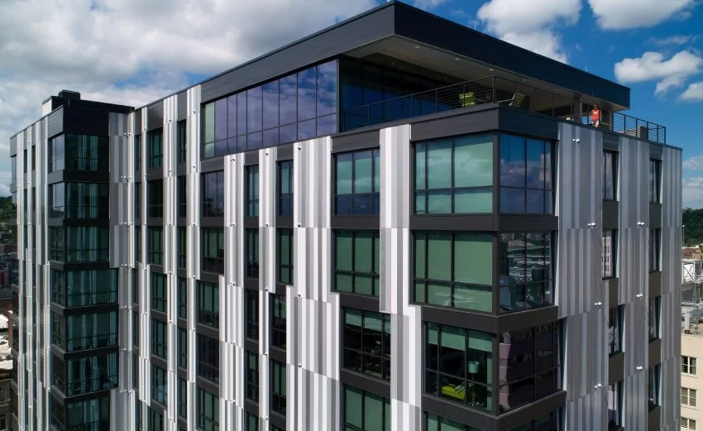
Section 1: Types of architectural metal cladding and how they are applied
Wall panel project review
Court and Walnut
Notes:
Court and Walnut, Ohio. Flush panel, .040 aluminum, finishes: whites, grays and silver, and a custom charcoal gray.

Slide 23
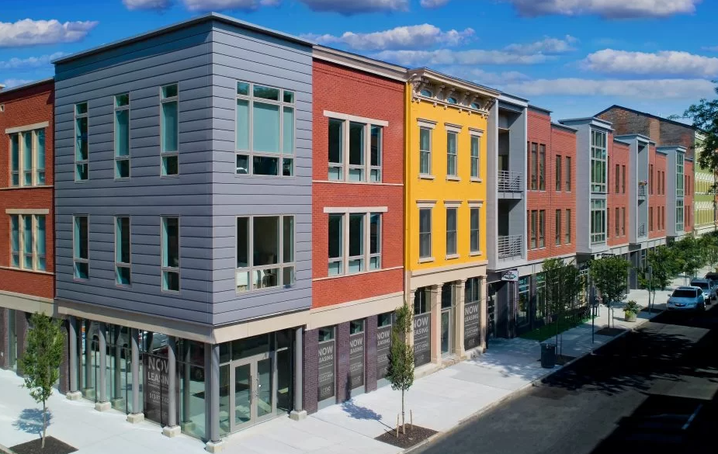
Section 1: Types of architectural metal cladding and how they are applied
Wall panel project review
Rennen & Beecher Flats
Notes:
Rennen & Beecher Flats, Ohio. Flush panel, slate gray, .040 aluminum.

Slide 24
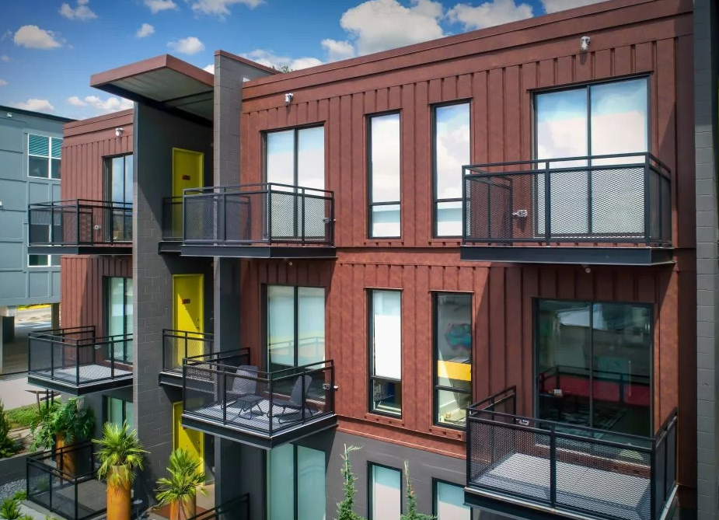
Section 1: Types of architectural metal cladding and how they are applied
Wall panel project review
Freight Yard Apartments
Notes:
Freight Yard Apartments, Florida. Ribbed wall panel, simulated weathered steel finish, 24-gauge steel.

Slide 25
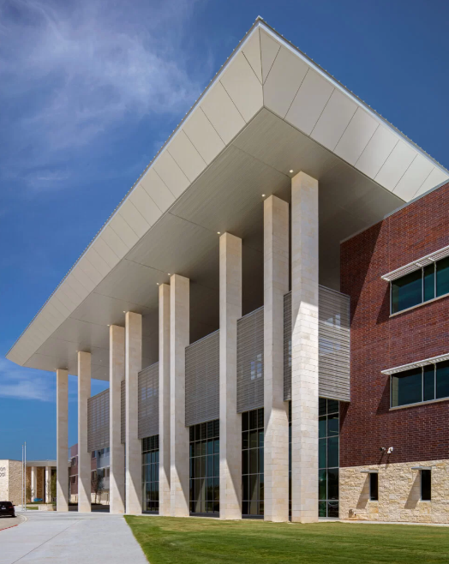
Section 1: Types of architectural metal cladding and how they are applied
Composite wall panel systems
Lightweight core material sandwiched between metal skins
Provides strength, durability and flatness while maintaining a lightweight structure
Used in commercial, industrial and residential buildings for exterior cladding, interior partitions and decorative elements
For example: car dealerships
Notes:
Johnson High School, Texas. Composite panels in silver, 24-gauge.
Composite metal wall panel systems are innovative construction materials that offer numerous benefits and find extensive applications in various industries. These panels consist of a combination of metal skins and a core material, typically made of lightweight materials like aluminum, titanium, or stainless steel. The unique composition provides exceptional strength, durability, and fire resistance while maintaining lightweight structure. Composite metal wall panel systems are widely used in commercial, industrial, and residential buildings for exterior cladding, interior partitions, and decorative elements.
They offer architects a wide range of options in terms of colors, finishes, and textures, enabling the creation of aesthetically pleasing and functional structures. Additionally, these panels provide excellent thermal and sound insulation properties, enhancing energy efficiency and occupant comfort.
Overall, composite metal wall panel systems are a versatile solution that combines aesthetic appeal, performance, and sustainability, making them an ideal choice for modern construction projects.

Slide 26
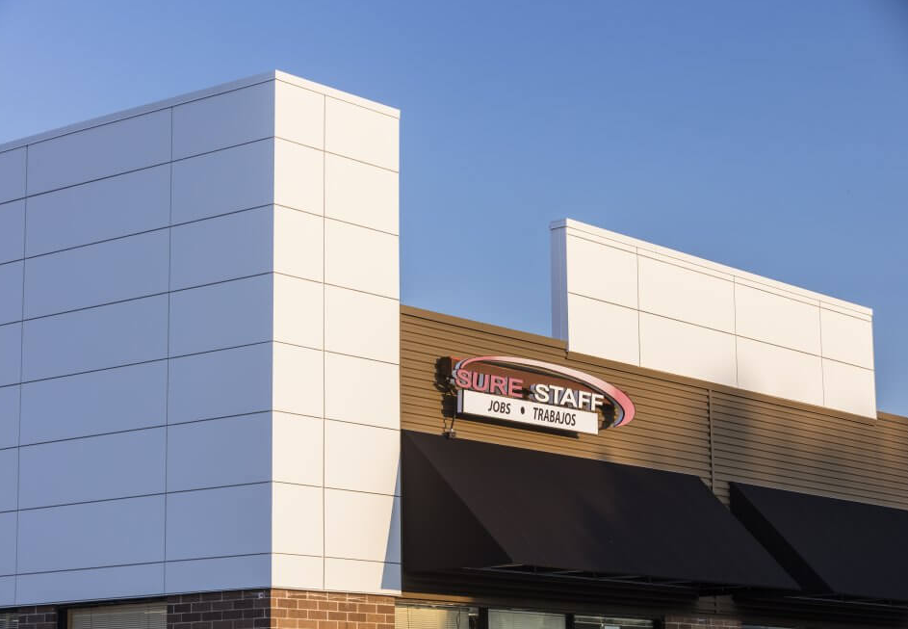
Section 1: Types of architectural metal cladding and how they are applied
Composite project review
Hanover Square Mall
Notes:
Hanover Square Mall, Illinois. Composite panel, custom white finish, rainscreen system.

Slide 27
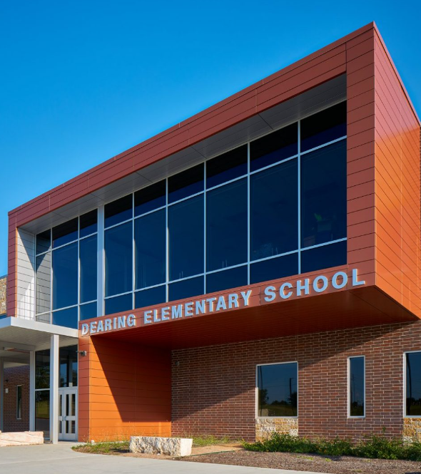
Section 1: Types of architectural metal cladding and how they are applied
Composite project review
Dearing Middle School
Notes:
Dearing Middle School, Texas. Composite panel rainscreen system, copper penny and silver finishes.

Slide 28
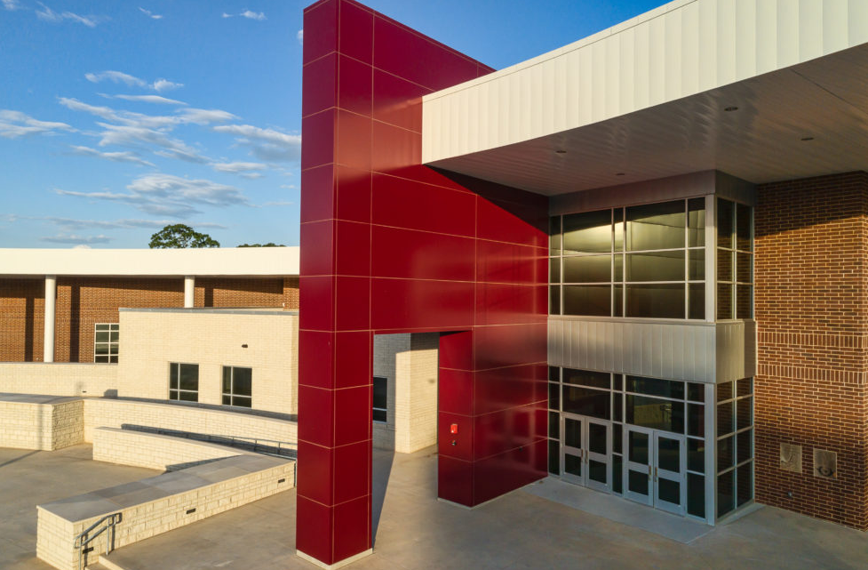
Section 1: Types of architectural metal cladding and how they are applied
Composite project review
Athens High School
Notes:
Athens High School, Texas. Composite panel, custom maroon finish, also flush panels in white and silver, 24-gauge 12-inch.

Slide 29
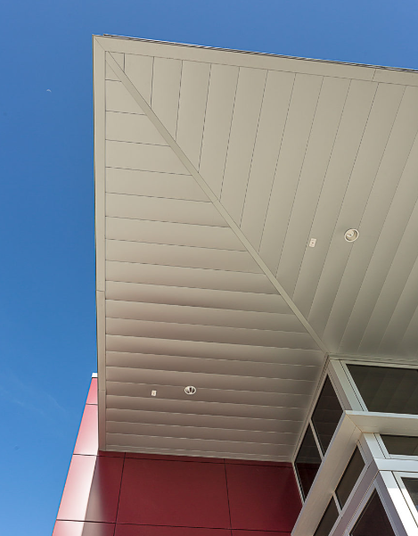
Section 1: Types of architectural metal cladding and how they are applied
Metal soffit systems
Soffit panels; flush, reveal
Full vent, half vent, solid
Metal soffit systems enhance aesthetics and functionality of buildings
Clean and sleek appearance
Effectively cover the underside of roofs and elevated structures
Advantages: durability, weather resistance, low maintenance
Notes:
Athens High School, Texas. Flush soffit panels, white, 24-gauge, 12-inch.
Metal soffit panel systems are an innovative architectural solution that enhances the aesthetics and functionality of buildings. These systems consist of metal panels installed beneath the eaves and overhangs, creating a clean and seamless appearance while effectively covering the underside of roofs and other elevated structures. Soffit metal panels offer numerous advantages, including durability, weather resistance, and low maintenance requirements.

Slide 30
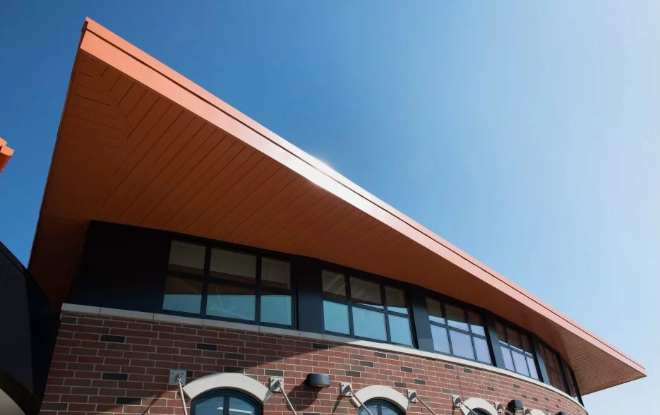
Section 1: Types of architectural metal cladding and how they are applied
Metal soffit project review
LaTrobe Elementary
Notes:
LaTrobe Elementary, Pennsylvania. 180-degree mechanically seamed roof, .032 gauge aluminum soffit, custom marquis orange finish.

Slide 31
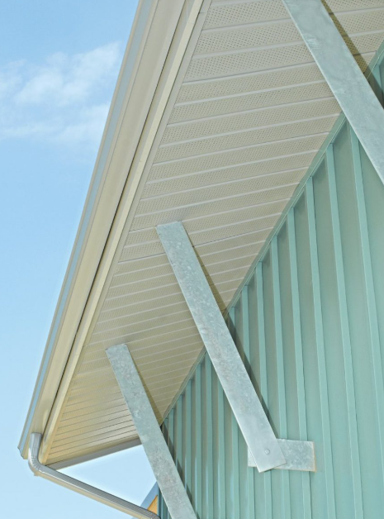
Section 1: Types of architectural metal cladding and how they are applied
Metal soffit project review
Bells Mill
Notes:
Bells Mills, Maryland. Vented aluminum soffit.

Slide 32
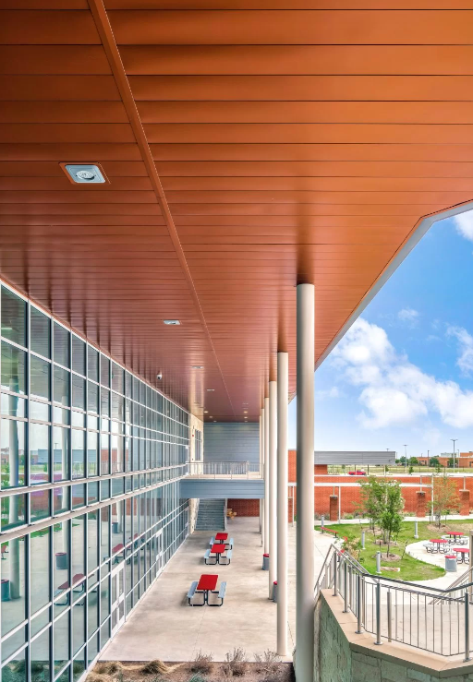
Section 1: Types of architectural metal cladding and how they are applied
Metal soffit project review
Lake Belton High School
Notes:
Lake Belton High School, Texas. Flush soffit, copper penny finish, 22-gauge steel.

Slide 33
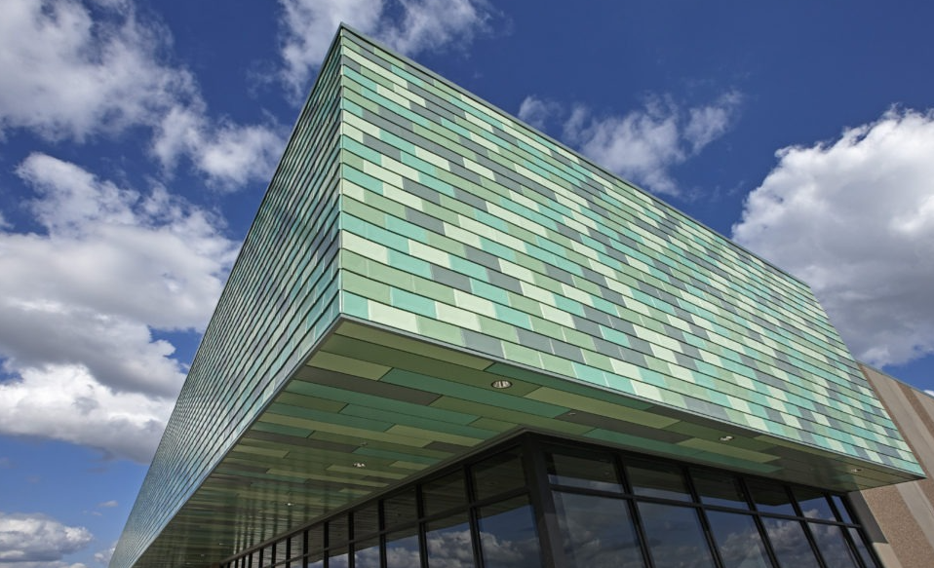
Section 1: Types of architectural metal cladding and how they are applied
Metal tile systems
Stamped not roll-formed
Straightforward installation
Versatile and appealing for modern architectural design
Combines durability and strength of metal with elegance of tiles
Customization:
Color combinations
Unique and personalized designs
Notes:
MSP Airport, Minnesota. Cupped tile, 24-gauge steel, finishes: Various greens and a custom aged copper.
A metal tile wall panel system is a highly versatile and aesthetically appealing solution for modern architectural design. This innovative system combines the durability and strength of metal with the elegance and timeless beauty of tiles. Each panel is meticulously crafted to provide a seamless and precise installation, creating a sleek and polished look. The metal tile system offers a wide range of customization options, allowing architects and designers to create unique patterns, textures, and color combinations.

Slide 34
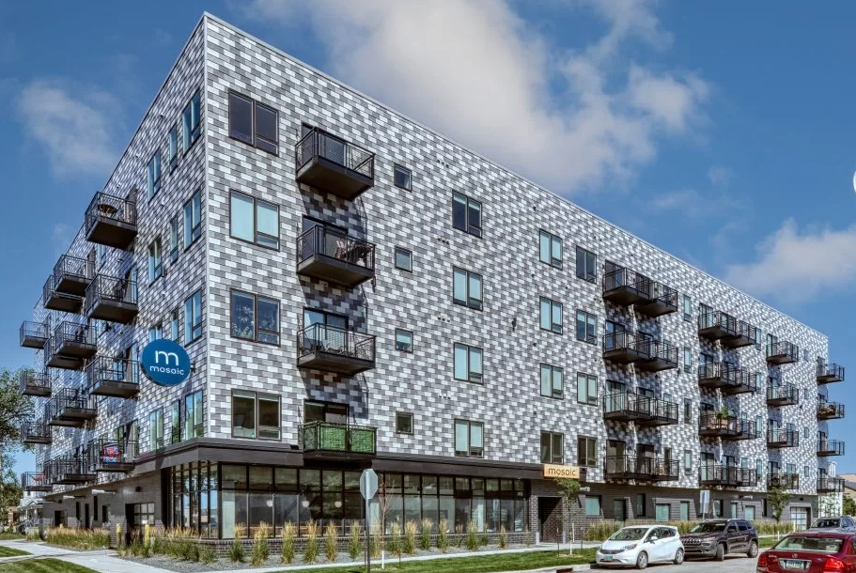
Section 1: Types of architectural metal cladding and how they are applied
Tile project review
Mosaic Apartments
Notes:
Mosaic Apartments, Minnesota. Stamped cupped tiles, finishes: various grays, 24-gauge steel.

Slide 35
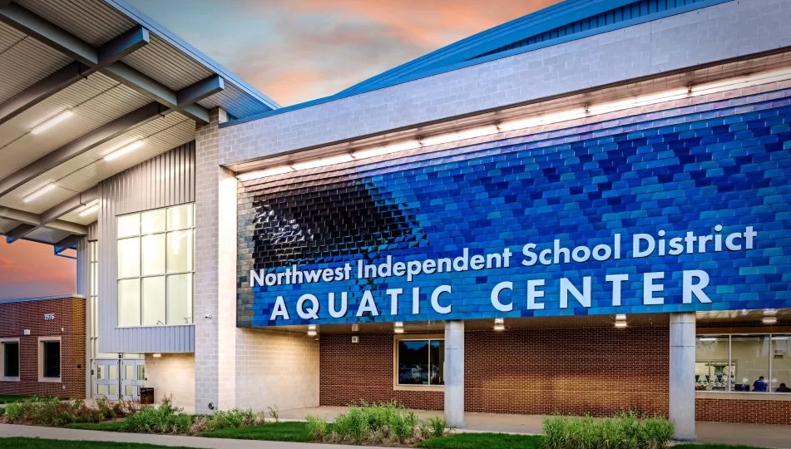
Section 1: Types of architectural metal cladding and how they are applied
Tile project review
NISD Natatorium Aquatic Center
Notes:
NISD Natatorium Aquatic Center, Texas. Stamped flat tile, steel, custom “bright blue” finish.

Slide 36
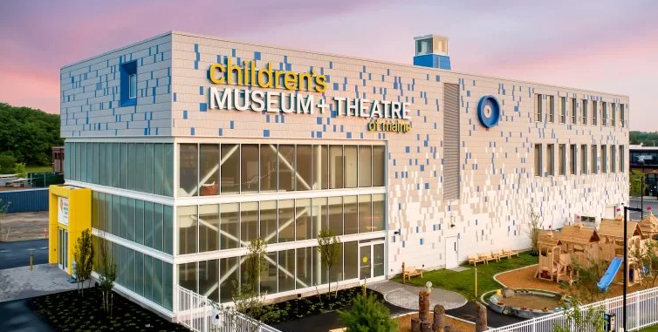
Section 1: Types of architectural metal cladding and how they are applied
Tile project review
Children’s Museum + Theatre
Notes:
Children’s Museum + Theatre, Maine. Flat tile, .032 aluminum, finishes: white, grays, and blue.

Slide 37
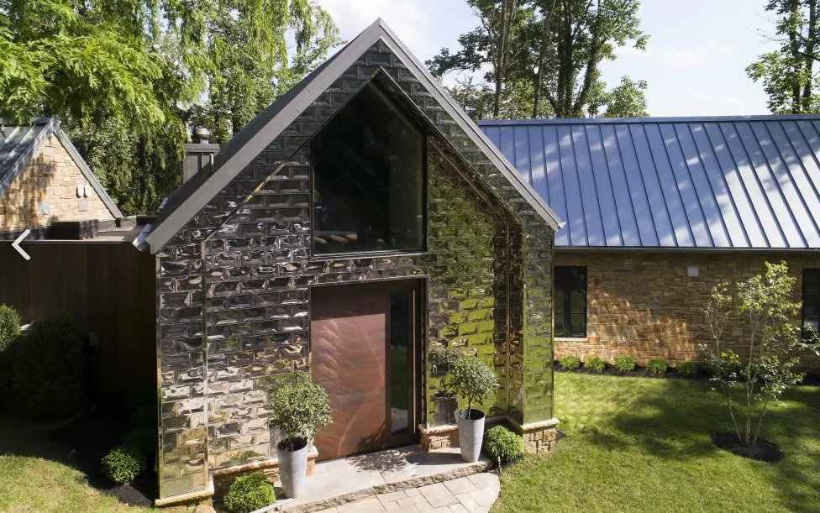
Section 1: Types of architectural metal cladding and how they are applied
Tile project review
Deignan House
Notes:
Deignan House, Pennsylvania. Cupped tile, steel, bright annealed finish.

Slide 38
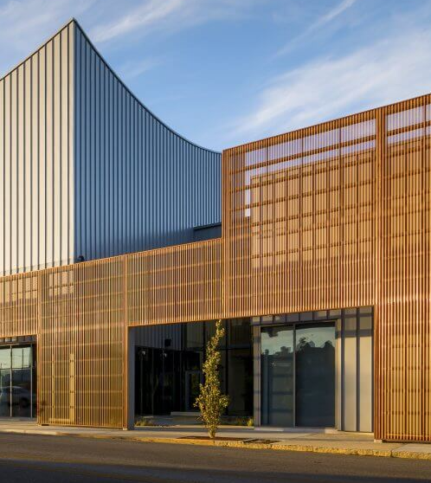
Section 1: Types of architectural metal cladding and how they are applied
Perforated metal
Innovative architectural tool
Functionality and aesthetic appeal
Precisely created perforations
Visually striking patterns
Perforations’ many purposes:
Enhancing ventilation
Providing natural light diffusion
Reducing noise transmission
Disguising eyesores
Architectural flair
Notes:
Ballet Memphis, Tennessee. Perforated corrugated natural copper, also snap-seam roof panels installed as wall panels.
Perforated metal wall panel systems are innovative architectural solutions that combine functionality with aesthetic appeal. These panels consist of sheets of metal with precisely designed perforations, creating a visually striking pattern while allowing for various functional benefits. The perforations serve multiple purposes, such as enhancing ventilation, providing natural light diffusion, and reducing noise transmission.

Slide 39
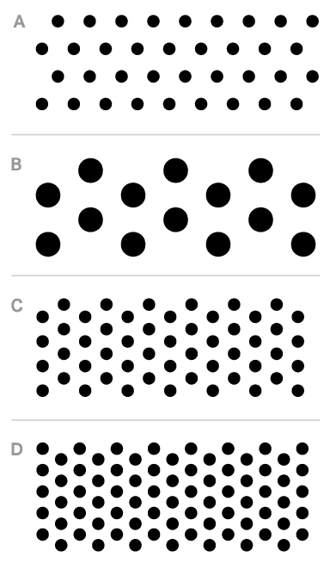
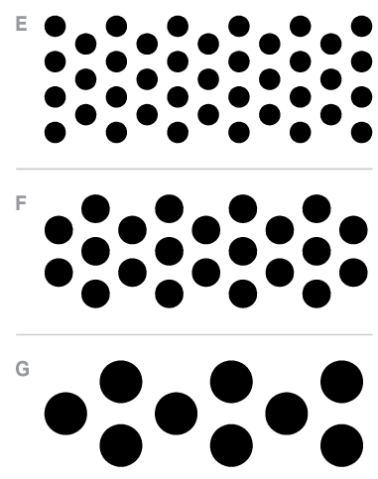
Section 2: Creative options and applications of perforated metal
Hole sizes
Varying the hole size allows for different aesthetic effects and functional purposes
Smaller holes can create visually appealing patterns or textures on surfaces like walls or ceilings
Larger holes can be used for ventilation or light diffusion in architectural designs
Hole size enables customization and adaptability

Slide 40
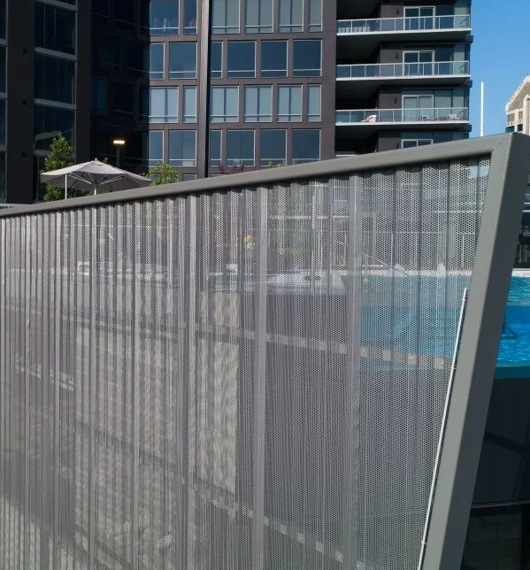
Section 2: Creative options and applications of perforated metal
Hole spacing and open space
Open space adds depth, dimension, interest
Adjusting spacing allows control over light, air, sound, or liquid passage
Suitable for sunshades, privacy screens, acoustic panels, filtration systems and more
Notes:
The Charles condominiums, Atlanta. Perforated 7.2 panel, .040 aluminum, weathered zinc finish.
The spacing between the holes and the resulting open space in perforated metal are crucial aspects that contribute to its functionality and performance. By adjusting the spacing, designers can control the amount of light, air, sound, or liquid that passes through the perforations. This makes perforated metal suitable for applications such as sunshades, privacy screens, acoustic panels, filtration systems, and more. The open space created by the perforations can also add depth, dimension, and visual interest to architectural facades or interior elements, giving them a contemporary and dynamic appearance.

Slide 41
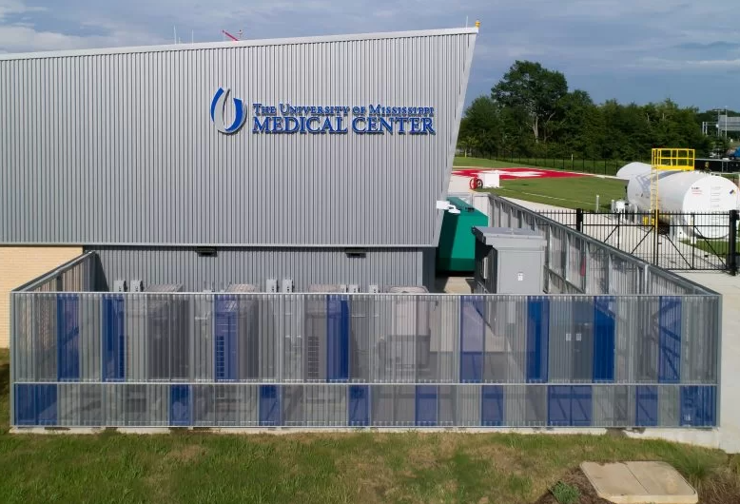
Section 2: Creative options and applications of perforated metal
Perforated metal applications
Creates visually appealing enclosures
Hide or camouflage mechanical equipment such as a/c units, generators, utility boxes
Sleek, modern look
Protects equipment from weather
Allows for proper ventilation, airflow
Introduce patterns, textures, interest
Play of light and shadow adds depth, dynamics
Notes:
The University of Mississippi Medical Center, Mississippi. Perforated aluminum ribbed/horizontal wall panels in silver and blue finishes.
Perforated metal cladding finds numerous applications in different industries and sectors, primarily due to its functional and aesthetic benefits. One common application is as equipment screens. Perforated metal panels can be used to create visually appealing enclosures that hide or camouflage mechanical equipment such as air conditioning units, generators, or utility boxes. These screens not only provide a sleek and modern look to the building exterior but also serve the practical purpose of protecting the equipment from weather elements while allowing for proper ventilation and airflow.

Slide 42
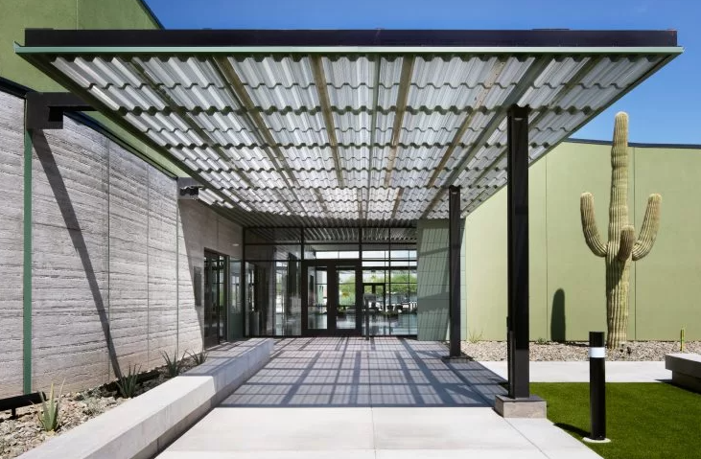
Section 2: Creative options and applications of perforated metal
Perforated metal applications
Acoustics in concert halls, auditoriums and large spaces
Control sound, improve acoustics
Absorb and diffuse sound waves, reducing echoes
Enhancing overall sound quality within the space
Regulating airflow for efficient ventilation, air distribution, and temperature control
Notes:
Eloy City Hall, Arizona. Perforated 7.2 panel, aged copper finish.
Perforated metal cladding also serves functional purposes, particularly in the realms of acoustics and airflow management. In acoustic applications, perforated metal panels are often used in concert halls, auditoriums, or other large spaces to control sound reflections and improve acoustics. The perforations help to absorb and diffuse sound waves, reducing echoes and enhancing the overall sound quality within the space. Similarly, in HVAC systems or industrial settings, perforated metal cladding can be utilized to regulate airflow, allowing for efficient.

Slide 43
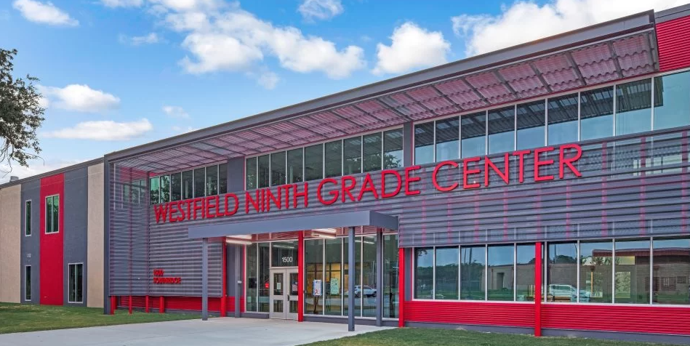
Section 2: Creative options and applications of perforated metal
Perforated metal project review
Westfield Ninth Grade Center
Notes:
Westfield Ninth Grade Center, Texas. Perforated rib panels, charcoal gray finish, .040 aluminum.

Slide 44
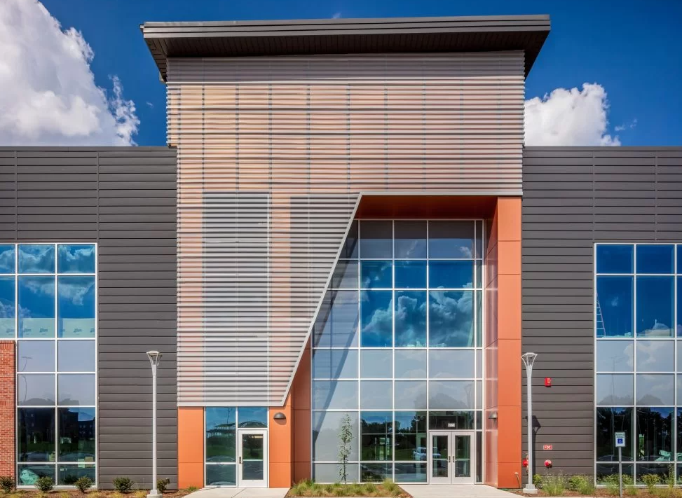
Section 2: Creative options and applications of perforated metal
Perforated metal project review
Wichita State #7
Notes:
Wichita State #7, Kansas. ribbed panels, .050 aluminum.

Slide 45
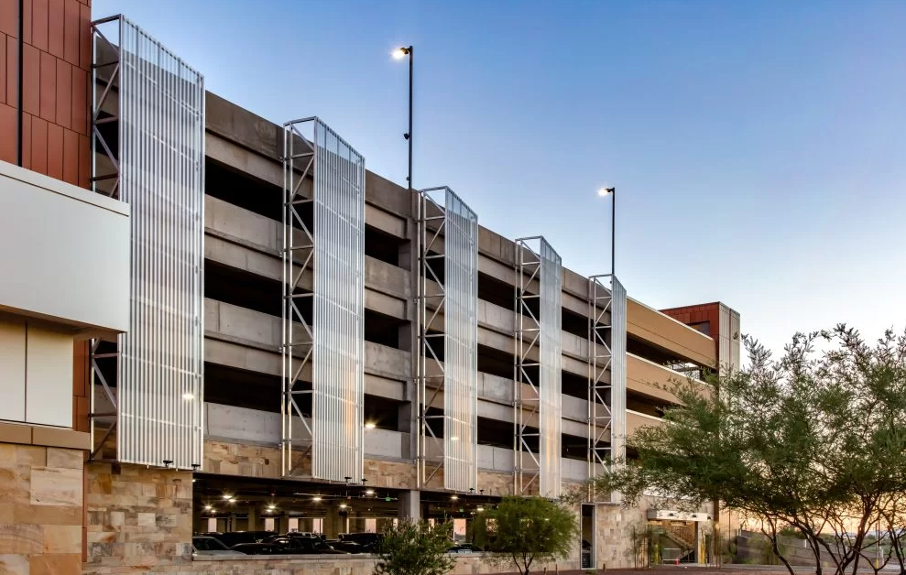
Section 2: Creative options and applications of perforated metal
Perforated metal project review
Desert Diamond Casino Parking
Notes:
Desert Diamond Casino Parking, Arizona. Perforated ribbed panel, .040-gauge aluminum, silver finish.

Slide 46
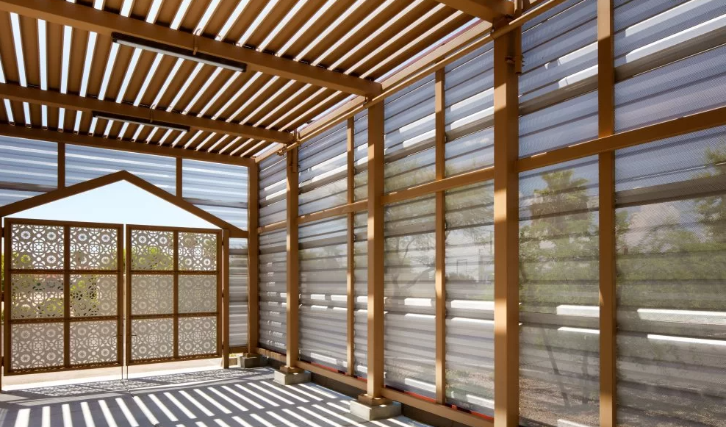
Section 2: Creative options and applications of perforated metal
Perforated metal project review
Best Funeral Services
Notes:
Best Funeral Services, Arizona. Perforated ribbed panel, .040-gauge, 22% open space, red finish.

Slide 47
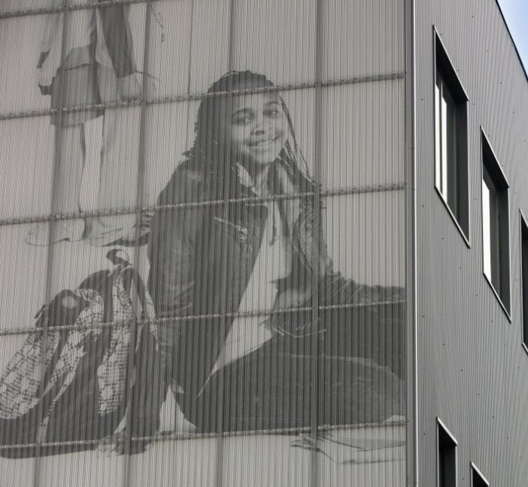
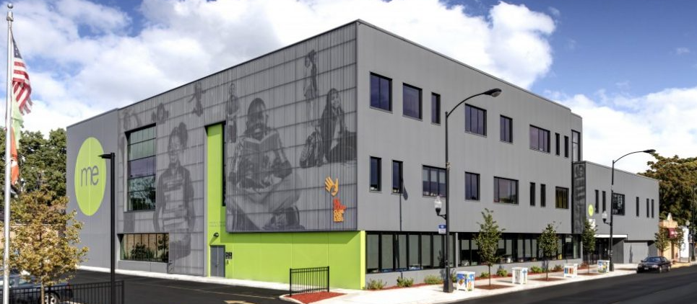
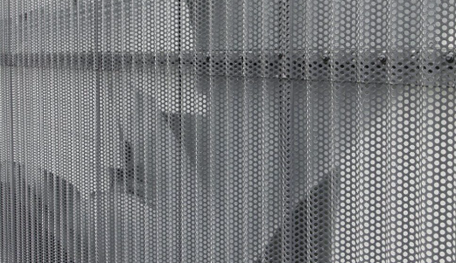
Section 2: Creative options and applications of perforated metal
Perforated metal project review
Moving Everest Charter School
Notes:
Moving Everest Charter School, Chicago. 7/8-inch corrugated panel, charcoal finish, hole specs: 3/8-in. on 9/16-in. centers.
Perforated corrugated installed 4 inches in front of the images of children. NOTE: Graphics of children are NOT within the manufacturer’s scope of capabilities.

Slide 48
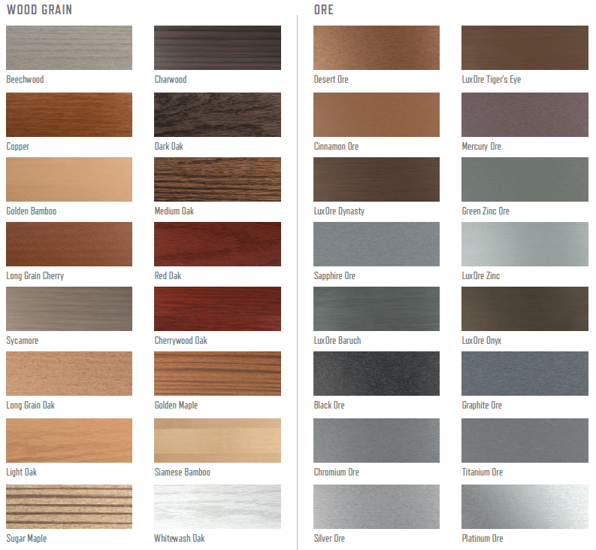
Section 3: Simulated finishes
Simulated finishes
Zinc
Copper penny
Weathered copper
Weathered steel
Weathered zinc
Wood grain
Ore
Notes:
Simulated finishes include:
zinc
copper
weathered metal
wood grain
natural wood grain
natural ore
as well as the anodized aluminum option to paint.

Slide 49
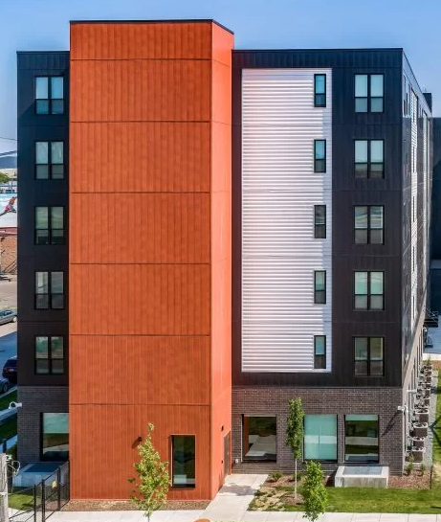
Section 3: Simulated finishes
Simulated finishes
Enhance aesthetic appeal
Weathered metal finishes provide rustic and industrial look
Wood grain finishes offer a natural, organic feel
Natural ore finishes mimic the raw beauty of minerals and stones
Creative possibilities for architects and designers
Notes:
Mino-Bimaadiziwin Apartments, Minnesota. Flush panels, 22-gauge, custom wood grain finish, which closely resembles wood milled from white cedar trees.

Slide 50
Learning objectives recap
Now that you have completed this course, you will be able to:
Describe the multiple types of metal cladding, including roofing, wall systems, soffits, perforated panels and tiles, and how they are applied to buildings of all shapes, sizes and purposes.
Explore creative options and applications of perforated metal including hole size, shape, spacing, open space, and how it is applied as equipment screens, aesthetic accents, acoustics and to aid airflow.
Consider simulated finishes, including copper, weathered metal, wood grain, natural ore, as well as anodized aluminum option to paint.
Discuss examples of architectural metal applications from numerous case studies showing the varied and creative ways metal is specified and applied.

Slide 51
Thank you for your time. This concludes the American Institute of Architects (AIA) Continuing Education System (CES) course.

