Slide 1
Welcome to this learning unit addressing Aluminum Railing For Construction & Renovation Projects

Slide 2
AIA Best Practices
Fairway Architectural Railing Solutions is a registered provider with the American Institute of Architects (AIA) Continuing Education Systems (CES). Credits earned on completion of this program will be reported to CES Records for AIA members. Certificates of Completion will be available at the conclusion of this course for record keeping and self-reporting purposes.
This program is registered with the AIA/CES for continuing professional education. As such, it does not include content that may be deemed or construed to be an approval or endorsement by the AIA for any material of construction or any method or manner of handling, using, distributing, or dealing in any material or product. Questions related to specific materials and services should be directed to Fairway Architectural Railing Solutions after completing this learning unit.

Slide 3
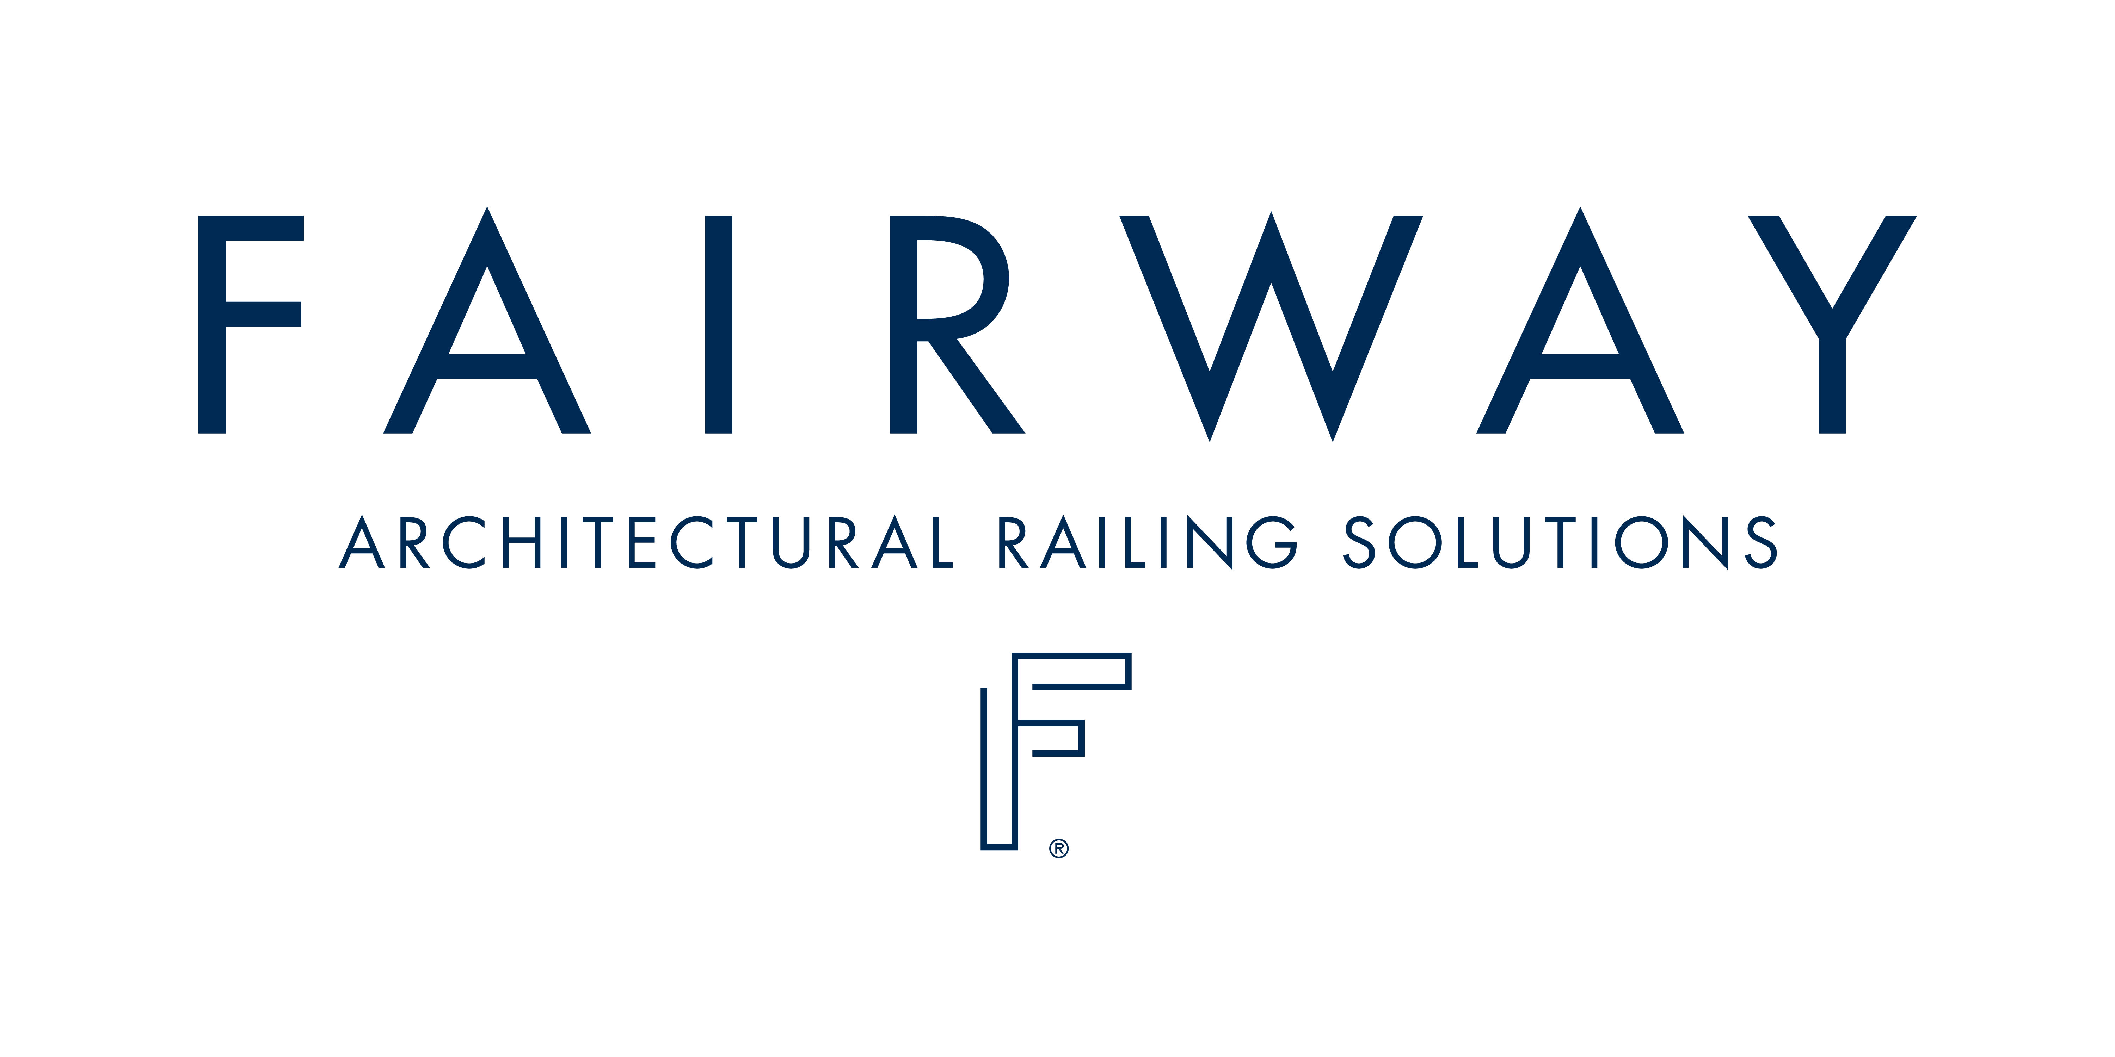
Copyright Notice
This presentation is protected by US and International Copyright laws. Reproduction, distribution, display and use of this presentation without permission from Fairway Architectural Railing Solutions is prohibited.
FAIRWAY ARCHITECTURAL RAILING SOLUTIONS© 2016

Slide 4
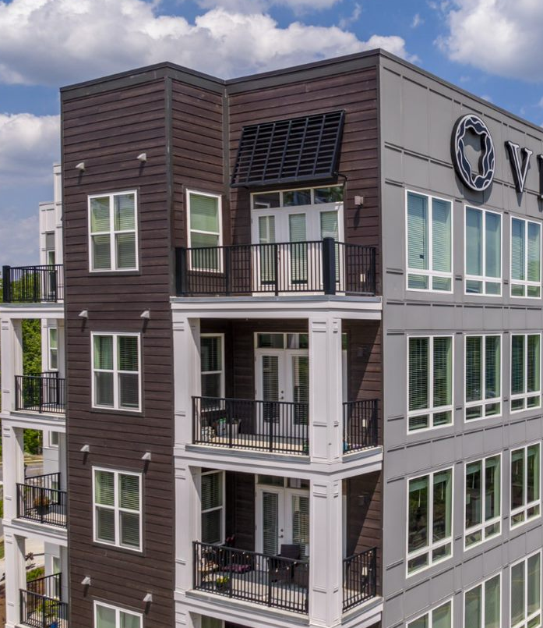
Learning Objectives
By the time you complete this course, you will be able to:
Identify common architectural aluminum railing system applications including balconies, amenity spaces, retaining walls, ramps, and stairs
Write more accurate specification for punched and welded architectural aluminum railing systems
Select an architectural design infill feature available for aluminum railing fabrications
Understand unique requirements associated with replacement of railing on an existing structure (renovations)
Discuss performance capabilities and finish specifications used in architectural aluminum railing systems
Notes:
When you complete this course, you will be able to:
1. Identify common architectural aluminum railing system applications including balconies, amenity spaces, retaining walls, ramps, and stairs
2. Write more accurate specification for punched and welded architectural aluminum railing systems
3. Select an architectural design infill feature available for aluminum railing fabrications
4. Understand unique requirements associated with replacement of railing on an existing structure (renovations)
5. Discuss performance capabilities and finish specifications used in architectural aluminum railing systems

Slide 5
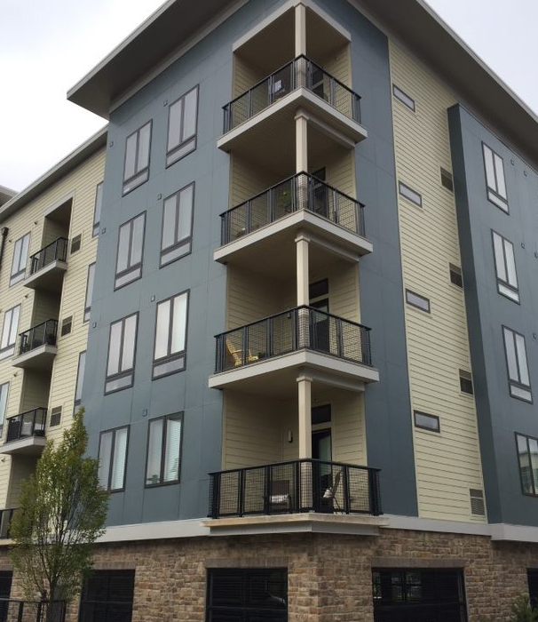
Aluminum: Best Choice For Balcony Railing
An ideal choice for architectural railings, aluminum offers optimized safety, an attractive appearance, and state-of-the-art finishing.
To keep up with continual upgrades to the International Building Code (IBC), architectural railing products are adjusting to meet significant alterations to railing requirements such as changes to the spacing and thicknesses of the posts required to support the railing system and allowable tolerances.
The IBC is expected to continue adopting more stringent policies. A qualified railing fabricator must be able to accommodate those changes as they’re presented.
Notes:
Aluminum is an excellent option for architectural railings due to its enhanced safety, appealing aesthetics, and advanced finishing. As the International Building Code (IBC) undergoes constant updates, architectural railing products are adapting to comply with significant changes to railing requirements. These changes include alterations to the spacing and thicknesses of posts necessary to support the railing system, as well as allowable tolerances. The IBC is expected to implement even more strict policies in the future, and it is crucial for a qualified railing fabricator to be able to adjust to these changes as they arise.

Slide 6
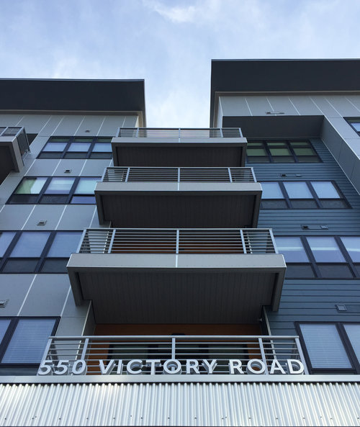
Aluminum: Best Choice For Balcony Railing
Available in a variety of aesthetics, architectural railing products offer assorted top rail shapes, sizes and configurations of the supporting posts, and a large variety of infill options.
Most frequently, architectural railings are depicted with combinations of squares, rectangles, and circles. The job of a good fabricator is to accommodate these shapes using proprietary materials to best facilitate fabrication and installation, while maintaining the architectural integrity of the project.
Notes:
It was previously mentioned that an iron railing aesthetic can be achieved with aluminum, as long as a qualified fabricator is utilized. Architectural railings commonly incorporate squares, rectangles, and circles, and a skilled fabricator must use specialized materials to accommodate these shapes during fabrication and installation, while maintaining the project's architectural integrity..

Slide 7
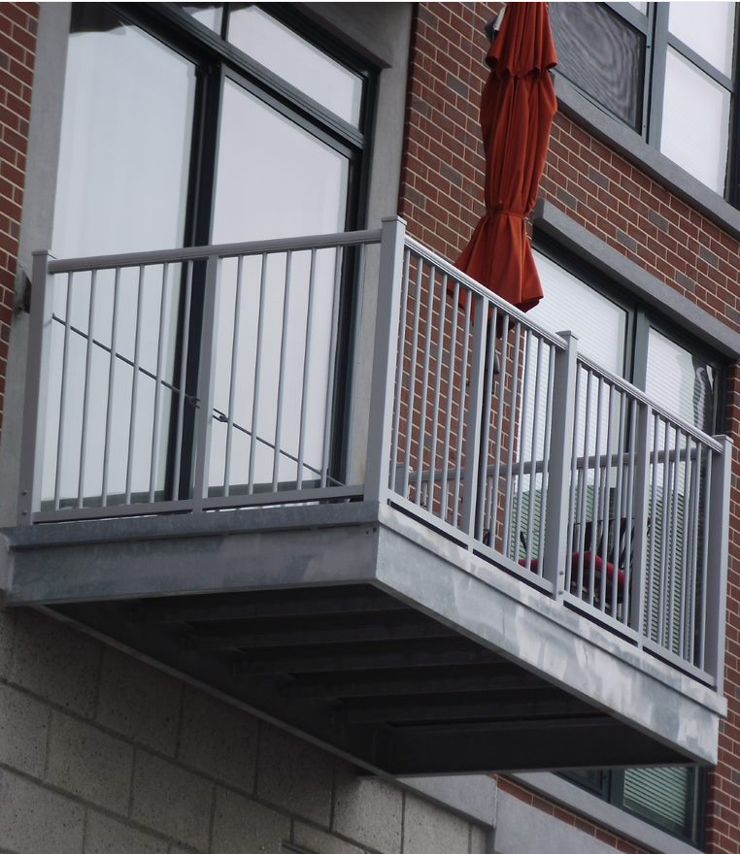
Aluminum: Best Choice For Balcony Railing
Because aluminum does not rust, a minimal amount of maintenance is required to maintain the product’s finish when following an outlined cleaning program. A welded system requires no maintenance under normal use as these are fabricated using permanent attachments, resulting in long-term durability. Damage due to abuse or accidents can usually be accommodated.
Adherence to a regular maintenance program will ensure that the finish endures to its expected life span. Finishing technologies are constantly being adopted to further lengthen the durability of the product finish.

Slide 8
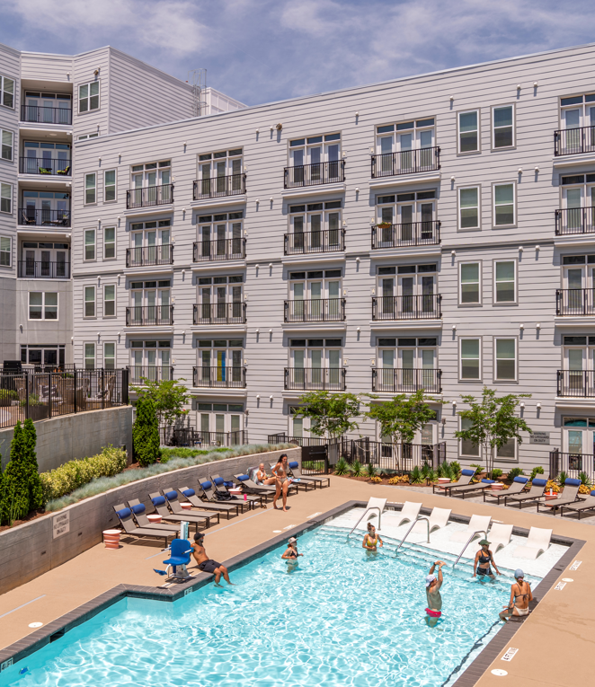
Aluminum Railing Applications
Multi-family New Construction: While comparatively minor in the scope of a larger project, balconies are featured on many multi-family and hospitality projects due to their high visibility. The railing should complement the architectural intent, while providing safety compliance with IBC requirements and taking into consideration budgetary constraints. This can be achieved with the help of a railing fabricator’s technological developments and offerings.
Amenity spaces are often found on a multi-family site and are typically similar in architectural appearance to the balcony railing or other parts of the project.
Notes:
New Construction Multi-Family Units.
Over the past decade, developers have been in a competitive race to attract new renters and increase rental rates in urban areas with high demand for apartments. As a result, various tactics are being implemented, such as the addition of amenity spaces and dog parks. These areas are increasingly popular, and aluminum has emerged as the ideal material for balcony rails and such spaces. You will also find aluminum railings can be customized to suit ramps and stairs.

Slide 9
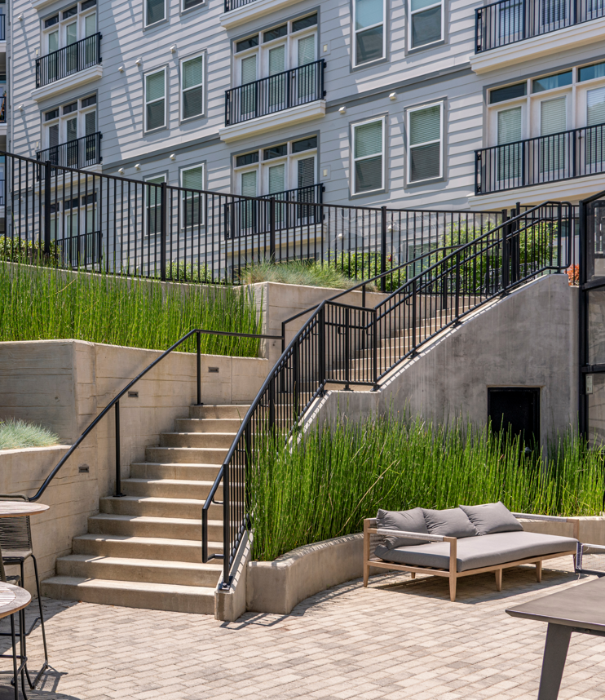
Aluminum Railing Applications
Ramps and Stairs: Besides balconies, aluminum railings can be fabricated according to the requirements of IBC, the International Residential Code, or the American Disabilities Act, using similar shapes and materials to complement the railing required on the other locations of the project.
Multifamily, Senior, and Student Housing: With both retirees and young adults moving into multifamily units, developers are offering more and more amenities. While gyms, pools, and computer labs are certainly part of that, the quality of life is greatly enhanced by having beautiful outdoor areas. These spaces, of course, must be enclosed by a railing system, which will also compliment the architecture of the building. Besides new construction, there are literally thousands of existing apartment buildings, both mid- to high-rise and garden communities, in constant need of ‘Value Add’ renovation in order to maximize those assets to building owners.

Slide 10
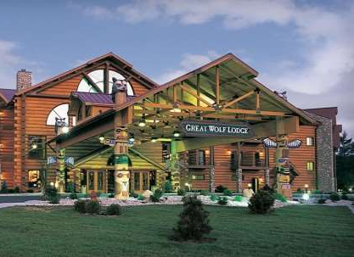
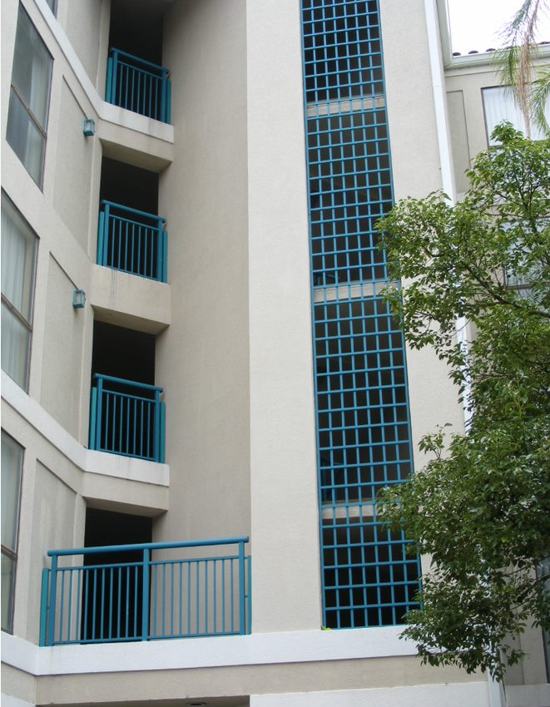
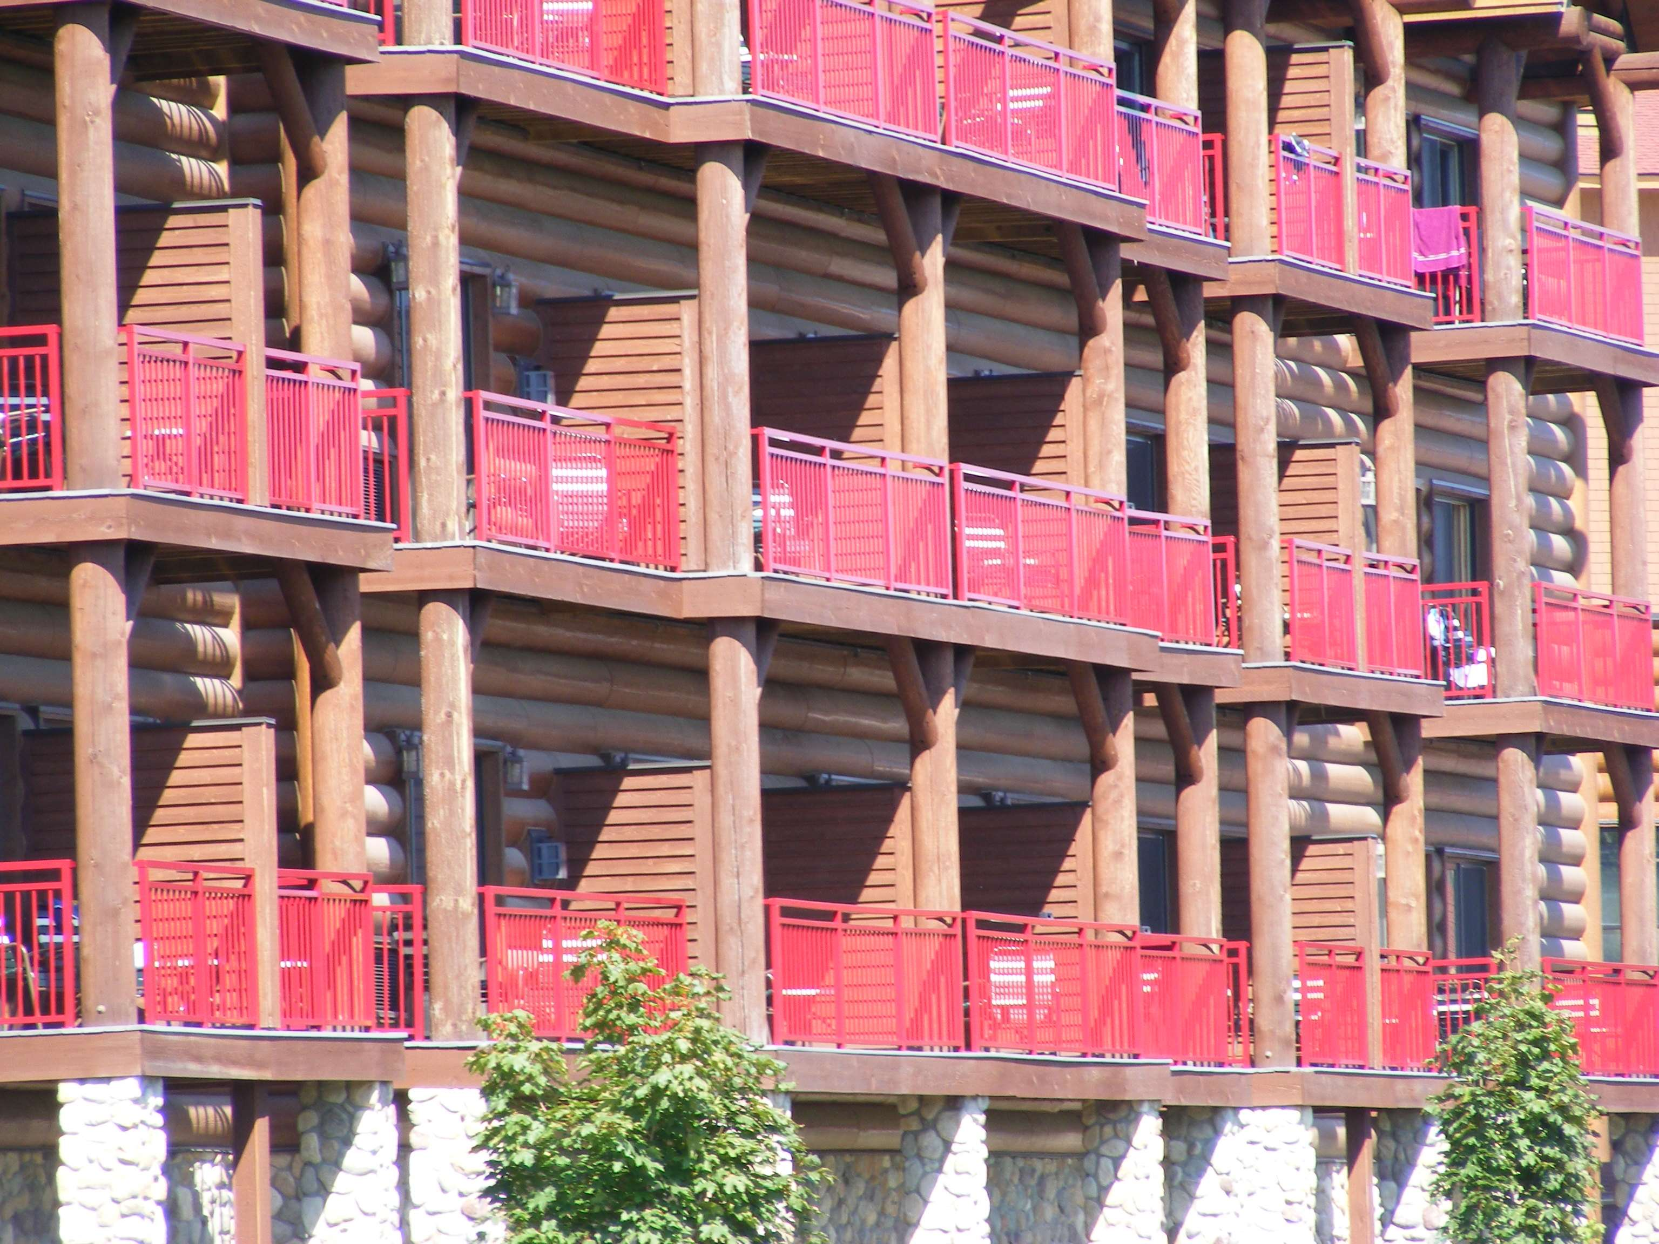
Aluminum Railing Applications
Hospitality: Resort and Hotel projects are a great opportunity for the architect to incorporate design developments of the property into the aluminum railing system. For example, using company logo, artwork, and brand-matched colors can be utilize as a component of the railing system in order to reinforce the brand or the theme of the property itself. A qualified aluminum fabricator can do this with ease with the assistance of their technology.
As part of the exterior renovation packages, old, out-of-code railings are frequently replaced. While that process is taking place, owners will typically elect to brighten up the appearance of their property by changing the tired iron railings into something brighter and more attractive, complementing their potential re-branding of an older property.
Notes:
Ramps and Stairs: Aluminum railings can be custom-made to meet the standards set by the International Residential Code, American Disabilities Act, and requirements of IBC for ramps and stairs. The materials and shapes used can match the railings on other parts of the project.
Multifamily, Senior, and Student Housing: With both retirees and young adults moving into multifamily units, developers are offering more and more amenities. While gyms, pools, and computer labs are certainly part of that, the quality of life is greatly enhanced by having beautiful outdoor areas. These spaces, of course, must be enclosed by a railing system, which will also compliment the architecture of the building. Besides new construction, there are literally thousands of existing apartment buildings, both mid- to high-rise and garden communities, in constant need of ‘Value Add’ renovation in order to maximize those assets to building owners.
Developers are meeting the demands of retirees and young adults who are settling in multifamily units by offering a wider range of amenities. While features like gyms, pools, and computer labs are essential, having well-designed outdoor spaces significantly improves the overall living experience. To complement the building's architecture, these areas need to be enclosed by a railing system that matches the aesthetic. Furthermore, there are numerous pre-existing apartment buildings, including mid to high-rise and garden communities, that would benefit from "Value Add" renovations to optimize their value for the owners.

Slide 11
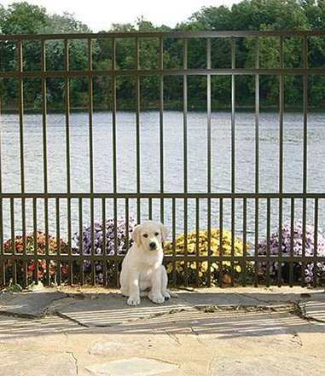
Where To Specify Aluminum Railing
When showcased in a multi-family setting, aluminum railings offer much diversity.
Roof decks, clubhouses, and amenity areas are ever-present in multi-family construction and renovation. The railing system may mimic the design selected for the remainder of the community
A noted trend in multi-family communities are dog parks. Thanks to the customizable nature of aluminum railing fabrication, the picket spacing is typically a large consideration. Small dogs can usually squeeze through the 4-inch picket spacing, so fabricators are often asked to tighten that spacing or utilize other infills such as glass or mesh so that small dogs cannot escape those areas.
Roof Decks Pool Areas Dog Parks Clubhouses
Notes:
When it comes to dog parks, aluminum rail designs are a great option. However, traditional picket fences can be problematic for smaller dogs as they often have four-inch pickets with gaps that smaller dogs can easily pass through. Fortunately, an experienced custom fabricator can solve this issue by producing a "puppy picket" with tighter spacing of approximately two inches for the lower portion of the fence while maintaining the standard four-inch spacing above that point.

Slide 12
Railing System Choices
Need Image
For aluminum railing fabrication, there are typically three different methods of manufacturing – mechanical, direct welded, and a punched and welded system.
Mechanically Assembled: These horizontal and vertical railing components are held together with a screw or rivet into the picket or utilize some other mechanical method of attachment.
Direct Weld: It’s important to note that with a direct welded system, the underside would be welded to the top rail and the top side of the bottom rail, resulting in visible welds.
Punched and Welded System: The vertical component goes all the way through the top and bottom rail. A profiled top rail is then welded into place, providing superior strength while concealing the welds. Punched and welded railing systems are far superior to those which are assembled mechanically or via direct welding
A fully punched and welded railing system provides unmatched structural integrity while enhancing visual appearance by concealing welds of vertical to horizontal railing members.
Notes:
When it comes to creating aluminum railings, there are three methods that are commonly used. The manufacturing process for aluminum railings involves mechanical assembly, direct welding, or a punched and welded system.
Mechanical assembly involves using screws or rivets to attach horizontal and vertical components of the railing.
Direct welding, on the other hand, involves welding the underside to the top rail and the top side of the bottom rail, which results in visible welds.
A punched and welded system involves running the vertical component through both the top and bottom rail, with a profiled top rail welded on top for added strength and a seamless appearance. Compared to the other two methods, punched and welded railing systems are significantly more superior.
For residential purposes, a punched and welded system is undoubtedly the most superior option among the three fabrication types. It is important to note that the text above was generated by the user and not by an AI-powered assistant.

Slide 13
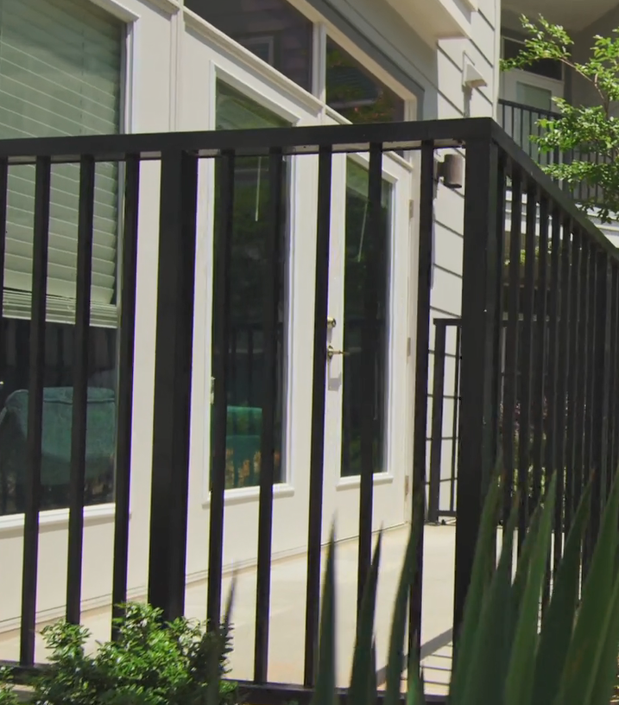
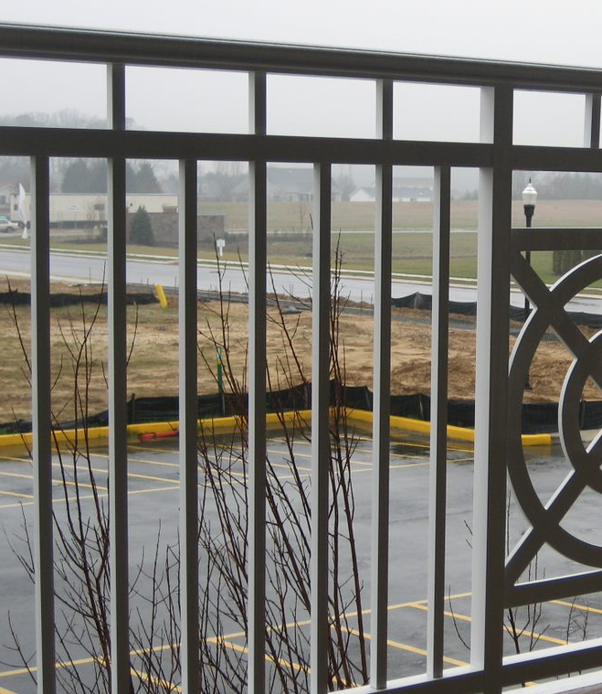
Punched & Welded Railing System
In order to comply with multi-family housing IBC requirements, the safest, strongest and most diverse railing system is punched and welded.
A punched and welded system means that the horizontal components of the railing system are 'punched' to accommodate vertical components, resulting in a finished product which is superior in strength while concealing visible welds
Notes:
To meet the standards set by multi-family housing and IBC regulations, a railing system needs to be both safe and sturdy. A punched and welded system is the best option as it involves creating holes in the horizontal pieces to fit in the vertical components. This technique results in a railing system that is not only stronger but also hides any visible welds for a more polished finish.

Slide 14
Punched & Welded Railing System
That punch is accommodated through computerized tooling and in doing so, conceals the welding to the underside of the horizontal components where they’re not visible.
This is incredibly strong because the railing is being held together not only via the weld, but it is being punched through a secondary aluminum component which adds strength.
In doing so, the performance capabilities, as pertaining to IBC requirements, are far greater than that of a mechanical or direct welded system.

Slide 15
Punched & Welded Railing System
As illustrated here, the computerized punch technology is shown punching out the rail. These punches can be either round, square, or rectangular to accommodate the picket selected.
Whether it’s ¾-inch square, ¾-inch round, or 1 ½-inch x ¾-inch rectangular, a computerized punch will accurately and cleanly punch the hole in the horizontal and vertical member to accommodate the picket.

Slide 16
Punched & Welded Railing System
This image showcases welding being done on the underside of the punch. In a direct welded system, these welds would be visible to the end-user. However, since they are punched, they are concealed on the underside, rendering them completely invisible.
By combining an automated welding system with computerized punching, a flawless weld is achieved through the punch every single time, resulting in a consistent and secure product.

Slide 17
Punched & Welded Railing System
A real-world test was conducted to showcase the performance of the punched and welded railing system shown in the picture. The results proved that the weld and mounting methods surpass the IBC concentrated load requirements.
Unlike other mechanical railing systems that are only compliant in a lab, this system meets project-specific criteria without requiring signed and sealed engineering calculations. The test was carried out in adherence to the standards set in ASTM E935 - Standard Test Methods for Performance of Permanent Railing Systems and Rails for Buildings.

Slide 18
Punched & Welded Railing System
Classic geometrical shapes present unique difficulties to a fabricator because it’s not always possible to punch and weld them.
More practical, proprietary shapes will maintain the architectural integrity of the project, while allowing the rail to be fabricated in a practical manner.
Notes:
Classic geometrical shapes present unique difficulties to a fabricator because it’s not always possible to punch and weld them.
More practical, proprietary shapes will maintain the architectural integrity of the project, while allowing the rail to be fabricated in a practical manner
Please note that all of our proprietary top rail shapes, except for one, have intentional curvature on the top. While there may not be any code specifically prohibiting the placement of a can or bottle on top of a guard rail, we believe that doing so could create a liability. Therefore, we have taken precautions to ensure that residents cannot place items on the top of our guard rails.

Slide 19
Infill Options
Over the years, the options for aluminum railings have greatly expanded. Back in the 1950s, balcony railings were typically basic painted wrought iron in a vertical layout.
Although vertical picket is still a popular choice, architects now have other possibilities to explore, including horizontal pickets, glass, mesh or perforated panels, bar grating, or personalized infill panels that can replace vertical pickets.

Slide 20
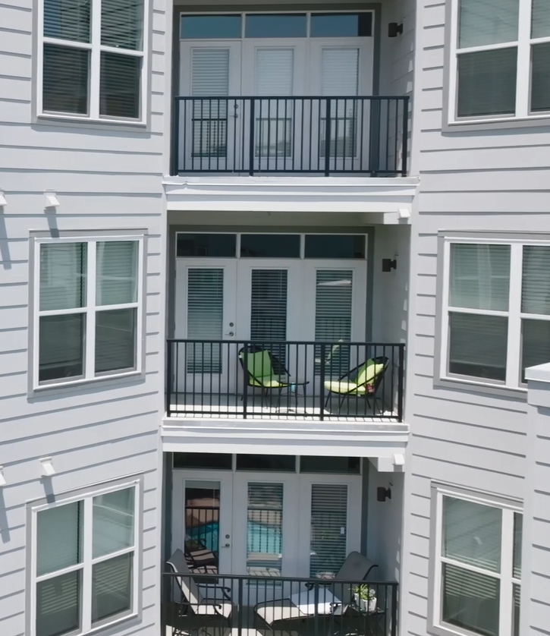
Vertical Picket Systems
The most commonly chosen infill for balcony railing systems is the vertical picket railing, especially when budget constraints play a major role in the design selection. This type of infill is usually the most affordable one available.
According to the IBC and IRC code requirements, the standard spacing between pickets should be less than 4 inches. However, some local authorities may require a smaller open space in certain cases.
Some older apartment complexes may have picket railings with more than 4 inches of spacing, which may have been allowed by building codes during their construction. However, these railings should be replaced during larger renovations in order to meet current code standards.

Slide 21
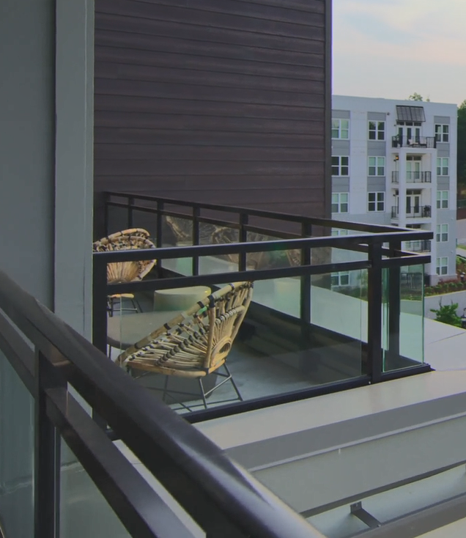
Glass Infill Systems
In high-rise multi-family and hospitality designs, glass is a popular choice for railing infills as it provides unobstructed views to occupants. This feature is highly sought after by owners or landlords.
According to the 2015 International Building Code, laminated glass made of fully tempered or heat-strengthened glass is required for handrails, guardrails, or guard sections. Additionally, it must comply with Category II or CPSC 16CFR Part 1201 or Class A of ANSI Z79.1.

Slide 22
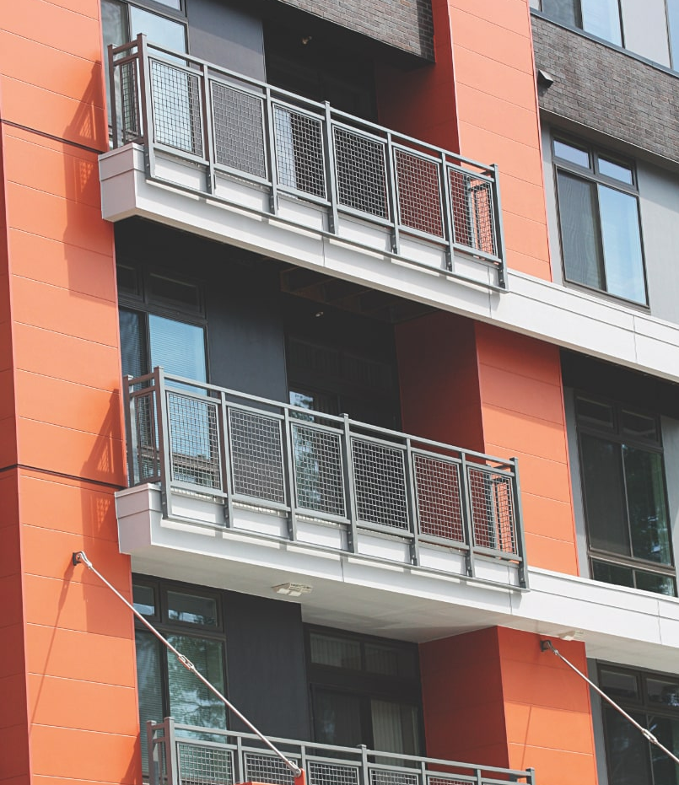
Mesh Infill Systems
Mesh is a popular material for both new construction and the repurposing of industrial spaces into residential areas. With the help of a skilled aluminum railing fabricator, the original commercial aesthetic of the structure can be maintained while also ensuring the safety and aesthetic appeal of the railing system.
Mesh is available in various opening sizes and configurations to match other architectural components of the structure.

Slide 23
Horizontal Picket Systems
Many architects opt for a horizontal picket infill when their clients request a modern, industrial, or sleek look. This type of infill also works well for garden-style and low-rise multi-family construction and renovation projects. Not only does it achieve the desired appearance, but it is also cost-effective, providing a similar look to cable rail for a fraction of the cost.

Slide 24
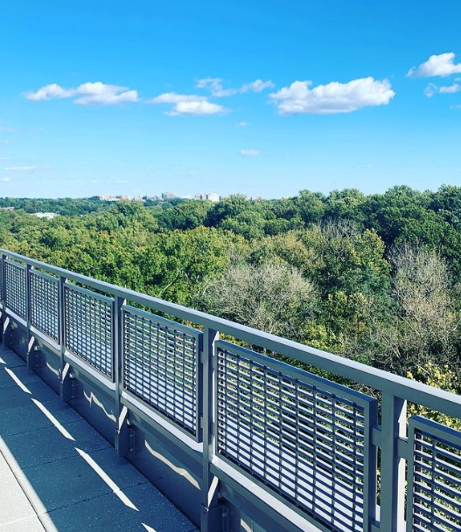
Bar Grating Panel Systems
When converting commercial or manufacturing space into residential areas, bar grating can offer an appropriate industrial look for adaptive reuse projects. Reliable and advanced fabricators can seamlessly incorporate this type of grating, available in various shapes, thicknesses, and opening sizes, into a railing design.

Slide 25
Laser Cut Infill Panels
A reputable fabricator can provide ornamental infill panels created with solid aluminum material and precision-cut using CRC Laser technology to ensure compliance with building codes.
These panels can be chosen from the fabricator's standard selection or customized to replicate specific themes, corporate logos, or patterns provided by the architect or developer.
Additionally, these panels can serve as a unique architectural feature, such as entry signage, or be used to complement the nearby classic architecture.

Slide 26
Laser Cut Infill Panels
A reputable fabricator can provide ornamental infill panels created with solid aluminum material and precision-cut using CRC Laser technology to ensure compliance with building codes.
These panels can be chosen from the fabricator's standard selection or customized to replicate specific themes, corporate logos, or patterns provided by the architect or developer.
Additionally, these panels can serve as a unique architectural feature, such as entry signage, or be used to complement the nearby classic architecture.

Slide 27
Laser Cut Infill Panels
A reputable fabricator can provide ornamental infill panels created with solid aluminum material and precision-cut using CRC Laser technology to ensure compliance with building codes.
These panels can be chosen from the fabricator's standard selection or customized to replicate specific themes, corporate logos, or patterns provided by the architect or developer.
Additionally, these panels can serve as a unique architectural feature, such as entry signage, or be used to complement the nearby classic architecture.

Slide 28
Laser Cut Infill Panels
A reputable fabricator can provide ornamental infill panels created with solid aluminum material and precision-cut using CRC Laser technology to ensure compliance with building codes.
These panels can be chosen from the fabricator's standard selection or customized to replicate specific themes, corporate logos, or patterns provided by the architect or developer.
Additionally, these panels can serve as a unique architectural feature, such as entry signage, or be used to complement the nearby classic architecture.

Slide 29
Mounting Methods
When it comes to installing architectural railing, there are multiple methods to choose from. The most widely used options include surface and fascia mounting or embedding the railing underneath lightweight concrete. These approaches guarantee a durable and sturdy installation that requires little maintenance.
• Fascia Mounting
• Surface Mounting
• Embedded

Slide 30
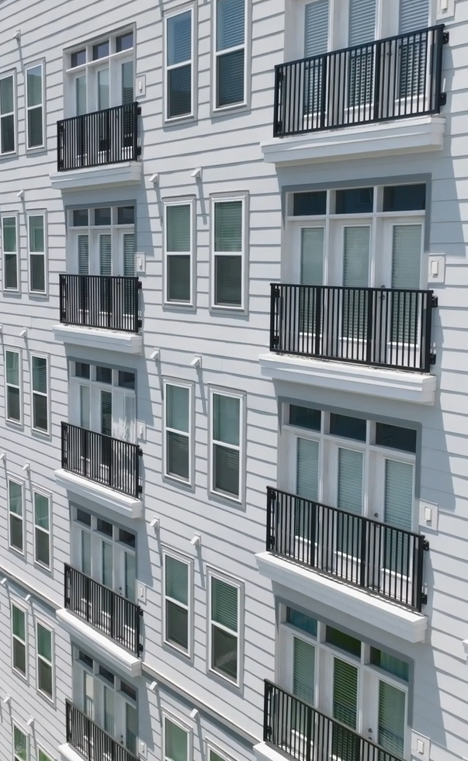
Fascia Mounting
Juliette balconies have become increasingly popular, leading to more fascia-mounted installations. However, it can be challenging to ensure that unsupported spans comply with structural regulations.
In the past, building codes allowed for a triple door with a 12-foot opening to be spanned without intermediate posts, but current IBC code requirements create obstacles. To address this, a skilled aluminum railing fabricator will collaborate with a structural engineer to adjust materials and fabrication methods while maintaining the design's aesthetic integrity.
Various factors, including the method of fascia mounting, guard railing height, infill weight, and accessibility, will be considered when selecting the best approach for the fascia-mounted installation.

Slide 31
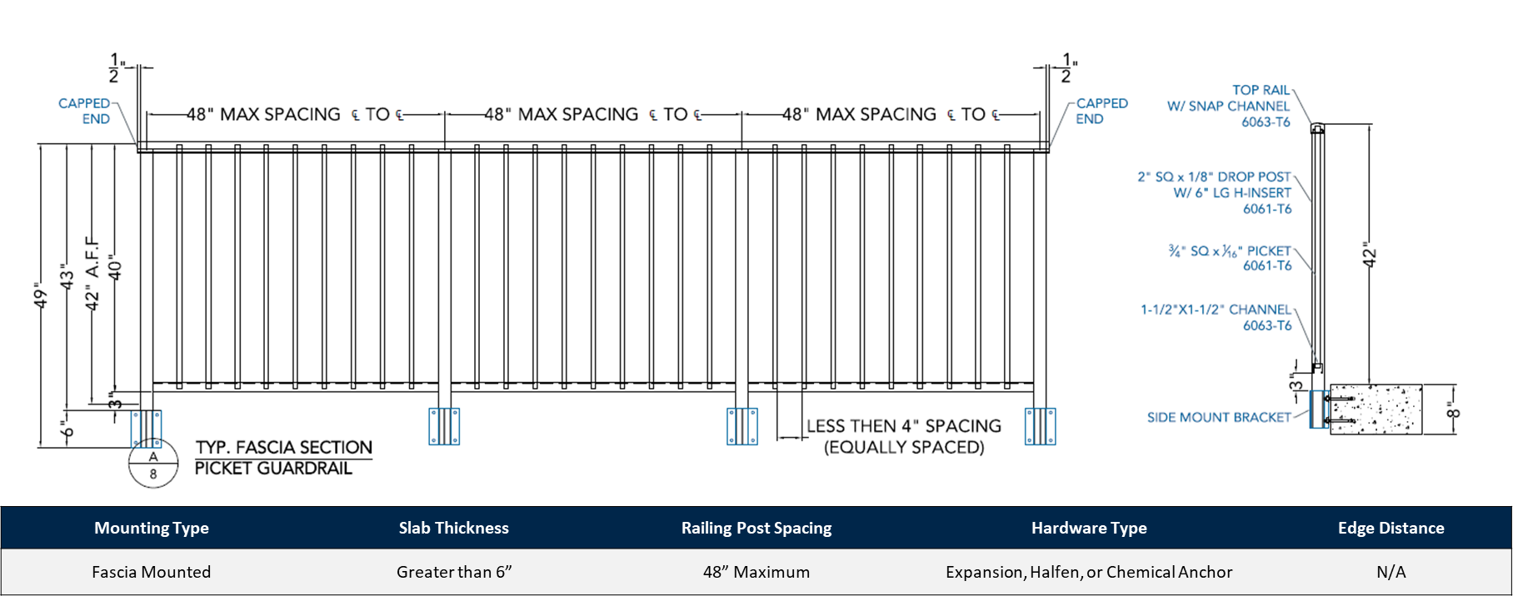
Fascia Mounting

Slide 32
Surface Mounting
Installing railing using the surface mounting method is the simplest and most convenient option. This method enables the installation crews to work directly on the deck without the need for external lifts or cranes.
The railing system can be set up from inside the building and securely fastened to the surface. When done correctly, surface mounting ensures that water cannot infiltrate and guarantees a secure installation that will last for many years.

Slide 33
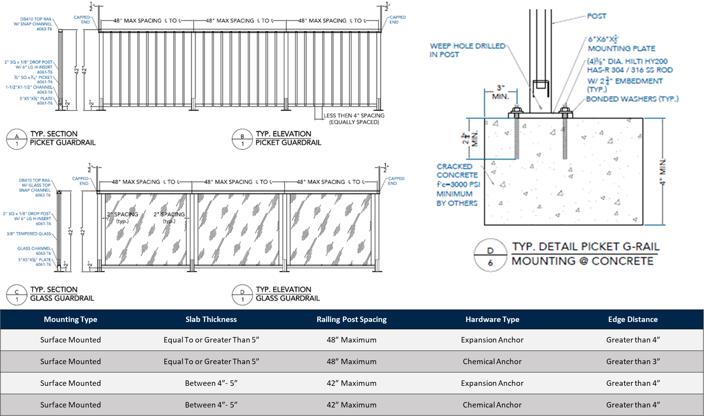
Surface Mounting Details: Concrete

Slide 34
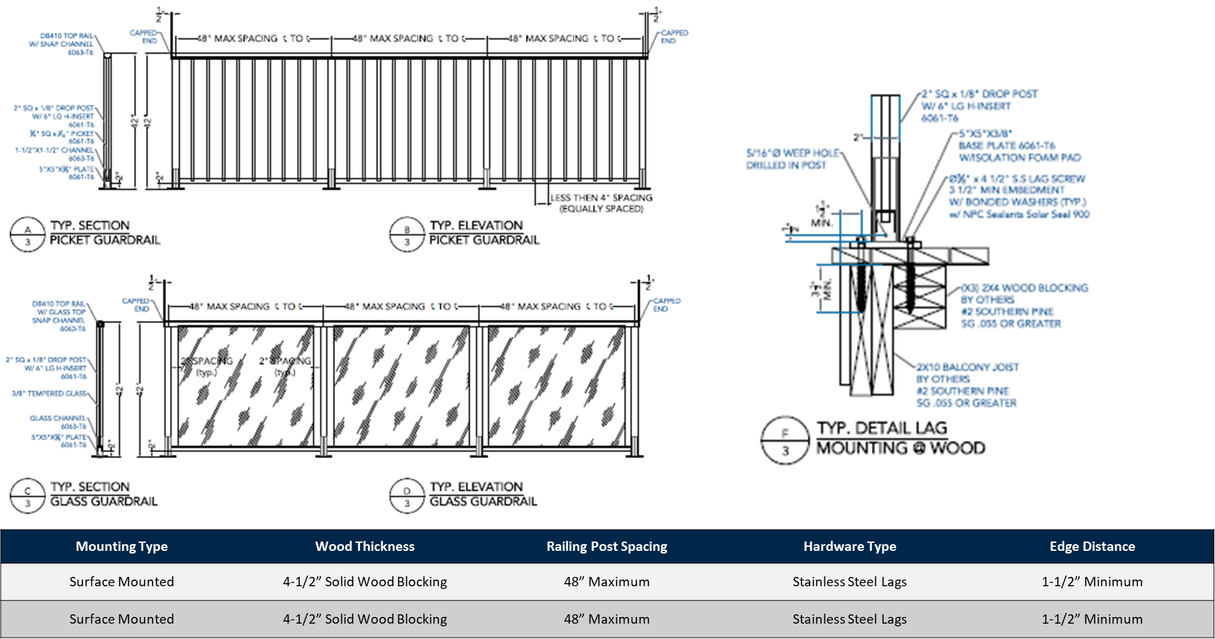
Surface Mounting Details: Wood

Slide 35
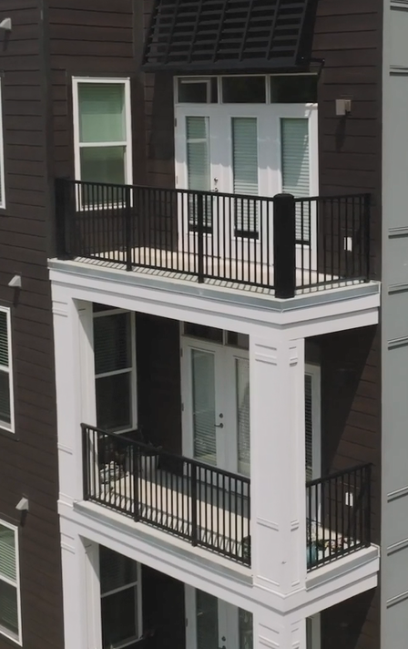
Embedded Mounting with Post Insert
Before installing the lightweight concrete, post tension cables, or deck membrane, it's possible to insert pre-set posts, also known as 'shoes' or 'stanchions'. This process involves a two-step installation that allows for the hardware and mounting plate to be hidden, resulting in a straightforward and weather-resistant installation. It is common practice to install preset post inserts before finishing a raised deck. This method ensures that the mounting plate and hardware can be hidden without the need for an escutcheon plate.
In freeze/thaw weather cycle areas, railing installations should not be done using core drilling as it poses a serious risk of water infiltration. This can lead to the gradual degradation of the installation over time, making it an unreliable and unsafe option.

Slide 36
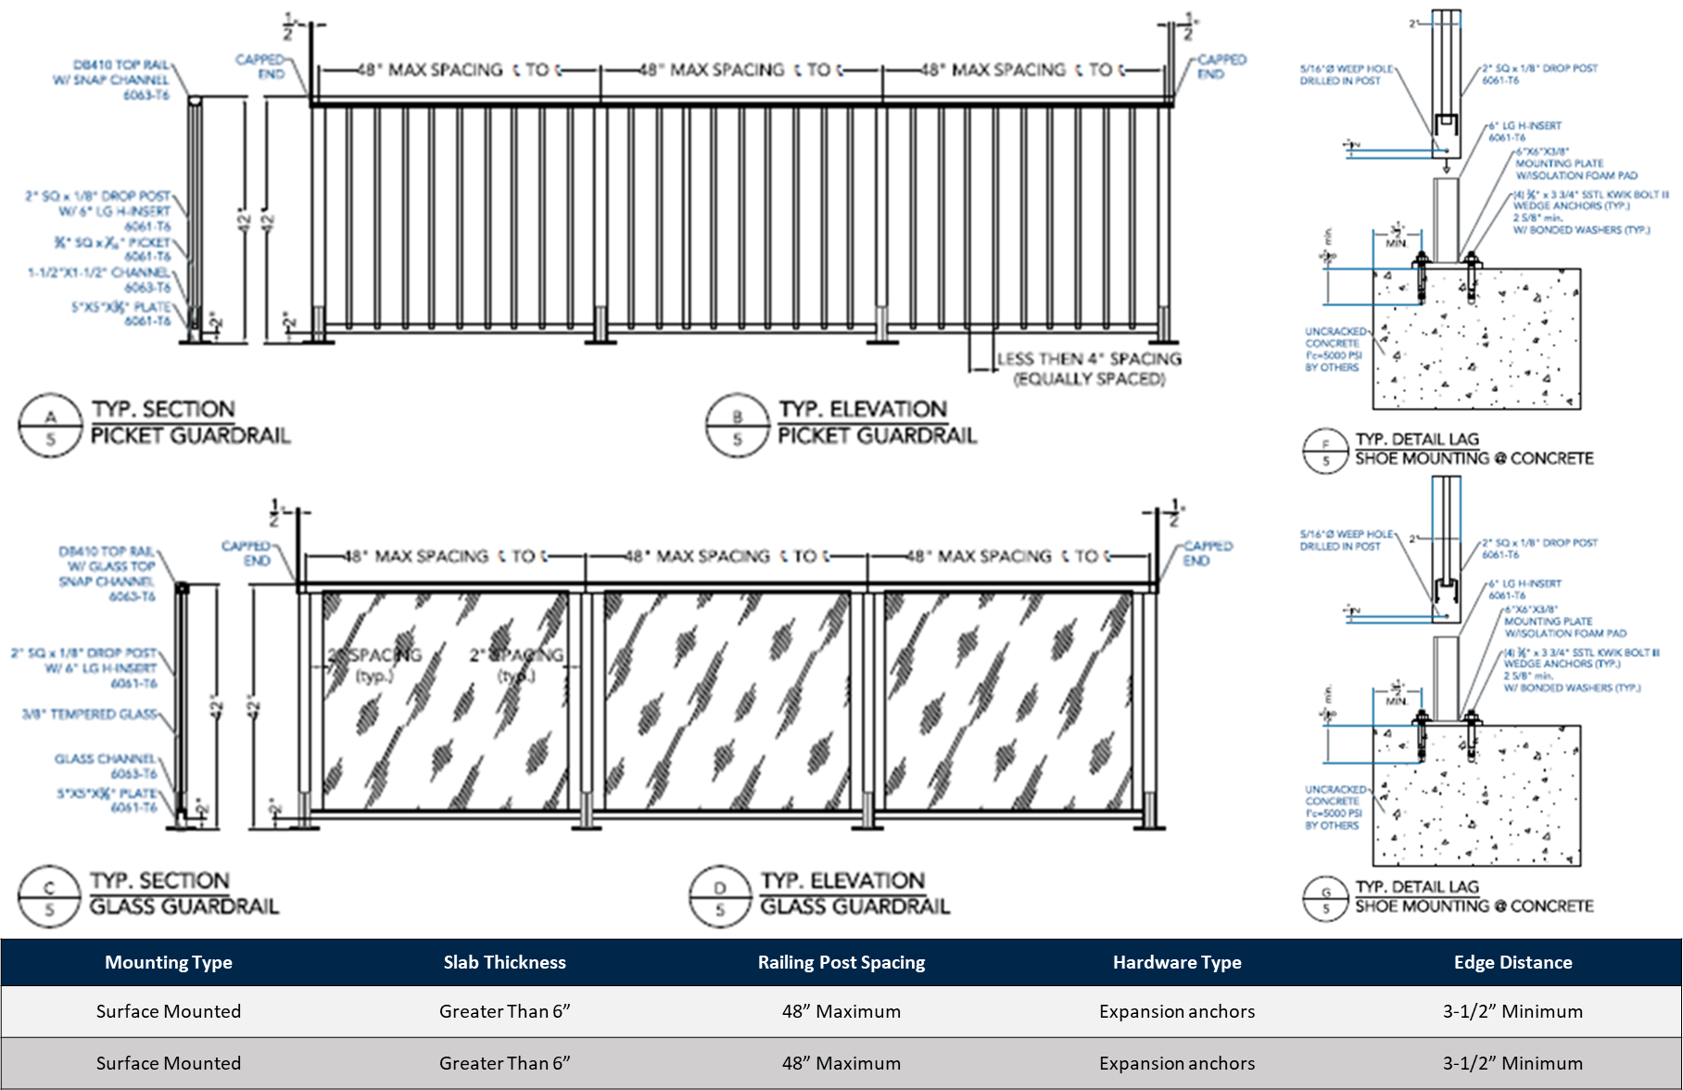
Embedded Mounting Details: Shoe (For Concrete)

Slide 37
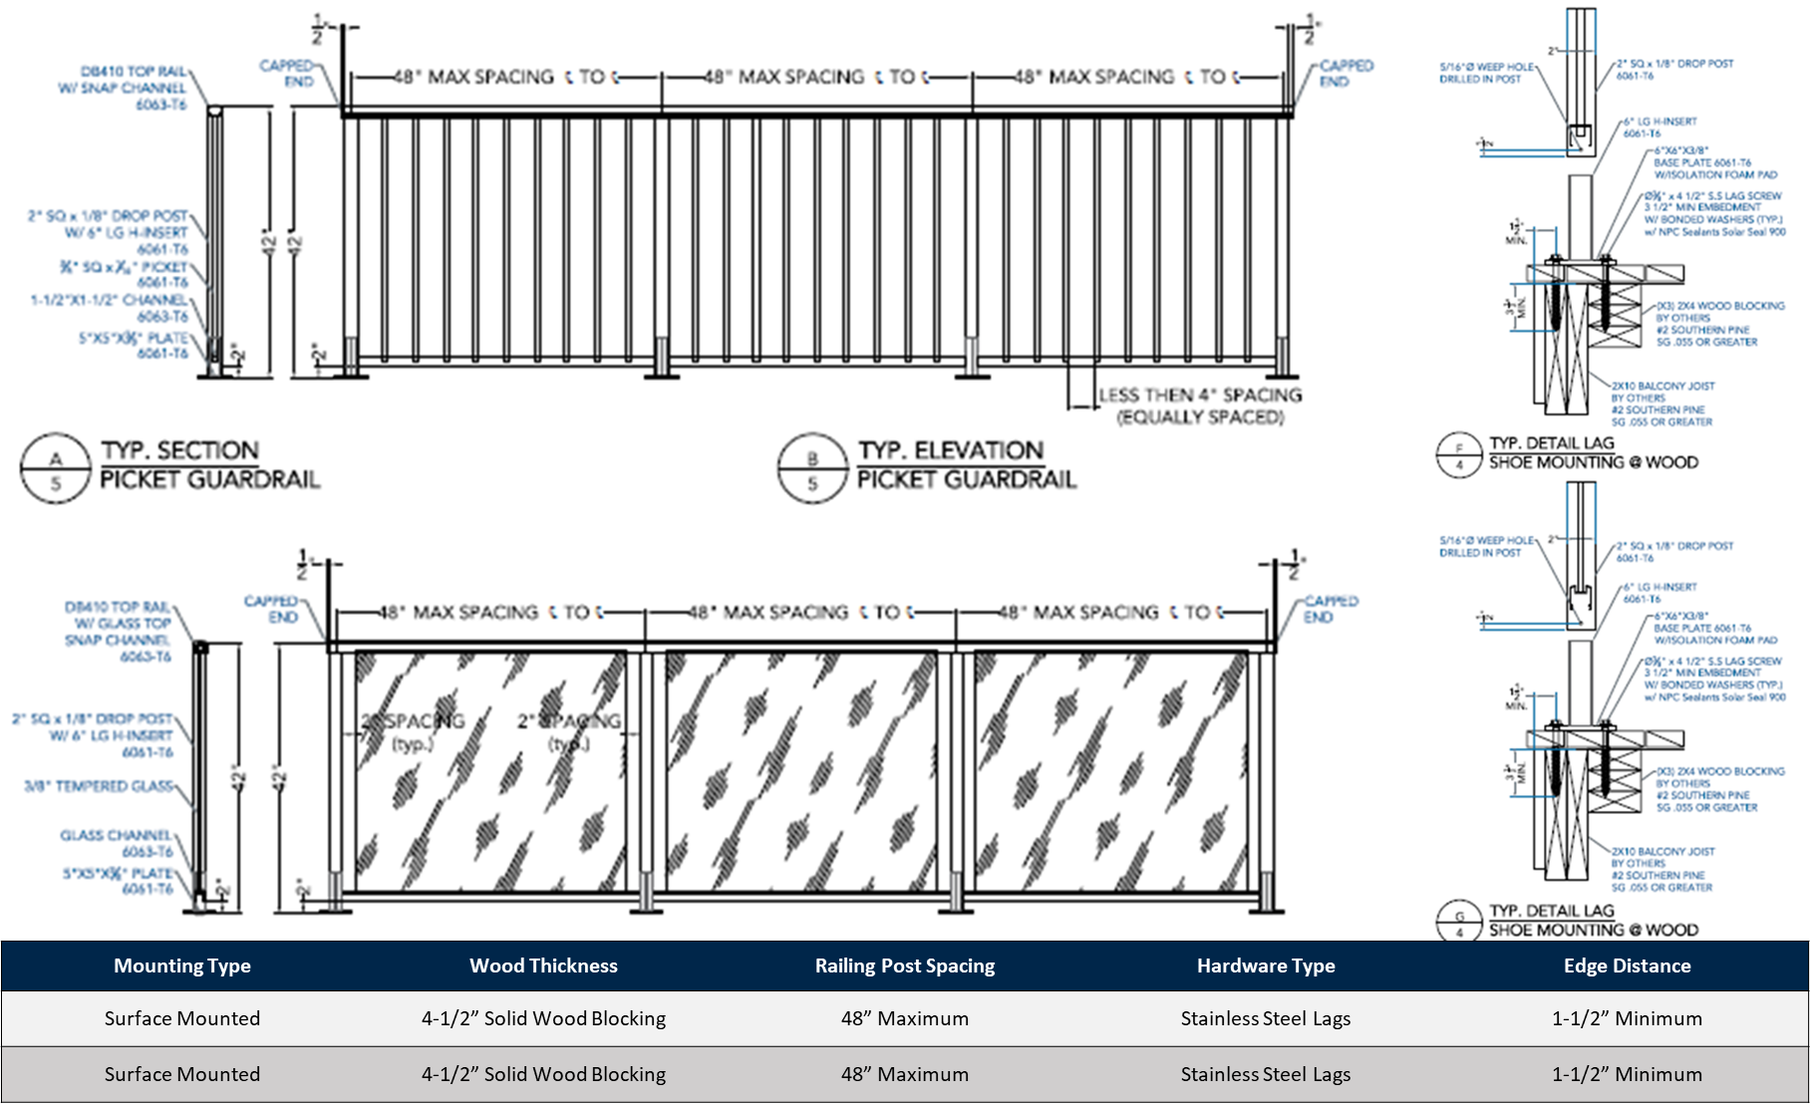
Embedded Mounting Details: Shoe (For Wood)

Slide 38
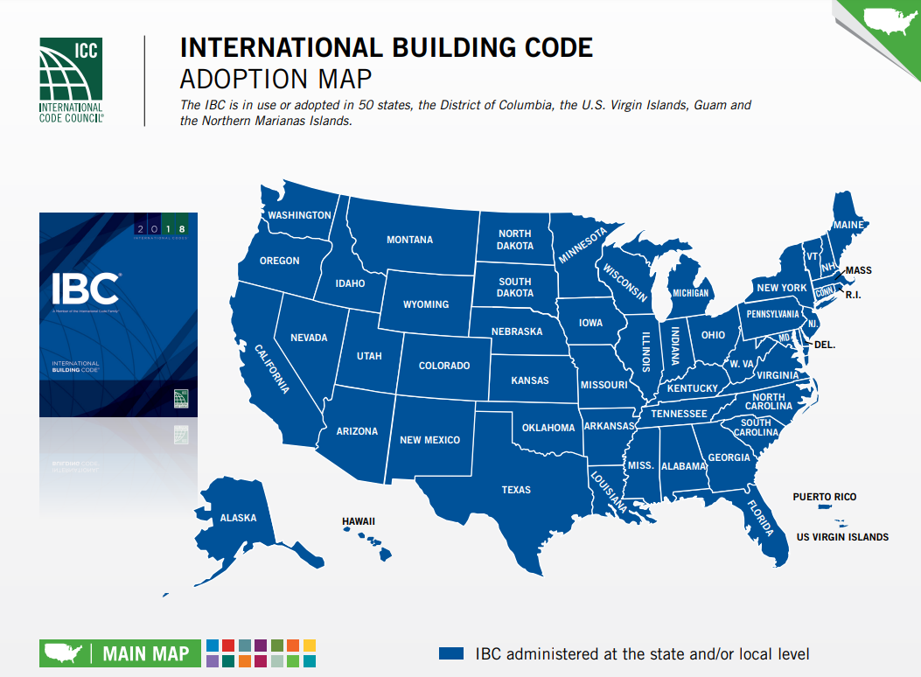
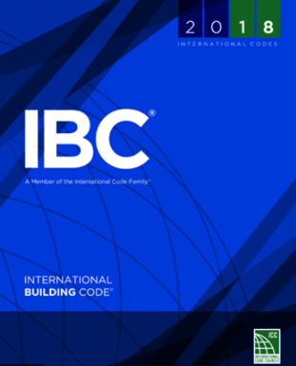
Railing Replacement With Balcony Repair
Code Compliance
One of the primary reasons for railing replacement during a concrete balcony repair is to address code compliance. Many older structures have balcony railings that do not meet current IBC requirements and must be ‘brought up to code.’
The IBC (International Building Code) contains specific references for guard- and hand-railing compliance, located within Sections 1014, 1015, and 1607.

Slide 39
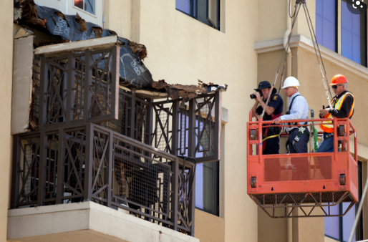
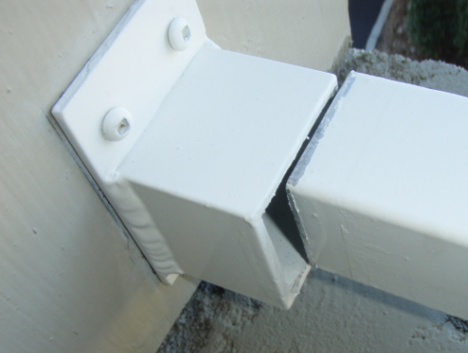
Railing Replacement with Balcony Repair: Renovation
A qualified structural engineer must conduct balcony and railing inspection to prepare a thorough survey, develop project specification(s), and distribute a complete Scope of Work.
Special attention must be paid to the slab thickness of the existing structure; if insufficient for surface mounting, a ‘thru-bolted’ or ‘sandwiched’ installation may be required to meet current engineering requirements for signed and sealed calculations.
DANGER!

Slide 40
Railing Replacement with Balcony Repair: Renovation
Special Circumstances
There are additional factors to consider when solid-panel design (such as glass) infill are to be utilized, such as:
Balcony/Railing height above ground floor
Structure location
Surrounding topography
Ultimate wind speed, risk category, etc.
Fascia mounted installation details are project specific and are to be developed with structural engineer consultation

Slide 41
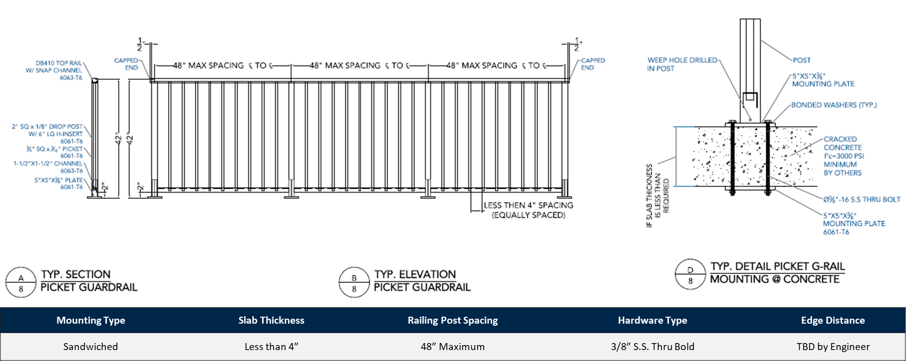
Railing Replacement with Balcony Repair: Thru-Bolted

Slide 42
Railing Replacement with Balcony Repair
Railing installation with a cored post is inherently problematic, allowing water infiltration and degradation of the installation. This former ‘industry practice’ for railing installation has been largely abandoned as more durable and effective, less costly, and structurally sound methods have been widely adopted, including:
Surface mounted, thru-bolted, or fascia mounted installation are the recommended attachment method for balcony railing installation
While expansion anchors meet criteria for load and shear requirements, although more costly, a chemical anchor will provide greater longevity and is less susceptible to moisture infiltration
Fascia mounted installation will require >6” slab thickness, and may also need installation with specialty hardware such as a Halfen anchor
Each renovation opportunity has unique conditions. Final mounting selection will be dependent upon factors such as slab thickness, balcony composition, and desired aesthetic

Slide 43
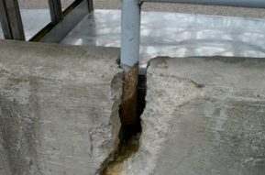
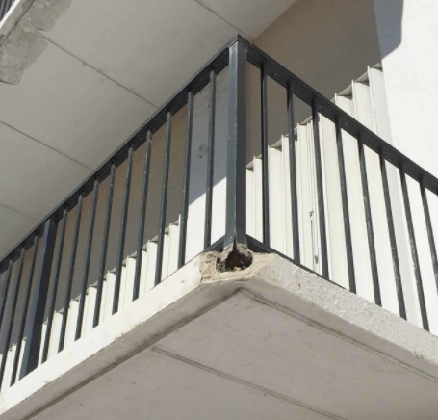
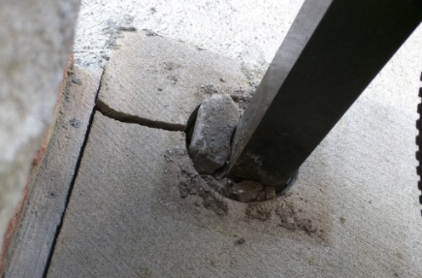
Railing Replacement with Balcony Repair: Renovation
Loose balcony railings are almost always a result of water infiltration:
When the core, where railing posts penetrate the concrete, have not been properly maintained, water seeps in, creating damage which is not always visible to the untrained eye.
In climates exposed to annual freeze/thaw, this infiltration allows more water to enter, causing even more cracks … a cycle which creates extensive and costly damage.

Slide 44
Railing Replacement with Balcony Repair: Concrete Mounting
While aluminum is a superior selection to other materials for balcony railing fabrications, proper protocols must be followed when mounting an aluminum railing system to a concrete balcony.
Because of the damaging effects of corrosion to concrete structures or to embedded metallic elements, it’s important to know what conditions lead to corrosion and which protective measures should be taken
Aluminum reacts with the alkalis found in Portland cement concrete which, when combined, creates a reaction producing hydrogen gas
Aluminum suffers attack when embedded in concrete, which may lead to serious damage to the embedment core
While a powder coated finish will provide protection from direct contact between concrete and aluminum, an insulative barrier such as urethane foam, bituminous coating, paper, or felt must be placed between the two surfaces to assure adequate separation of the two materials.

Slide 45
Surface Mounting Details: Concrete

Slide 46
AAMA-Defined Finish Specification
American Architectural Manufacturers Association (AAMA) has raised the peak performance requirement bar for the long-term durability of organic coatings on aluminum extrusions used for high-quality aluminum railing fabrications. A new series of performance standards sets forth increasingly stringent requirements for, “Good”, “Better”, and “Best” grades of factory-applied organic coatings.
This section will focus only on AAMA 2604 (Better) and AAMA 2605 (Best) specification. These specifications will serve architects, building owners, and contractors to select and specify the appropriate level of performance of factory spray-applied organic coatings for different job requirements.

Slide 47
AAMA-Defined Finish Specification
The American Architectural Manufacturers Association furnishes the two main architectural aluminum finish specifications – AAMA 2604 and AAMA 2605. The key difference between these specifications is the treatment of the surface before finish is applied. AAMA 2604 requires a 3-stage pre-treatment whereas AAMA 2605 requires a 5-stage pre-treatment.
The potential adherence of the finish is only as good as the pre-treatment. A sophisticated and responsible fabricator will use a 5-stage pre-treatment regardless of finish specification. AAMA 2605 is typically specified when a project is located in a harsh environment such as near a body of salt water, whereas projects inland typically require only an AAMA 2604 finish.

Slide 48
AAMA-Defined Finish Specification
AAMA 2604 finishes are applicable to coatings of at least 30-micron (1.2 mils) thickness, intended primarily for commercial and architectural-grade applications.
AAMA 2604 recognizes high-performance coatings that could involve non-chrome pre-treatments, a necessity in some markets where chrome pre-treatments are not allowed due to environmental concerns over the use of heavy metals.
1.2 mills is the minimal allowable for a 2605 specification finish. The finish is applied with either a chrome or non-chrome finish. Chrome used to be all that was used, but due to environmental considerations and the potential health concerns of the discharge associated with a chrome pre- treatment, modern processes are now non-chrome.

Slide 49
AAMA Specification Comparison
This chart shows the key differences between AAMA 2604 and AAMA 2605, and the criteria by which they’re judged, illustrating what the end-user should expect based upon the finish specification.

Slide 50
5-Stage Pre-Treatment and Powder Coating
Prior to the 5-stage pre-treatment, all surfaces are roughed and welds are dressed to prepare for finish.

Slide 51
5-Stage Pre-Treatment and Powder Coating
It’s important that a pre-treatment system be monitored regularly by the finishing contractor to ensure that their protocol is being followed, as pertaining to the application of the finish, in addition to the pre-treatment, as warranty issues may come into play if the protocol is not being followed.

Slide 52
5-Stage Pre-Treatment and Powder Coating
Pre-treatment and powder-coated system needs to be monitored regularly to make sure that the chemicals and rinse water are sufficient and appropriate for the pre-treatment process.
This rinse will remove any dust, impurities and oils being powder coated and make sure that there’s a completely pure surface to apply the powder coating.

Slide 53
5-Stage Pre-Treatment and Powder Coating
Here you can see a closer view of the chemical wash being applied during stage 1 of the pre-treatment process.
Material is properly pretreated after all 5 stages have been completed and is then ready to accept the powder coat finish.

Slide 54
5-Stage Pre-Treatment and Powder Coating
After all five stages of washing and rinsing have been completed, the railing exits the dry-off stage, after which it travels along the automated track to the powder coating booth.

Slide 55
5-Stage Pre-Treatment and Powder Coating
The powder coating process is performed with an electrostatic application. As opposed to wet paint, the finish is applied as a fine powder mist. For the powder to adhere, the railing is grounded prior to application of the powder.
Whether an automated or manual process, powder is applied with electrostatic equipment that ensures the material is consistently and fully covered before entering the curing phase.

Slide 56
5-Stage Pre-Treatment and Powder Coating
By spraying in the general direction of the metal piece, the metal is fully covered with the powder.

Slide 57
5-Stage Pre-Treatment and Powder Coating
The powder then adheres.

Slide 58
5-Stage Pre-Treatment and Powder Coating
After the powder is applied, it goes into a curing oven. The timing varies based on the speed of the conveyer belt. The faster the speed, the higher the temperature for curing.
When the cure is completed, the railing comes out ready to install.

Slide 59
Care and Maintenance
Care and maintenance of powder coated railings is an important aspect that should be followed to maintain the beauty and durability of the product. AAMA Publication Number 609.1 ‘Voluntary Guide Specification for Cleaning and Maintenance of Architectural Aluminum’ outlines a cleaning schedule:
Cleaning of externally located powder coating surfaces must take place at a minimum every six months. Where salts and/or pollutants are more prevalent, such as is found within one mile of a body of salt water, cleaning must take place at a minimum every three months.
A proper cleaning record must be kept and well-documented.
For gloss, color retention, and chalking, it is important to follow the recommended guidelines recommended for each finish. In harsh locations where salts and pollutants are more prevalent, such as seaside and industrial areas, a cleaning program should be carried out more frequently.

Slide 60
Conclusion
As building codes continue to evolve, as reflected in the latest railing requirements mandating changes to the spacing and thicknesses of the posts required to support the railing system and allowable tolerances, it behooves architects to partner with experienced railing fabricators.
With an eye on quality, architects are advised to seek out the most effective manufacturing technology to support the various top rail designs, shapes, and sizes for the assorted posts and infill options incorporated in their designs.

Slide 61
Conclusion
As established in this presentation, the punched and welded system is superior to other methods and is best suited to help building teams meet multifamily housing IBC requirements.
With its precise computerized punch, the weld is discreetly contained underneath the horizontal components while creating an exceptionally strong weld, via the weld itself, and the fact that the railing has been punched through to another piece of aluminum.

Slide 62
Conclusion
From traditional picket railing to custom infills, architectural aluminum railing systems combine safety, code compliance, and an attractive aesthetic for a variety of applications.

Slide 63
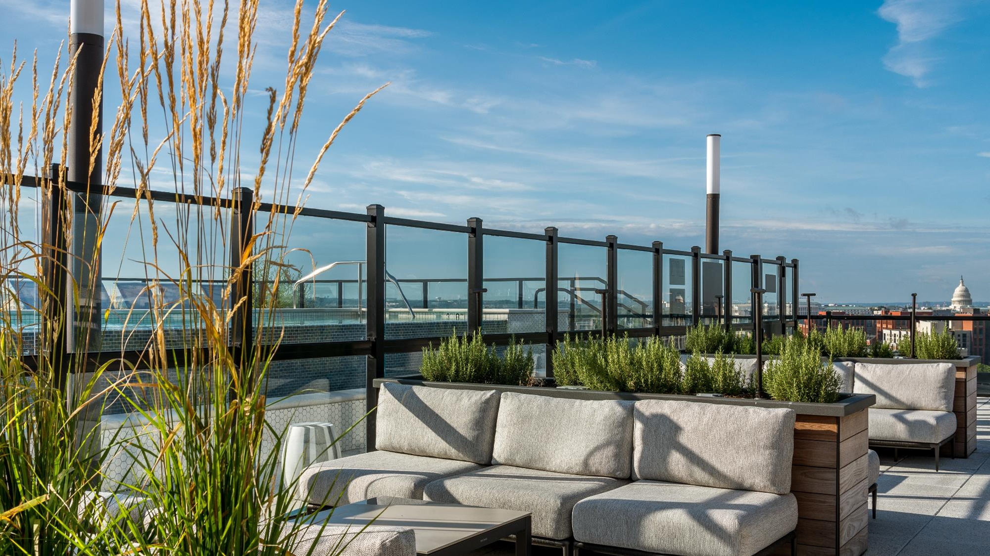
Thank you for your interest in this learning unit on
Architectural Aluminum Railing For New Construction or Renovation sponsored by Fairway Architectural Railing Solutions. For more information, please contact Fairway or visit www.FairwayArchitectural.com
FairwayArchitectural.com

Slide 64
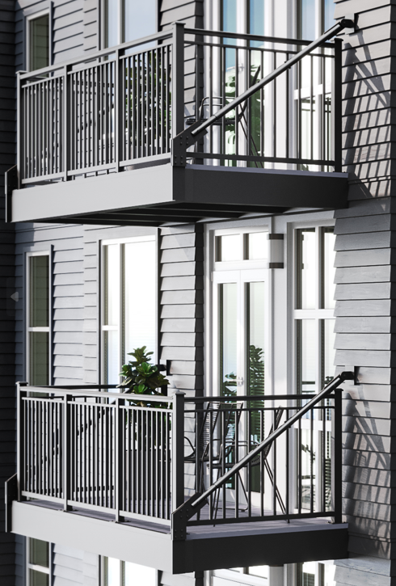
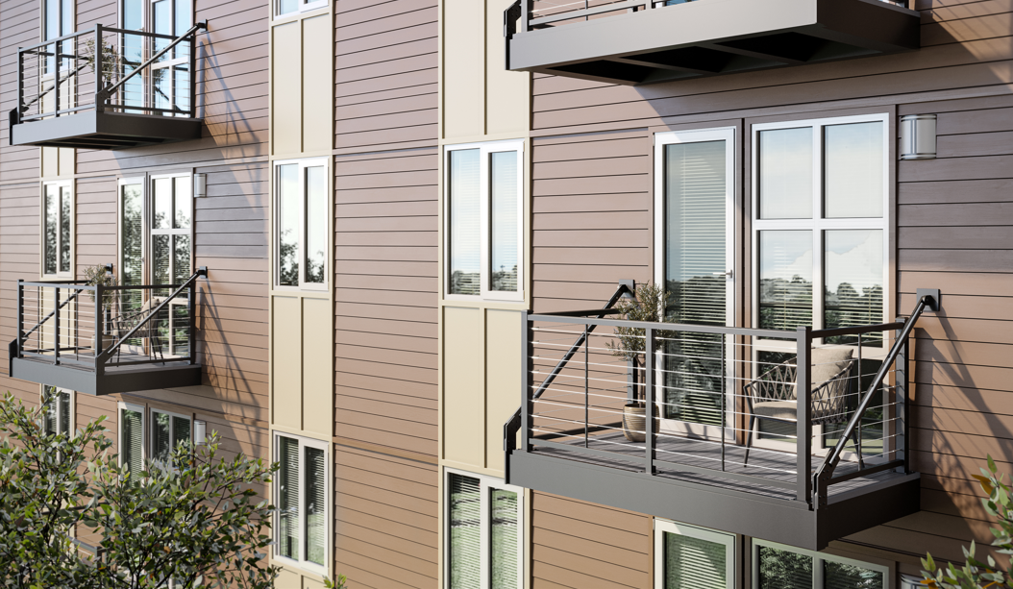
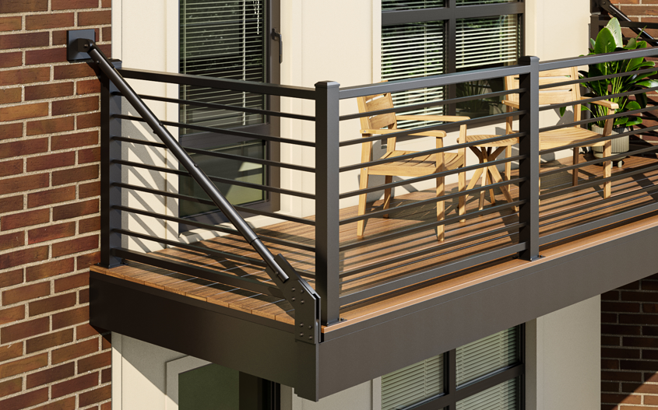
Aluminum Prefabricated Balcony with RV-100 Dual Decking System Launch

Slide 65
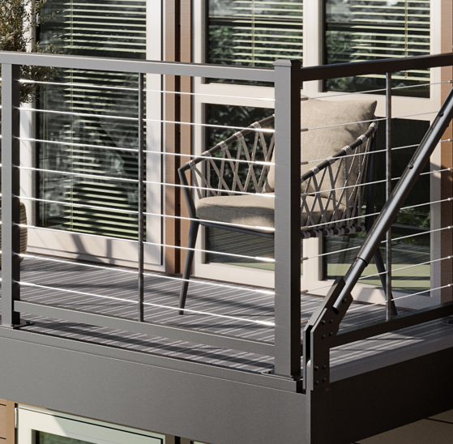
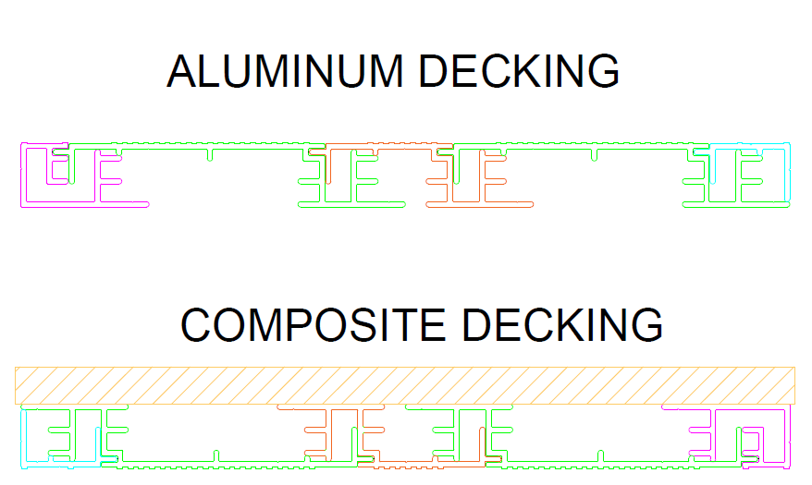
Product Details
Our patent pending aluminum pre-fabricated balcony is a complete turnkey solution custom designed to fit your specific project, including the balcony frame, railing, and dry deck system featuring aluminum or composite decking.
All top rail options, colors, and infills* available as part of solution.
Same finishing quality as traditional railing
RV-100 Dual Decking System
Two decking options within same system
Aluminum – powder coated
Traditional decking – composite, wood, etc
Designed as a dry deck system to keep water from running through
*Glass infill not currently an option with prefabricated balcony
Composite
Aluminum

Slide 66
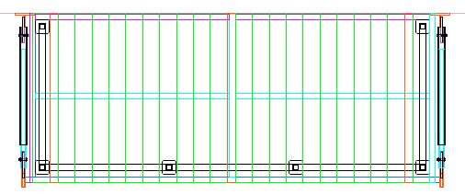
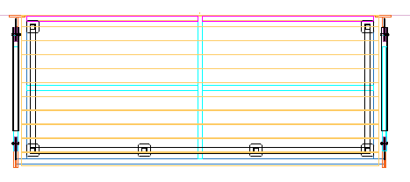
Product Details
Deck board orientation
When installed as aluminum decking, boards run perpendicular to building
When installed as traditional decking, boards run parallel with building
Composite
Aluminum
Composite

Slide 67
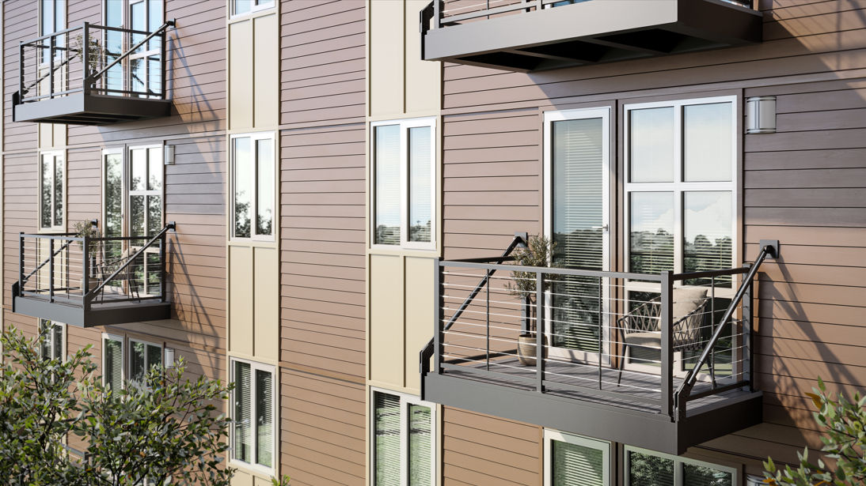
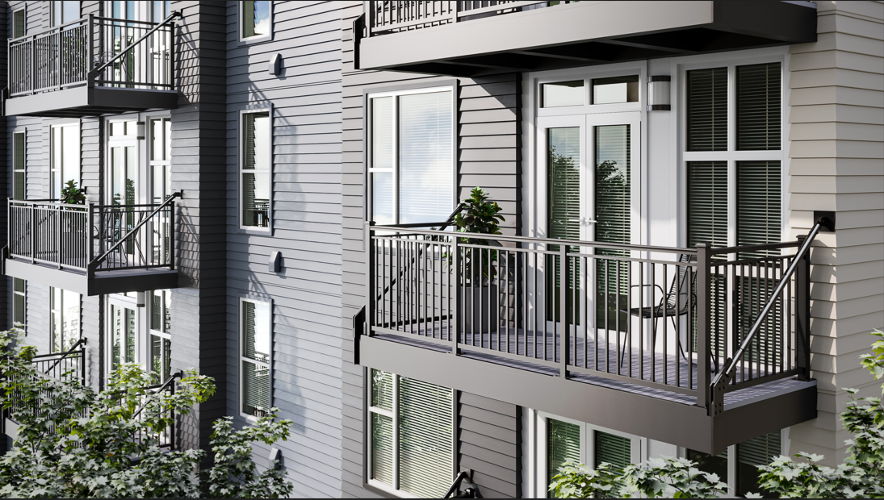
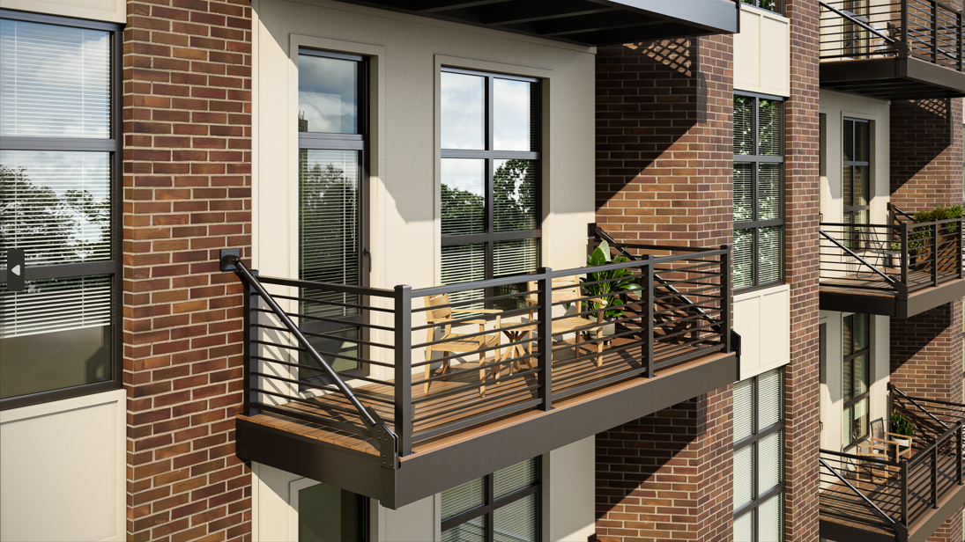
Image Details
Composite
Huntington top rail
Grey aluminum decking
Laguna top rail
Grey aluminum decking
Monterey top rail
Spiced Teak composite decking

