Slide 1
REDUCING CARBON EMISSIONS USING ALUMINUM
Notes:
Project: Vicinity Apartments
Installer: Nordstrom Architectural Sheet Metal
Location: Minneapolis, MN
Product: 6" V-Groove in Light Cherry

Slide 2
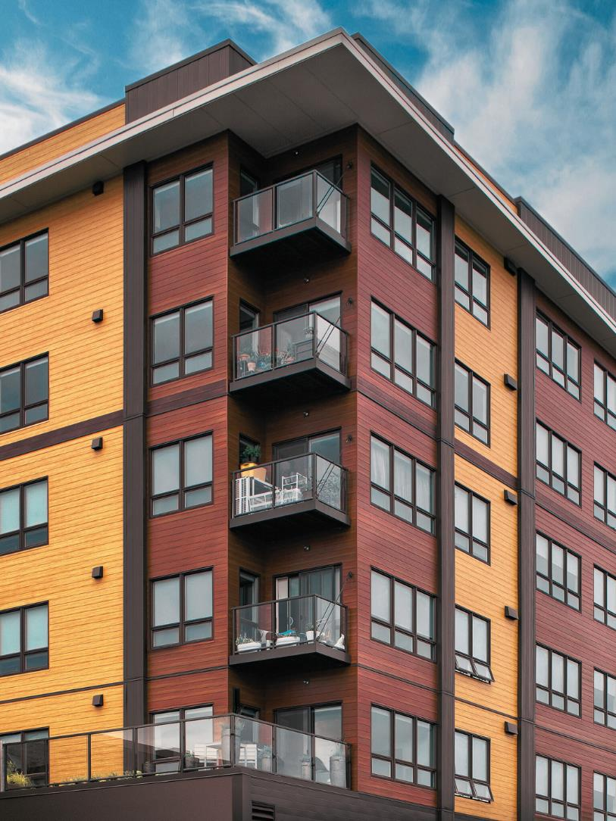
COPYRIGHT MATERIALS
This presentation is protected by US and International copyright laws.
Reproduction, distribution, display, and use of the presentation without permission of the speaker is prohibited.
Notes:
Project: The Commons
Installer: Henbart LLC
Location: Seattle
Product: 6" V-Groove in Dark Cherry, Dark National Walnut, and Light Fir

Slide 3
Longboard Architectural Products is a registered provider with The American Institute of Architects Continuing Education Systems. Credit earned on completion of this program will be reported to CES records for AIA members. Certificates of completion for non-AIA members are available on request.
This program is registered with the AIA/CES for continuing professional education. As such, it does not include content that may be deemed or construed to be an approval or endorsement by the AIA of any material of construction or any method or manner of handling, using, distributing, or dealing in any material or product.
AIA/CES PROGRAM
REGISTRATION
Notes:
Project: 564 Beatty
Architect: IBI Group Architects
Location: Vancouver, BC
Product: 6” V Groove

Slide 4
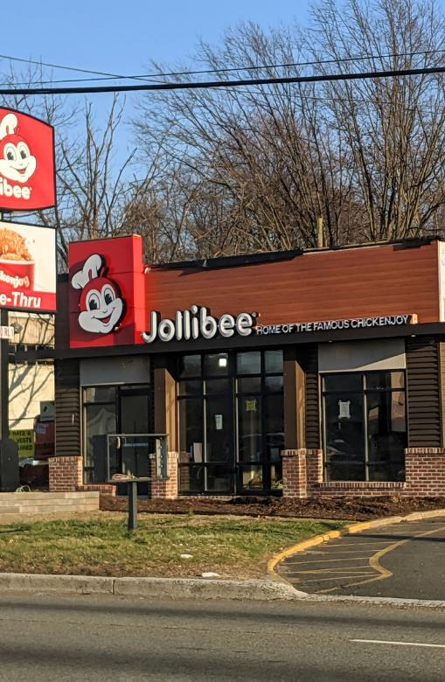
PRESENTED BY:
120-1777 Clearbrook Rd
Abbotsford, BC
V2T 5X5
This presentation provides an overview of the sustainability of aluminum extrusions and examines why it is selected for architectural cladding in new and existing buildings.
The American Institute of Architects - Course No. 3 - This program qualifies for 1.0 LU|HSW.
Notes:
Project: Jolibee Calgary
Location: Calgary, AB
Product: 5" V-Groove
Finish: Light Cherry
Installer: South Pacific Builds

Slide 5
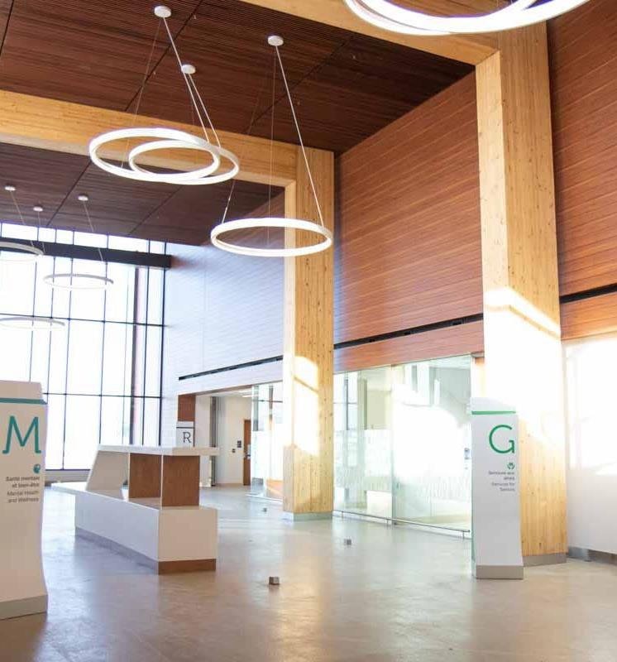
GREEN BUSINESS CERTIFICATION INC™
This course is approved by GBCI for continuing education. Approval for this course indicates it will be monitored by GBCI to ensure that it upholds the quality, relevance, and rigor necessary to contribute to ongoing learning in knowledge areas relevant to the green building industry.
Course title:
Course ID:
Reducing Carbon Emissions
Using Aluminum
0920028568
Approved for:
Approval date:
1 CE Hour
August 1st, 2023
Notes:
Project: Orleans Health Hub
Installer: BBS Construction
Location: ON, Canada
Product: 6” V Groove, Light Cherry & 1x5 Beam

Slide 6
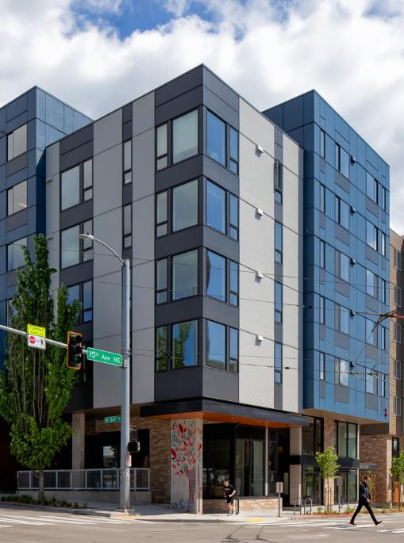
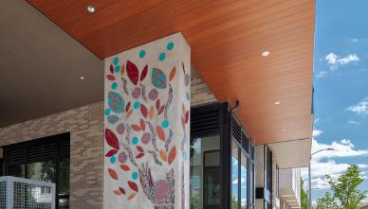
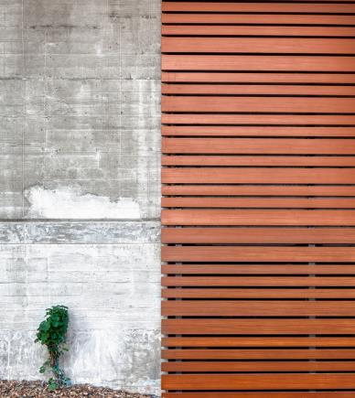
AGENDA
1. Introduction to Carbon Footprint
2. Aluminum Life Cycle
3. Aluminum Cladding Comparison
4. Understanding Passive House
5. Circular Economy Introduction
6. AIA 2030 Commitment
7. Case Studies
8. Summary
Notes:
In this CEU Course, we will:
- Introduce you to carbon footprint concept; and how materials choice can impact it
- Introduce the PASSIVE HOUSE concepts;
- Introduce Circular Economy concepts
- Understand how materials selection can help you achieve the 2030 AIA Commitment
- We will also share some case studies from various residential and commercial projects;
- And finally, we’ll conclude with a summary of key learnings.
Project: Abora Court
Installer: AVA Siding LLC
Location: Seattle
Product: 6" V-Groove, 4" and 6" Link & Lock Battens in Light Cherry

Slide 7
LEARNING OBJECTIVES
Notes:
Following this seminar, you’ll have learned:
- How to select materials in order to reduce the construction carbon footprint.
- Understand the benefits of aluminum siding when compared to wood, Fiber Cement, and Vinyl.
- Consider the significance of thermal break components to achieve Net Zero and Passive House Certification.
- Understand the basics of the circular economy.
- Summarize the various case study applications.
Project: Hilton Garden Inn
Location: Brookfield, Wisconsin
Product: 6” V Groove in Dark Fir

Slide 8
INTRODUCTION TO CARBON FOOTPRINT
Carbon Footprint
The total amount of greenhouse gasses that are generated by our actions.
Notes:
A carbon footprint is the total amount of greenhouse gases that are generated by our actions. Many of our daily activities cause emissions of GHG, for example burning gasoline when we drive, burning oil or gas when cooking, or using electricity generated from coal, natural gas, and oil.
Project: Whole Foods
Location: Birmingham, Michigan
Product: 6” V Groove

Slide 9
EMBODIED AND OPERATIONAL
CARBON EMISSIONS
24%
33%
31%
67%
76%
69%
Office
Warehouse
Residential
75%
of a buildings' total emissions from a typical 60-year lifetime can come from embodied carbon.
Embodied Carbon
Operational Carbon
Notes:
The term embodied carbon refers to all greenhouse gas (GHG) emissions associated with the extraction and manufacture of a product or delivery of a service. They differ from operational carbon emissions, which are associated with the energy used in heating, cooling, lighting, and powering a building or related equipment (e.g. lift).
In buildings, embodied carbon includes emissions associated with the extraction and supply of raw material, their transportation to the manufacturing plant and their manufacturing and fabrication into building materials and products. Following this product stage, construction causes further emissions through the transport of these materials and assembly on site, and the construction and installation process on the project site itself. Lastly embodied carbon emissions are generated through repair, refurbishment, and maintenance throughout a building’s lifespan, and finally the disposal of these materials and products or demolition at the end of a building’s life.

Slide 10
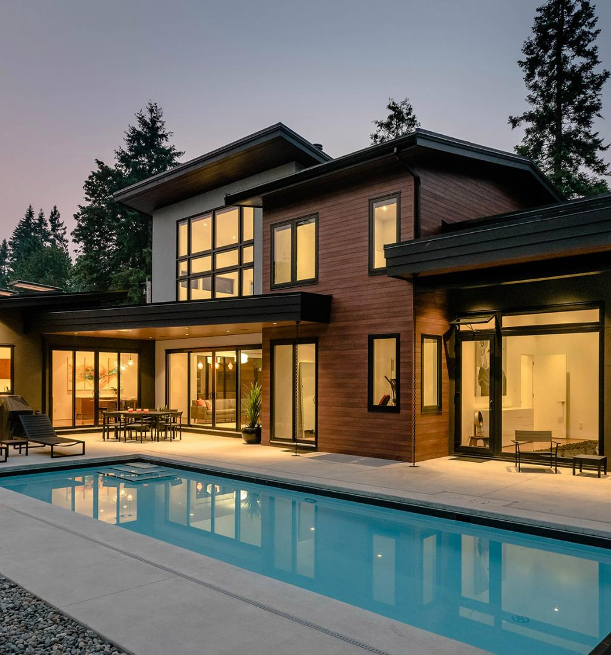
WHAT IS YOUR CARBON FOOTPRINT?
The average per capita carbon emissions in Canada is 18.5 tonnes CO2e per year.
This is higher than the USA, which is sitting at 15.5 tonnes of CO2e per year. This is due to the colder climate and the additional space heating required for our houses.
The global average is around 4.0 tonnes CO2e per person per year.
Notes:
The average carbon footprint for a person in Canada is 18.5 tonnes and 15.5 in the United States, one of the highest rates in the world.
This is due to the colder climate and the additional space heating required for our houses.
The global average is around 4.0 tonnes CO2e per person per year.

Slide 11
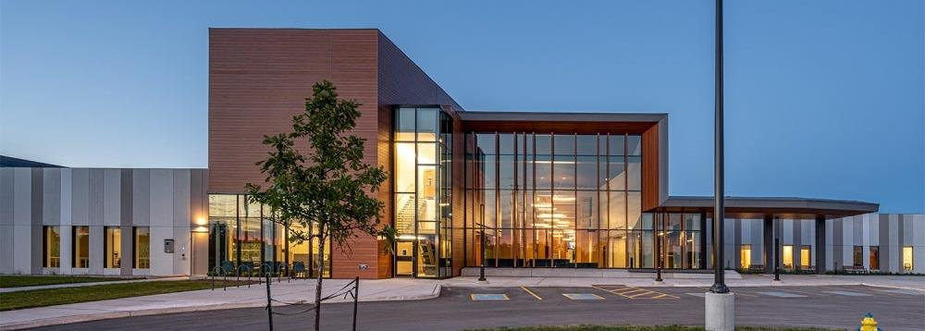
C02 emissions from buildings and construction hit a new high, leaving the sector off track to decarbonize by 2050.
Notes:
According to a press release published by UN in November 2022, CO2 emissions from buildings and construction hit new high, leaving sector off track to decarbonize by 2050.
Despite an increase in energy efficiency investment and lower energy intensity, the building and construction sector’s energy consumption and CO2 emissions have rebounded from the COVID-19 pandemic to an all-time high. The sector accounted for over 34% of energy demand and around 37 per cent of energy and process-related CO2 emissions in 2021.
The sector’s operational energy-related CO2 emissions reached ten gigatonnes of CO2 equivalent – five per cent over 2020 levels and two per cent over the pre-pandemic peak in 2019. In 2021, operational energy demand for heating, cooling, lighting and equipment in buildings increased by around four per cent from 2020 and three per cent from 2019.
This, according to the report from the Global Alliance for Buildings and Construction (GlobalABC), means that the gap between the climate performance of the sector and the 2050 decarbonization pathway is widening.
Project: Orleans Health Hub
Installer: BBS Construction
Location: ON, Canada
Product: 6” V Groove, Light Cherry & 1x5 Beam

Slide 12
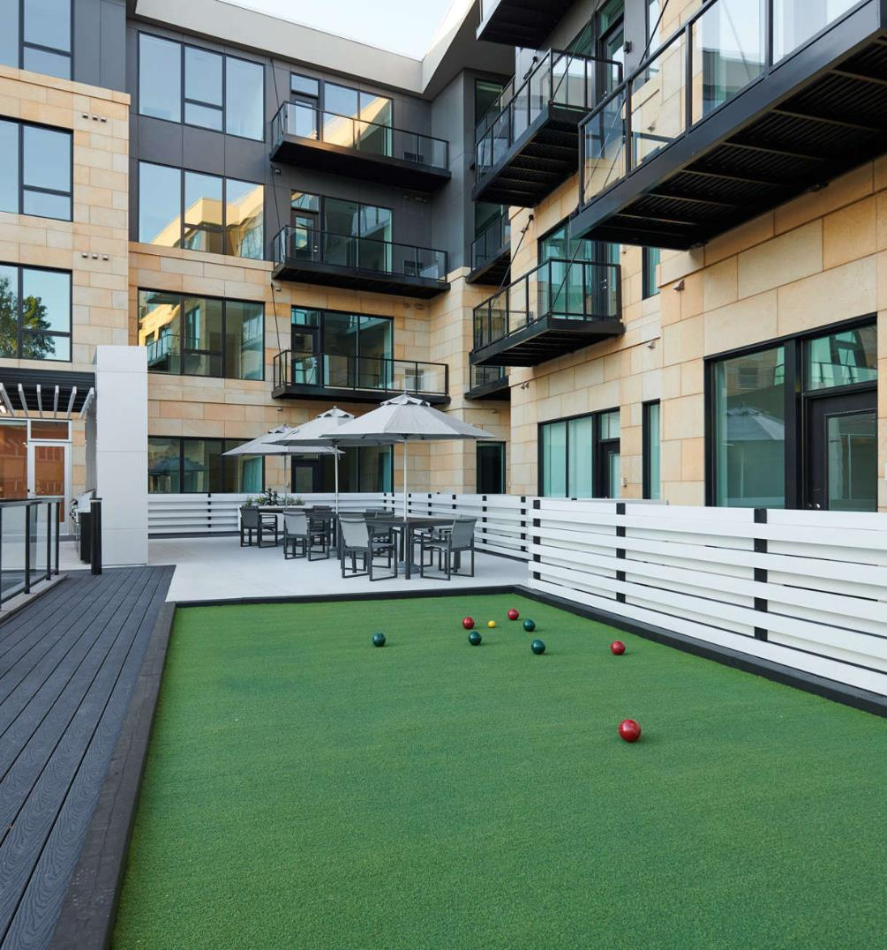
DECARBONIZING
THE BUILDINGS SECTOR BY 2050 IS CRITICAL
To reduce overall emissions the sector must:
Improve building energy performance
Decrease building materials' carbon footprint
Multiply policy commitments alongside action
Increase investment in energy efficiency
Notes:
Decarbonizing the buildings sector by 2050 is critical to delivering these cuts. To reduce overall emissions, the sector must improve building energy performance, decrease building materials’ carbon footprint, multiply policy commitments alongside action and increase investment in energy efficiency.
Project: Luxe Apartments
Location: Minnetonka, MN
Product: 1x5 Beam, White Oak

Slide 13
ALUMINUM LIFE CYCLE
Notes:
We’ll now talk about Aluminum life cycle.
Project: Crystal MOB Clinic
Location: Crystal, Minnesota
Product: 5" Privacy beams in Light National Walnut
Installer: Specialty Systems Inc

Slide 14
C02 CRADLE-TO-GATE
(USING 0% RECYCLED ALUMINUM)
Notes:
When using extruded aluminum products with no recycled content, you are adding to your building all the CO2 emissions from the full cycle.
From extracting the Bauxite Ore mining, to adding it to aluminum, smelting it , alloying, extrusion and decoration.
After ore is mined, the Bayer process which refines bauxite into alumina accounts for 28% of the entire embodied carbon of aluminum products.
Next, the electrolysis smelting Hall–Héroult process produces 99.5–99.8% pure. This energy intensive process is the largest contributor to the carbon emissions of the aluminum production cycle. Recycled aluminum requires no electrolysis, thus it does not end up in this process.

Slide 15
C02 CRADLE-TO-GATE
(USING 50% RECYCLED ALUMINUM)
Notes:
When using aluminum with recycled content you begin the process at the casthouse, alloying the aluminum, extruding it, powder coating and decorating it. It results in less greenhouse gas emissions and generates less than 50% of the industry average embodied carbon.
These products meet the same strict quality benchmarks as a premium architectural extruded aluminum product, and are offered with the same robust warranties, and possess verified life cycle impact analysis (LCIA) and environmental product declarations (EPD). This provide architects, designers, and builders with a sustainable option for reducing embodied carbon, support LEED certification, and make achieving net-zero emissions attainable.
Less mining, less refining, and less smelting means a savings of approximately 45% of total embodied carbon in our Longboard ECO™ aluminum products. Our products have more recycled aluminum than the industry average, meaning we are reducing embodied carbon on a tangible level to make change.

Slide 16
SUSTAINABILITY THROUGH EFFICIENCY
CO2
CO2
CO2
CO2
CO2
PRODUCT
CONSTRUCTION
USE
END-OF-LIFE
Raw material
supply
Manufacturing
Construction-Installation
Operations
Maintenance and repair
Deconstruction/demolition
Waste processing, disposal
Product Design & Manufacturing
Building Design
& Construction
Building Operations
Cradle-To-Cradle Circular Economy
Responsible Raw Material Sourcing & Supply Chain
Design for Manufacturing & Assembly (DFMA)
Product Durability & Quality
Integrated Project Delivery (IPD)
Building Information Modeling (BIM)
Prefab & Modular
Offsite Construction
Water & Energy Efficiency
Responsible Waste Management
Maintenance & Repairs
Re-Use or Recycle Materials
Remodel or Renovation Ready
Notes:
Here are some ways manufacturers can contribute to reducing material waste and improving resource efficiencies throughout the building life cycle.
PRODUCT:
manufacturing
Choose a product with recycled content
Product with specific EPD & LCA;
Finishes with AAMA 2605 Performance Level Durability
Innovative Product Design
services
Materials estimate & Shop drawings. Having the manufacturer providing it, can help reduce waste. Reducing carbon, reduces cost!
Design Assist
Pre construction training & support
CONSTRUCTION:
IPD helps with materials optimization reducing waste. As much as 30% of all building materials delivered to a typical construction site can end up as waste.
The Environmental Protection Agency (EPA) reported that the Construction & Demolition Waste (CDW) is double that of municipal waste from households and businesses.
USE:
Passive house buildings consume 90% less energy compared to conventional buildings.
Operational carbon saving.
END-OF-LIFE:
Environmental Protection Agency (EPA) reported that demolition represents 90% of the Construction & Demolition Waste (CDW) while construction represents only 10% of total CDW
Aluminum is Infinitely Recyclable

Slide 17
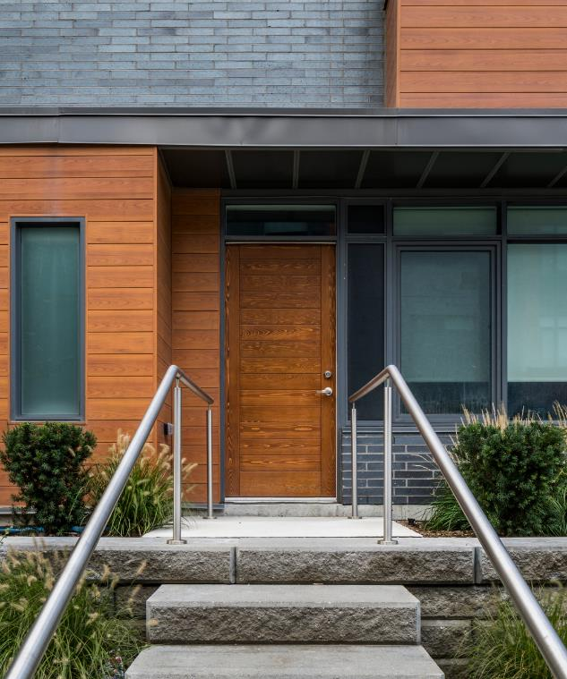
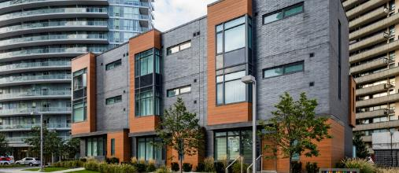
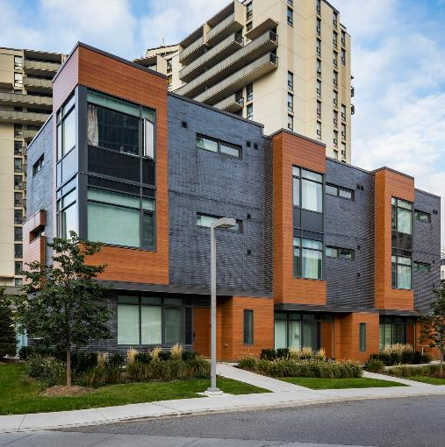
EPD SYSTEM
Type III Environmental Declaration (ISO 14025)
An EPD is a declaration.
EPDs consider the full LifeCycle Assessment of goods and services
Compared to alternative reporting formats such as eco-labels and self-declared labels that only cover aspects of a lifecycle perspective, EPDs cover the full LCA of goods and services.
EPDs can be used for all types of goods and services
There are no restrictions regarding what products that can have EPDs as there are no criteria on environmental performance that must be met. EPDs works for both goods and services and companies all sizes have registered EPDs.
Notes:
Type III EPD is a declaration that considers the full Life Cycle Assessment (LCA) of goods and services.
Project: The Towns at Emerald City
Location: Toronto, Ontario
Product: 6" Channel
Finish: Light Cherry
Architect: WZMH Architects
Installer: Frost Inc

Slide 18
COMPARING ALUMINUM CLADDING TO OTHER FINISHING MATERIALS
Notes:
We’ll now explore the advantages of using aluminum cladding when compared to real wood, fiber cement, and vinyl.
Project: Starbucks
Product: 6" V-Groove

Slide 19
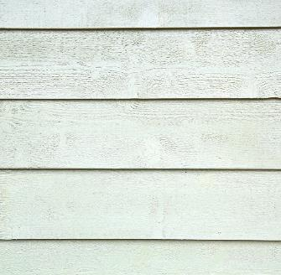
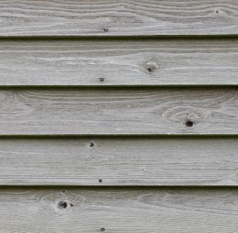
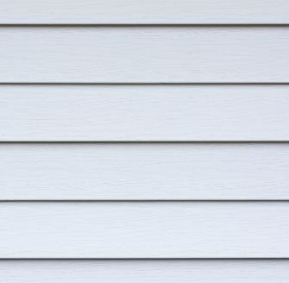
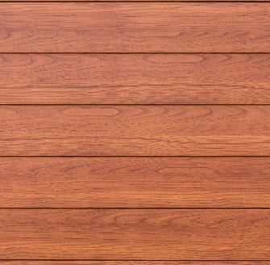
COMPARING MATERIALS
Fiber Cement
Wood
Vinyl
Aluminum
Overtime the layers of fiber cement can separate or delaminate
Susceptible to cracking
Challenging install
Challenging to recycle
Can release chemicals into the environment with each new application of paint/stain
Frequent maintenance
Combustible
Susceptible to insects
Fading, cracking, warping
Susceptible to damage
Limited color options
Requires maintenance
Guaranteed years of worry-free solutions without the need for repair or periodic maintenance
Solvent-free process
No hazardous pollutants released during manufacturing
Non-combustible
Will not crack over time, rot, minimum color variation, and it is impact, abrasion, and chemical resistant
Infinitely recyclable
Notes:
Fiber cement siding is a popular and durable material used in construction for its resistance to fire, moisture, and pests, as well as its low maintenance requirements.
However, like any building material, fiber cement siding has its drawbacks and potential issues.
Overtime the layers of fiber cement can separate or delaminate. It's susceptible to cracking and the install can be challenging.
Wood can release chemicals into the environment with each new application of paint or stain.
Vinyl siding is a popular choice for homeowners because it is relatively inexpensive, durable, and low-maintenance. However, there are several disadvantages to vinyl siding, including: fading, cracking and warping. Specially under extreme temperatures, such as during hot summers or cold winters. This can lead to gaps in the siding that can allow moisture to enter and cause damage to the underlying structure.
Although vinyl siding is relatively durable, it can be damaged by hail, flying debris, and other impacts.
It has limited color variation and requires maintenance over time.
Aluminum does not require maintenance. It has a solvent free process. No hazardous pollutants are released during manufacturing. It will not crack, it has minimum color variation over time. It's impact, abrasion and chemical resistant.
It is durable and strong, approximately 34 times stronger than vinyl and 43 times stronger than wood.

Slide 20
Notes:
Here is a video showing some projects with aluminum siding.

Slide 21
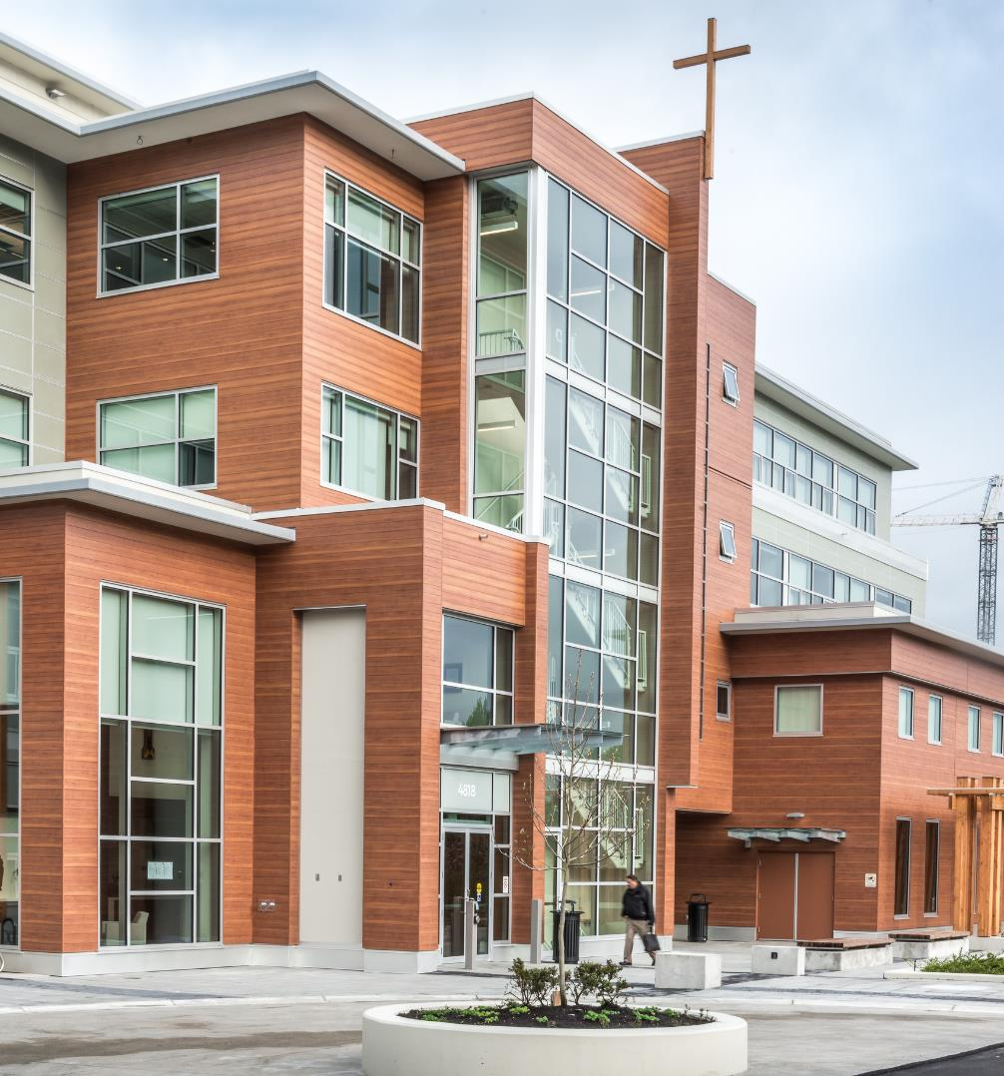
PREMIUM ALUMINUM ARCHITECTURAL PRODUCTS
Guarantees years of worry-free solutions without the need for repair or periodic maintenance
Critical to the ongoing shift towards sustainable construction as it does not emit harmful gases, and it is non-toxic, making it safe for interior and exterior use
100% recyclable
Available in a wide range of solid colors, and woodgrain finishes
Designed to follow the trends contributing to curb appeal
Non-combustible
Notes:
We'll now summarize the main aluminum architectural products atributes:
Guarantees years of worry-free solutions without the need for a repair or periodic maintenance
Critical to the ongoing shift towards sustainable construction as it does not emit harmful gases, and it is non-toxic, making it safe for interior and exterior use
100% recyclable
Available in a wide range of solid colours, and woodgrain finishes
Designed to follow the trends contributing to curb appeal
Non-combustible
Project: John Paul Pastoral
Location: Vancouver, BC
Product: 6” V Groove

Slide 22
RECYCLING CENTERS
Notes:
In the US, there are different types of recycling centers depending on the materials they accept and process.
Project: Texcan
Location: Vancouver, BC
Product: 6” V Groove

Slide 23
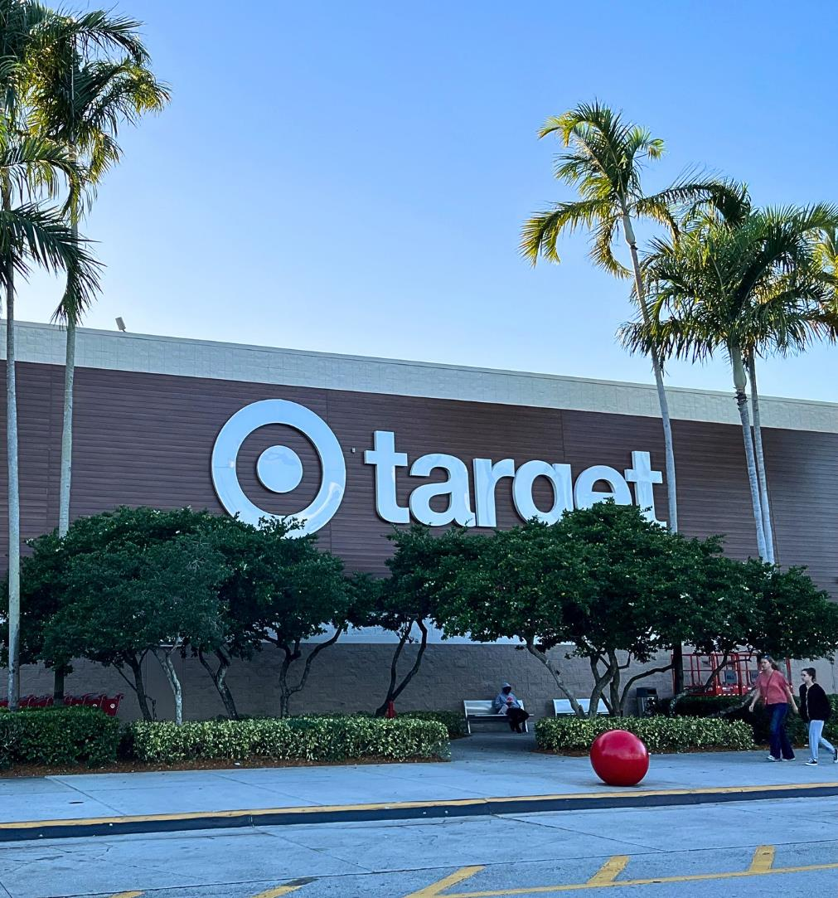
TYPES OF RECYCLING CENTERS
Single-stream
Paper
Plastic
Glass
Metal
Electronics
Hazardous waste
Notes:
Here are some of the most common types:
Single-stream , paper, plastic, glass, metal, electronics and hazardous.
Metal recycling centers: These centers focus on collecting and processing metal products, such as aluminum cans, steel cans, and scrap metal.
Single-stream recycling centers: These centers accept a wide range of recyclables, including paper, plastic, glass, and metal, which are all placed in the same bin.
Paper recycling centers: These centers focus on collecting and processing paper products, including newspapers, magazines, cardboard, and office paper.
Plastic recycling centers: These centers specialize in collecting and processing plastic products, such as bottles, containers, and bags.
Glass recycling centers: These centers are dedicated to collecting and processing glass products, such as bottles and jars.
Electronics recycling centers: These centers specialize in collecting and processing electronic waste, such as old computers, TVs, and cell phones.
Hazardous waste recycling centers: These centers accept and dispose of hazardous waste, such as batteries, paint, and chemicals.
Project: Target (Sawgrass)
Location: Florida
Product: 4" V-Groove

Slide 24
ALUMINUM: A SUSTAINABLE BUILDING MATERIAL
Abundant
Third most abundant element after oxygen and silicon and the most abundant metal on earth. Aluminum makes up about 8% of the earth's crust.
Non-Combustible
Aluminum is a non-magnetic, non-sparking, and non-combustible metal.
Light-Weight
Aluminum is extremely lightweight, weighing only a 1/3 of steel and reduces the need for excessive structural requirements on buildings.
Strong
It is durable and strong, approximately 34x stronger than vinyl and 43x stronger than wood.
Corrosion Resistant
It generates its own protective oxide coating that is corrosion resistant and surface treatment and finishes enhance this property.
Health Safe
Aluminum is non-toxic, impermeable, and doesn't release odors.
Infinitely Recyclable
100% and infinitely recyclable with no loss of its inherent properties at only 8% of the original energy. Aluminum supports the principals of a Circular Economy.
Since 1991, the energy required for producing primary aluminum has been cut by over 25%, and Greenhouse Gas Emissions by nearly 50% as a result of:
Technological progress in which computerized process controls have enabled less electric power consumption during the electrolysis process
Renewable energy
Gradual phase out of old Soderberg smelting technology
Increased use of recycled aluminum
Notes:
Aluminum is a sustainable building material.
- It’s the most abundant element after Oxygen and silicon; and the most abundant metal. Aluminum makes up about 8% of Earth’s crust.
- It’s non combustible
- It’s lightweight. Aluminum is extremely light weight and reduces the need for excessive structural requirements on buildings.
- Strong. It is durable and strong, approximately 34 times stronger than vinyl and 43 times stronger than wood.
- Corrosion resistant. It generates its own protective oxide coating that is corrosion resistant and surface treatment and finishes enhance this property.
- Aluminum is non-toxic, impermeable and doesn’t release odors.
- 100% and Infinitely recyclable with no loss of its inherent properties at only 8% the original energy. Aluminum supports the principles of a Circular Economy.

Slide 25
Notes:
The aluminum industry has made great strides over the past three decades to improve the production and energy efficiencies of the aluminum process. The Aluminum Association recently reported that since 1991, the carbon footprint of primary aluminum production has declined by 49%.

Slide 26
INNOVATIVE TECHNOLOGY FOR
THE FUTURE OF ALUMINUM
ELYSIS is a Canadian company delivering a disruptive technology for the aluminum smelting industry by generating oxygen as a by-product. It is a partnership between Aloca, Rio Tinto, Apple, the Canadian Government, and the Quebec Government.
Commerical launch by 2024.
Ends the use of carbon anode in the aluminum smelting process
Features breakthrough proprietary materials that are stable and do not react during the process
Eliminates direct greenhouse gas (GHG) emissions
The first technology ever that emits oxygen as its by-product
Notes:
Here is what comes next on aluminum manufacturing.
Elysis a Canadian company is a delivering a disruptive technology for the aluminum smelting industry by generating oxygen as a by-product. It is a partnership between Aloca, Rio Tinto, Apple, the Canadian Government, and the Quebec Government.
Commerical launch by 2024.

Slide 27
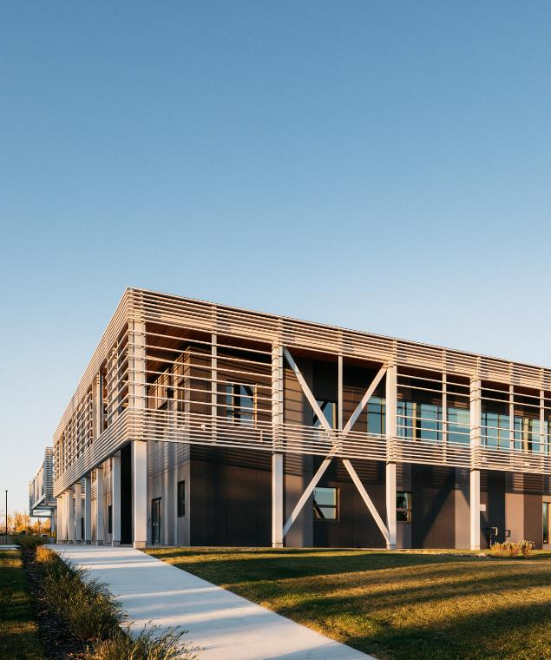
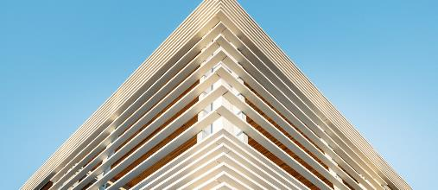
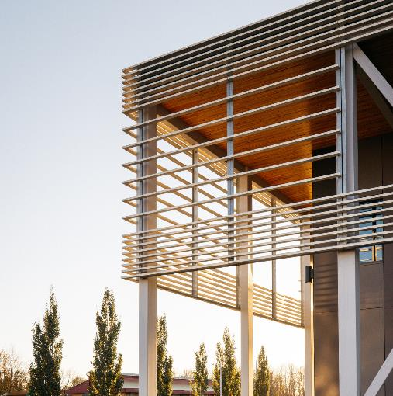
PASSIVE
HOUSE
Notes:
We'll now going to talk about Passive House.
Passive House is a high-performance building standard which is recognized internationally as the optimal way to build healthy, climate-resilient, affordable, and energy-efficient. The Passive House Institute (PHI) is an independent research institute founded 1996 in Germany.
It's a construction method that prioritizes energy efficiency and comfort, resulting in buildings that require very little energy for heating and cooling.
Passive Houses allow for space heating and cooling related energy savings of up to 90% compared with typical building stock and over 75% compared to average new builds. A Passive House requirement is that the Space Heating & Cooling Energy Demand will not exceed 15 kWh per square meter of net living space per year.
Project: Northern Lakes College
Architect: Reimagine Architecture
Location: Alberta, Canada
Product: 4” Link & Lock

Slide 28
DESIGNING ENERGY EFFICIENT BUILDINGS
Passive House Climate Zones vs
Insulation Thickness
Arctic 15"
Cold 11"
Cool Temperate 10"
Warm Temperate 5"
Warm 2.5"
Notes:
Passive Houses make efficient use of the sun, internal heat sources and heat recovery, rendering conventional heating systems unnecessary throughout even the coldest of winters. During warmer months, Passive Houses make use of passive cooling techniques such as strategic shading to keep comfortably cool.

Slide 29
DESIGNING ENERGY EFFICIENT BUILDINGS
5 Principles of Passive House Design:
No thermal bridging
Superior windows
Mechanical ventilation with heat recovery
Quality insulation
Airtight construction
Vertical Z-Girts
20-45% Effective
Discrete Clip & Rail
40-95% Effective
Exterior
Insulated
Split
Insulated
Interior
Insulated
Effectiveness Reduces
Notes:
The following five basic principles apply for the construction of Passive Houses:
1) Passive House certified low-e triple pane windows
2) Air Tightness
3) Ventilation with Heat Recovery
4) Super Thermal Insulation
5) No Thermal Bridging
Because of the unique building aspects and specialized building components Passive Houses do cost 7-10% more upfront compared to conventional homes.

Slide 30
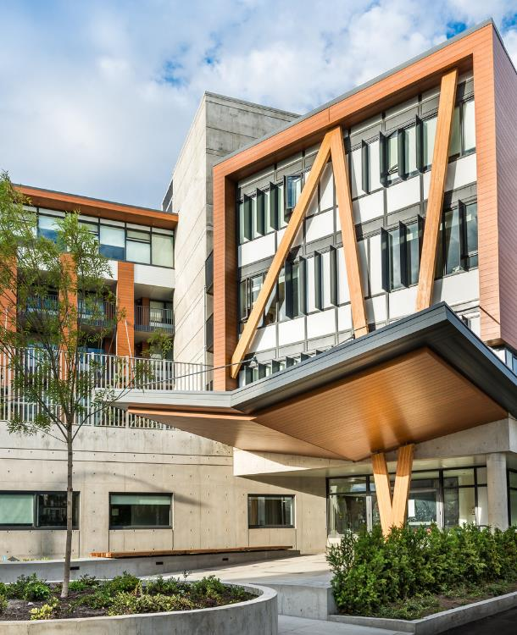
BENEFITS OF PASSIVE HOUSE CONSTRUCTION
Energy Efficiency
Comfort
Health
Durability
Cost Savings
Sustainability
Notes:
Energy Efficiency: Passive House buildings can reduce energy consumption by up to 90% compared to conventional buildings. They achieve this through a combination of super-insulation, airtight construction, and passive solar heating.
Comfort: Passive House buildings are designed to maintain a constant and comfortable indoor temperature year-round, with no cold spots or drafts. This is achieved through careful design and high-quality building materials.
Health: Passive House buildings prioritize indoor air quality, using mechanical ventilation systems that filter and distribute fresh air throughout the building. This can improve the health and well-being of occupants, particularly those with respiratory issues.
Durability: Passive House buildings are designed to last for decades, with high-quality materials and construction methods that are less prone to damage from weather or wear and tear.
Cost Savings: While the initial construction costs for a Passive House building may be higher than a conventional building, the long-term cost savings in energy bills and maintenance costs can be significant. In many cases, the cost savings can offset the initial investment within a few years.
Sustainability: Passive House buildings are a sustainable building option, reducing the demand for fossil fuels and lowering carbon emissions. They can also be designed to incorporate renewable energy sources such as solar panels or geothermal heating.
Overall, Passive House construction offers numerous advantages, including improved energy efficiency, comfort, health, durability, cost savings, and sustainability. It is becoming an increasingly popular choice for new construction and retrofit projects, particularly in regions with cold climates.
Project: ISS
Architect: Henriquez Partners Architects
Location: Vancouver, BC
Product: 6” V Groove

Slide 31
PASSIVE HOUSE
Certified Passive House components help you design a Passive House construction.
Notes:
Building codes and high-performance energy standards like Passive House and Net-Zero are evolving to meet multiple objectives, including reducing energy consumption and reducing greenhouse gas emissions.
The most efficient methods of insulating a building’s exterior walls are those that incorporate the principles of continuous exterior insulation with no or minimal thermal bridging to limit thermal loss.
Thermal break components are essential for achieving Net Zero and Passive House Certification because they help to minimize heat loss through building envelopes. Net Zero and Passive House buildings are designed to be highly energy-efficient, and one of the key strategies to achieve this is to reduce the amount of heat that is lost through the walls, roof, windows, and other building components.
By reducing heat loss through building components, thermal breaks help to reduce the amount of energy required to maintain comfortable indoor temperatures, which is a key component of achieving Net Zero and Passive House Certification. In addition, they can help to improve indoor comfort, reduce the risk of condensation, and prolong the lifespan of building components.
Attachment systems with thermal break, can achieve effective R-values exceeding R60 for various types of wall assemblies while supporting heavy cladding loads in high wind load and seismic conditions. The attachment system can accommodate continuous exterior insulation thicknesses between 1” and 16” and is therefore suitable for use in all Passive House and ASHRAE climate zones across North America.
Products that hold the Passive House Component certification have been tested for quality assurance and reliability with regards to energy performance, comfort, and indoor air quality criteria.

Slide 33
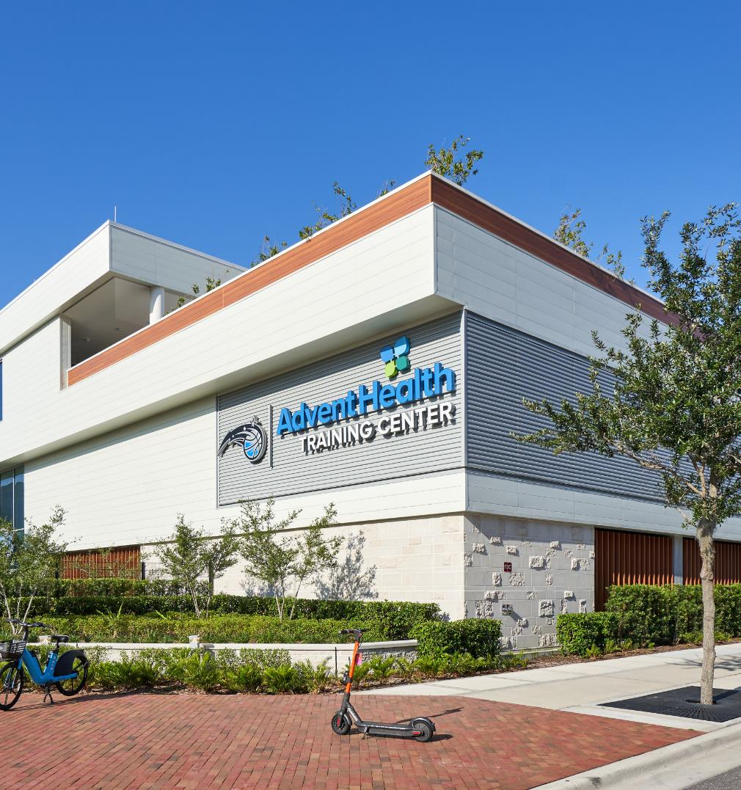
The circular economy is an economic system that aims to reduce waste and maximize the use of resources by keeping products, components, and materials in use for as long as possible. In contrast to the traditional linear economy, which follows a "take-make-dispose" model, the circular economy seeks to create a closed loop where products and materials are reused, repaired, or recycled at the end of their useful life.
Notes:
The circular economy is an economic system that aims to reduce waste and maximize the use of resources by keeping products, components, and materials in use for as long as possible. In contrast to the traditional linear economy, which follows a "take-make-dispose" model, the circular economy seeks to create a closed loop where products and materials are reused, repaired, or recycled at the end of their useful life.
Project: AdventHealth Training Center
Location: Orlando, FL
Product: 6" V-Groove & 6" Link & Lock

Slide 34
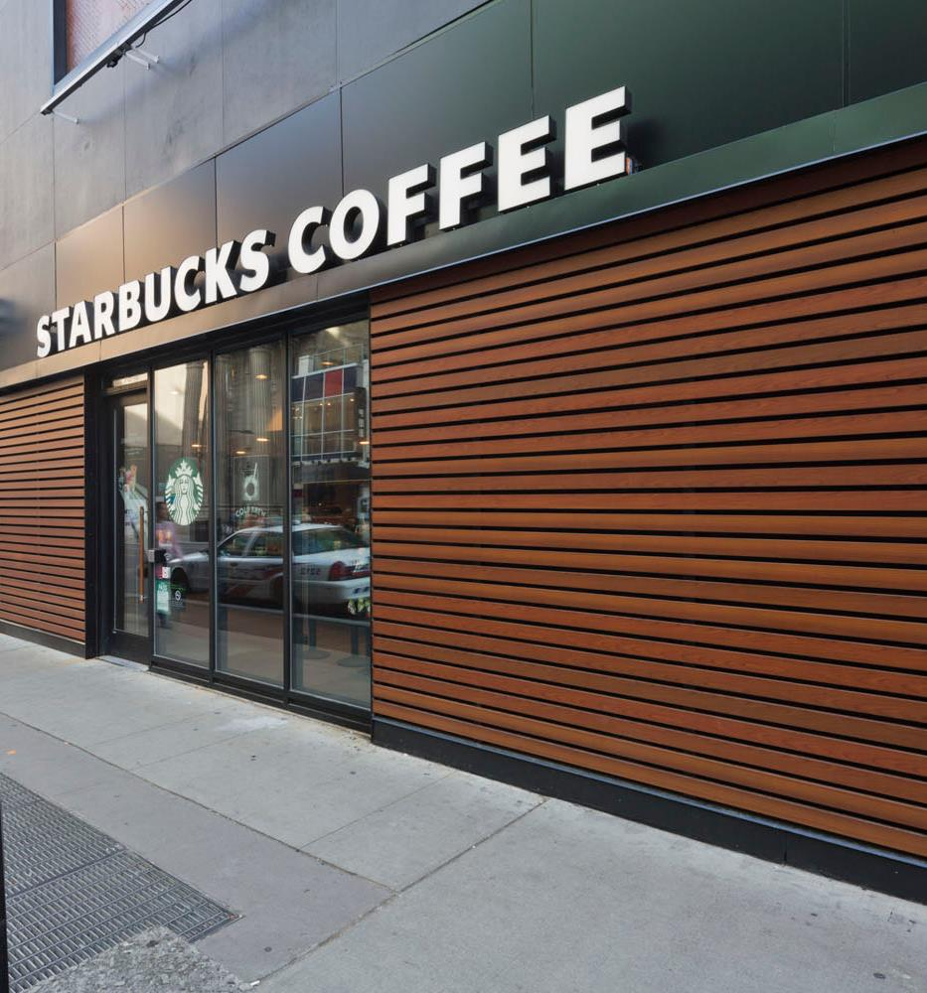
USING ALUMINUM PRODUCTS CAN HELP PROMOTE A CIRCULAR ECONOMY BY REDUCING THE NEED FOR VIRGIN RAW MATERIALS
Notes:
In a circular economy, products are designed to be durable, repairable, and reusable. When products are no longer needed, they are either disassembled and their components are reused, or they are recycled to create new products. This reduces the need for new raw materials and minimizes waste, contributing to a more sustainable and efficient economic system.
The circular economy is gaining popularity as a way to address the environmental challenges of the modern world, including climate change, resource depletion, and waste generation. By prioritizing resource conservation, product design, and waste reduction, the circular economy can help create a more sustainable and equitable world for future generations.
Project: Starbucks TO
Location: ON, Canada
Product: 1 x 5" Privacy Beam

Slide 35
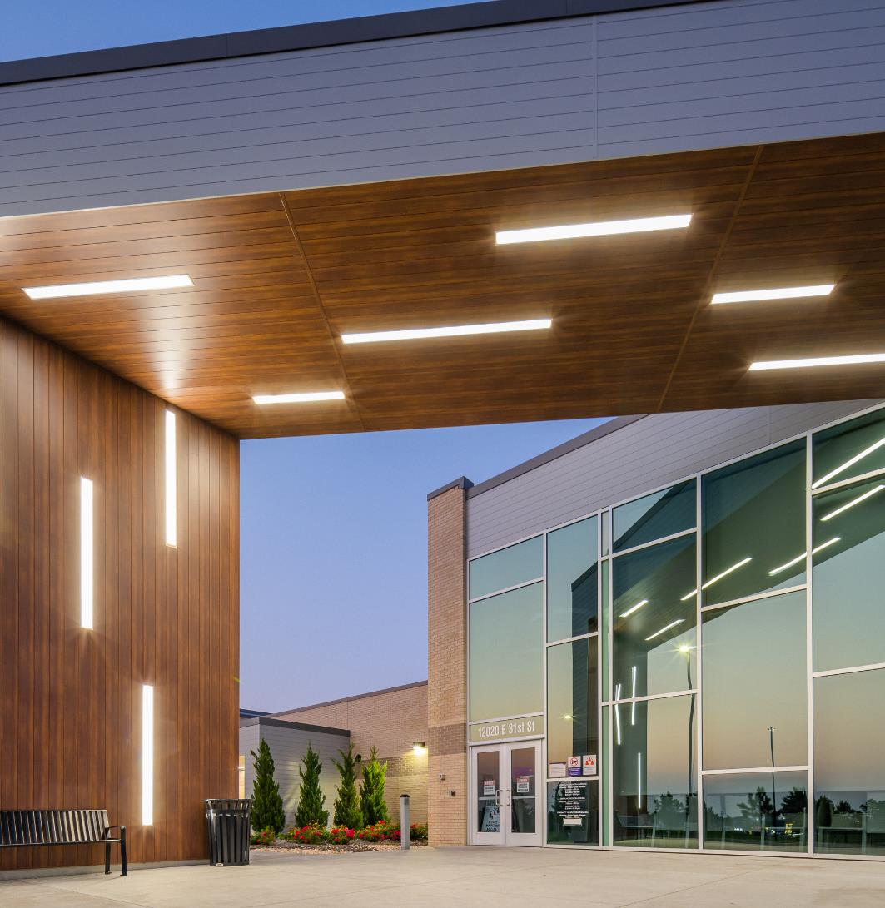
AIA 2030 COMMITMENT
This is a program initiated by the American Institute of Architects that encourages architects to strive for Net-Zero constructions by 2030.
Notes:
Project: Union Community Health Connection
Architect: KKT Architects
Location: Tulsa, OK
Product: 6” V Groove

Slide 36
MORE THAN 40% OF U.S. GREENHOUSE GASSES CAN BE ATTRIBUTED TO THE BUILT ENVIRONMENT; ARCHITECTS, ENGINEERS, AND OWNERS PLAY A KEY ROLE.
Notes:
The latest climate data tells us that reducing carbon emissions is not enough. More than 40% of U.S. greenhouse gases can be attributed to the built environment; architects, engineers, and owners play a key role.
To make the biggest impact, we must all commit to net zero emissions by 2030—a path that requires strong, immediate action. By setting ambitious targets and promoting sustainable design practices, the commitment aims to reduce the environmental impact of the built environment and promote a more sustainable future. By joining the commitment, the firm reassure its commitment with improving energy performance.
Source: https://www.aia.org/pages/6464938-the-aia-2030-commitment

Slide 37
THE ROLE OF
ARCHITECTS
Notes:
Now, we’ll explore the role of the architects on the AIA 2030 Commitment.
Project: The Haven at National Harbor
Architect: Peterson Companies
Location: MD, USA
Product: 6” V Groove, Light Cherry

Slide 38
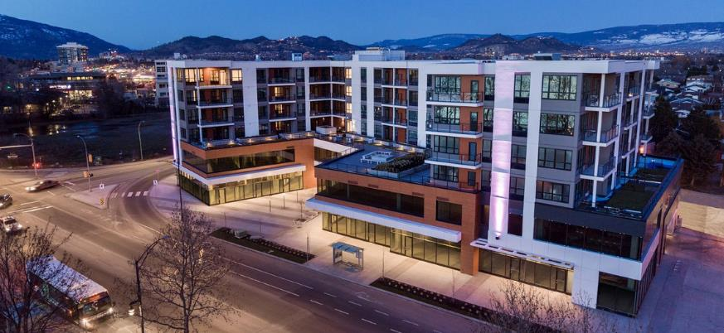
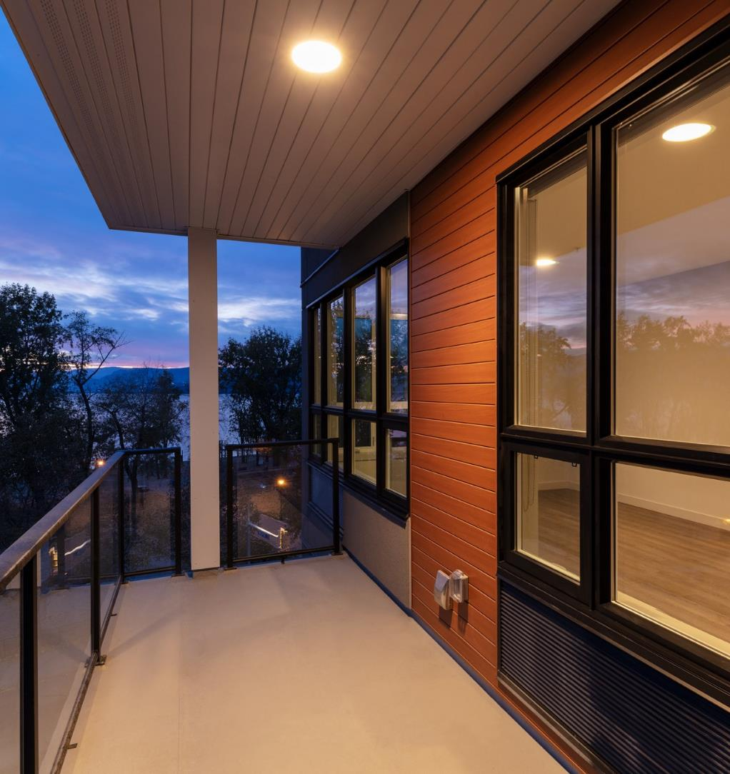
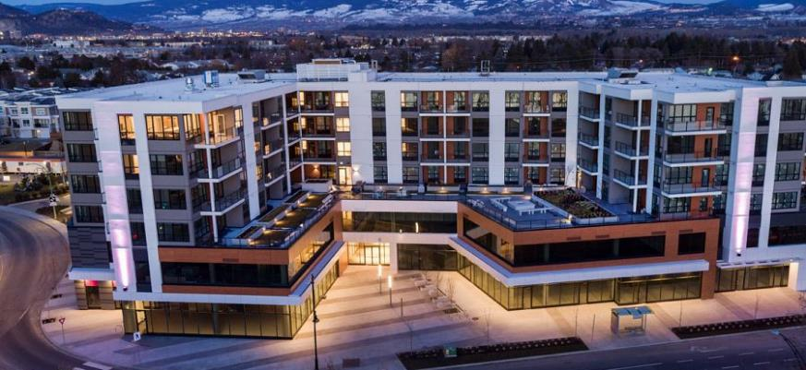
ENERGY
Buildings must use and produce only clean energy.
Notes:
Energy: Buildings must use and produce only clean energy.
• Use climate-responsive design on all projects.
• Specify high-performance, long-lasting envelopes and systems.
• Move buildings to clean-sourced all-electric, incorporating building integrated renewable energy.
• Move to islandable microgrid connections, potentially at the neighborhood scale.
Project: The Shore Condominiums
Architect: Zeidler Architecture
Location: Kelowna, BC
Product: 6” V Groove

Slide 39
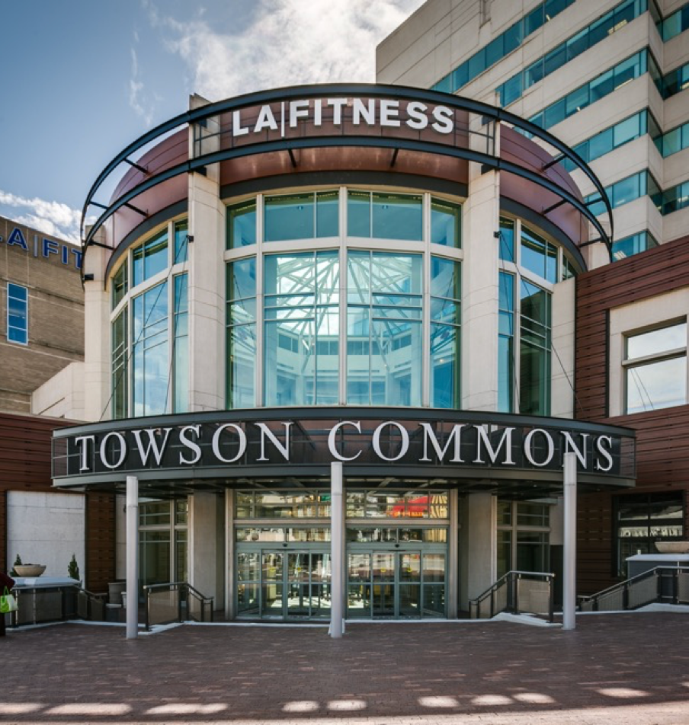
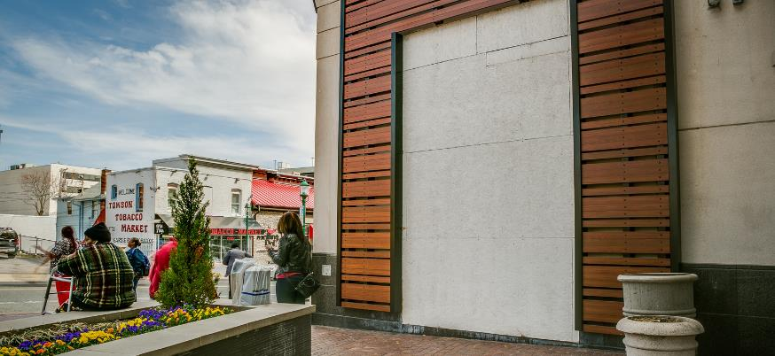
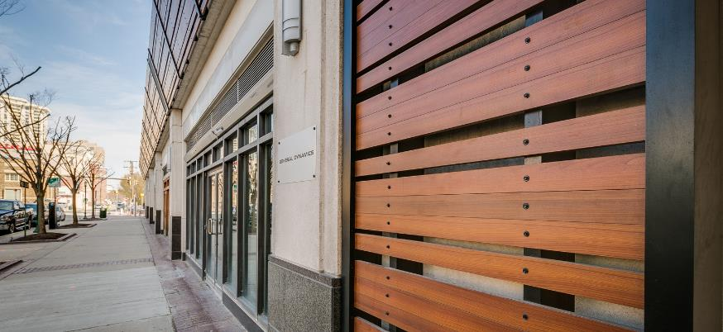
MATERIALS
Buildings must sequester carbon.
Notes:
Materials: Buildings must sequester carbon.
• Re-use buildings and building materials first before recycling.
• Address building life cycles through cradle-to-cradle resource use.
• Practice embodied carbon design on all projects.
• Evaluate materials on end-of-life reuse, off-gassing, and impacts from natural and man-made disasters.
• Design for adaptability and deconstruction.
Project: Townson Commons
Location: Townson, Maryland
Product: 1x3 Privacy Beam

Slide 40
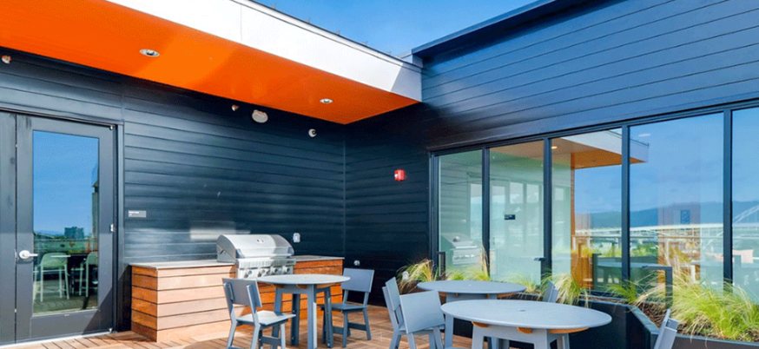
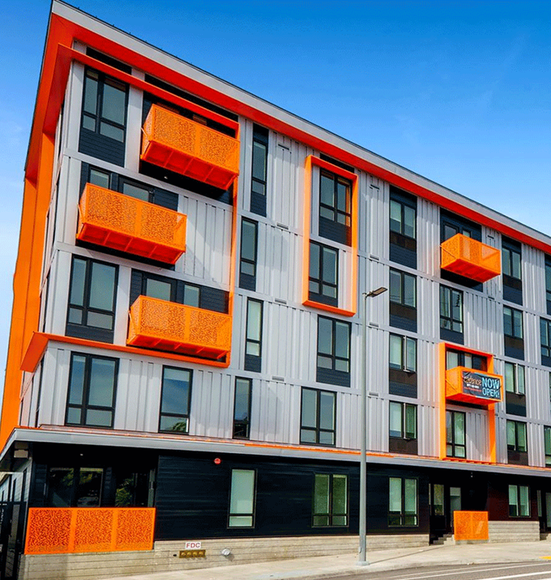
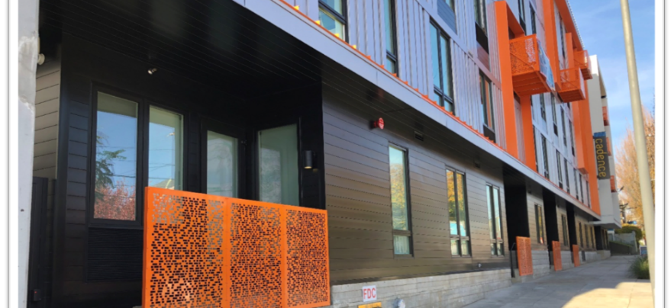
DESIGN & HEALTH
Buildings must be designed to promote health and wellbeing.
Notes:
Design and Health: Buildings must be designed to promote health and wellbeing.
• Design buildings to improve air and water quality.
• Design buildings to promote activity and fitness.
• Design buildings to connect people and nature.
• Design buildings to support mental health and social wellbeing.
Project: Cadence
Location: Portland, Oregon
Product: 6” V Groove

Slide 41
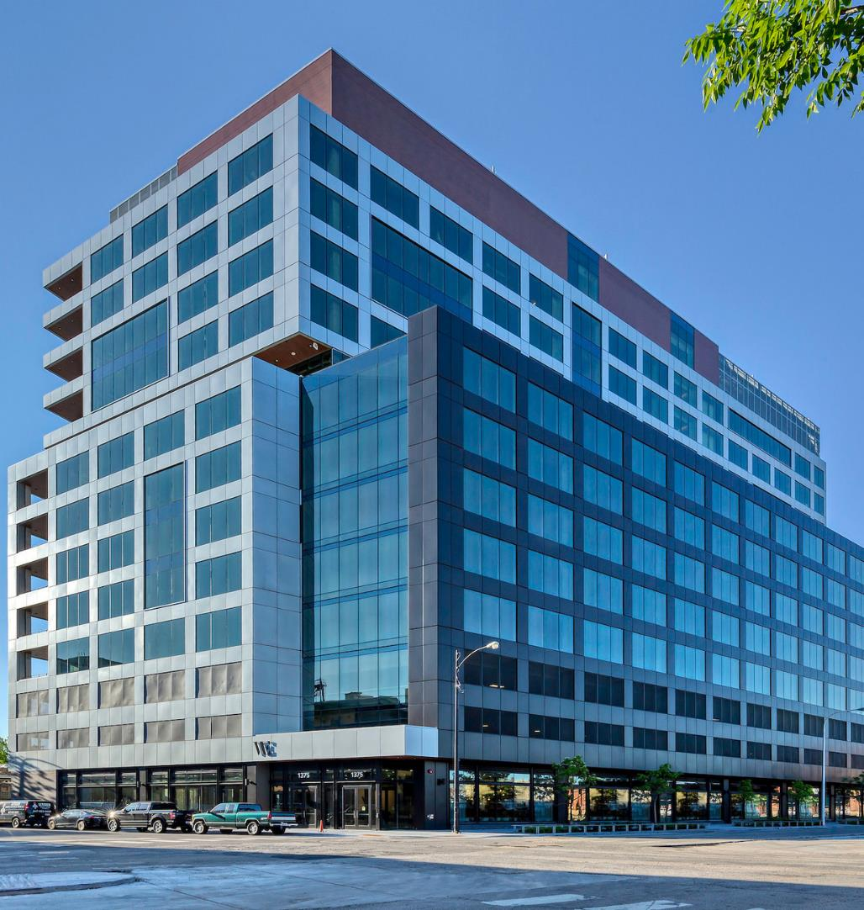
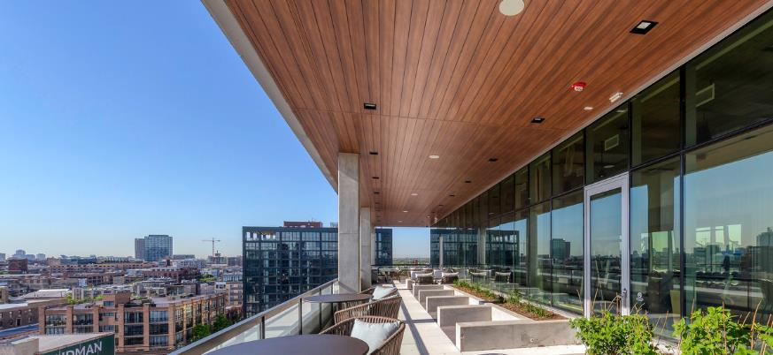
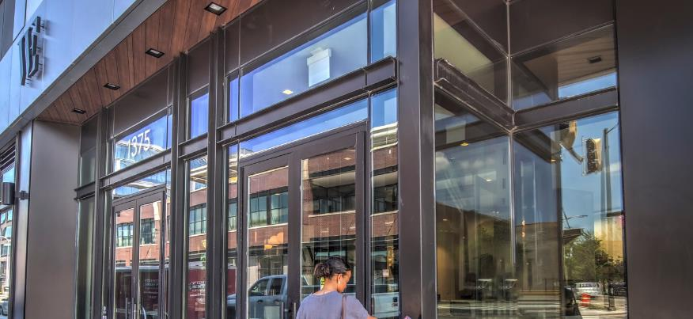
RESILIENCE
Buildings must be resilient and adaptable.
Notes:
Resilience: Buildings must be resilient and adaptable.
• Design buildings to be safe and secure.
• Design buildings to survive and recover.
• Design buildings to adapt to future climate conditions.
• Avoid building in highly vulnerable locations.
Project: Fulton & Ogden
Location: Chicago, IL
Architect: ESG Architecture & Design
Product: 6” V Groove

Slide 42
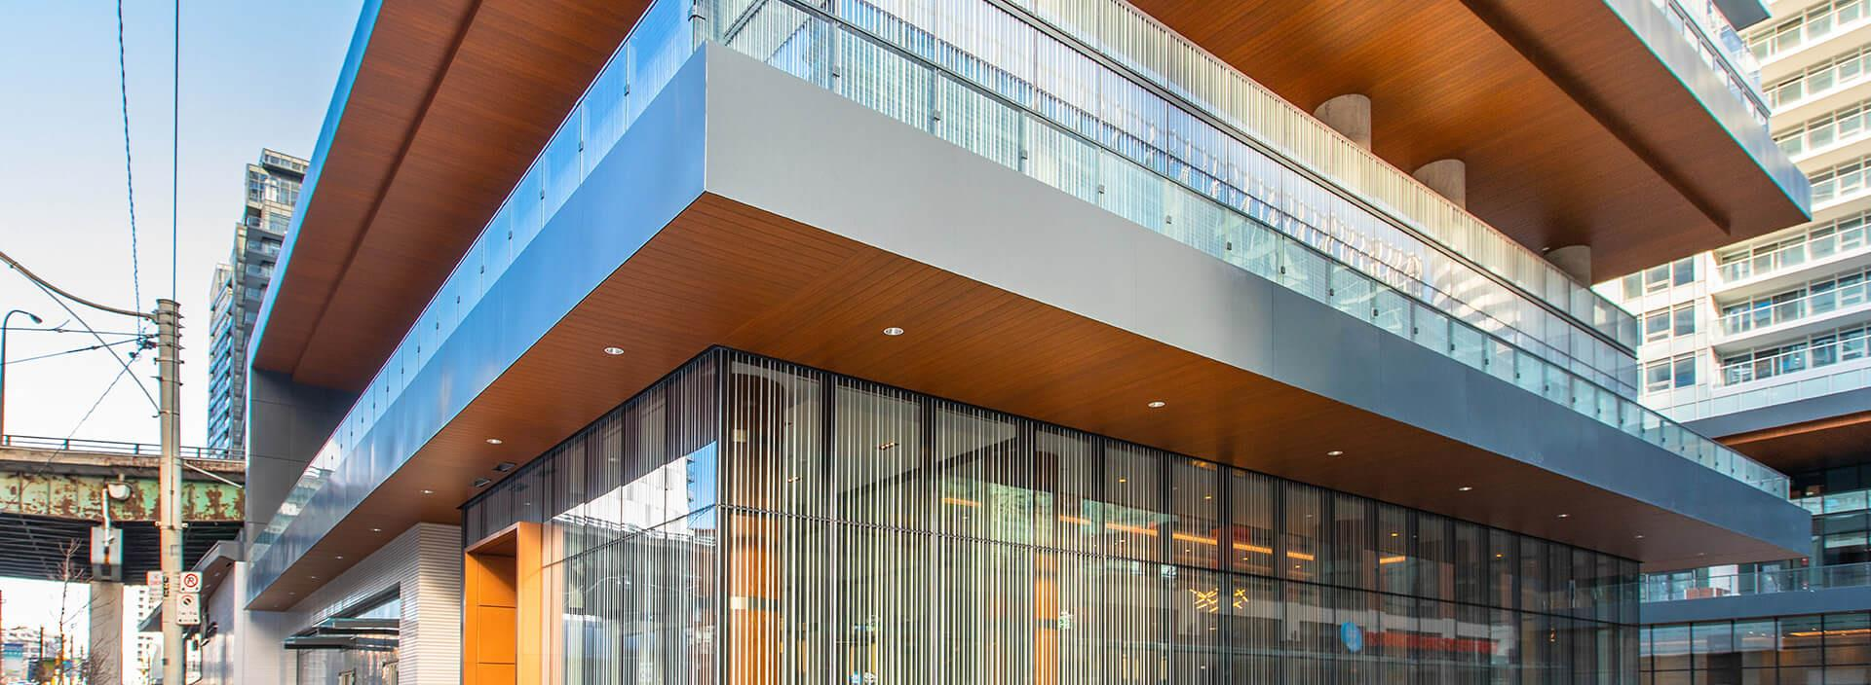
MATERIALS SELECTION AND
THE AIA 2030 COMMITMENT
Notes:
The materials selection have a big influence on the achievement of the AIA Commitment.
To achieve an Energy efficient building it’s important to prioritize a high-performance, long-lasting envelopes and systems.
Project: Lakeshore Condos
Location: Ontario, Canada
Product: Soffit

Slide 43
CASE STUDIES
Notes:
Project: Tandem Apartments
Architect: Fugere Architecture
Location: QC, Canada
Product: 4” V Groove

Slide 44
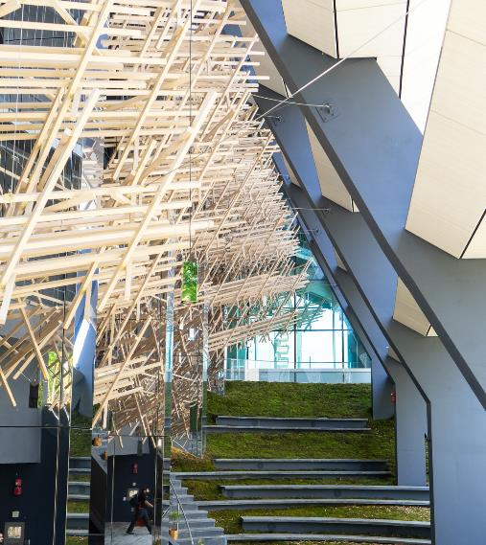
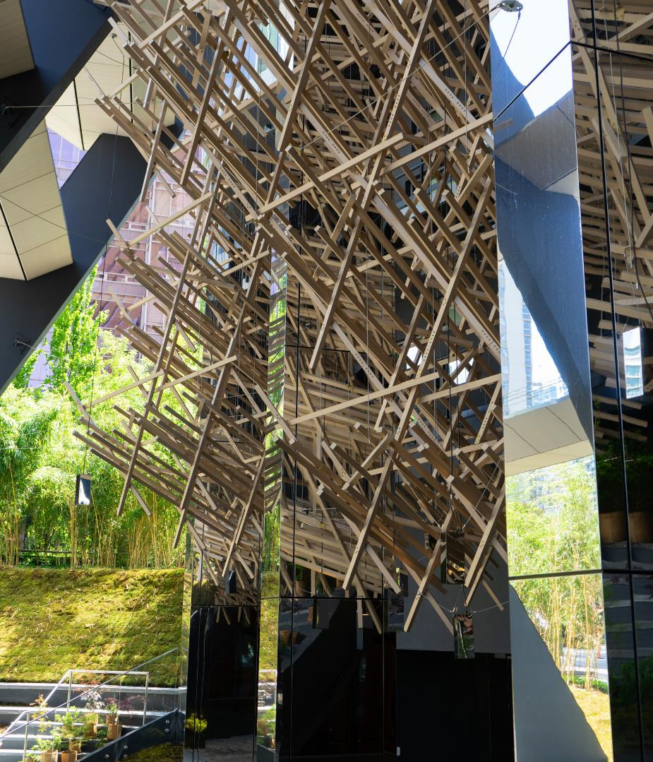
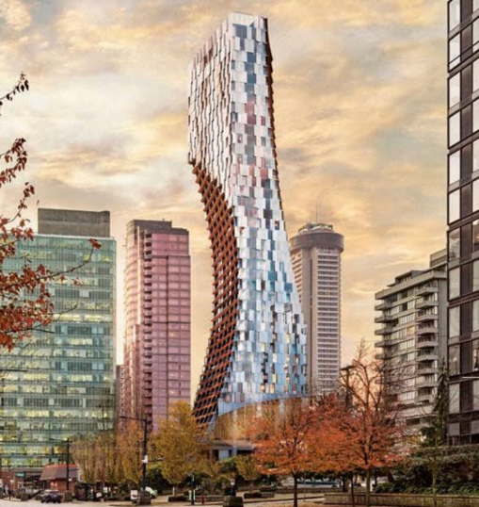
ALBERNI
TOWER
Custom Specialty Ceiling Feature
Kengo Kuma Architects & Merrick Architecture
Vancouver, BC
LEED GOLD
Notes:
World Renowned Japanese Architect Kengo Kuma
43 storey High-end Residential Tower
Design Assist Partner in an Intricate Japanese Inspired Ceiling Feature:
- 27,000 lf of custom woodgrain aluminum tubes
- 4,000 Individual tubes
- 190x Unique Fabricated Parts
- Total Ceiling Feature Weight of 23,000lbs

Slide 45
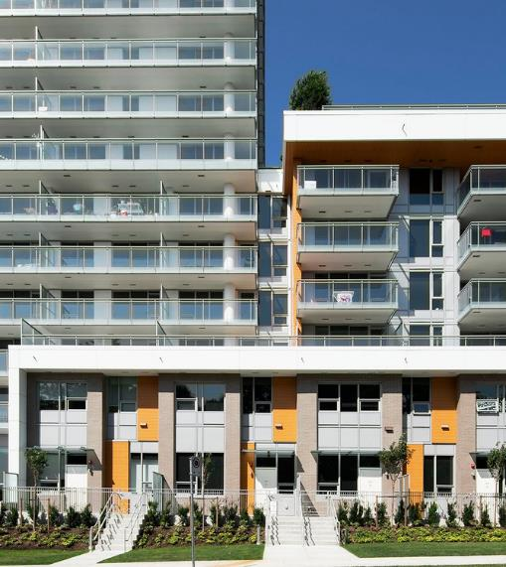
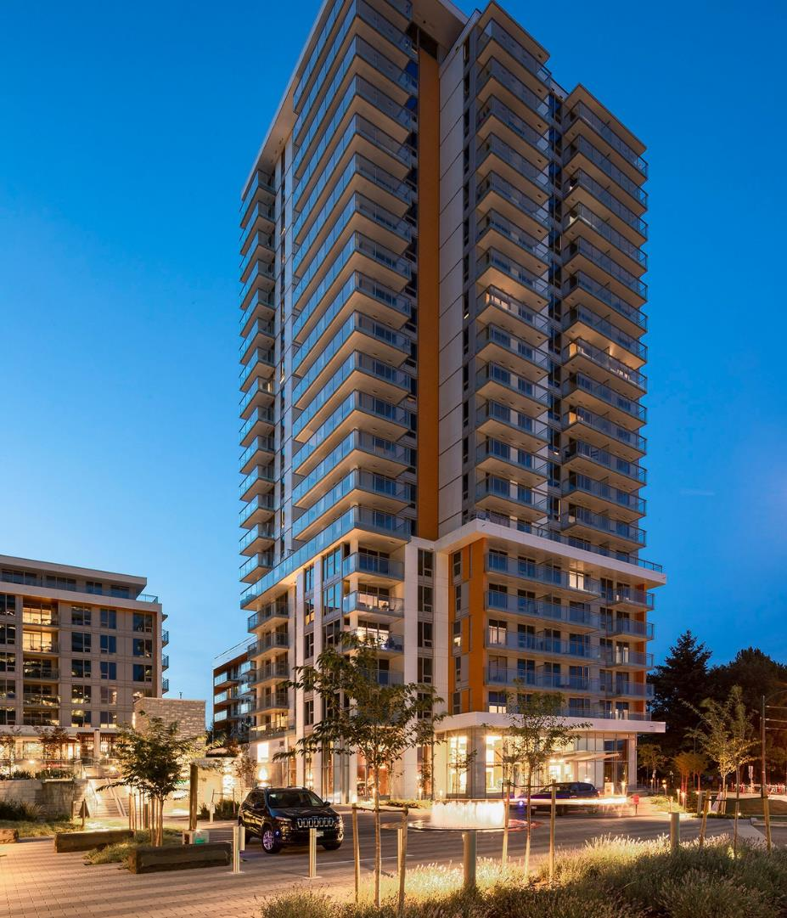
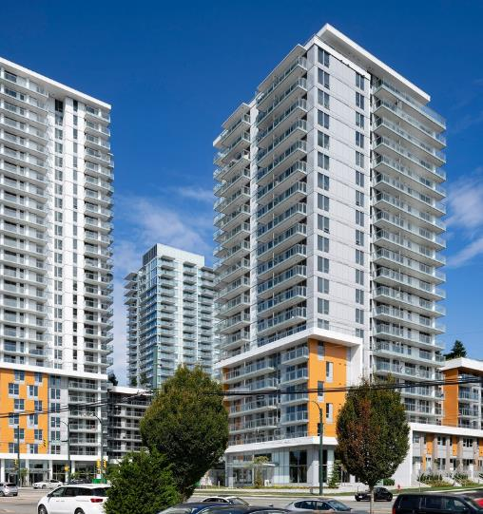
W1 MARINE
GARDENS
6" V-Groove
Light Fir
GBL Architects
Vancouver, BC
LEED GOLD

Slide 46
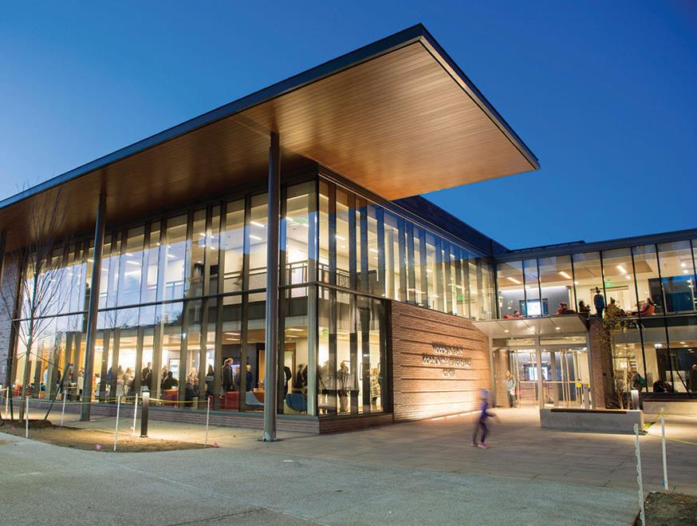
MOSES BROWN SCHOOL
6" V-Groove
Light Fir
DBVW Architects
Providence, RI
LEED SILVER
Notes:
Providence, Rhode Island

Slide 47
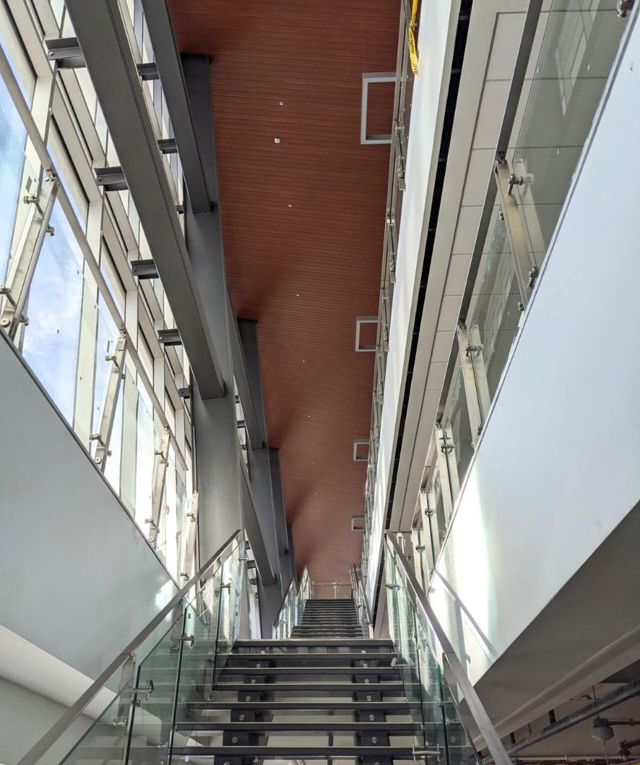
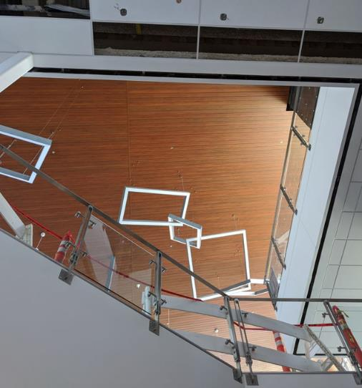
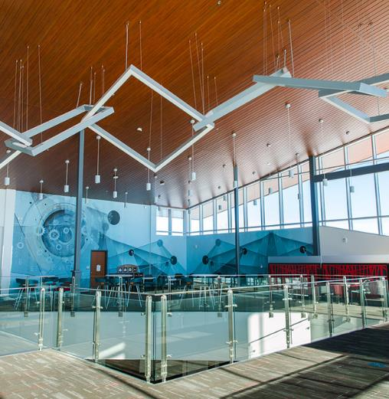
WSCU - PAUL M. RADY SCHOOL
6" Channel
Dark Cherry
Farnsworth Group
Gunnison, CO
LEED GOLD
Notes:
Western Colorado University

Slide 48
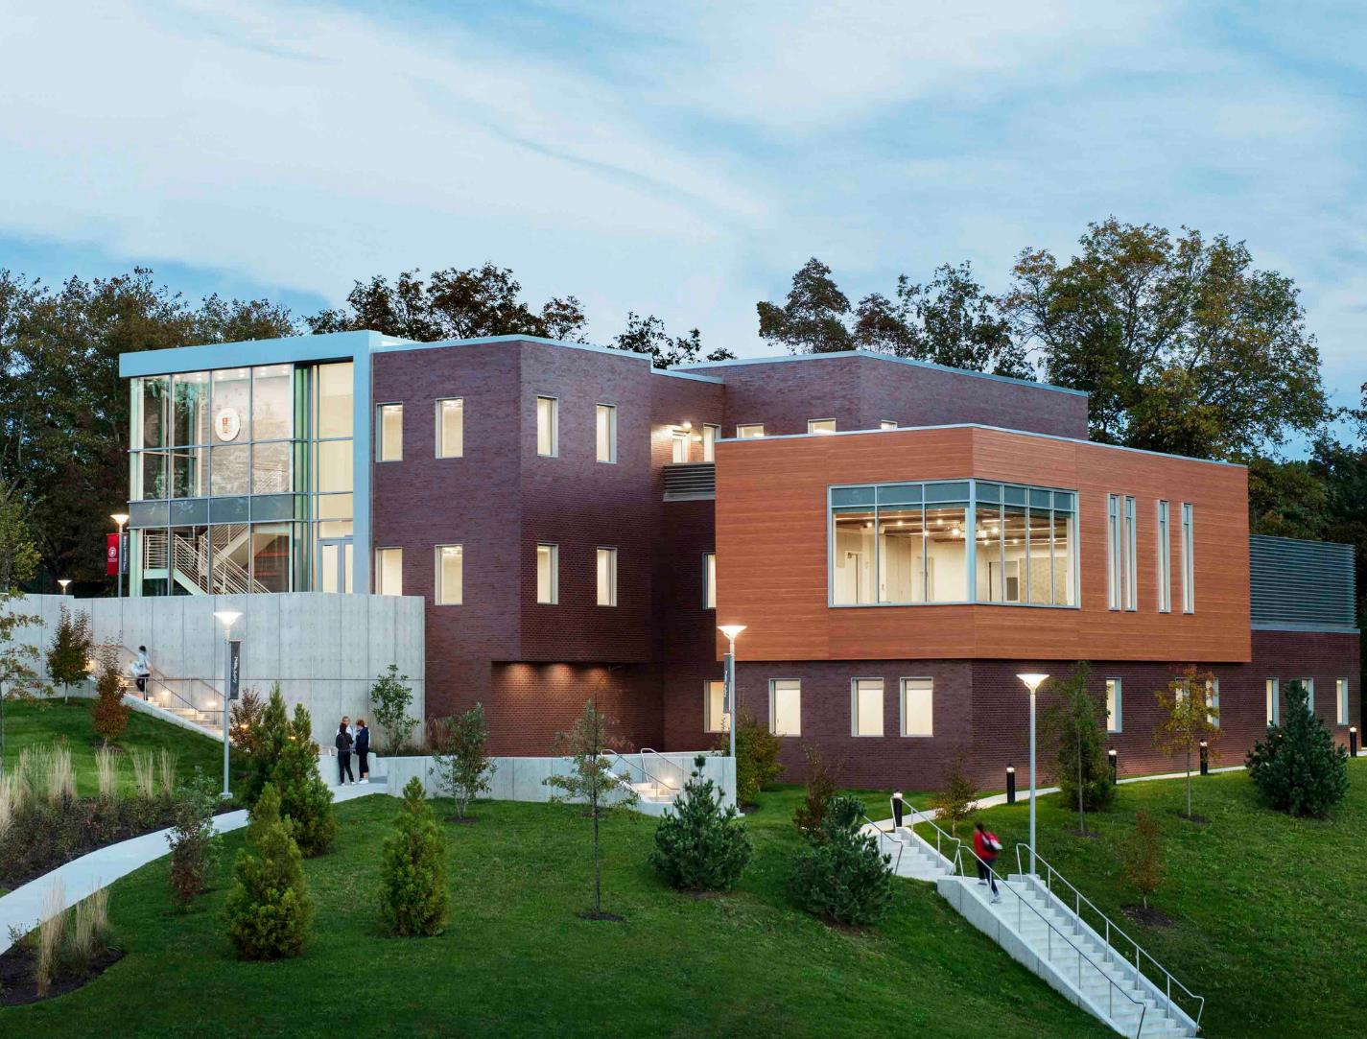
SACRED HEART UNIVERSITY
6" V-Groove
Light Fir
SGA Architecture
Fairfield, CT
LEED SILVER
Notes:
Fairfield, Connecticut

Slide 49
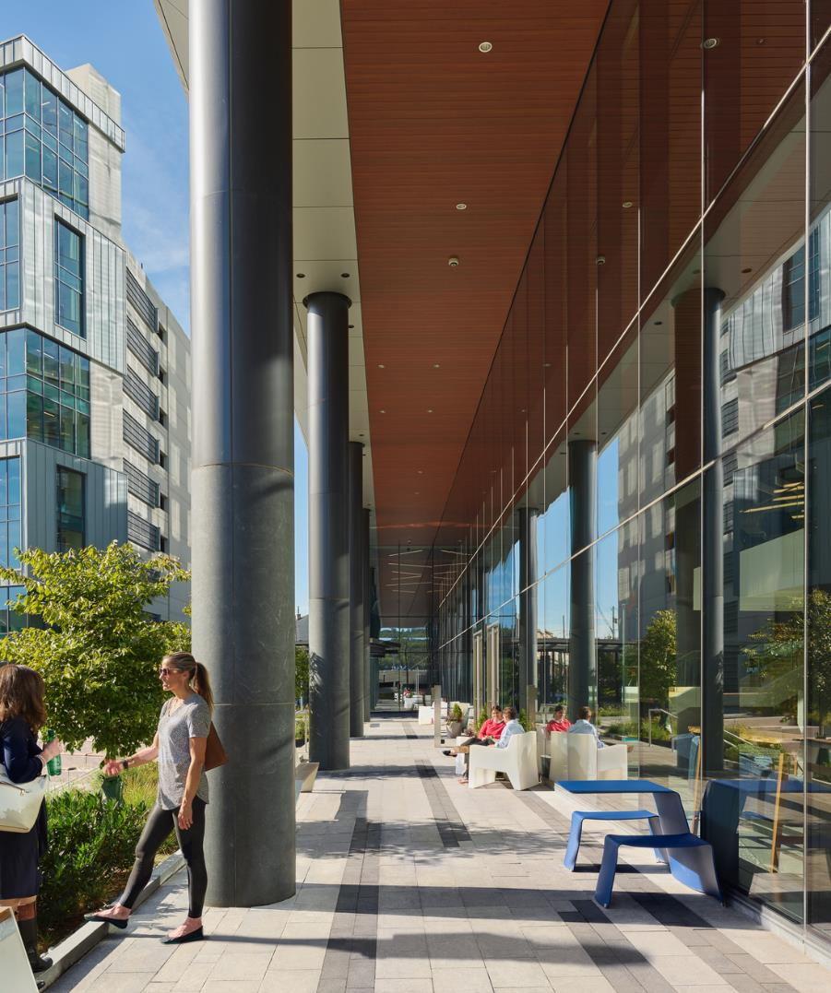
SORA WEST
6" V-Groove
Dark Cherry
Gensler Architects
Conshohocken, PA
LEED SILVER

Slide 50
METROPOLITAN MIDTOWN
4" and 6" Link & Lock
Light National Walnut
505 Design
Charlotte, NC
LEED SILVER

Slide 51
CASA
QUERETARO
6" V-Groove
Custom Solid Colors
DesignBridge Ltd
Chicago, IL
LEED PLATINUM
Notes:
45-unit affordable housing development

Slide 52
HUMBER
COLLEGE
6" V-Groove
Light Oak
Perkins and Will
Toronto, ON
LEED PLATINUM & NET ZERO

Slide 53
NORTHERN
LAKES
COLLEGE
4" Link & Lock
Birchwood
MANASC ISAAC Architects
High Prairie, AB
LEED SILVER

Slide 54
SUMMARY
Notes:
Project: AdventHealth College Boulevard
Location: Kansas, US
Product: 6” V-Groove, 1 x 5 Privacy Beam
Finish: Dark Cherry
Installer: Standard Sheet Metal

Slide 55
SUMMARY
Aluminum provides the economic and systematic foundation for many other recycling initiatives. Choosing aluminum-based products accelerates our drive to sustainability.
The fact that premium products and finishes are extremely durable and will last for many years further reduces operational carbon impacts when it comes to repair and maintenance.
By reducing heat loss through building components, thermal breaks help to reduce the amount of energy required to maintain comfortable indoor temperatures, which is a key component of achieving Net Zero and Passive House Certification.
LCIA show that when using aluminum siding with a minimum of 50% recycled content, from a cradle-to-gate perspective it shows that it contains 45% less embodied carbon compared to the industry average extruded products.
Notes:
Aluminum provides the economic and systematic foundation for many other recycling initiatives. Choosing aluminum based products accelerates our drive to sustainability.
The fact that premium products and finishes are extremely durable and will last for many years further, / reduces operational carbon impacts when it comes to repair and maintenance.
By reducing heat loss through building components, thermal breaks help to reduce the amount of energy required to maintain comfortable indoor temperatures , which is a key component of achieving Net Zero and Passive house Certification.
LCIA show that when using aluminum siding with a minimum of 50% recycled content, from a cradle-to-gate perspective it shows that it contains 45% less embodied carbon compared to the industry average extruded products.

Slide 57
THANK YOU
Selma Marinangelo
LEED Green Associate
Office: 1-800-604-0343

