Slide 1
AIA CES Provider Statement
GKD USA a registered provider of AIA-approved continuing education under Provider Number K097. All registered AIA CES Providers must comply with the AIA Standards for Continuing Education Programs. Any questions or concerns about this provider or this learning program may be sent to AIA CES (cessupport@aia.org or (800) AIA 3837, Option 3).
This learning program is registered with AIA CES for continuing professional education. As such, it does not include content that may be deemed or construed to be an approval or endorsement by the AIA of any material of construction or any method or manner of handling, using, distributing, or dealing in any material or product.
AIA continuing education credit for this learning program have been reviewed and approved by AIA CES. Learners must complete the entire learning program to receive continuing education credit. AIA continuing education Learning Units earned upon completion of this course will be reported to AIA CES for AIA members. Certificates of Completion for both AIA members and non-AIA members are available upon request.
Notes:
GKD USA is a registered provider of AIA-approved continuing education under Provider Number K097. All registered AIA CES Providers must comply with the AIA Standards for Continuing Education Programs. Any questions or concerns about this provider or this learning program may be sent to AIA CES (cessupport@aia.org or (800) AIA 3837, Option 3).
This learning program is registered with AIA CES for continuing professional education. As such, it does not include content that may be deemed or construed to be an approval or endorsement by the AIA of any material of construction or any method or manner of handling, using, distributing, or dealing in any material or product.
AIA continuing education credit for this learning program have been reviewed and approved by AIA CES. Learners must complete the entire learning program to receive continuing education credit. AIA continuing education Learning Units earned upon completion of this course will be reported to AIA CES for AIA members. Certificates of Completion for both AIA members and non-AIA members are available upon request.

Slide 2
Enhance the Building Environment with Architectural Mesh Fabric
Notes:
Welcome to the course, Enhancing the Built Environment with Architectural Mesh Fabric, sponsored by GKD Metal Fabrics.

Slide 3
Copyright Materials
This presentation is protected by U.S. and International copyright laws. Reproduction, distribution, display and use of the presentation without written permission of GKD Metal Fabrics is prohibited.
© GKD Metal Fabrics, 2021
Notes:
This presentation is protected by U.S. and International copyright laws. Reproduction, distribution, display and use of the presentation without written permission of GKD Metal Fabrics is prohibited.

Slide 4
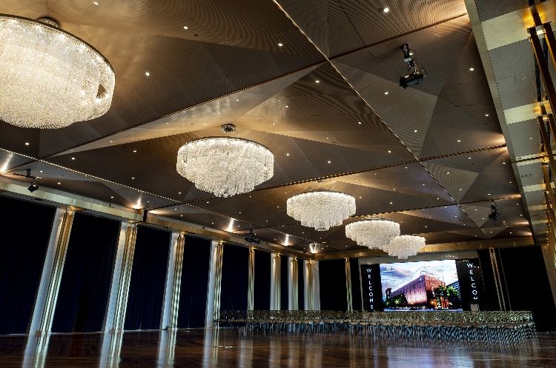
Course Description
Architectural metal fabric is a dynamic exterior and interior material than can be used to create beautiful and functional facades, balustrades, screening, ceilings and wall coverings for libraries, academic buildings, parking garages, stadiums, and other public and commercial buildings.
This course will discuss exterior and interior applications for metal fabric and its performance benefits including safety, security, solar management and sustainability. We will also explore coatings and graphics technologies that can be incorporated into metal fabrics to create a building and brand’s visual identity.
Notes:
Architectural metal fabric is a dynamic interior and exterior material than can be used to create beautiful and functional facades, balustrades, and screening for libraries, academic buildings, parking garages, stadiums, and other public and commercial buildings.
This course will discuss exterior and interior applications for metal fabric and its performance benefits including safety, security, solar management and sustainability. We will also explore coatings and graphics technologies that can be incorporated into metal fabrics to create a building and brand’s visual identity.
PICTURED:
Museum of the Bible, Washington, DC
Houston Area Safety Council, Houston, TX

Slide 5
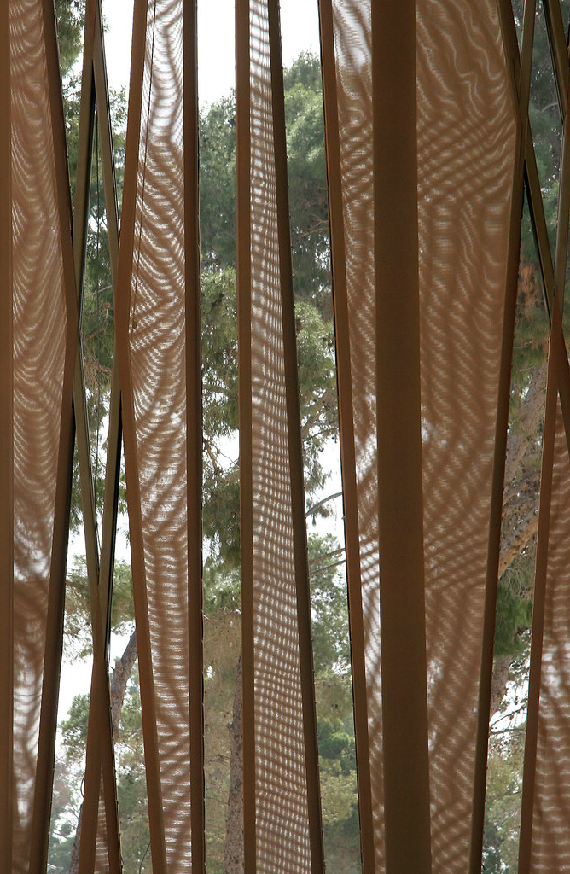
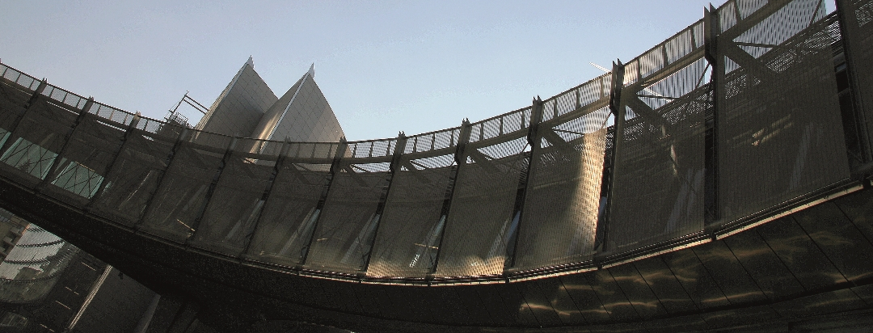
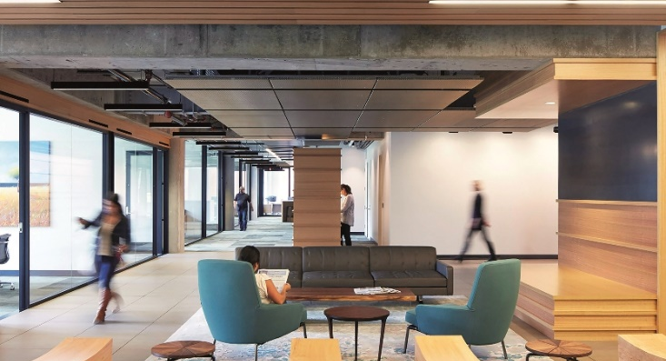
Learning Objectives
Examine how architectural metal fabrics for interior and exterior applications provide solutions for design challenges.
3
Explore how to create visual identity and branding with metal fabrics, including etching, lighting, color, and transparent media facades.
1
Learn the performance benefits of metal fabrics including safety and security, solar management, and sustainability.
4
Identify ideal applications for the product and review case studies where the material was used.
2
Notes:
By the end of this learning unit, learners will be able to:
Examine how architectural metal fabrics for interior and exterior applications provide solutions for design challenges.
Learn the performance benefits of metal fabrics including safety and security, solar management, and sustainability.
Explore how to create visual identity and branding with metal fabrics, including etching, lighting, color, and transparent media facades.
Identify ideal applications for the product and review case studies where the material was used.
PICTURED:
Tripoli International Convention Center
Adelaide Airport Façade, Adelaide, Australia
Gould Evans Investment Firm, San Francisco, CA

Slide 6
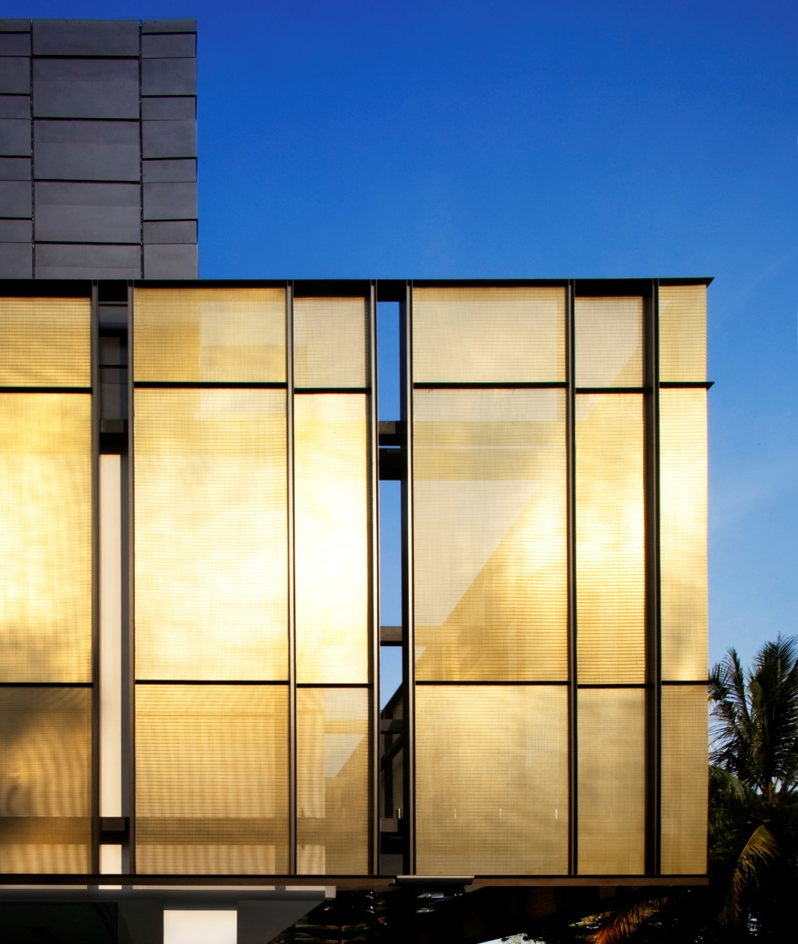
Learning Objective #1
Examine how architectural metal fabrics for interior and exterior applications provide solutions for design challenges.
Notes:
First, let’s begin by examining how architectural metal fabrics for exterior and interior applications provide solutions for design challenges.
PICTURED:
Golden Box (private residence), Singapore

Slide 7
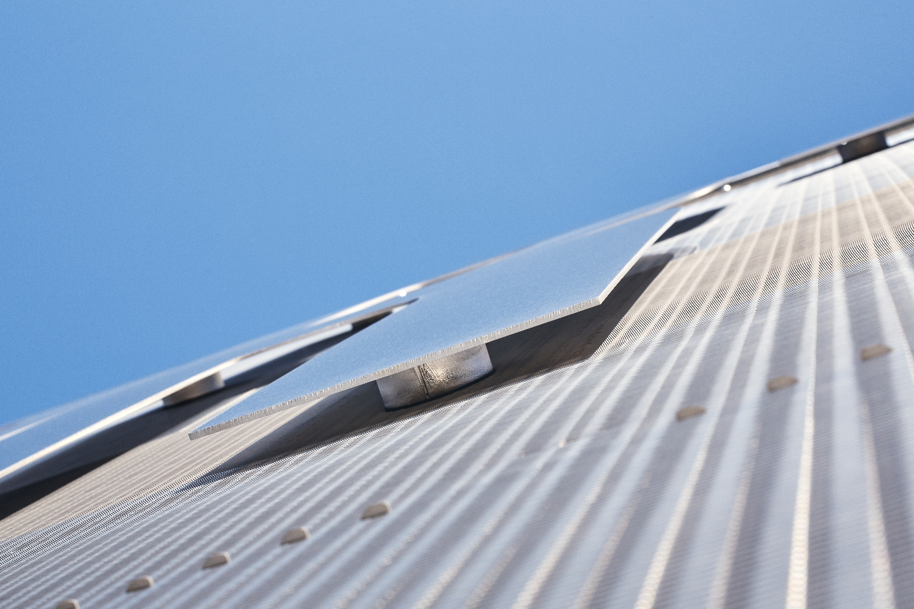
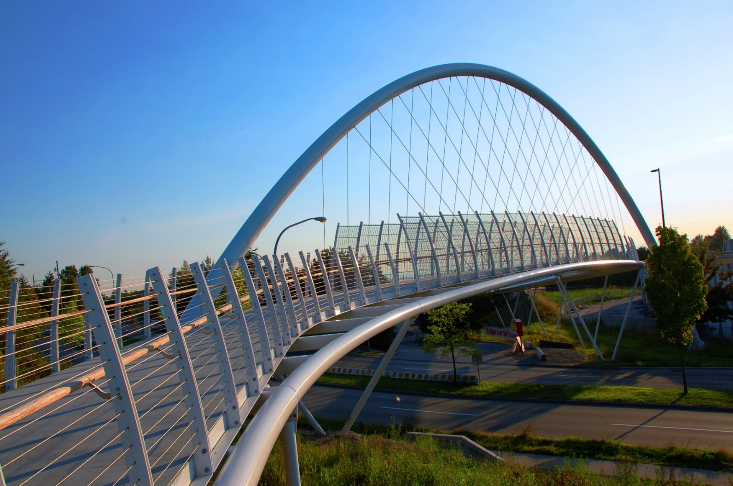
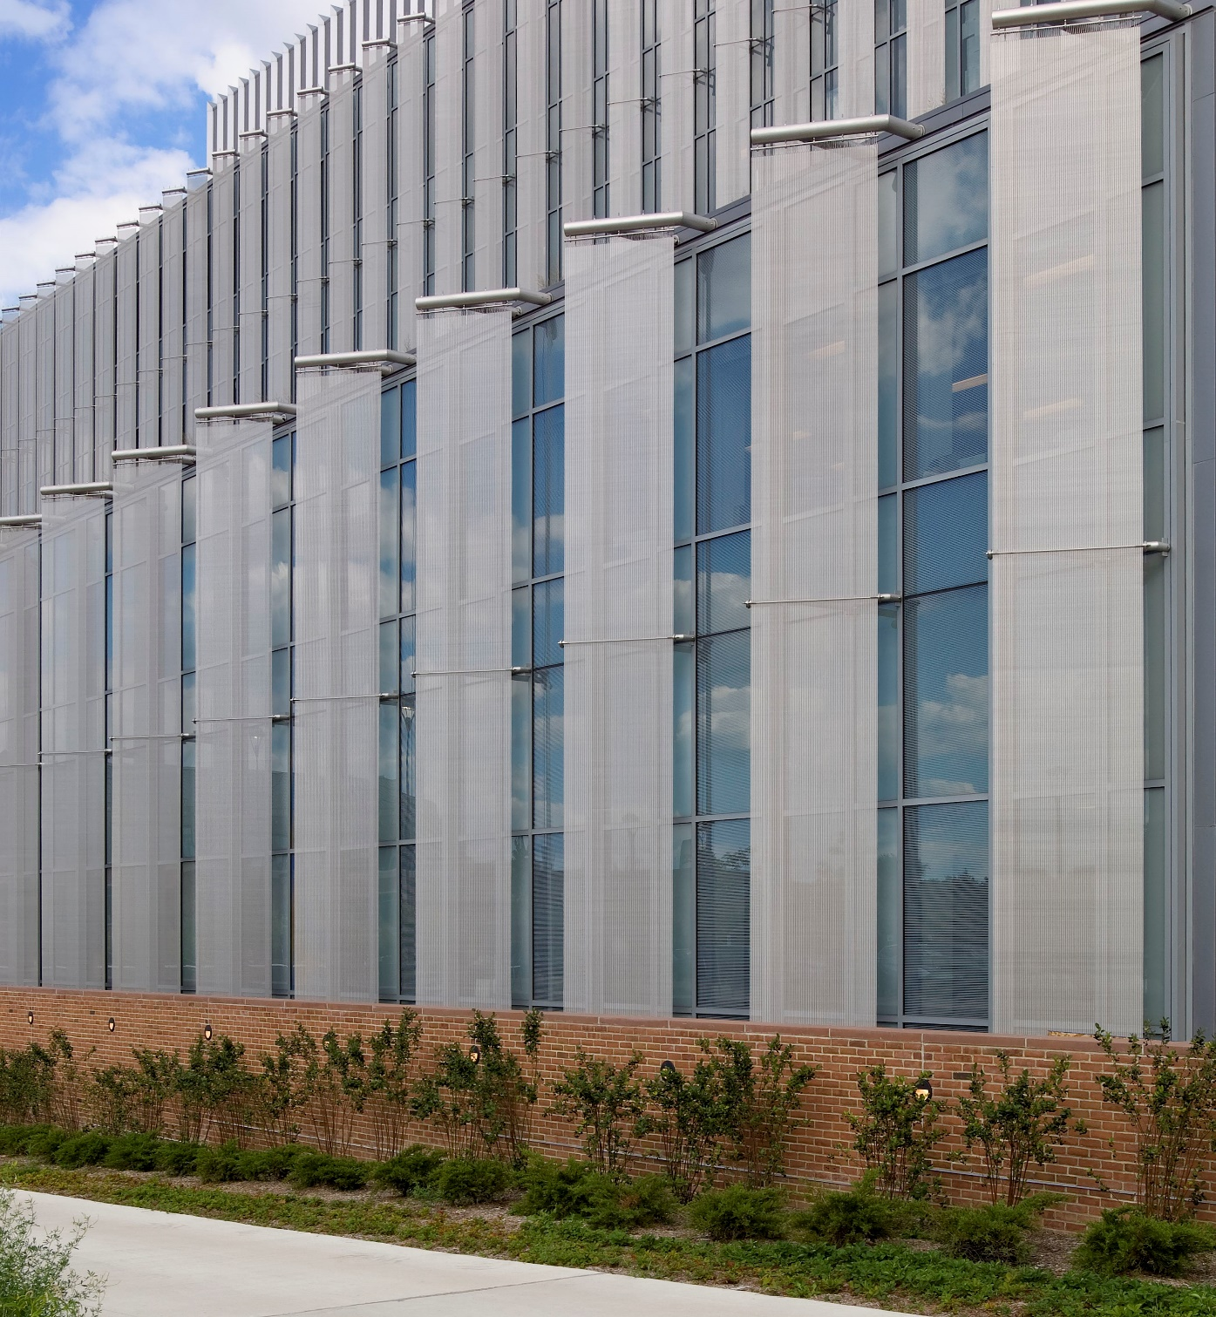
Architectural Metal Fabric Solves the Challenges of Outdoor Design
Building Products Need to Be:
Weather resistant
UV Resistant
Corrosion resistant
Stainless steel is extremely durable and perfectly suited for exterior applications.
Notes:
Designing exterior architectural features can be challenging, as natural elements such as wind, rain and snow test even the most durable materials. Building products must not only be weather resistant, but also UV resistant to combat the damaging effects of sunlight, and corrosion resistant when used in coastal environments and other harsh climates. Materials such as wood will rot and is vulnerable to insect infestation; PVC products will yellow in sunlight and become brittle; and porous concrete will stain, crack, and spall. Stainless steel is extremely durable and perfectly suited for exterior applications.
PICTURED:
Newark Liberty International Airport
Griffiths Avenue Pedestrian Bridge, Burnaby, British Columbia
Eastern Michigan University, Ypsilanti, MI

Slide 8
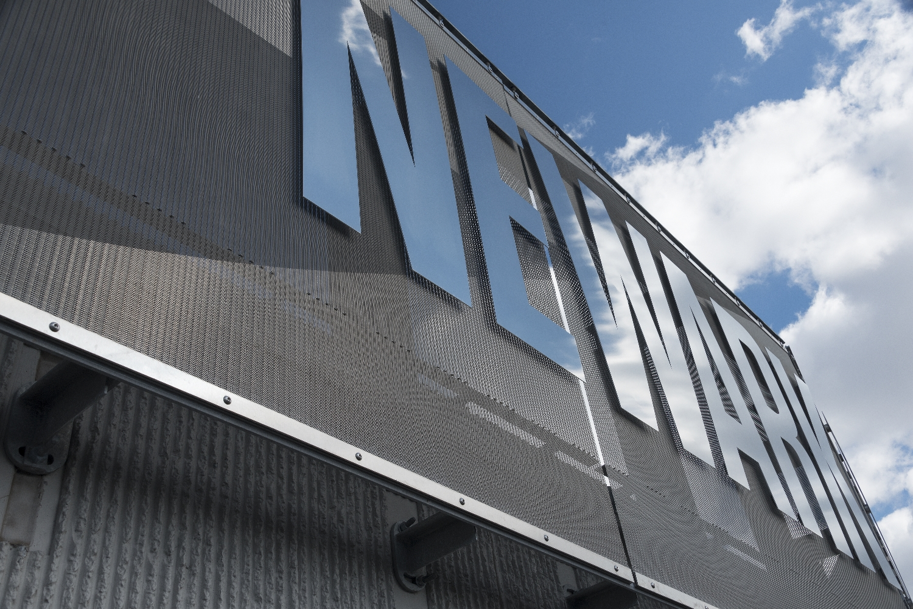
Woven Metal Fabrics – A Durable Outdoor Solution
Fabric types developed specially for architecture, design, and function are manufactured from cables and wires (predominantly stainless steel)
Different fabric types offer different degrees of penetrability and reflectance – creating virtually invisible facades
Constructed of AISI Type 316L stainless steel – creates visual permanency and surface durability
Notes:
For project teams seeking a dynamic exterior material with a very long-life cycle, one solution is technologically advanced woven metal fabrics. Fabric types developed specially for architecture, design, and function are manufactured from cables and wires, which are predominantly made of stainless steel, although other metals such as copper, bronze, and aluminum are also used. Different fabric types offer different degrees of penetrability and reflectance which vary strongly in terms of effect and color on the building according to lighting and weather. These enable the creation of virtually invisible facades. Metal fabrics are suitable for large or small-scale projects, in both interior and exterior applications.
High-quality woven metal fabrics are primarily constructed of AISI (American Iron and Steel Institute) Type 316L stainless steel, which for over half a century has provided architects with the means to produce a permanent expression of their design concepts. This visual permanency is due to the material’s excellent resistance to corrosion as the “L” stands for low carbon. This allows the surface to retain its original appearance indefinitely with very little maintenance. Adding to stainless steel’s design appeal is its excellent performance properties of fire, heat and impact resistance. Consequently, it is not surprising that stainless steel has been specified with confidence by generations of architects for so many indoor and outdoor applications.
PICTURED:
Newark Liberty International Airport

Slide 9
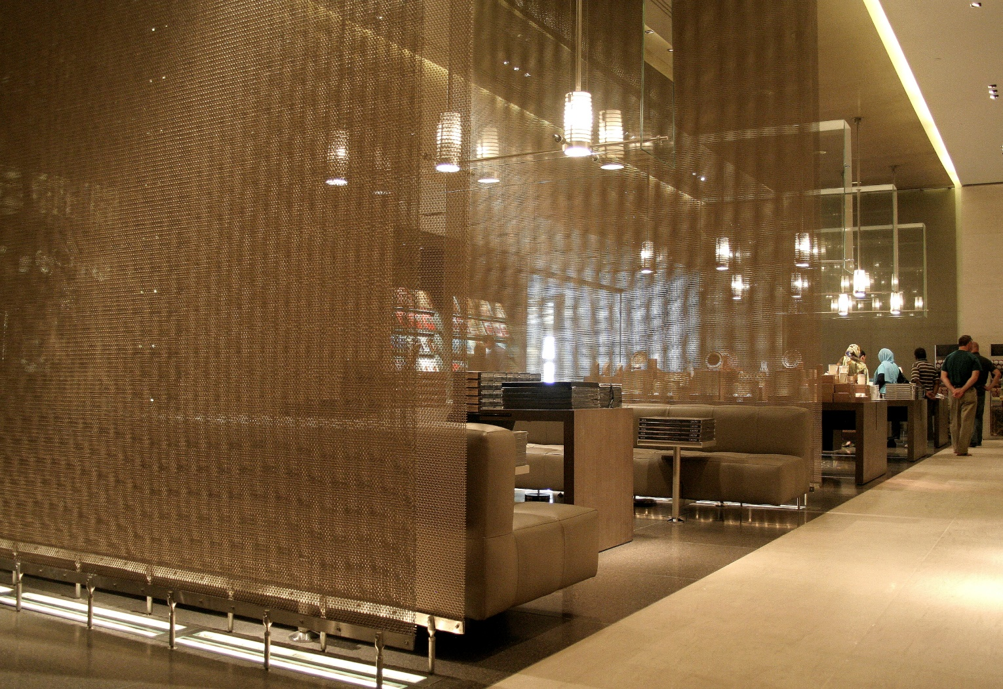
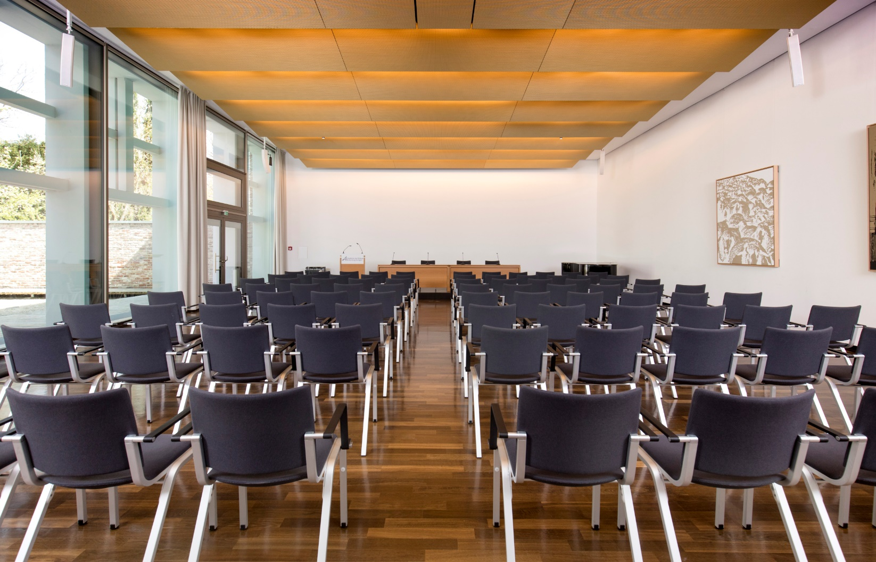
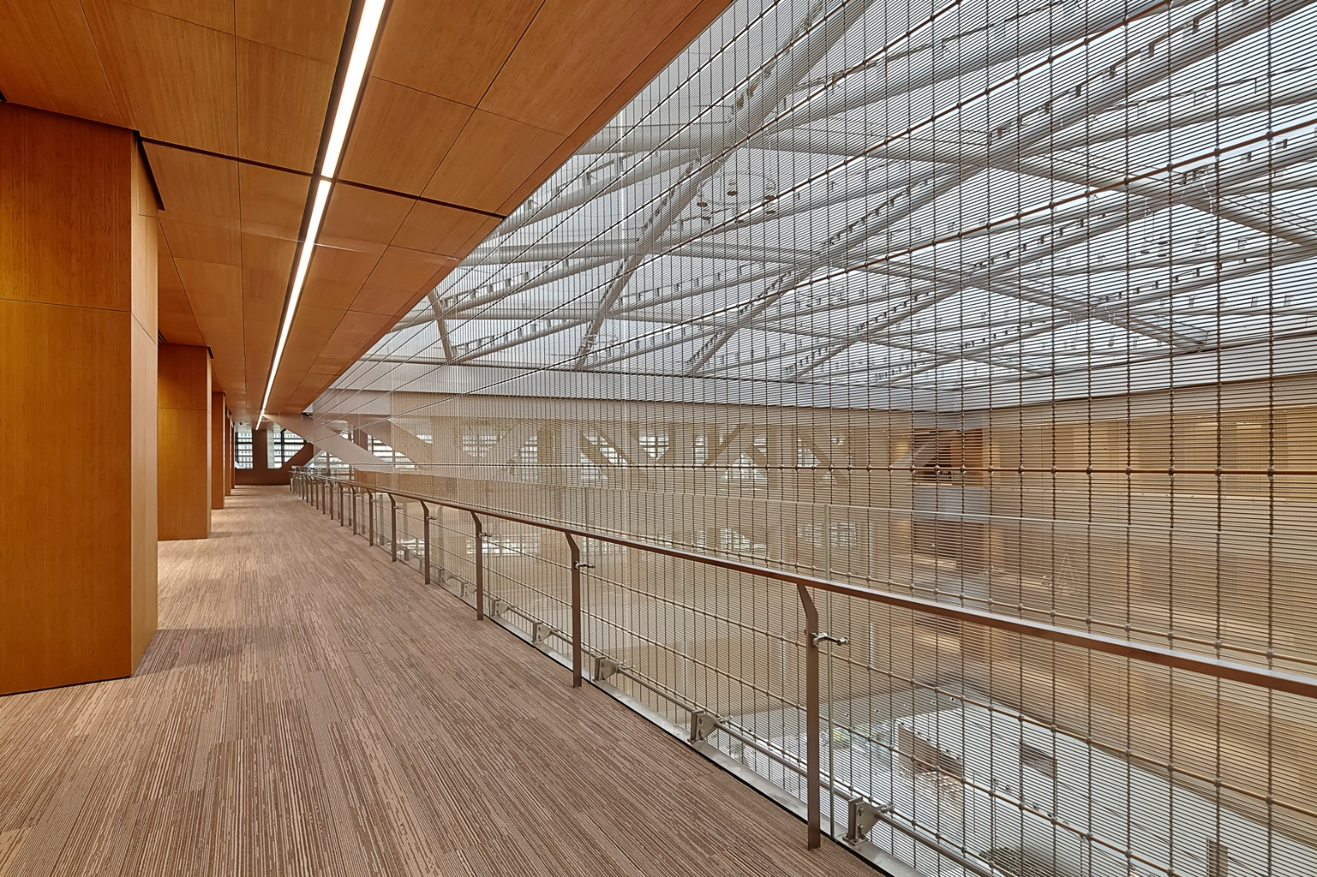
Woven Metal Fabric – High Performance Solutions for Interior Design
Durable, low-maintenance material for use in a variety of applications
Partitions, walls, columns, ceilings, specialty furniture
With tailor-made attachment solutions, the panels are optimally integrated into the building structure, thereby creating a high-grade, protective shell.
Notes:
Interior Surfaces Shine
While metal fabrics used on an exterior can affect the indoor environmental quality regarding views, solar management, thermal comfort and acoustics, they can also be used effectively on interior surfaces to complement outdoor designs and create spaces that are both highly functional and pleasant to live in.
Metal fabrics adorn the walls of the finest hotels, museums, office buildings, and restaurants. They can be used for partitions to create isolated private enclosures or more airy spaces depending on whether a tight or open weave is specified. Metal fabrics are also an ideal material to clad interior surfaces such as walls, columns and ceilings. They can be tiled or framed for flat surfaces, but their flexibility allow free-form installations such as draped from columns or suspended from ceilings.
Metal fabric always adds aesthetic quality and durability, making it an easy material for maintenance and the first choice for high traffic environments. In many cases, a metal fabric wall can also provide sun-shading benefits, depending on whether it’s an inside or outside installation. In any interior application, metal fabrics add glamour and allure.
PICTURED:
Museum of Islamic Art, Doha, Qatar
Akademie Hohenheim, Stuttgart-Hohenheim, Germany
Tencent Headquarters, Shenzhen, China

Slide 10
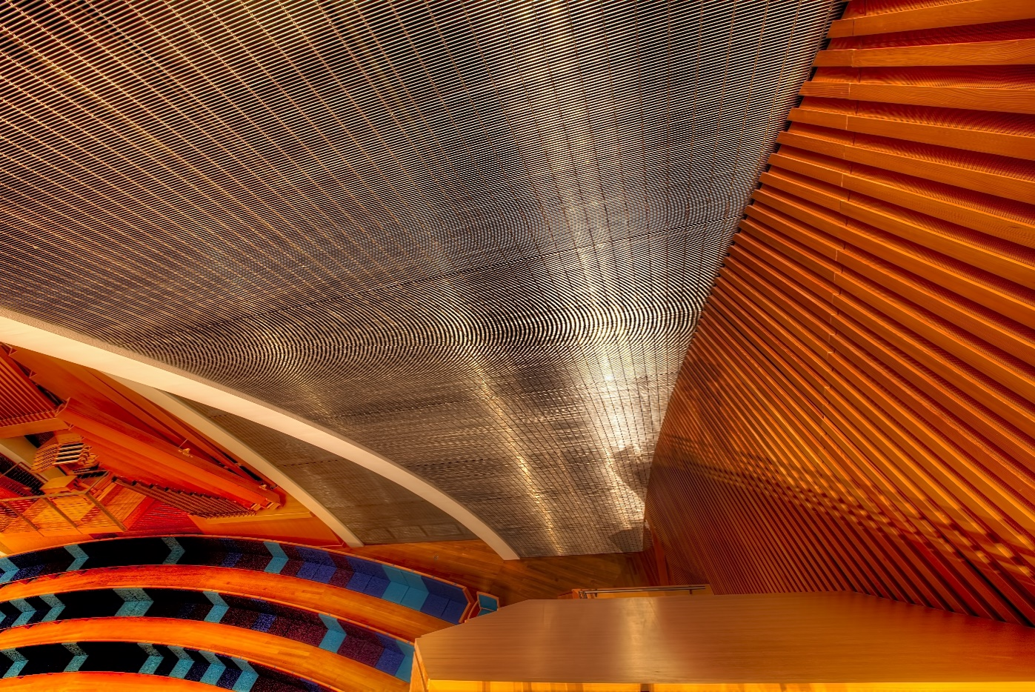
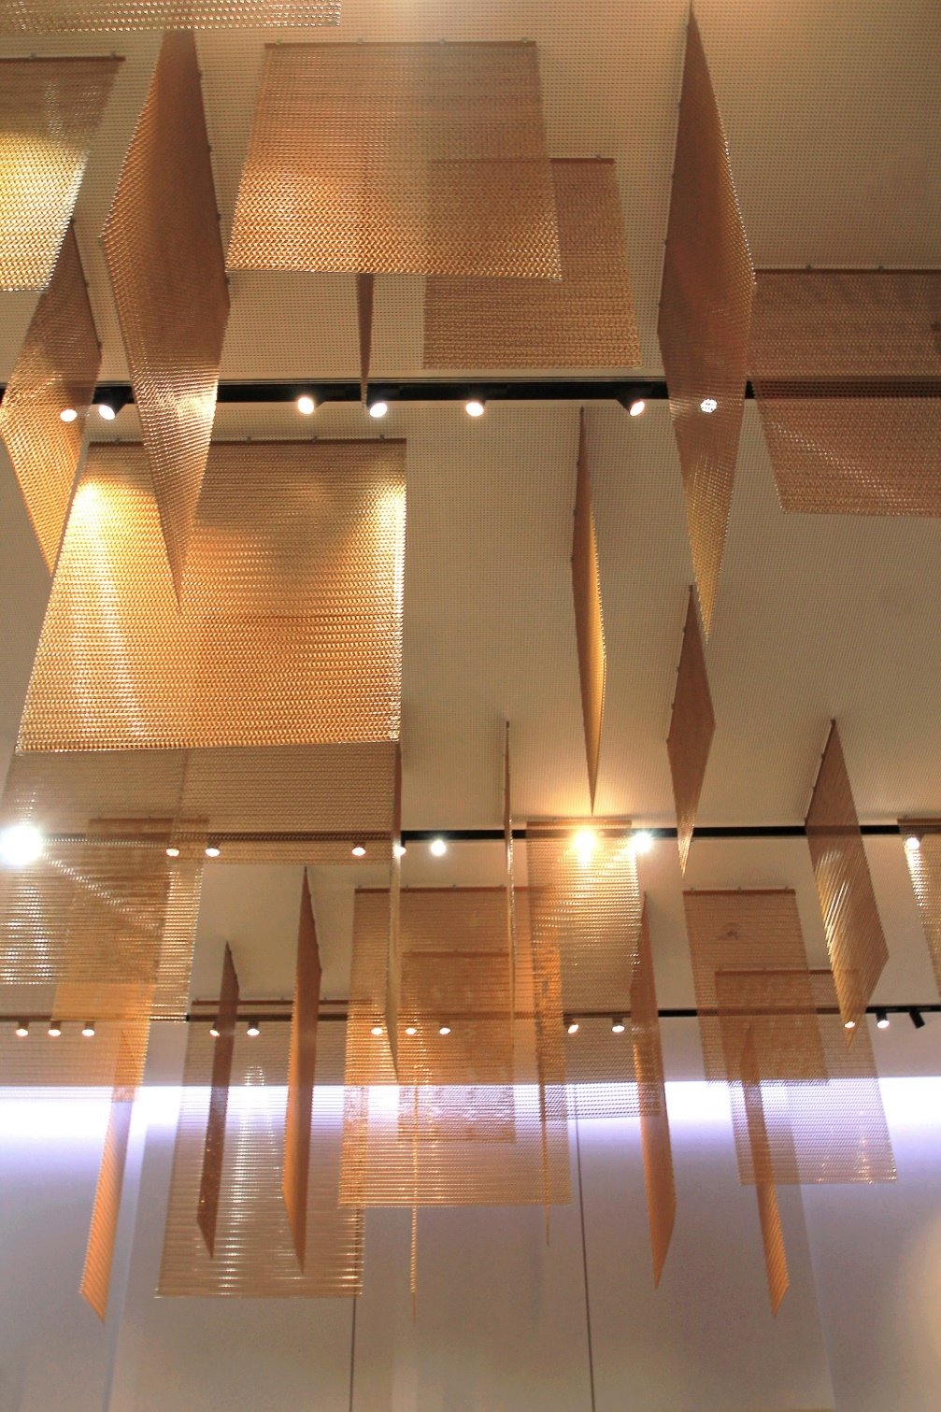
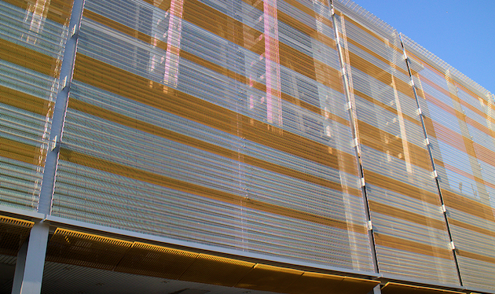
Woven Metal Fabrics – Aesthetic Juxtaposition
A new world of design in the interplay between aesthetics and function, lightness and robustness, transparency and reflection, screening and views, daylight and sun protection
Installed horizontally or vertically, framed in panels or hung like curtains, and shaped into fins, curves, axial twists, screens, or fixed elements
Etched, lighted, manipulated, and coated to great aesthetic effect
Notes:
In commercial and institutional buildings, metal fabrics provide both visual versatility and functional elements. They open up a new world of design in the interplay between aesthetics and function, lightness and robustness, transparency and reflection, screening and views, and daylight and sun protection. They can be installed horizontally or vertically, framed in panels or hung like curtains, and be shaped into fins, curves, axial twists, screens, or fixed elements. Metal fabrics in a wide variety of patterns and weaves can be etched, lighted, manipulated, and coated to great aesthetic effect. We will discuss each of these treatments later in the course, but it is important to know that engaging a manufacturer that can provide innovative material combinations and holistic system solutions is the key to design freedom and a well-executed project.
PICTURED:
Chamber of Commerce and Industry (IHK) for Munich and Upper Bavaria, Germany (left)
Kauffman Center for the Performing Arts, Kansas City, MO (top)
Paris Expo Porte de Versailles, France (middle)
Elswick Place, Ashford, England (bottom)

Slide 11
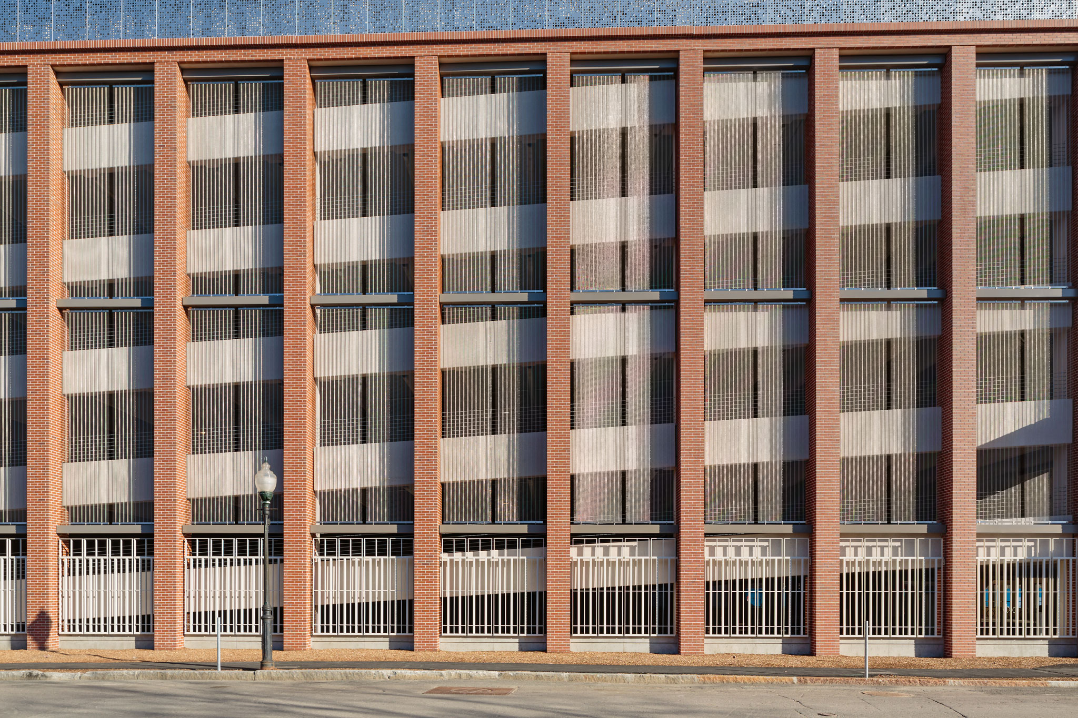
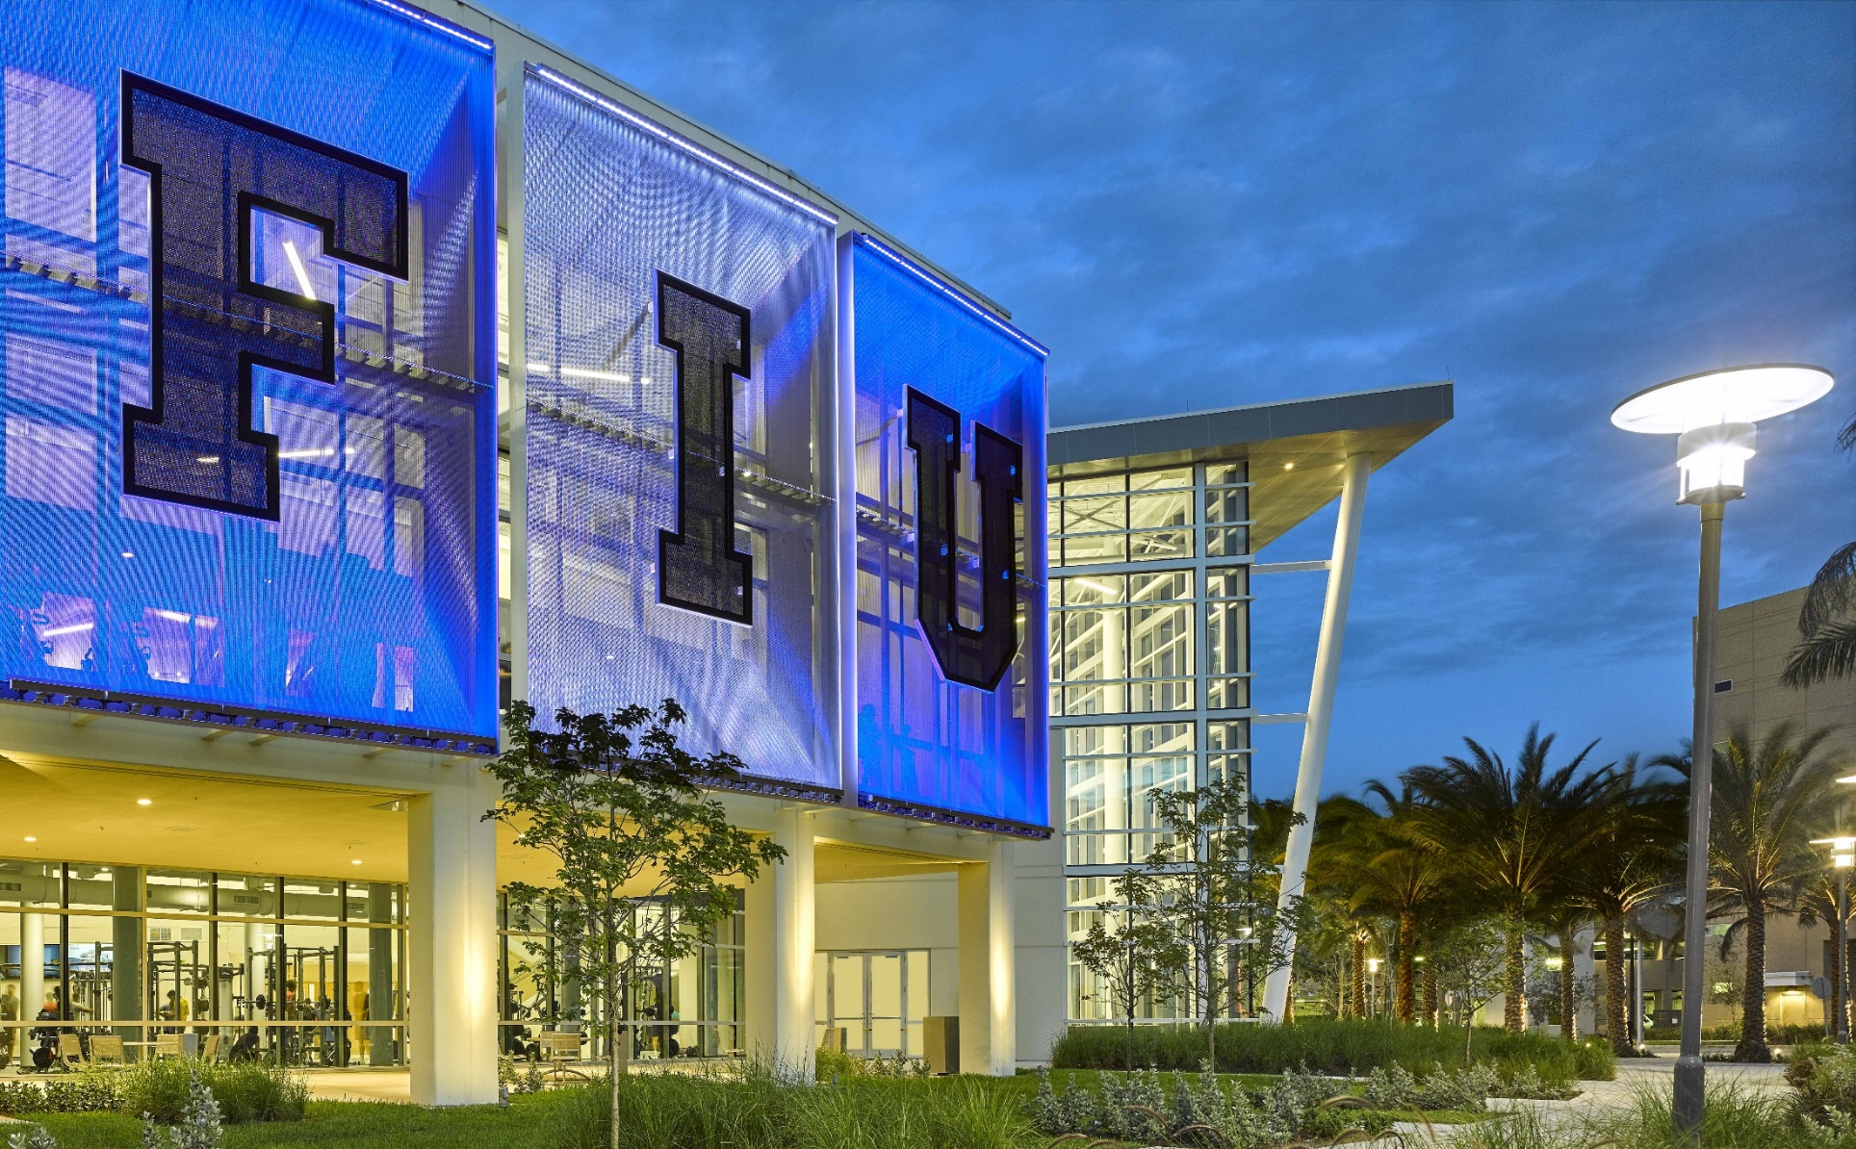
Woven Metal Fabrics –
Functional Advantages
Some buildings such as multi-story parking garages or stadiums require an outer shell that permits air transmission for ventilation
Buildings with large glass surfaces need protection from the sun, driving rain, wind or privacy for occupants
A connecting outer shell is often desired to lend surfaces a sense of homogeneity
Notes:
Alongside a striking visual effect, metallic fabrics also offer an impressive array of functional advantages. Some buildings such as multi-story parking garages or stadiums require an outer shell that permits air transmission for ventilation. On other buildings, large glass surfaces need protection from the sun, driving rain, wind or privacy for occupants. Elsewhere, a connecting outer shell is desired to lend surfaces a sense of homogeneity. Robust, high-grade metal fabric is perfect for all these applications. Not only do they provide cost-effective installation, plus efficiencies associated with stainless steels long lifespan, but they are also easy to maintain and suitable for all climates.
Woven metal fabrics both protect and enrich structures around the world, and are ideal for parking garages, facades, and interiors in numerous types of buildings from residences, offices, and factories to hospitals, schools, and sports facilities. It is no longer necessary to choose between attractive design and the essential functions of these structures.
PICTURED:
One Brookline Place, Brookline, MA
Florida International University, Miami, FL

Slide 12
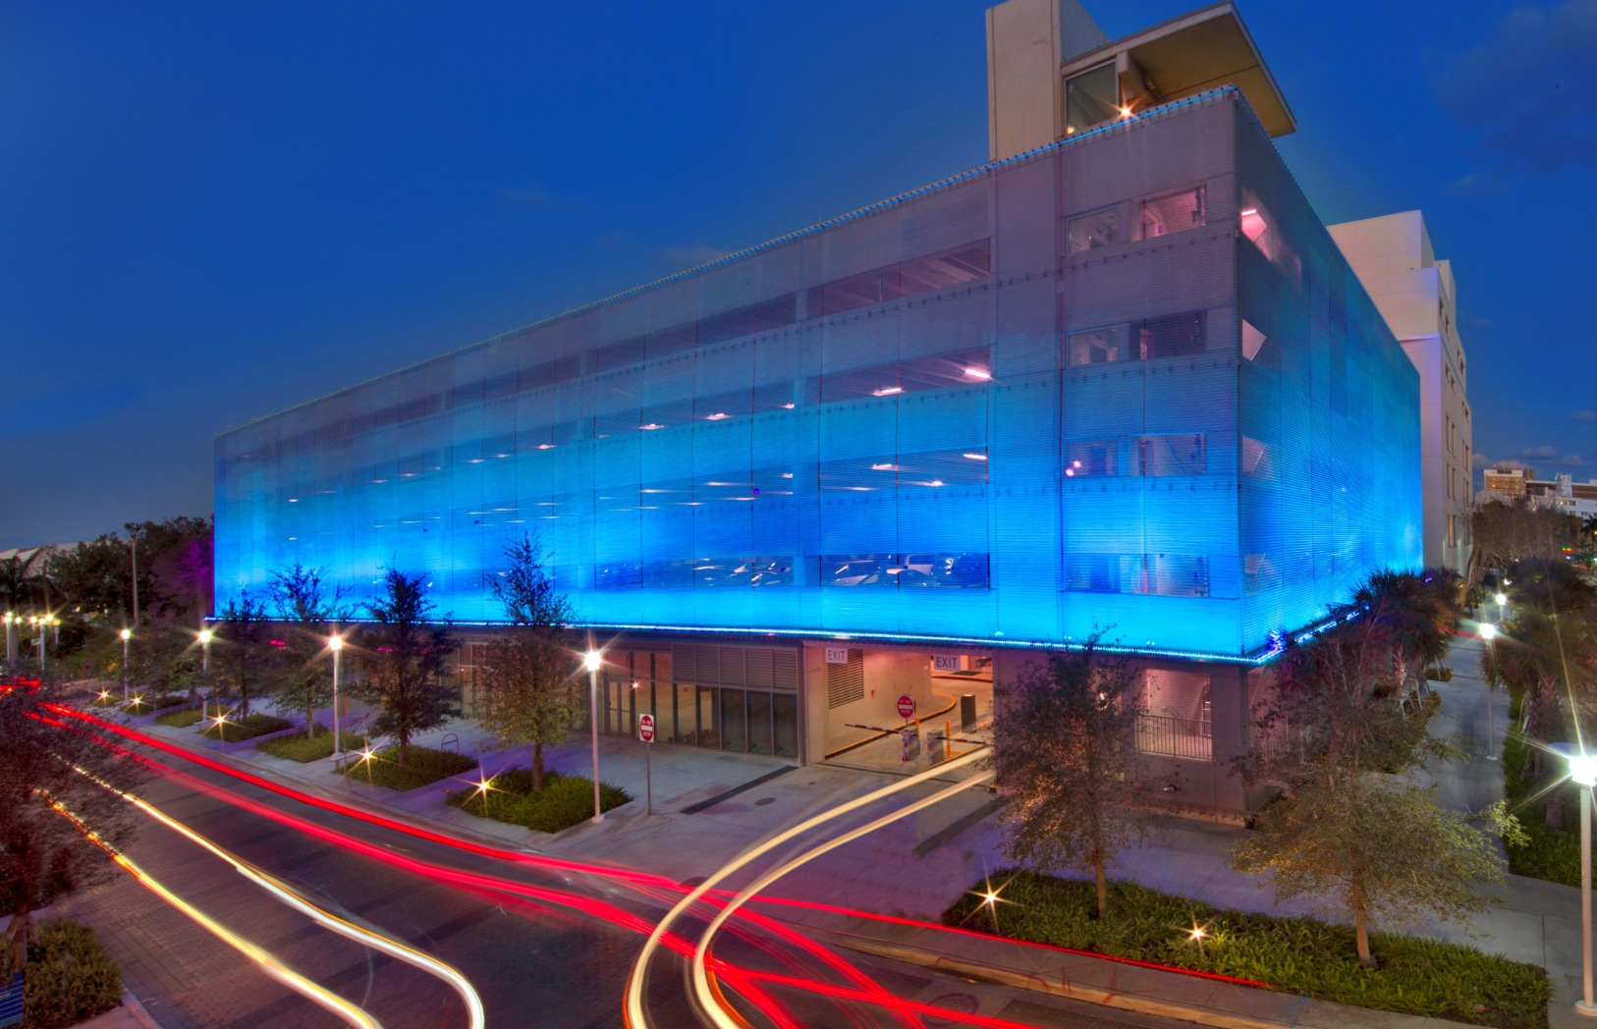
Practical Benefits of Metal Fabric Parking Facades
Ubiquitous and Bland
Works of Art
Notes:
Ubiquitous bland parking garages are being transformed into works of art with woven metal fabric. There are no longer limitations to how good a parking structure can look or how safe and secure it can be. Some parking garages require mechanical systems for ventilation to reduce the effect of vehicle emissions within the space. Their open nature also lends itself to safety issues, so fall protection is a key concern in parking garage design. Vehicle and occupant security are also high-priority safety concerns. Metal fabrics are the optimal material to provide both ventilation, fall safety, and security.
PICTURED:
New World Symphony Parking Garage, Miami Beach, FL

Slide 13
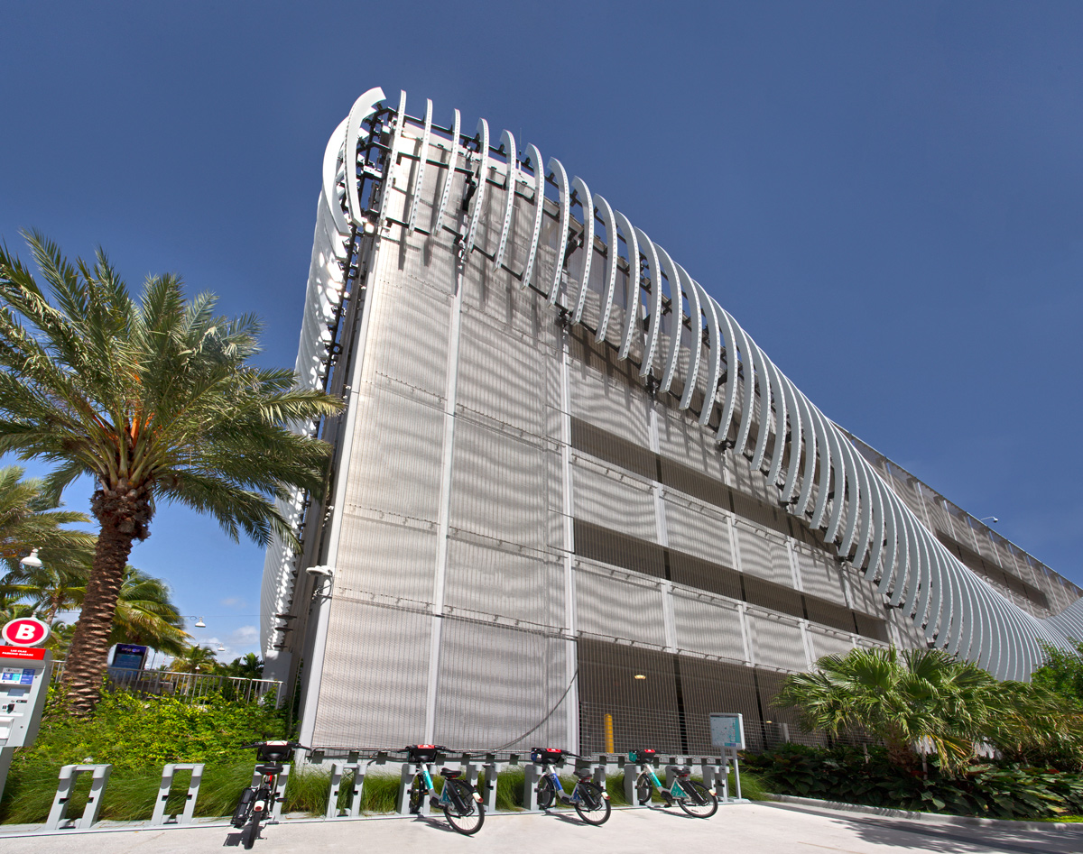
Practical Benefits of Metal Fabric Parking Facades
Code Concerns
IBC 406.4: Enclosed vehicle parking garages must be equipped with a mechanical ventilation system in accordance with the International Mechanical Code
IBC 406.3.3.1: For natural ventilation purposes in open garages, the exterior side of the structure should have uniformly distributed openings on two or more sides
IBC 406.2.3: Guardrails must be provided at these exterior and interior vertical openings on floor and roof areas where vehicles are parked and where the vertical distance to the ground or surface directly below exceeds 30 inches
Notes:
Code concerns
There are fundamentally two types of parking garages regulated by the International Building Code (IBC): private garages and public garages. Although there is no specific definition for either type of garage, the primary difference between private and public garages is the size of the facility, rather than the use.
A public parking garage is then further characterized as one of two types—either an enclosed parking garage or an open parking garage—and regulated accordingly. According to IBC 406.4, enclosed vehicle parking garages must be equipped with a mechanical ventilation system in accordance with the International Mechanical Code. In open parking garages, only the percentage of openings is specified, not mechanical ventilation.
IBC 406.3.3.1 states that for natural ventilation purposes in open garages, the exterior side of the structure should have uniformly distributed openings on two or more sides. The area of the openings in exterior walls on a tier (floor) must be at least 20 percent of the total perimeter wall area of each tier. The aggregate length of the openings considered to be providing natural ventilation should constitute a minimum of 40 percent of the perimeter of the tier. Interior walls should be at least 20 percent open with uniformly distributed openings.
According to IBC 406.2.3, in both commercial and private facilities, guardrails must be provided at these exterior and interior vertical openings on floor and roof areas where vehicles are parked and where the vertical distance to the ground or surface directly below exceeds 30 inches.
Source: https://media.iccsafe.org/news/eNews/2013v10n17/2012_ibc_sigchanges_p27-28.pdf
Source: http://www.ibc-wiki.com/section-406/
PICTURED:
Las Olas Parking Garage Fort Lauderdale, FL

Slide 14
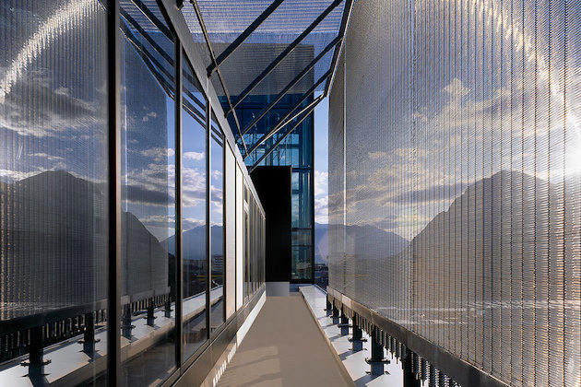
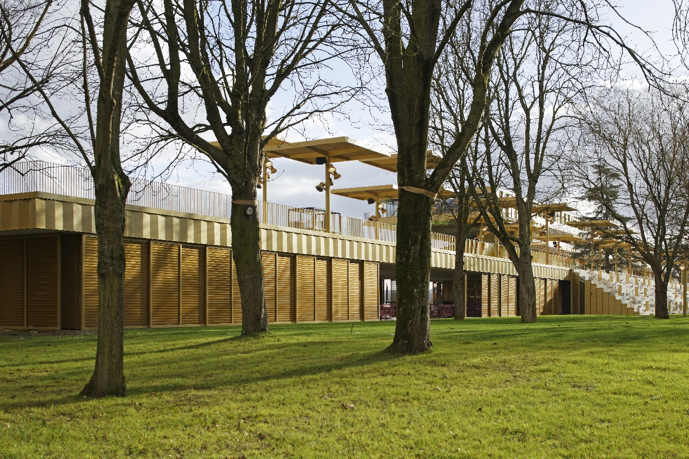
Solution – Metal Fabric Systems
Vehicle | Pedestrian Security
Visual Appeal
Energy | Cost Savings
Protects from the Elements
Metal fabrics provide a secure environment that limits unwanted access, protects from the elements and provides pedestrian safety by way of balustrades.
Notes:
Solution - Metal Fabric
You can see how open parking garages, which require a large percentage of open area at significant heights, could pose a fall hazard and a security concern. Metal fabric systems and hardware have been developed so that metal fabric facades can be incorporated into a parking structure to create an environment for vehicle security and visual appeal. Because of the fabric’s transparent characteristic, no mechanical systems are required for ventilation, translating into energy and cost savings. Metal fabrics provide a secure environment that limits unwanted access, protects from the elements like wind, rain, snow, and ice, and provides pedestrian safety by way of balustrades.
Woven fabrics are available with varying open area that range from 0% to 71%. Open weave is the amount of light and fresh air permitted through a woven metal fabric panel. The open area that is driven by code ensures that loads experienced against the building are not so severe that they result in damage either building or Metal Fabric. The open area allows enough movement of air to relieve pressure. In fact, it is often the building, not the fabric system, that fails in such circumstances. Building code language is project specific to the physical location of the garage. Local codes will dictate the required open area of the product.
***A note about ventilation: ventilation is not only important in parking garages, but also other open-air facilities such as stadiums. It would be wasteful to heat or cool an entire stadium that is largely exposed to the elements, but with the right mix of cooling and natural ventilation, the stadium becomes instantly more comfortable reducing temperatures and saving energy costs. This is particularly important because stadiums are expensive to build and maintain and many have to operate as fully multi-use venues for economic survival. Lowering energy costs while letting ventilation work its magic is a win-win. Like in parking garages, fabric mesh systems can be used to provide both natural ventilation and fall protection.
Source: https://www.macair.co.uk/blog/importance-stadium-ventilation/
PICTURED:
Kunsthalle Mannheim Museum of Modern and Contemporary Art, Mannheim, Germany
Rathaus Galerie Hotel, Innsbruck
Longchamp Racecourse, Paris, France

Slide 15
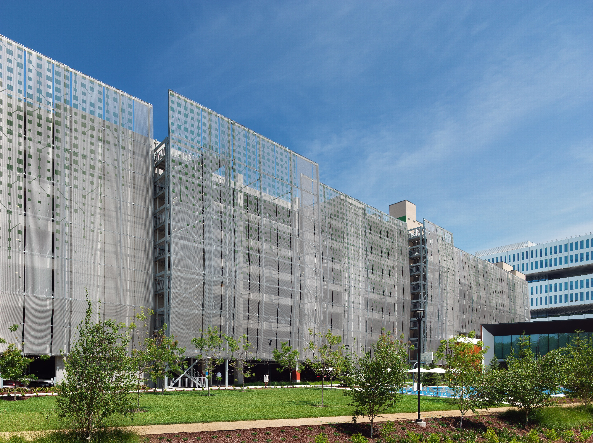
Case Study: Samsung American Headquarters Parking Garage
Notes:
Samsung American Headquarters Parking Garage
San Jose, CA
The Samsung American Headquarters Parking Structure was enveloped in metal fabric and artistically upgraded with a color coating in a design provided by the owners that combines technology and nature. The pattern represents a printed circuit board and when placed on the façade mimics vegetative growth winding its way from top to bottom. A special process was used to layout, apply the coating, match the panels, and then install them all on site. Engineering, substructure, and mounting hardware were also supplied by the manufacturer. This was a turnkey project with a major benefit being that there was only one company for a General Contractor/Construction Manager to manage where typically there would be several.

Slide 16
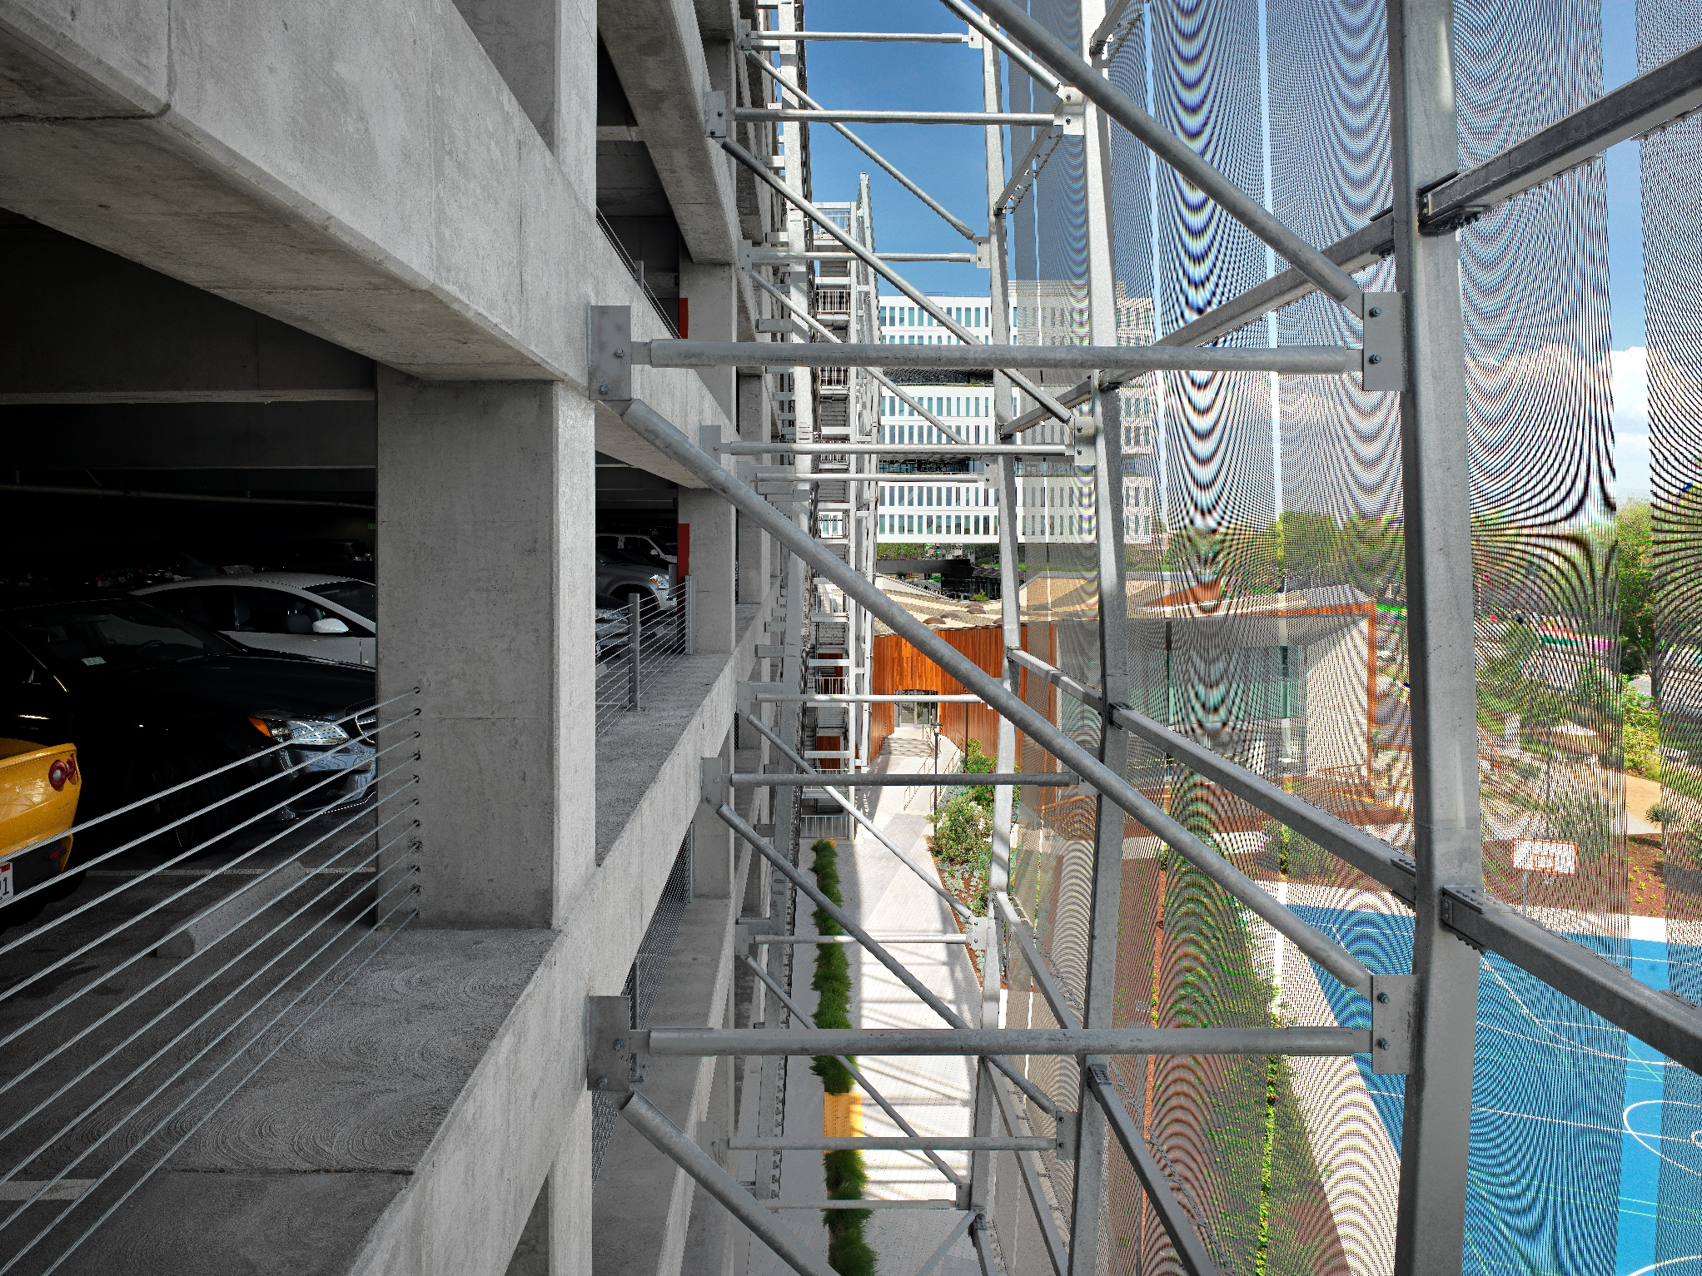
Case Study: Samsung American Headquarters Parking Garage
Notes:
Samsung American Headquarters Parking Garage
San Jose, CA
Facades – Not Just a Pretty Face
Flexible, woven metal fabric façades provide both utility and beauty for nearly any structure, from parking lots to museums. The open weaves offer transparency and functionality thus enticing the building from the outside without obscuring views from within, allowing for air circulation while also providing necessary security. Metal fabric facades stylize a structure by covering an old or visually unappealing building by giving it a living breathing skin.
In fact, you can put a “new face” on buildings of most every type, shape, size, and age as you can see here where an otherwise standard parking garage becomes a striking visual addition to the campus. Fabric facades also help to hide mechanical systems from view. And, with their durability and ease of maintenance, transparent metal fabric facades last for many decades. Some metal fabric manufacturers can assist at every step of the design process, from facade concept and design to engineering and installation.

Slide 17
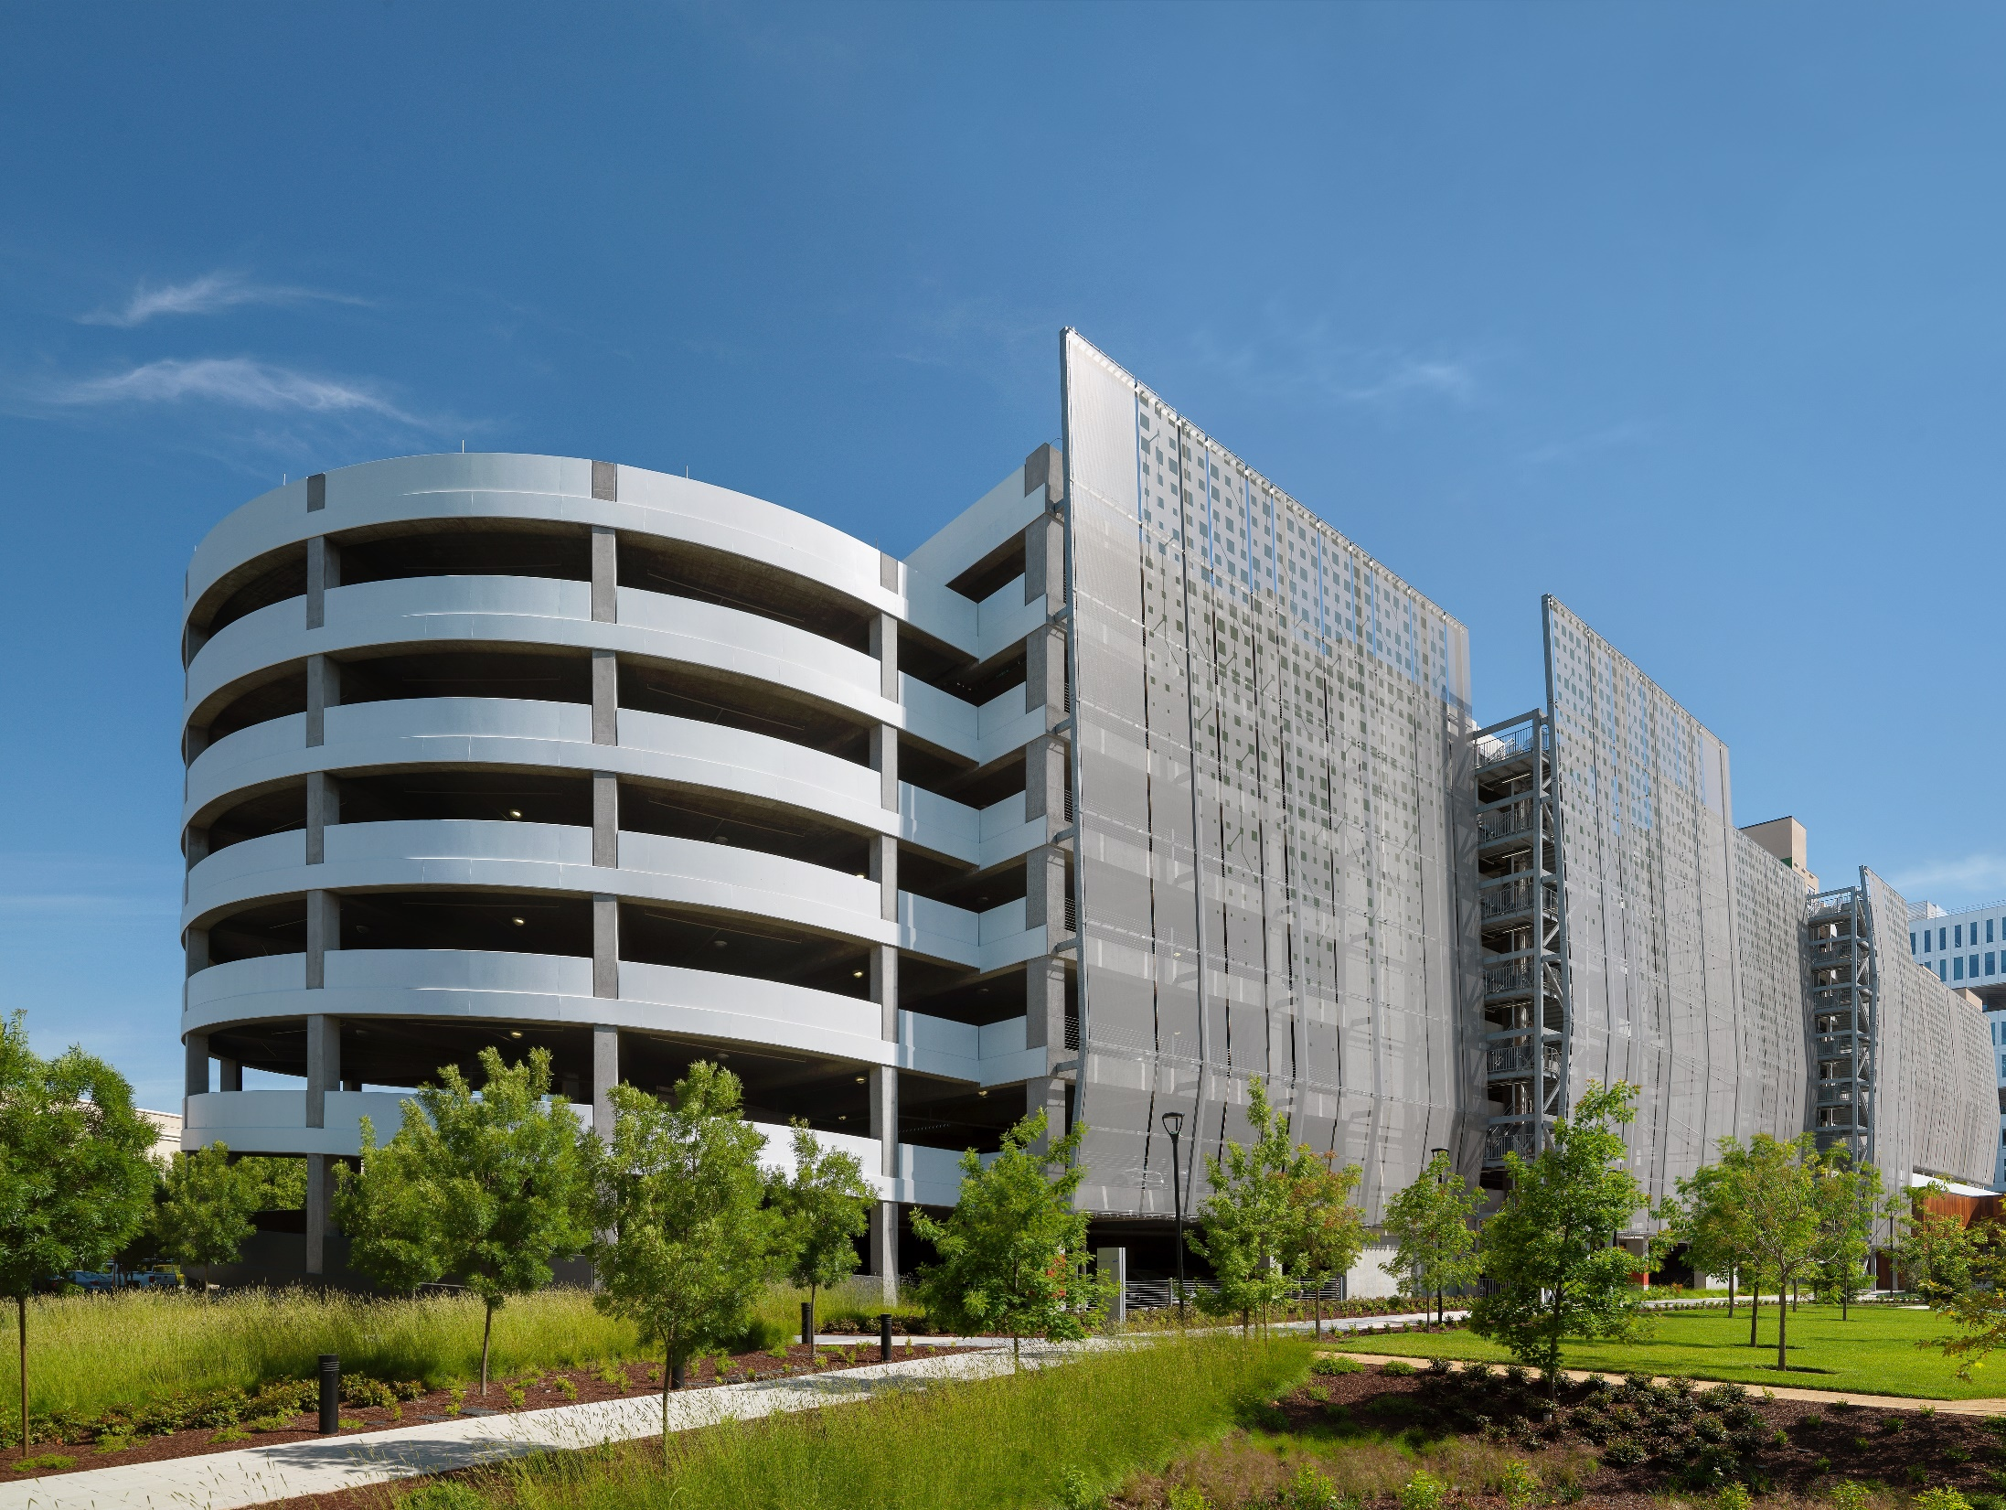
Case Study: Samsung American Headquarters Parking Garage
Notes:
Samsung American Headquarters Parking Garage
San Jose, CA
It’s important to remember that metal fabrics can often be seen from within the building and effect the indoor environmental quality regarding views, solar management, thermal comfort and acoustics.

Slide 18
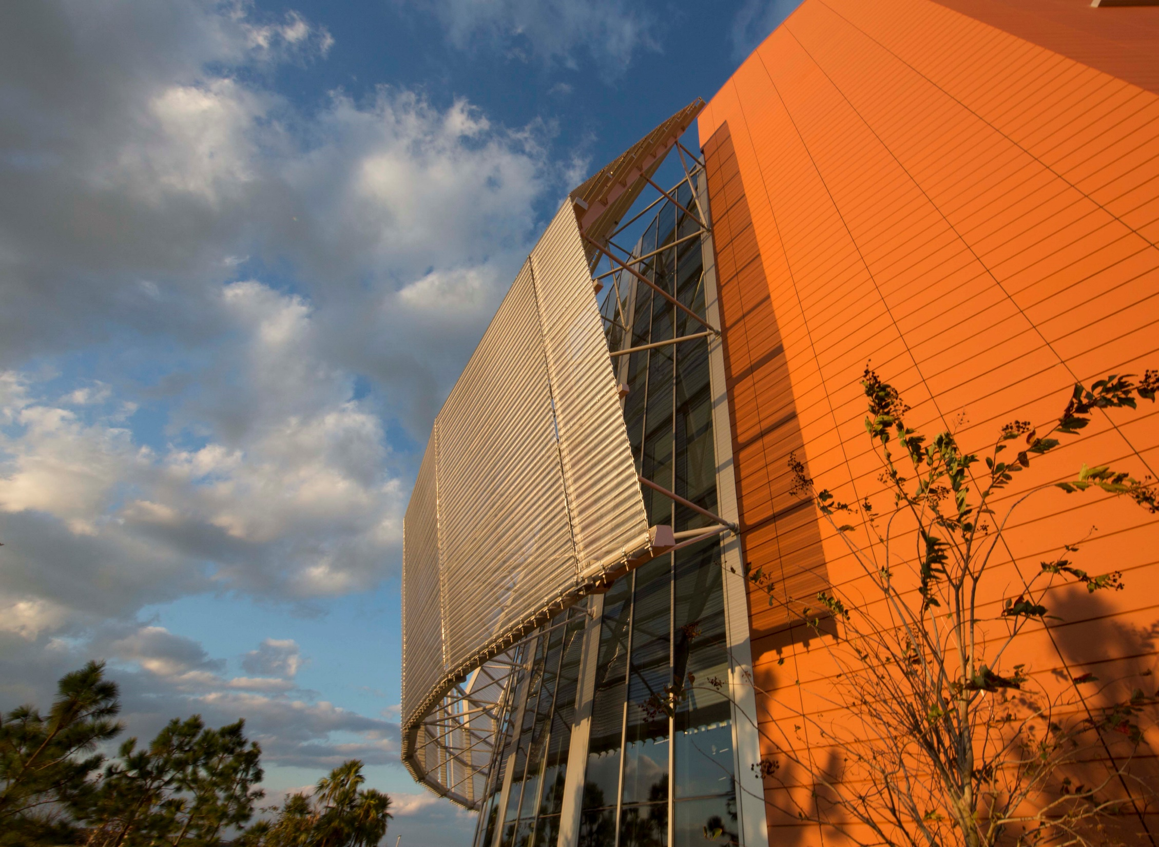
Learning Objective #2
Learn the performance benefits of metal fabrics including safety and security, solar management, and sustainability.
Notes:
Next, we will learn the performance benefits of metal fabrics including safety and security, solar management, and sustainability.
PICTURED:
University of Florida Research and Academic Center at Lake Nona, Orlando, OH

Slide 19
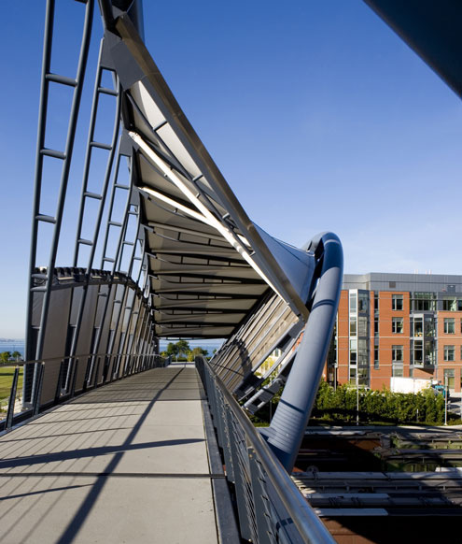
Performance Benefits
Safety | Security
Balustrades
Roller Shutters
Fall guard protection
Fire resistance
Solar Management
Maximizes energy efficiency in buildings
Provides a thermal environment for occupants
Plays a key role in sustainable design
Notes:
Aside from the aesthetic and functional features we have discussed thus far, metal fabric systems go far beyond to provide excellent performance benefits such as safety and security, solar management and sustainability. Metal fabric provides safety and security via balustrades, roller shutters, fall guard protection, and fire resistance. These safety features are extremely important in stairwells, open structures, and pedestrian walkways, while the added security that metal fabric provides is useful in parking garages, shops, and restaurants. Solar management helps to maximize energy efficiency in buildings and provide a comfortable thermal environment for occupants and plays a key role in sustainable design.
PICTURED:
Amgen Helix Pedestrian Bridge, Seattle, WA

Slide 20
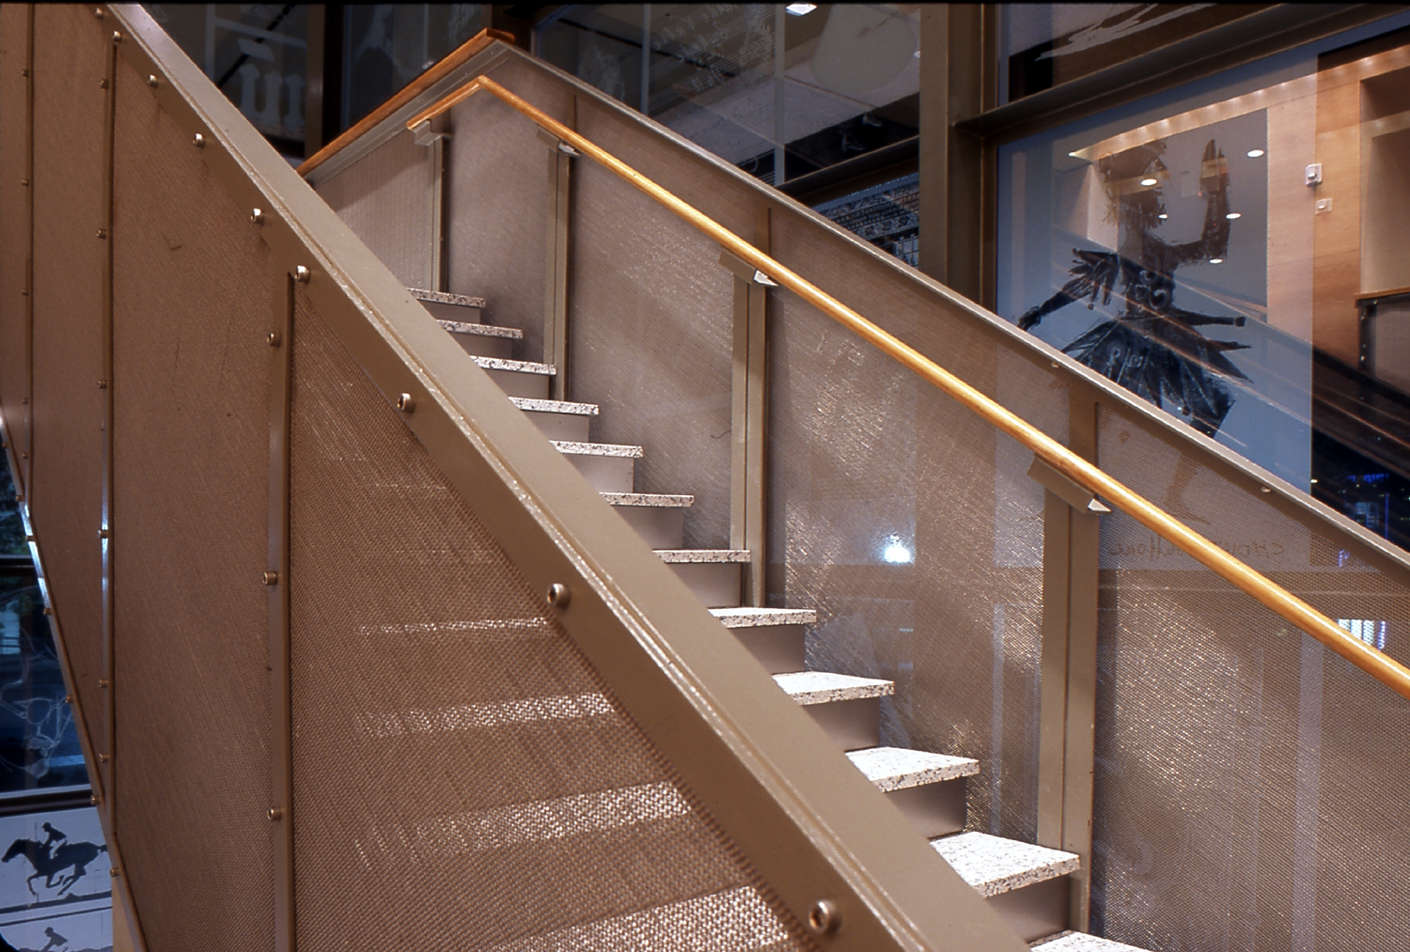
Safety & Security (Metal Fabric Balustrades)
Design
Light and graceful presence
Varying metal fabric patterns
Material flexibility
Ability to make more complex, organic design options
Safety
Reliable
Rugged Durability
Notes:
Metal Fabric Balustrades
All railing and balustrade applications focus on two key aspects: design and safety. These materials are suitable for both indoor and outdoor applications and provide security while retaining a light and graceful presence. The availability of various metal fabric patterns allows designers to perfectly tailor a solution to individual balustrades. Flexible patterns easily follow the rise of staircases, while typical metal balustrades are comprised of metal fabric panels with an external frame ready for point fittings, posts, and handrails. The material’s flexibility also facilitates use on more complex, organic designs and the project team can select the degree of transparency as required by the application or code. Exceptional aesthetics coupled with reliable safety and minimal care or maintenance coupled with rugged durability, make these balustrades ideal for both new buildings and renovations.
PICTURED:
Harry Ransom Center, Austin, TX

Slide 21
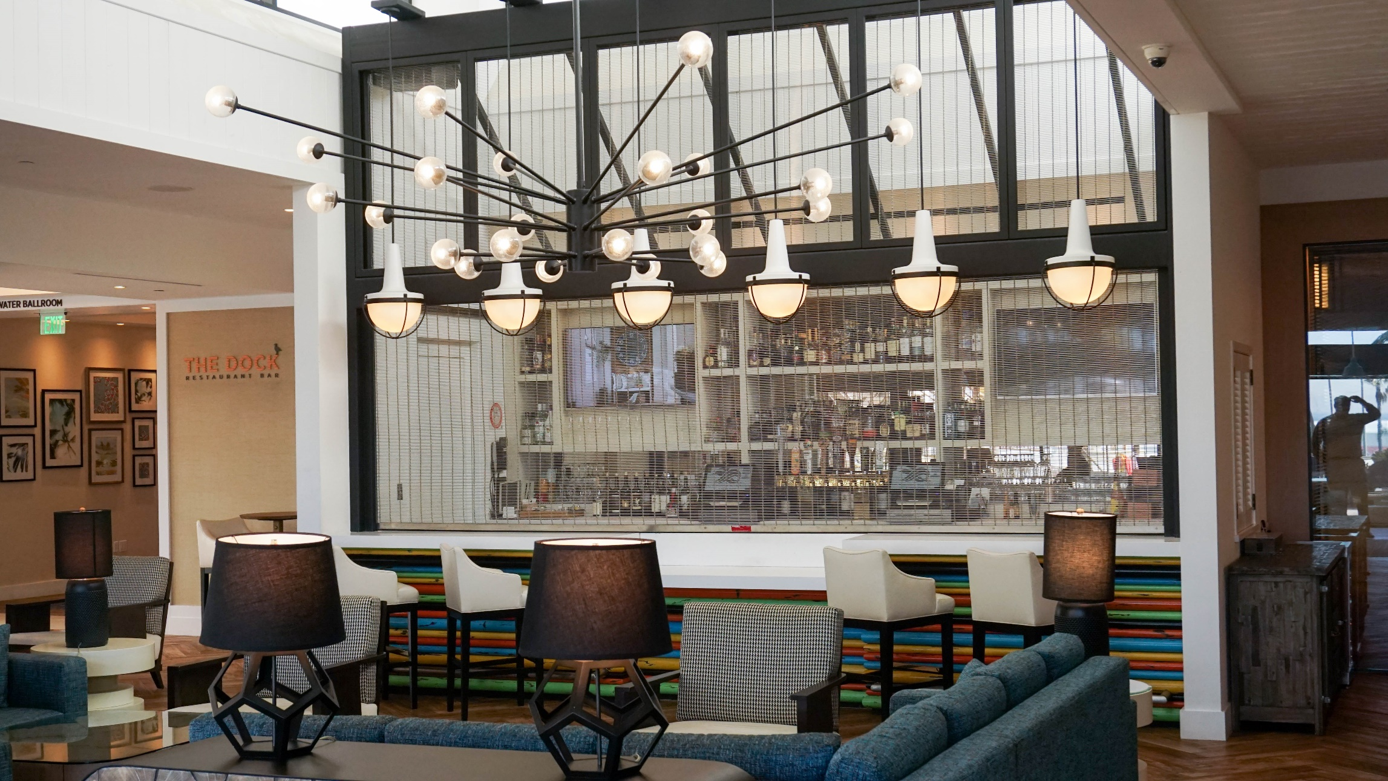
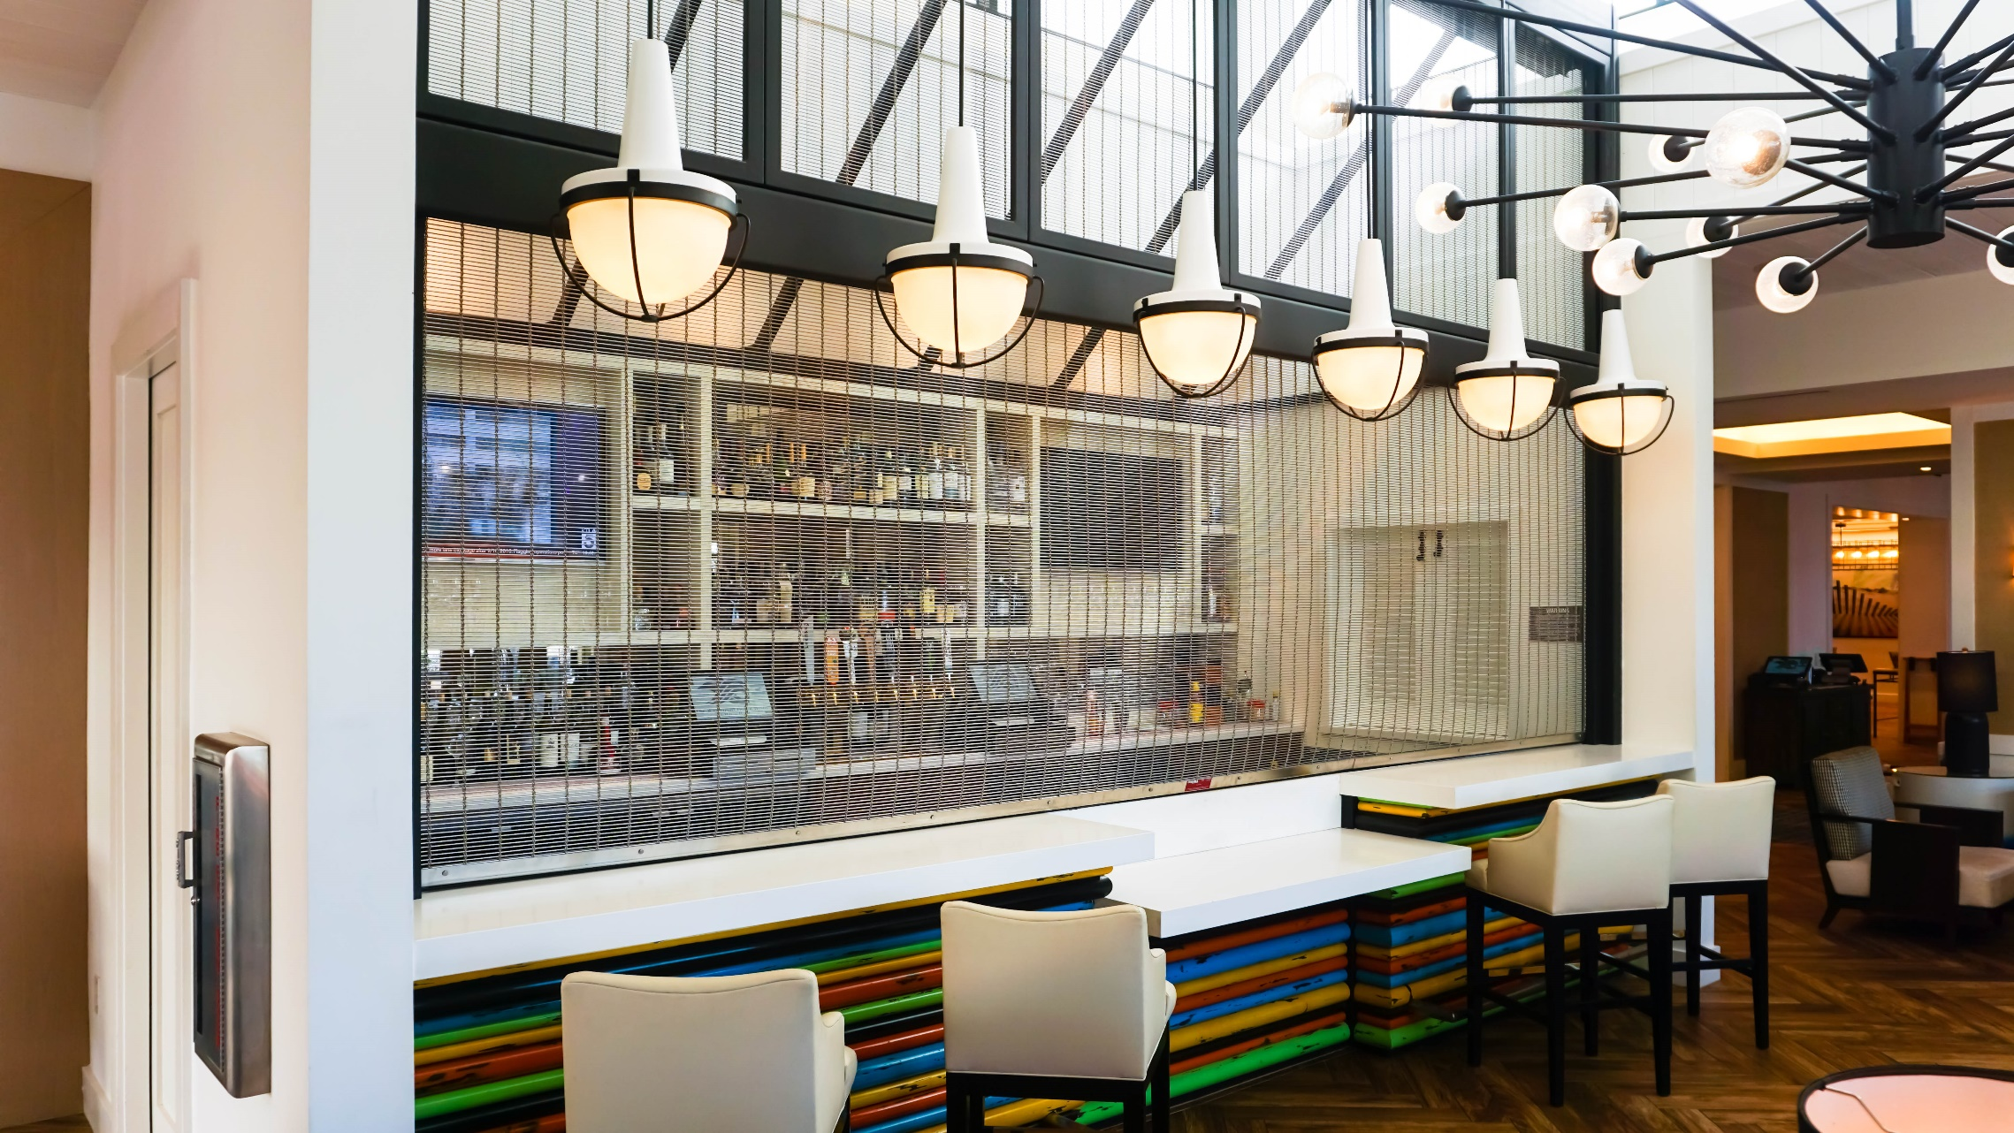
Safety and Security
(Roller Shutters)
Safety & Security Considerations
Effectively segregate sensitive areas
Protect areas from unauthorized access
Can be used primarily as a barrier
Can be equipped with a self-locking system to offer effective theft protection
May be operated manually or automatically with a fully motorized system
Notes:
Roller Shutters
Roller shutters made of metal fabric effectively segregate sensitive areas and protect them from unauthorized access. This can be useful in shopping malls, jewelry stores, bars and restaurants where open-air environments are prominent. Depending on security requirements, the metal fabric can be used primarily as a visual access barrier or it can be equipped with a self-locking system to offer effective theft protection. Roller shutters made of metal fabrics can be operated manually or automatically with a fully motorized system. Lateral guides ensure that the grid sections slide down smoothly.
Metal fabrics have long been used in harsh exterior applications and roller shutter systems are a simple extension of this application for both indoor and outdoor use. With their transparent appearance, metal meshes grant a view of the areas they cover, creating an overall sense of space that can be enhanced by complementary lighting. Various fabric types are available, and selection depends on the degree of transparency desired.

Slide 22
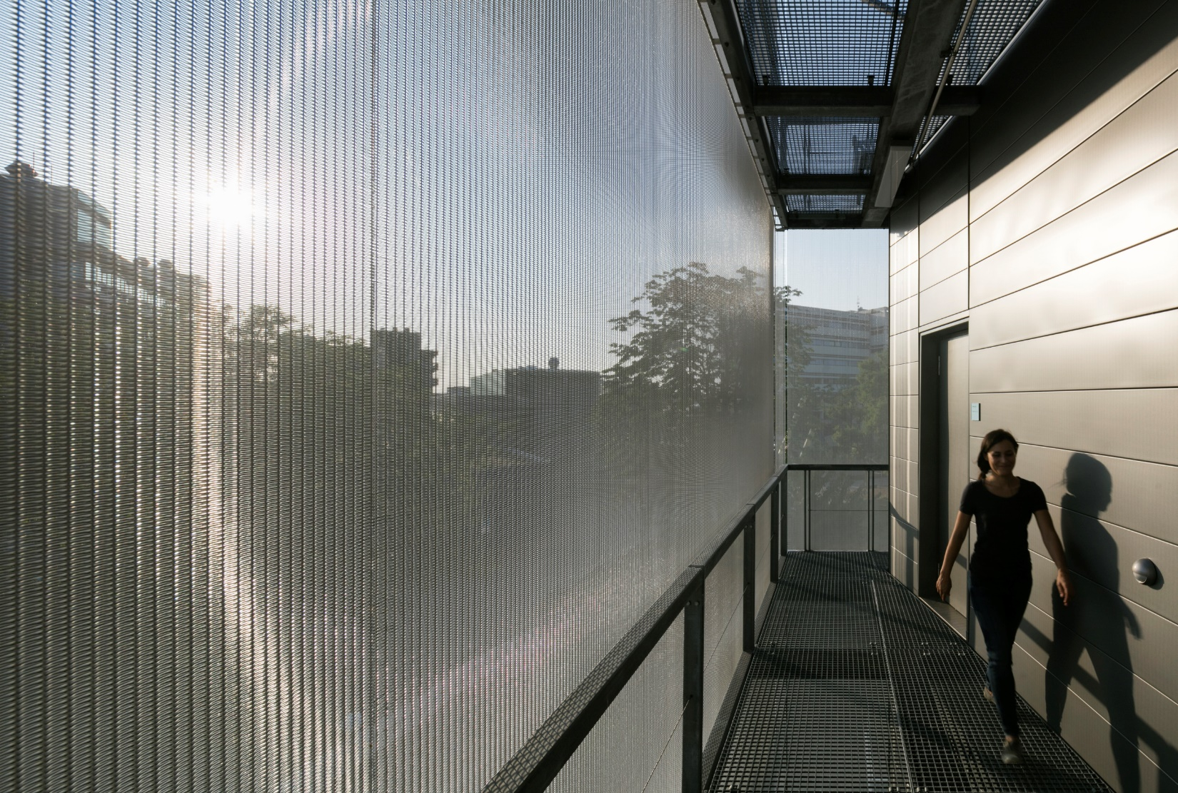
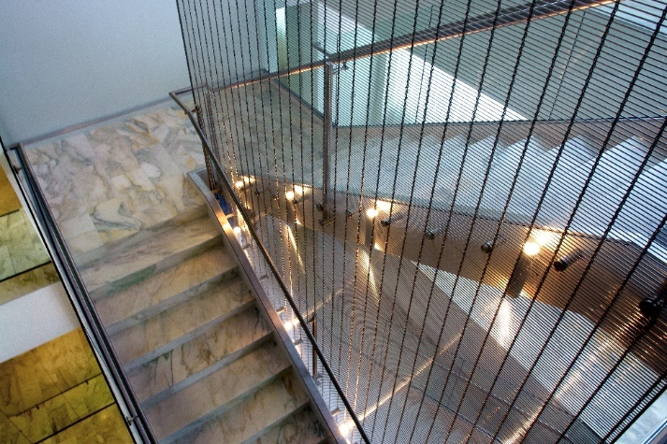
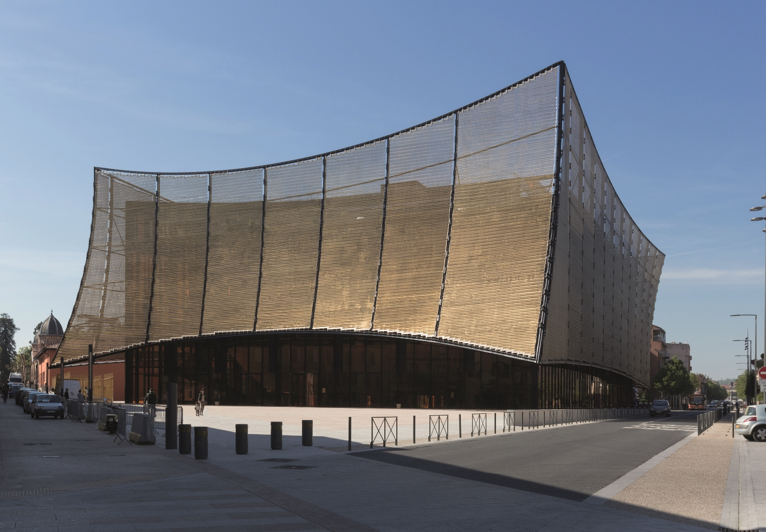
Safety and Security (Fall Guard Protection)
Protection for both indoor/outdoor staircases
No distracting seams or butt joints
With tailor-made attachment solutions, the panels are optimally integrated into the building structure, thereby creating a high-grade, protective shell.
Notes:
Fall Guard Protection
Whether designed as an enclosure or tensioned in the center of a stairwell, stainless steel metal fabrics offer woven protection and safety for both indoor and outdoor staircases. Manufacturing ability of up to 26 feet in width and over a 100 feet in length, make tensioning over several floors simple. The fabrics offer protection over a large area without any distracting seams or butt joints. Different fabric types meet various requirements for transparency and robustness. Due to their structure, metal fabrics can be shaped in a straight cable direction and are even capable of cladding circular building structures almost seamlessly. With tailor-made fastening solutions, the panels are optimally integrated into the building structure, thereby creating a high-grade, protective shell.
PICTURED:
University of Heidelberg, Germany
Phelps Dunbar, Baton Rouge
Grand Theatre des Cordeliers, Albi, France

Slide 23
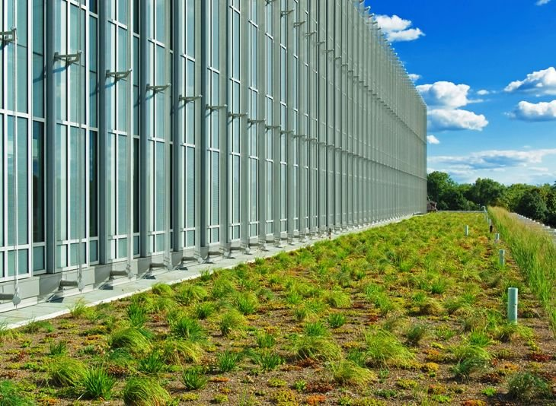
Solar Management
Metal fabric panels envelope building facades made of glass, metal, and other cladding materials to provide protection from direct sunlight and solar heat.
Software can calculate the solar parameters of a metal fabric solar protection system for any type of glazing.
Solar protection plays a key part in supporting sustainable energy efficiency goals.
Notes:
Solar management is a recent trend that is driving growth in the metal fabric market. Solar management tactics can include solar protection, solar heat gain, shading, daylighting, and views. The goal is to achieve optimum energy efficiency using the outer shell to support climate control by allowing solar heat into the building in winter and screening the building from solar radiation during summer.
Woven stainless steel facades are not only visually appealing but provide function by offering excellent solar protection properties. This is especially true during blazing hot days of summer or the horizon’s low direct sun during winter. Modern façade-cladding materials generally allow the heat generated by solar radiation to enter the building very quickly. During the summer months or in climate zones with a lot of daily sunshine this drives up the interior temperature and consequently the additional cooling requirements too. This creates a negative impact on the building‘s energy balance, but by using a well-designed metal fabric solution the building will minimize the harsh effects of direct sunlight and the heat that accompanies this. Metal fabric panels envelope building facades made of glass, metal, and other cladding materials to provide protection from direct sunlight and solar heat.
A pleasant outward view is combined with relief from harsh direct sunlight and solar heating, particularly when the summer sun is high in the sky. This will additionally occur when the sun is low in the sky during winter and solar heat gains are achieved depending on the type of glazing used. Software can calculate the solar parameters of a metal fabric solar protection system for any type of glazing. Besides creating a pleasant working environment for employees, and other commercial building occupants, solar protection plays a key part in supporting sustainable energy efficiency goals. Early and comprehensive planning for solar protection is important in order to maximize energy efficiency.
PICTURED:
Eastern Michigan University, Ypsilanti, MI

Slide 24
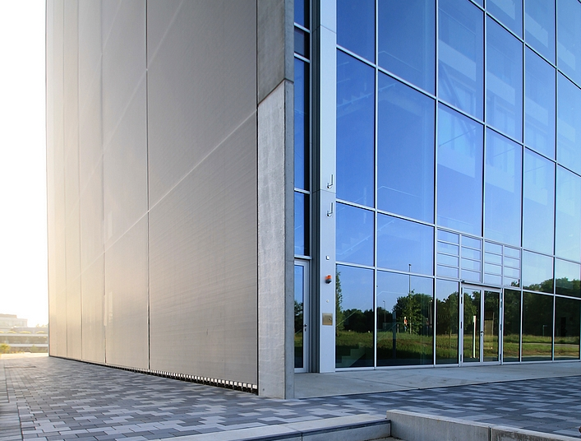
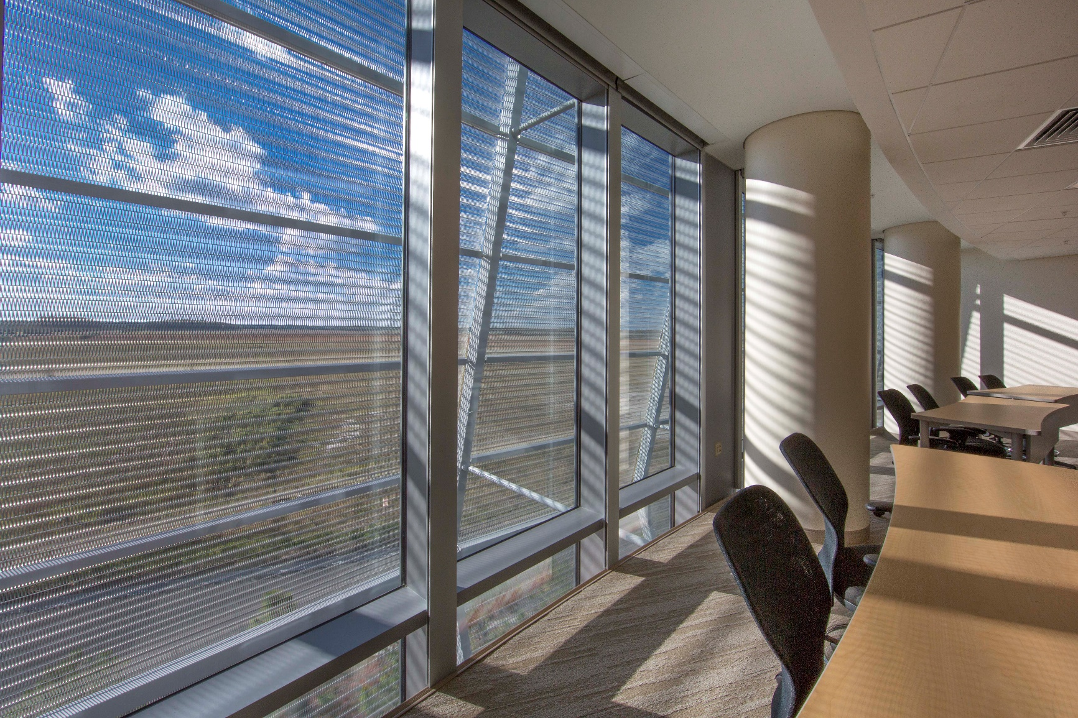
Solar Management - Daylighting
Minimizes the need for artificial lighting
Less waste heat is generated
Does not restrict outward views
With tailor-made fastening solutions, the panels are optimally integrated into the building structure, thereby creating a high-grade, protective shell.
Notes:
Controlling daylight and maintaining a clear outward view are other important factors that can improve occupant comfort. In many countries, these basic conditions are legally required for workplaces even when active solar protection systems are already in place. The use of metal fabric to daylight can help reduce power consumption in buildings in two different ways: it minimizes the need for artificial lighting, and since less artificial lighting is used, less waste heat is generated too. The open structure of metal fabrics allow daylight to enter the building without restricting any outward views.
As you can see, metal fabrics play a key role in achieving solar management goals. Solar protection, solar heat gain, and daylighting can be accomplished through fixed metal fabric panels, tensioned vertical panels, and roll-up systems for solar protection. The amount of protection will depend on the pattern of the metal fabric and the open area of that pattern, then whether it is placed horizontally or vertically on the building. Solar management isn’t just a benefit to facility managers and building owners who face increasing energy costs, it also aids occupant comfort while reducing a building’s overall burden on the environment, as we will discuss in the next section.
PICTURED:
Bio-Medical Engineering Cluster, RWTH Aachen Campus, Germany
University of Florida Research and Academic Center at Lake Nona, Orlando, OH

Slide 25
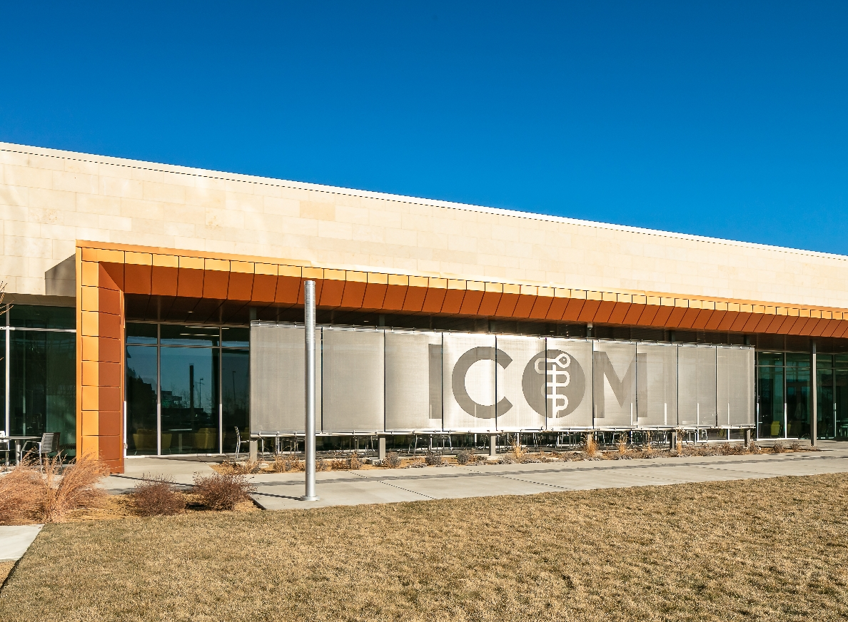
Case Study: Idaho College of Osteopathic Medicine (ICOM)
Notes:
Solar Shading Made of Stainless Steel Metal Fabric
Idaho College of Osteopathic Medicine (ICOM)
Folsom, CA
The Idaho College of Osteopathic Medicine (ICOM) near Boise, ID inhabits a new 94,000-square-foot campus. Architect Dekker/Perich/Sabatini (D/P/S) identified stainless steel metal fabric as a design solution for solar control and soon discovered metal fabric as an ideal solution. After providing solar control test data, it was decided that metal fabric would offer optimal solar control without disrupting views of the campus from the inside. Etching capability provided an opportunity to underscore the ICOM brand identity. Etching creates visual imagery that is durable, weather- and fade-resistant. The multifunctional fabric provides the campus with increased energy savings through solar control while adding to the comfort level of the building occupants. Additionally, the campus is enhanced by the prominent etched graphics that serve to instill a sense of school pride as one of the few osteopathic medical schools in the country.

Slide 26
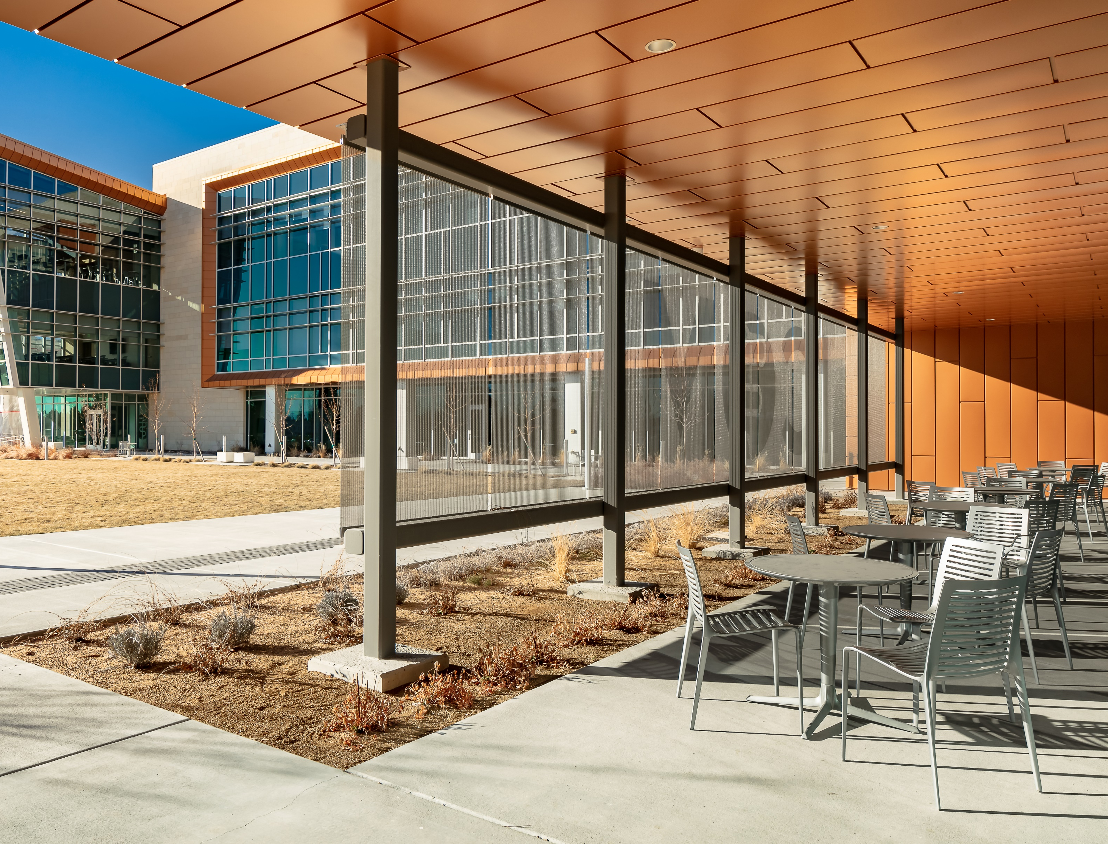
Case Study: Idaho College of Osteopathic Medicine (ICOM)
Notes:
Solar Shading Made of Stainless Steel Metal Fabric
Idaho College of Osteopathic Medicine (ICOM)
Folsom, CA
Sustainability
In an increasingly disposable world, reducing demand on our natural resources and providing long-term value is important. Woven metal fabrics optimize the environmental performance of buildings and are thereby gaining importance in green building certification. Utilizing metal fabrics is an environmentally responsible and resource efficient choice because stainless steel used in metal fabrics contains greater than 60% post-industrial and post-consumer recycled content. Recyclability directly correlates with minimization of waste and recycling stainless steel does not involve any hazardous materials. Stainless steel is the readily available and active metal markets are currently in place making facilitation and re-use of the product prominent.
Not only is stainless steel made of recycled materials and is 100% recyclable, retaining its inherent qualities throughout the recycling process, but it does not require hazardous cleaning products to maintain or a surface coating that can deteriorate and possibly pollute the environment. Metal fabrics are non-corrosive, durable, heat, fire, and impact resistant. As just discussed, they can be utilized as a building façade or skin in all climates and environments to mitigate intense sunlight while providing natural light and ventilation for energy savings.

Slide 27
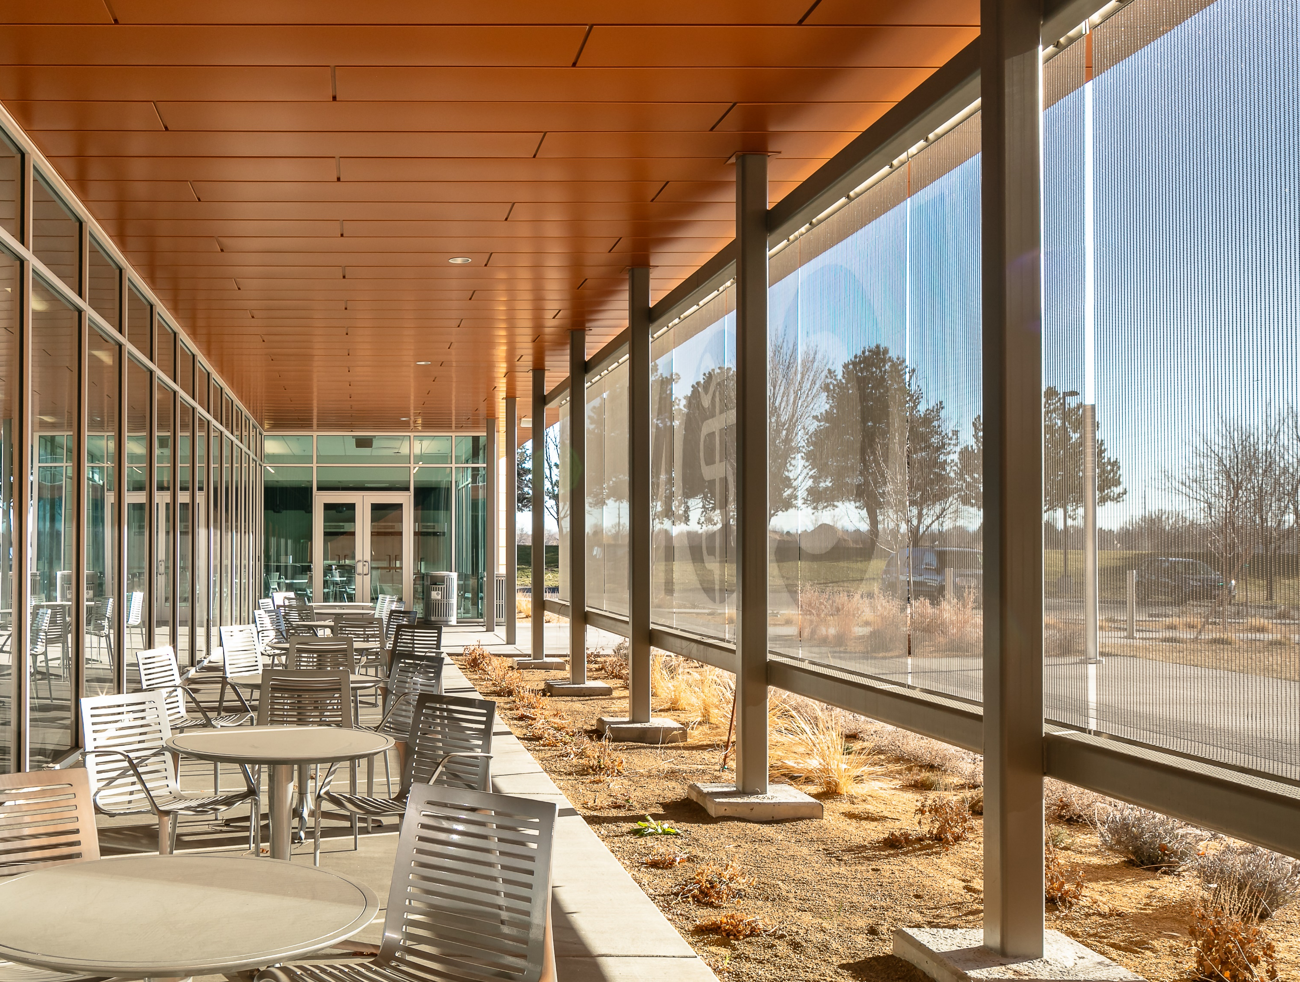
Case Study: Idaho College of Osteopathic Medicine (ICOM)
Notes:
Solar Shading Made of Stainless Steel Metal Fabric
Idaho College of Osteopathic Medicine (ICOM)
Folsom, CA
LEED
Additionally, the environmental benefits of metal mesh solar management products support LEED goals. Earning LEED credits through the New Construction, Schools, Healthcare, Commercial Interiors, and Retail rating systems is now more than ever important. The credit categories that metal fabrics can contribute to are as follows:
Optimize Energy Performance: Metal fabric utilized as a veil or exterior façade reduces solar heat gain by shading the building, thus reducing the energy required to power HVAC systems. Metal fabric also allows the transmission of natural light, providing effective internal illumination while reducing the related energy costs.
Building Product Disclosure and Optimization – Material Ingredients: The cable and materials of metal fabrics are typically 60% recycled materials and 40% new materials. During manufacturing 100% of the scrap or unused material is recycled. The material is 100% recyclable when it reaches its’ useful life.
Building Product Disclosure and Optimization – EPDs: Environmental Product Declarations are available for metal fabric products, earning projects points in this category.
Building Life-Cycle Impact Reduction and Building Reuse: An existing building can be fitted with a façade of metal fabric material for a long-lasting, new appearance with the same sun shading and energy saving benefits of a new building.
Daylight: The use of a metal fabric façade has the benefit of connecting occupants with indoor and outdoor spaces. Undeniably, this leads to greater productivity, healthier environments, increased airflow, and shading.
LEED Accredited Professional: To earn points in this category, choose a manufacturer that maintains LEED certified professionals on staff.
Light Pollution Reduction: A metal fabric façade on the outside of a building helps to control light intensities from natural and unnatural sources. Reasonable light can pass and visibility to the outside is allowed.
Acoustic Performance: When used for interior ceilings, attractive and durable acoustic ceiling systems provide noise reduction and control.
Quality Views: The transparency of a metal fabric façade allows for a clear view while shading light and heat.

Slide 28
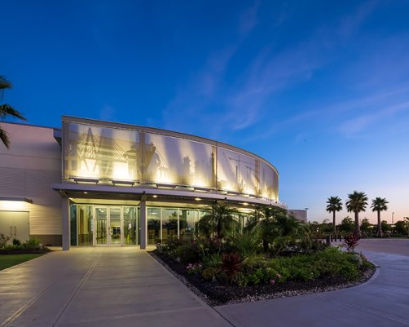
Learning Objective #3
Explore how to create visual identity and branding with metal fabrics, including etching, lighting, color, and transparent media facades.
Notes:
Next, we will explore how to create visual identity and branding with metal fabrics, including etching, lighting, color, and transparent media facades.
PICTURED:
Houston Area Safety Council, Houston, TX

Slide 29
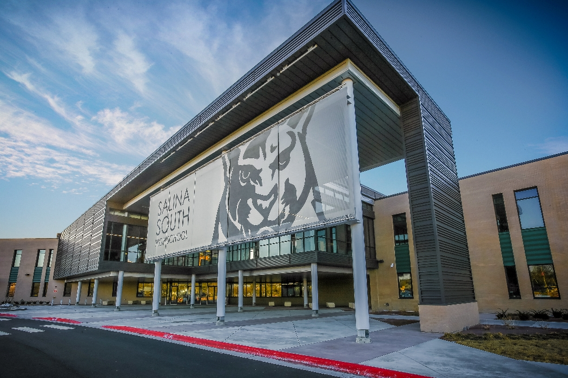
Etched Graphics
Etching – process that transfers graphic elements onto a hard metal surface
Import a graphics file into a masking plotter
Plotter creates masks – transferred to grids – and applied to the metal fabric for etching
Contrast of the graphics is controlled by the duration of the blasting and blasting media used
Results are permanent
*Note that because the graphics are etched on the flat surface of the front of the panel, they are not clearly visible from the back of the panel. However, both sides of the metal fabric may be etched if desired.
Notes:
Etched Graphics
Etched metal fabric combines form and function to provide architects, designers, and facility managers with a unique and artistic solution to traditional building façades, curtains, and other applications. The etching process creates visual imagery that is nothing short of amazing. When used as an exterior or interior façade, transparency is also achieved, allowing visibility and measured lighting. Etching brings logos or permanent branding to life by producing a matte surface that contrasts with the polished surrounding area, providing artwork that is unlimited in scale. The results are unique and artistic, with appearances altering as the viewing and lighting angles change throughout the day.
Etching is the process that transfers graphic elements (i.e. branding, logos, etc.) onto a hard metal surface such as metal fabric. Because the graphic elements are etched directly into the surface, it is weather-resistant, durable, and fade-resistant. The etching process begins by importing a graphics file, which has been created in a suitable program such as AutoCAD, into a masking plotter. The plotter creates masks, which are then transferred onto grids and applied to the metal fabric for etching. The contrast of the graphics is controlled by the duration of the blasting and the blasting media used. Since the graphics are etched directly onto the metal surface, the result is permanent.
There are some factors to take into consideration before a graphic is created for etching. Graphics are only limited by the intricacy of the details, but because metal fabrics are woven and contain some degree of porosity, subtle details may be lost. Therefore, large scale graphics rather than fine line detailing is more amenable to etching. Lighting and other effects can be added, which we will discuss in the next section.
*Note that because the graphics are etched on the flat surface of the front of the panel, they are not clearly visible from the back of the panel. However, both sides of the metal fabric may be etched if desired.
PICTURED:
Salina South High School, Salina, KS

Slide 30
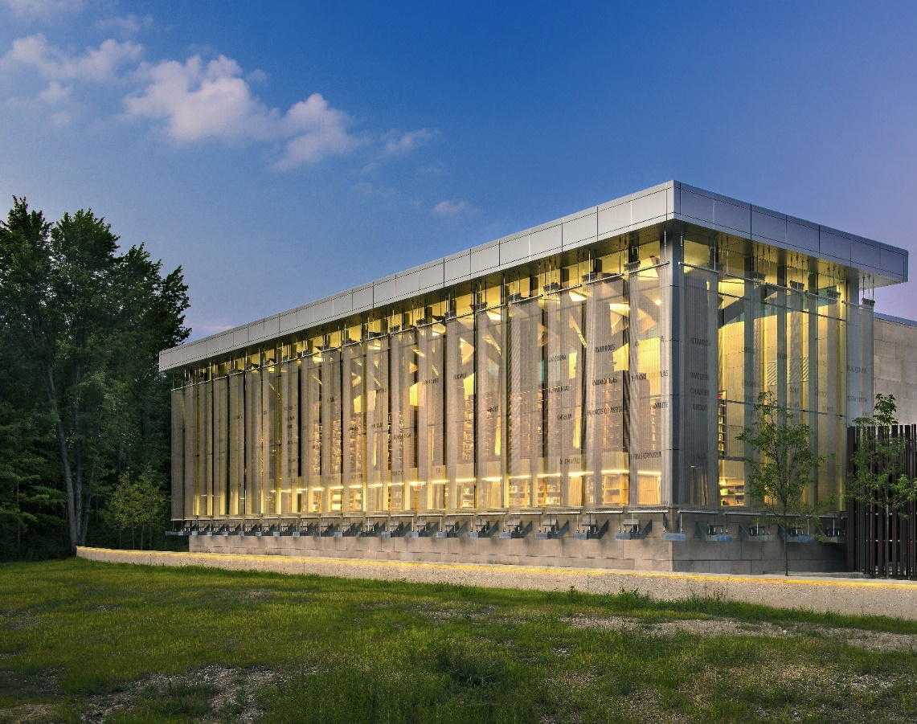
Case Study: Liberty Fund Library Project
Notes:
ETCHING CASE STUDY
Liberty Fund Library Project
Carmel, IN
A case study that demonstrates etching is the Liberty Fund library project. It began with the purpose that the pursuit of Liberty be at the forefront of the establishment and their priceless collection of books should be visible to passersby.
Clear glass was paired with 30 stainless steel metal fabric sunscreens, totaling 4,771 feet, with etching and custom-designed galvanized steel brackets.

Slide 31
Case Study: Liberty Fund Library Project
Notes:
ETCHING CASE STUDY
Liberty Fund Library Project
Carmel, IN
Liberty Fund's founder Pierre Goodrich, created a timeline with key people, writings and events, which provided the basis for the organization's mission.
The letters etched onto the material became a visual 35-foot high representation of that mission, with the metal fabric cut in specific widths that represented the centuries.

Slide 32
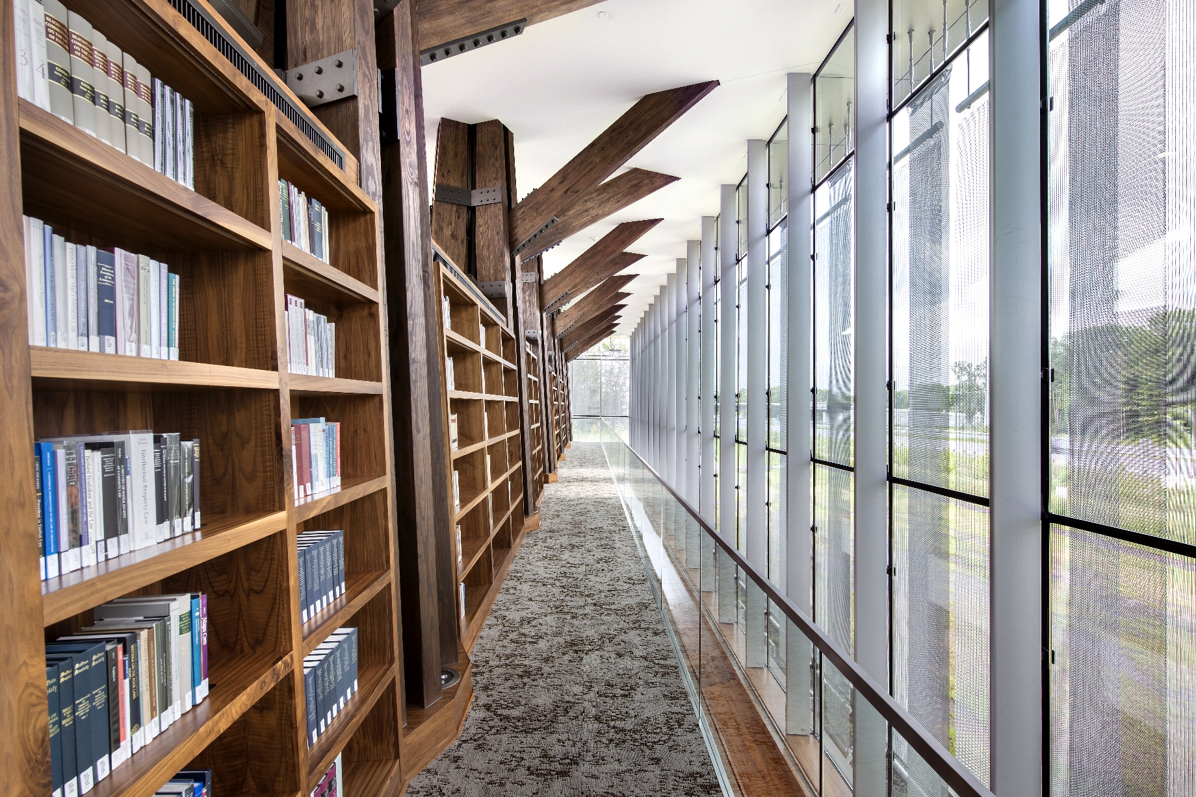
Case Study: Liberty Fund Library Project
Notes:
ETCHING CASE STUDY
Liberty Fund Library Project
Carmel, IN
Flexible, one-direction metal fabric was used as a second screen behind each panel that created a continuous solar shading effect. This contrasting of metal fabrics helps to avoid geometric shift which is also known as the moiré pattern effect which would be visible to cars passing by.

Slide 33
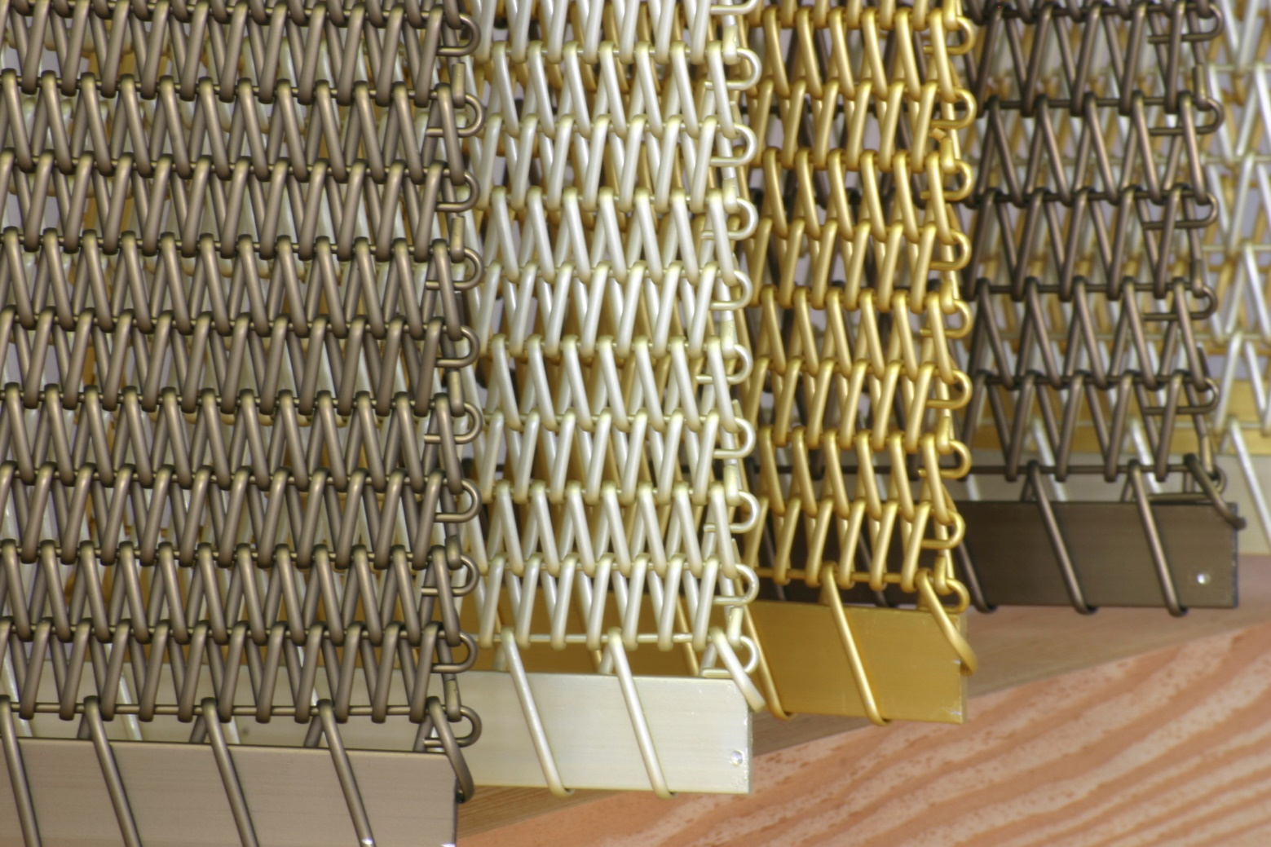
Colors and Surfaces
Austenitic Stainless Steel (AISI Type 316)
Protective coating not required to maintain durability
Color coatings and a variety of finishes and surfaces are an option
Colored coatings produce different impressions and external appearances
May be applied to give the project aesthetic merit
Able to be coated, anodized, and printed to great effect
Notes:
Colors and Surfaces
Because austenitic stainless steel (AISI Type 316) is noncorrosive, protective coatings are not required to maintain maximum durability, but color coatings and a variety of finishes and surfaces are an option. Depending on the location, colored coatings can produce different impressions and external appearances and may be applied to give the project an aesthetic merit not otherwise realized with raw metal. Metal fabrics can be coated, anodized, and printed to great effect.

Slide 34
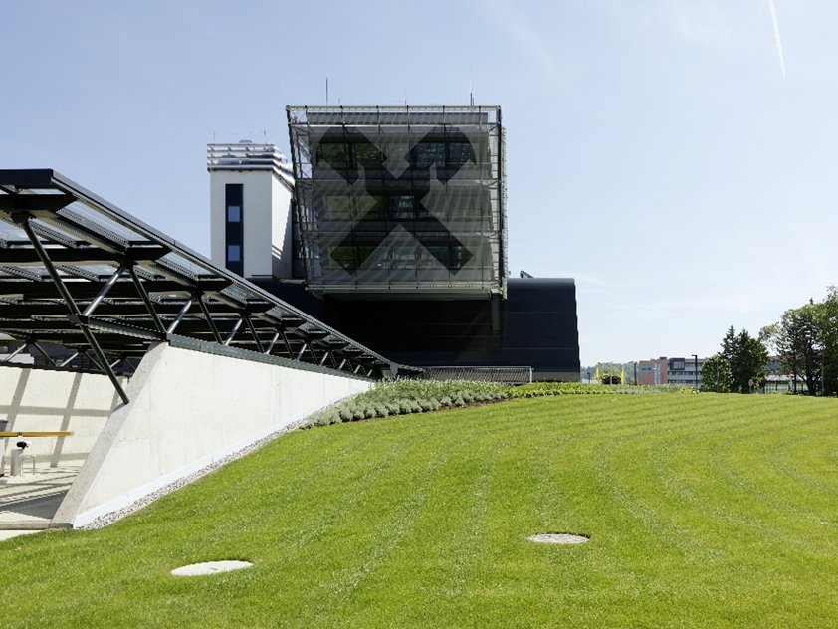
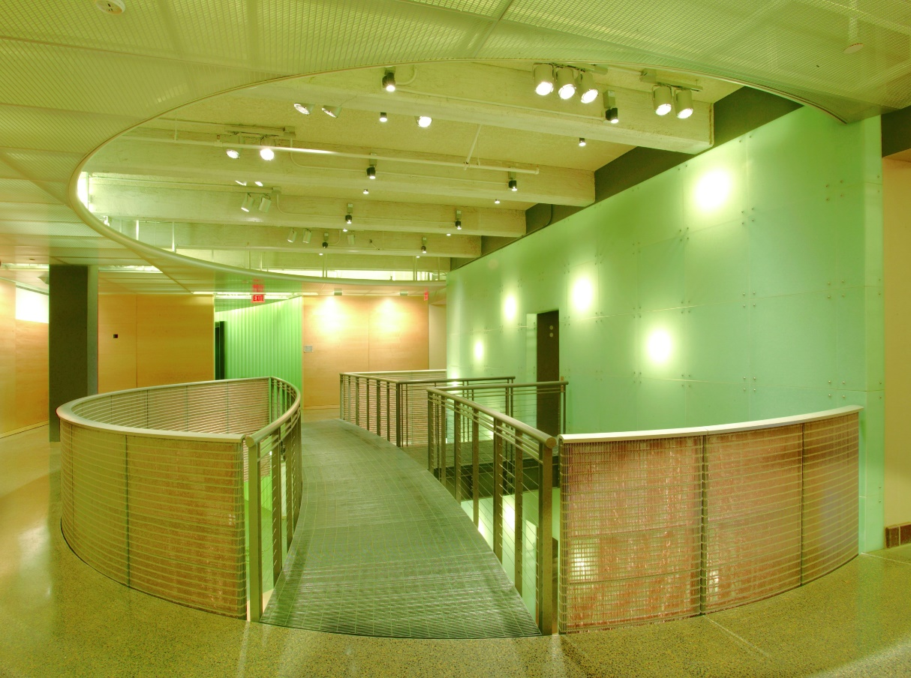
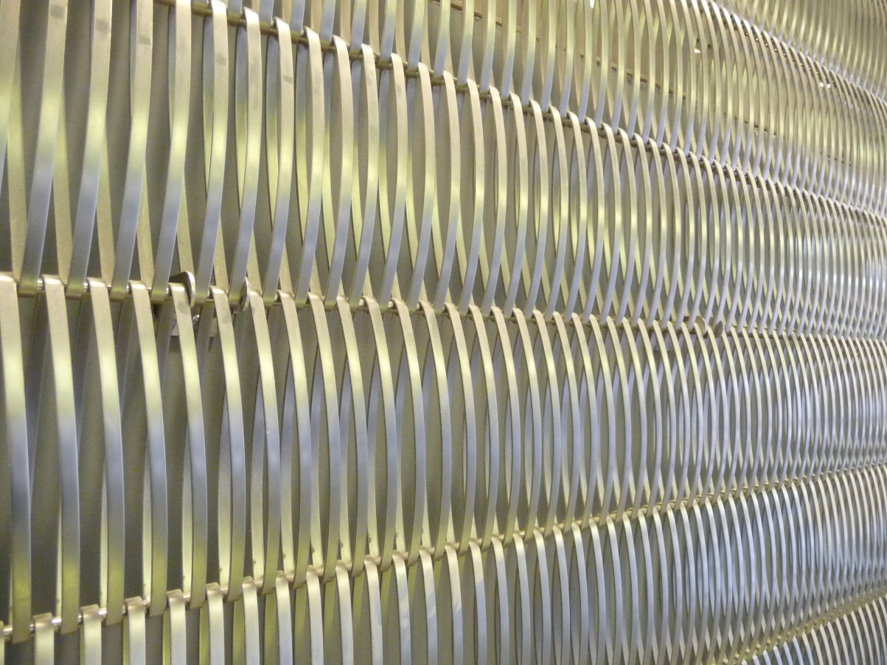
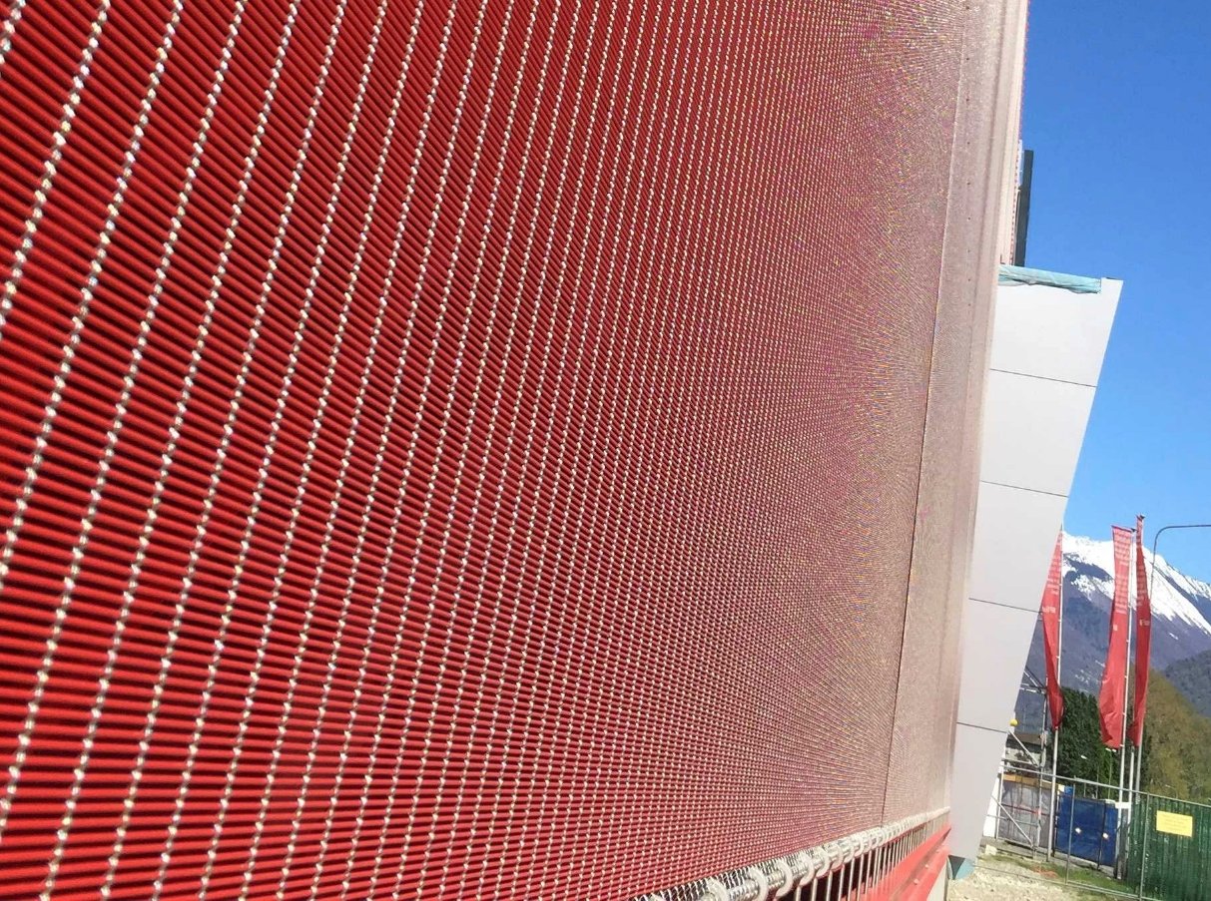
Coated Metal Fabrics
Painted Metal Fabric
Produced using a continuous wet-coating process that coats both flat and round wires
Best used with relatively dense mesh types
Suitable for both indoor and outdoor applications
Spiral and cable fabrics can be coated with a variety of colors
Colored metal fabrics offer a wide range of colorful architectural textures.
Notes:
Colored metal fabrics open a wide range of colorful architectural textures. In fact, metal fabrics were discovered as a colorful functional design element in architecture around twenty years ago.
Painted metal fabric is produced using a continuous wet-coating process that coats both flat and round wires; it is best used with relatively dense mesh types and is suitable for both indoor and outdoor applications. During this continuous process, high-grade special coatings are applied and heated to create a powerful bond. The continuity of the process allows any quantity of wires to be permanently color-coated and, depending on the mesh, enables finished products of up to 26 feet and virtually any length. Stress tests carried out by an independent party guarantee the durability of the material.
Spiral and cable fabrics can be coated in a variety of standard colors such as black, white, red and gold, and custom RAL colors when ordered in large quantities. Other factors such as the background, viewing distance, and viewing angle as well as lighting and light reflections on the metal fabric have a significant effect on the structure and mounted mesh fabric. Other effects and constantly changing light conditions, such as daylight with varying sun positions and cloud cover, or artificial light from different light sources, can also change how colors are perceived.

Slide 35
Anodized Aluminum Mesh
Continuous Process (Electrochemical Process)
Creates an oxide coating that protects the aluminum from corrosion
Allows fabric to be used indoors and outdoors
Wire is anodized prior to weaving
Multi-colored panels can be created by interweaving different colored wires
Protects against environmental influences - UV radiation or temperature deviations
Batch Process (Electrochemical Process)
Suitable only for rigid types of mesh
Notes:
Aluminum is another material sometimes used for designing facades. The lightweight metal has a low, specific weight while also offering high strength and good corrosion resistance. When exposed to air, aluminum gradually forms a natural protective layer that insulates it from corrosion and gives it a matte-grey appearance. However, aluminum profiles or plates in facades are usually anodized to protect them from environmental influences and mechanical effects. Aluminum mesh can be anodized via a continuous or batch process.
Flexible meshes are anodized in a continuous electrochemical process to create an oxide coating that protects the aluminum from corrosion, which allows the fabric to be used both indoors and outdoors. The wire is anodized prior to weaving and then subsequently colored, which contrasts with the batch process. Multi-colored panels can be created by interweaving different colored wires. Alongside its decorative properties, this type of coating also guarantees protection against environmental influences such as UV radiation or temperature deviations.
The batch process is also an electrochemical process for creating a protective layer on the aluminum wires. However, this method differs in that it is only suitable for rigid types of mesh. The interwoven material is divided into pre-assembled mesh panels that are immersed in individual tanks where they undergo various coating stages in this static tank system. The resulting oxide layers can achieve highly individualized properties by selecting different electrolytes and bath parameters such as temperature and aluminum content.
PICTURED:
Luna Apartments, Melbourne, Australia

Slide 36
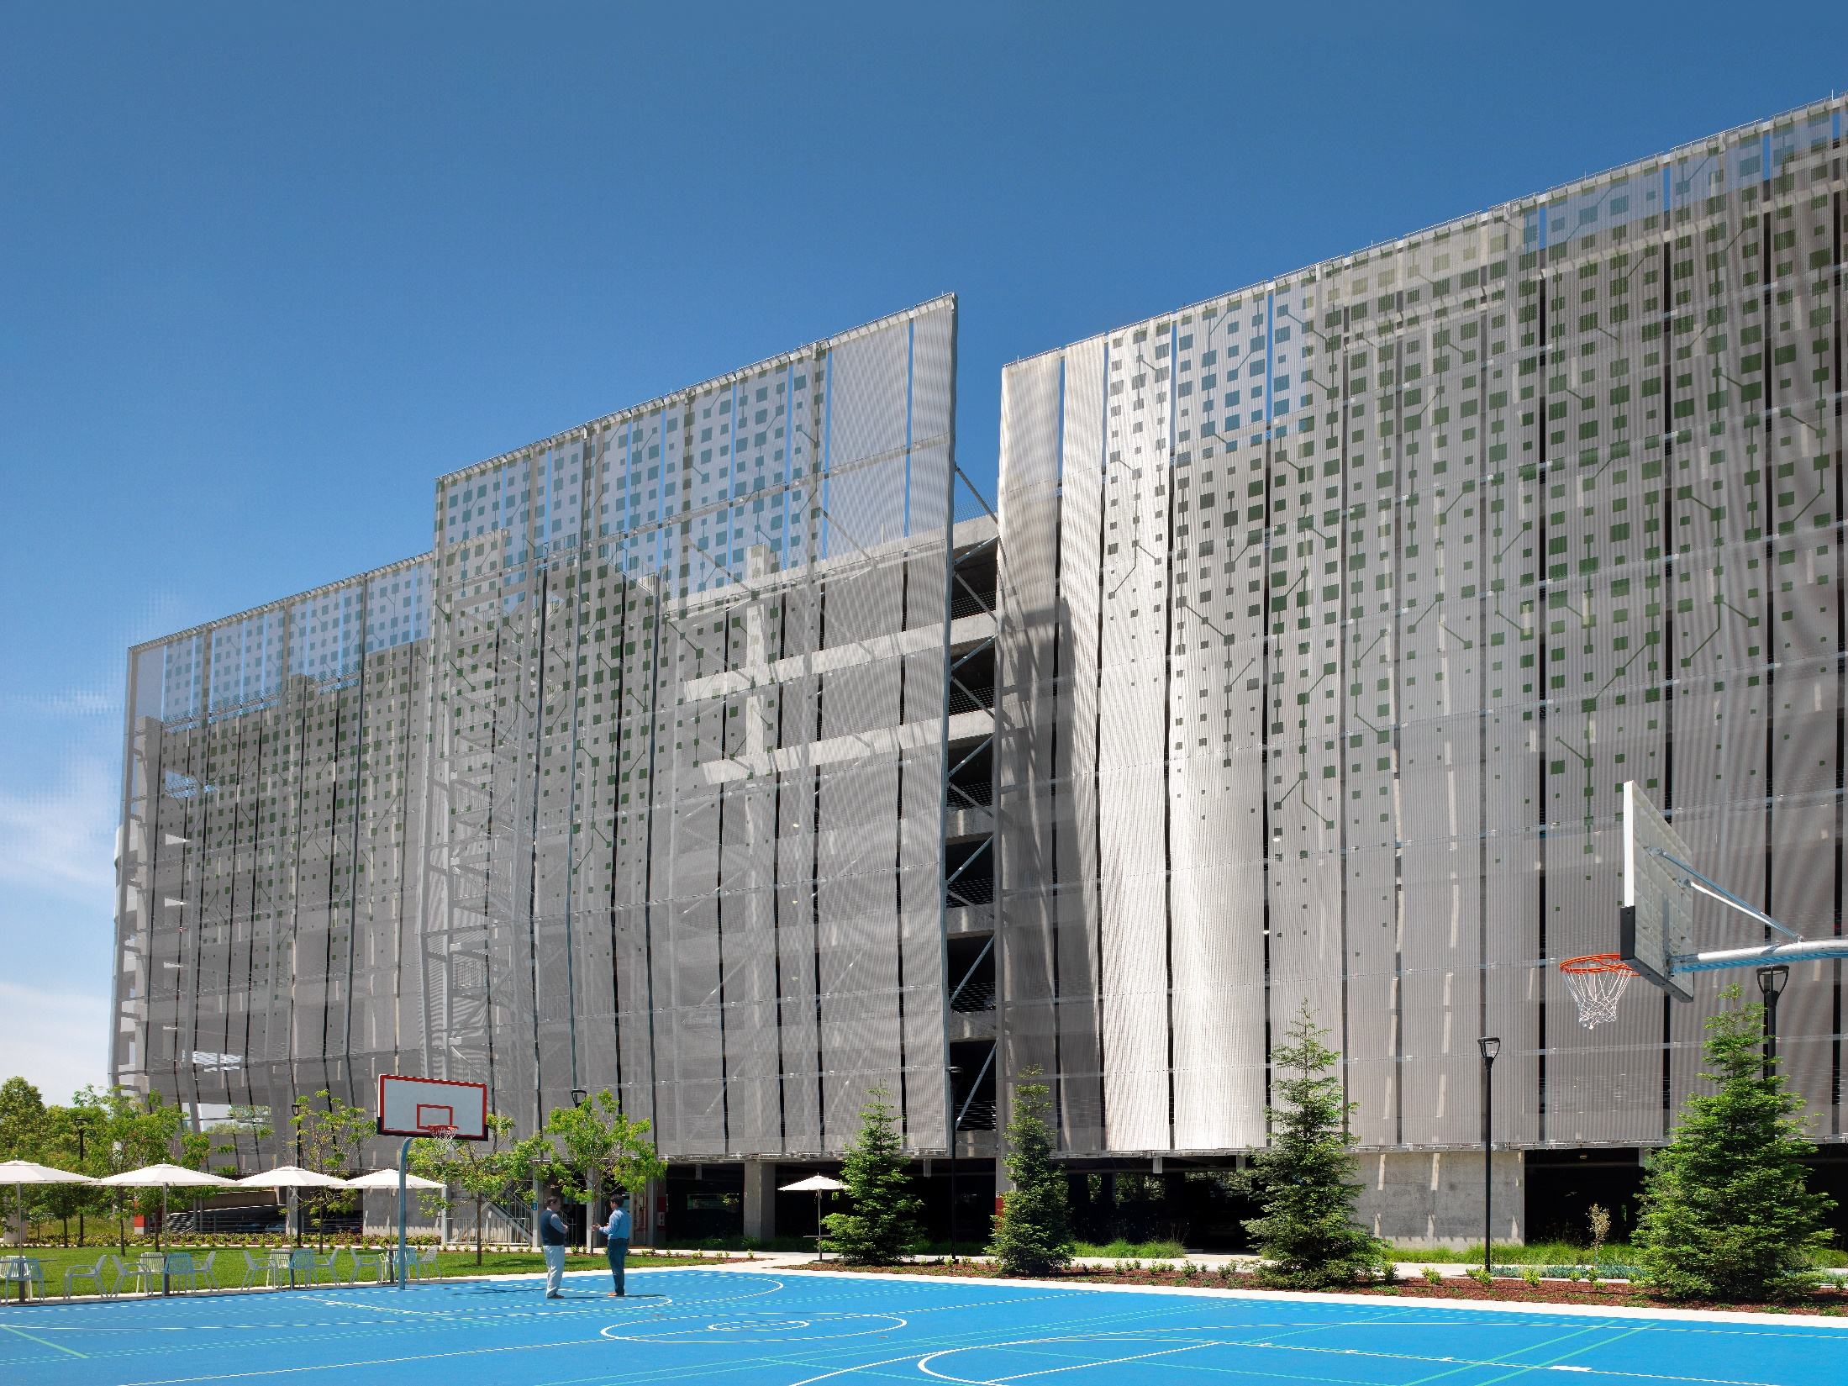
Printed Metallic Mesh – Screen Printing Process
Allows for complex graphics
Hardens under UV light
5x to 10x thicker paint layers than other printing methods
Notes:
Complex graphics can be applied to exterior metallic mesh projects, such as facades, using screen printing technique. One advantage of screen printing is the ability to vary the color application by using different grades of mesh fineness. The paint is applied to the mesh by a template on a frame and then hardens under UV light. Areas not to be printed are covered by the template. The desired motif is thereby reproduced on the surface of the metal. This process results in very thick paint layers that are five to ten times thicker than other printing methods, making screen printed meshes perfect for indoor and outdoor applications. All colors can be printed, but blended colors cannot, so screen printing is more suited to full-surface graphics.
Alongside the various methods for printing solid colored mesh surfaces, UV direct printing allows complex graphics and even photographs with fine color gradients to be printed onto mesh. The digital printing process can be used to print mesh sheets up to 2.50 meters wide and 20 meters long. The motif is applied to the surface of the mesh using a large-format printer and is then immediately hardened with ultraviolet light. Therefore, the ink does not dry out through the ambient air – as is the case on paper – but is rather hardened immediately after its application. With mesh types such as Omega, Lamelle or Lago this produces impressive results. If the motif to be printed has a white background, the mesh surface is printed white in the first printing pass and the actual motif is applied in a second pass. GKD uses metallic mesh printed using a digital printing process solely for indoor applications. UV technology produces the best matt or glossy effects or a combination of the two.
Thanks to its structure and surface, the printed mesh is generally wind-permeable and robust in all weather conditions regardless of the weave type. In the digital printing process, the motif is applied to the surface of the mesh using a large-format printer and is then immediately hardened with ultraviolet light. If the motif to be printed has a white background (for example), the mesh surface is printed white in the first printing pass and the actual motif is applied in a second pass. UV technology produces both matte and glossy effects or a combination of the two can be used. This type of printing is not suitable for outdoor applications.

Slide 37
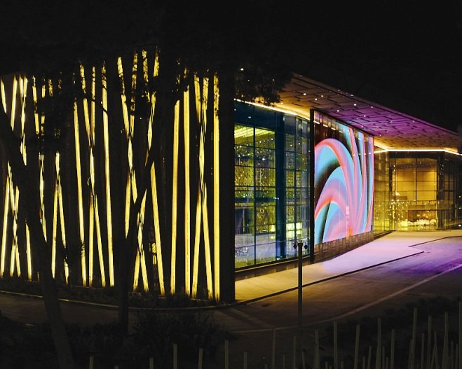
Learning Objective #4
Identify ideal applications for the product and review case studies where the material was used.
Notes:
We have already shared with you several case studies that showcase the many ways that metal fabric can contribute to modern building design and construction:
Samsung Headquarters showed metal fabric in a parking garage application as well as the some of the secondary finishes that can be applied to realize a design component.
ICOM demonstrated the solar management capabilities that can be gained through the use of metal fabric and also branding opportunities with capabilities such as etching.
With the Liberty Fund Library, we again saw metal fabric used in a transparent façade application that allows views to the inside as well as views from the inside out.
In this last portion of the presentation, we would like to discuss the use of metal fabric as a communication medium. Stainless steel metal fabric combined with LED technology creates an architectural material that can be used for large format media displays.
PICTURED:
Tripoli International Convention Center

Slide 38
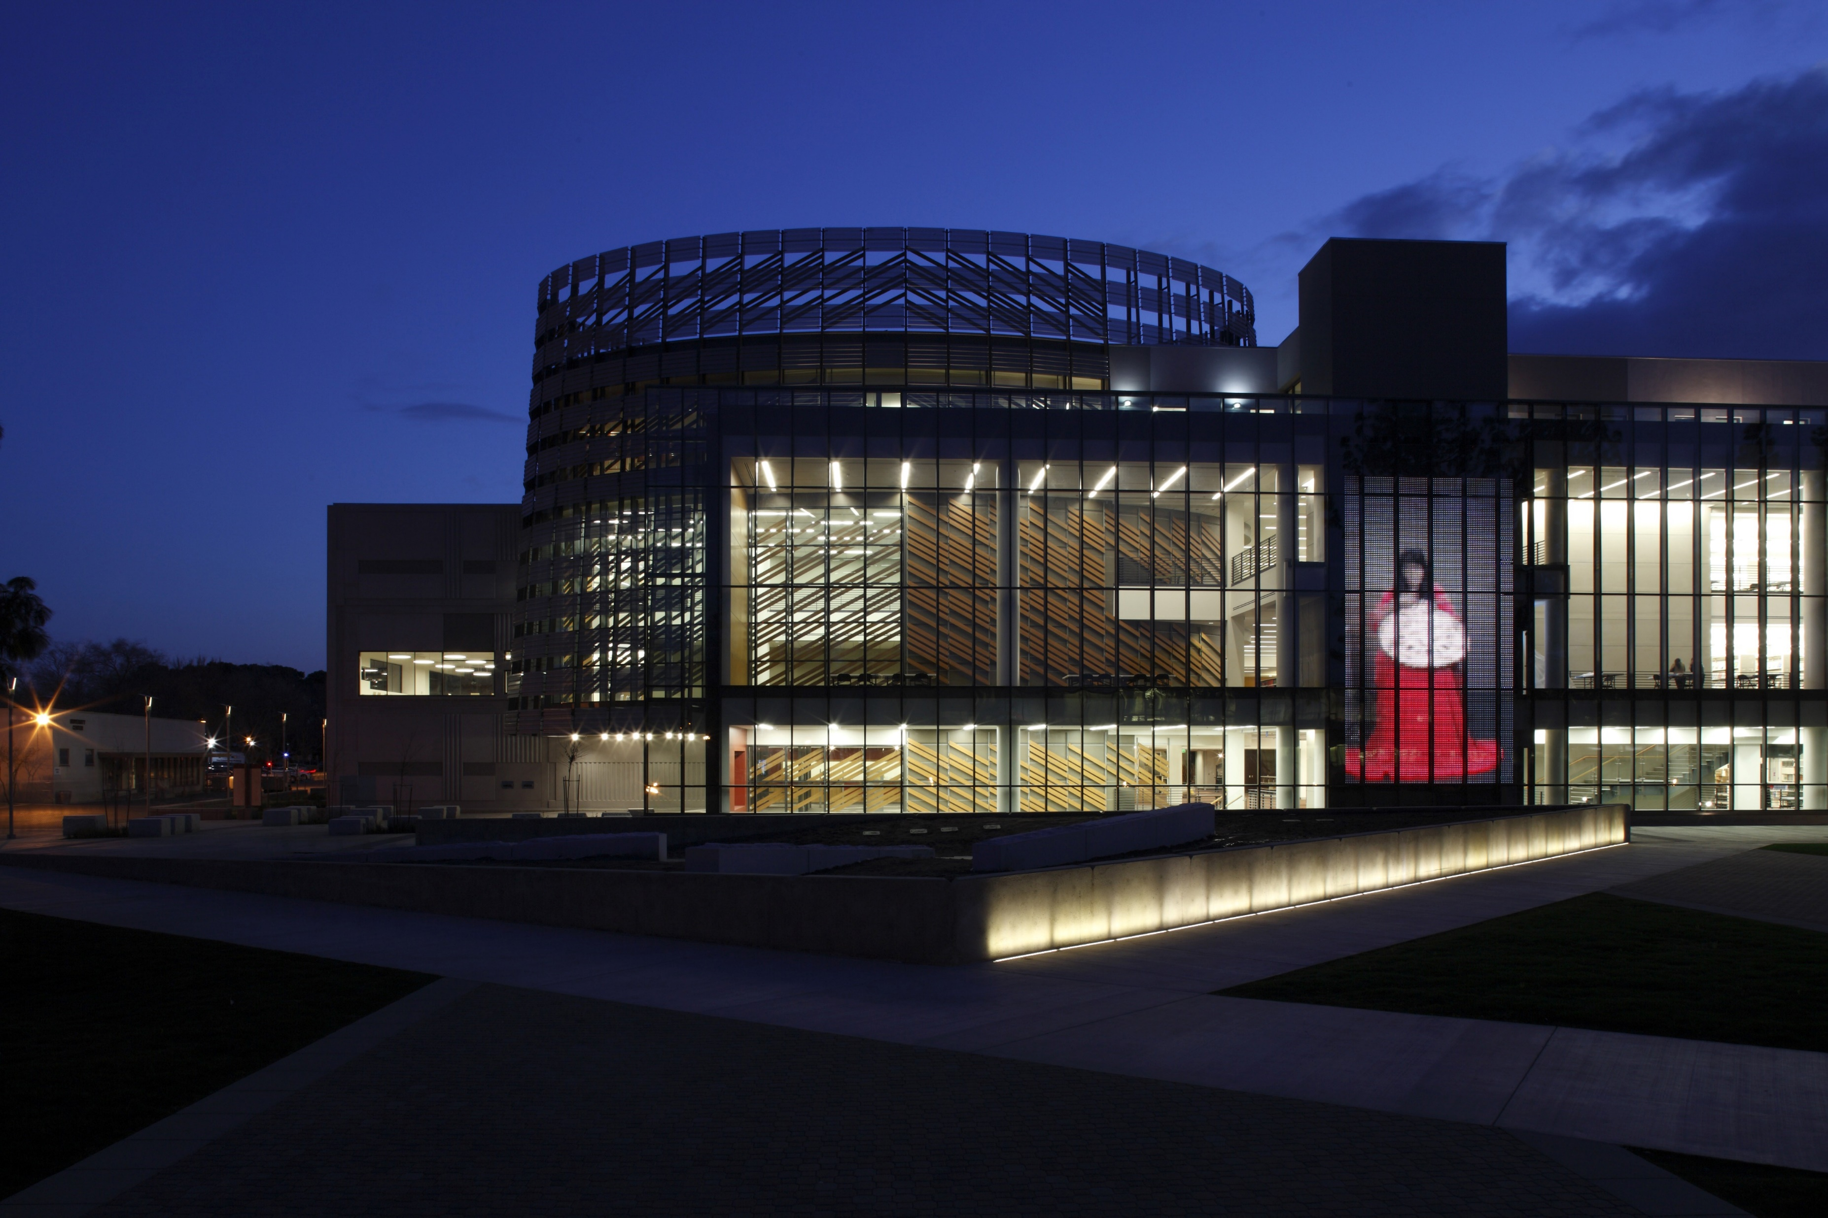
Transparent Media Façade Technology
Transparent media facades consist of stainless steel mesh with LED lights interwoven into the fabric to create a transparent, digital display of images, text, logos, video, live broadcast, public service announcements, and art.
Media façade technology conforms to a structure’s unique shape and design and transforms them into a dynamic communications medium.
Notes:
Through digital technology and the visual power of energy-efficient LEDs, everything from branding graphics to video, live broadcast to conceptual art, can be displayed on what has become the “silver screen” of the 21st century. Transparent media facades consist of stainless steel mesh with LED lights interwoven into the fabric to create a transparent, digital display of images, text, logos, video, live broadcast, public service announcements, and art. Media facades are easily installed over any building surface where transparency, scale, and long viewing distances are present. Media façade technology conforms to a structure’s unique shape and design and transforms them into a dynamic communications medium.
PICTURED:
California State University, Henry Madden Library, Fresno

Slide 39
Transparent Media Façade Technology
Up to 60% transparency
Allows for natural, filtered daylighting
Allows for views to be maintained
The perfect solution when transparency is required so that a building’s unique architectural elements are visible.
Notes:
With up to 60% transparency, the mesh still allows for natural, filtered daylighting while also shading the building. This is the perfect solution when transparency is required so that a building’s unique architectural elements are visible. Views from within the building are maintained and natural daylighting and ventilation to the building surfaces are still provided while generating little residual light into the space.
PICTURED:
Cook Children’s Hospital, Fort Worth, TX (left and right)
Celebrity Cruises’ Terminal 25, Port Everglades, FL (center)

Slide 40
Transparent Media Façade Technology
Large Format Display
Ideal for large-scale applications
Longer, broader viewing range
Greater message rotation
Supports a wide range of advertisers on one display
Transforms a building into a media icon
Notes:
Transparent media facades are ideal for large-scale applications; the average installations are approximately four times the size of traditional billboards. This larger format allows a longer and broader viewing range and greater message rotation. It also supports a wide range of advertisers on one display without compromising the graphic quality of the message. Dynamic media presentation will draw attention and transform a building into a media icon. Several resolution options are available to meet the needs for viewing distance and clarity.
PICTURED:
Long Beach Court House, CA

Slide 41
Transparent Media Façade Technology
Graphics and brightness are controlled through a web-based interface via many formats, so messages can be quickly changed out for promotions, news, weather, or to convey market conditions.
Real-time messages are possible for live events such as sporting events or concerts.
The graphics may be viewed both day and night due to high quality LEDs with more than 90,000+ hours of high performance with low electrical consumption.
Notes:
Graphics and brightness are controlled through a web-based interface via many formats, so messages can be quickly changed out for promotions, news, weather, or to convey market conditions. Real-time messages are possible for live events such as sporting events or concerts. Civic messaging such as National Emergency Broadcasts, Amber Alerts, traffic, and weather conditions can be conveyed in real time. The graphics may be viewed both day and night due to high quality LEDs with more than 90,000+ hours of high performance with low electrical consumption.
PICTURED:
Stanford University Bass Biology Building, Palo Alto, CA

Slide 42
Transparent Media Façade Technology
Cover 4x the surface area of traditional media displays but use up to 80% less electricity
Transparent media facades are sustainable covering four times the surface area of traditional media displays but use up to 80% less electricity.
Notes:
Sustainability
Transparent media facades are sustainable because they can cover four times the surface area of traditional media displays but use up to 80% less electricity. Automatic LED luminance controls adjust light intensity for ideal viewing and significant energy reductions, while mesh provides passive solar shading, daylighting, and improved air circulation. LED sleeves slide out and permit LED lights to be replaced after their useful life while the stainless steel mesh remains in place.
PICTURED:
Celebrity Cruises’ Terminal 25, Port Everglades, FL (center)
Long Beach Court House, CA

Slide 43
Case Study: Stanford University Bass Biology Building
Notes:
Stanford University Bass Biology Building
Palo Alto, CA
Origin
With the completion of the Anne T. and Robert M. Bass Biology Research Building at Stanford University, biology faculty and students that were once spread across campus were brought together under one roof. The five-story structure is dedicated to research in life sciences, providing a shared environment that fosters intellectual and social interaction. Stanford desired an additional layer of design to crown the new building, especially given its high-profile location. Knot, a firm specializing in landscape architecture and experiential graphic design, was hired to create the concept for this next phase of design.
Knot was tasked with telling stories of science in a non-literal, abstract way and were given broad artistic license to explore multiple themes and variations.
A Beacon of Science
The result was Morphogenesis (Morpho-GEN-uh-sis), the first installation that connects user interaction with a large-scale media mesh platform. Based on Alan Turing’s theory of Morphogenesis, which describes how spots and stripes manifest in nature, users of interact with a generative algorithm by manipulating parameters via a touchscreen at the building’s main entrance. Users play with the interactive interface and save the patterns they create. Those settings populate the permanent art piece shown on the display. The longer the artwork is running, the more diverse its content will become.

Slide 44
Case Study: Stanford University Bass Biology Building
Specification
Install transparent fabric media on a glass bridge spanning Discovery Walk
Fabricate a 32-foot-tall display using transparent media façade technology
“[A fabric media façade] was most appropriate because it’s an architecture material and a perfect product for the scale of the piece.” Michael Yun, Knot Principal and Director of Anti-Disciplinary Design
Notes:
TRANSPARENT FABRIC MEDIA TECHNOLOGY CASE STUDY
Telling Stories Through Science
Stanford University Bass Biology Building
Palo Alto, CA
Specification
With the intent for this public art to be highly visible and interactive, the design team saw an opportunity to install it on a glass bridge spanning Discovery Walk. A metal mesh manufacturer was brought in to fabricate a 32-foot-tall display using transparent media façade technology. “Stanford wanted to have impact, something that was large-scale and took advantage of the position on campus,” said Michael Yun, Knot Principal and Director of Anti-Disciplinary Design. “[A fabric media façade] was most appropriate because it’s an architecture material and a perfect product for the scale of the piece.”
Seismic-related building codes did not allow placement of the media mesh on the building’s exterior. The solution was to hang the media facade between large glass panels located just inside the building envelope. The fabric’s finished quality added to the interior space for pedestrians crossing the bridge span rather than detract from it. As an interior product, noise and heat were of no concern. Transparent media façade technology uses electronic power supplies which are extremely efficient, low voltage and do not require energy-consuming fans.

Slide 45
Case Study: Stanford University Bass Biology Building
Notes:
TRANSPARENT FABRIC MEDIA TECHNOLOGY CASE STUDY
Telling Stories Through Science
Stanford University Bass Biology Building
Palo Alto, CA
Challenge
While the project ran smoothly, it was not without its inherent challenges. “The biggest thing was attention to detail,” said Mike Leonard, Assoc. AIA, DSCE, GKD Technical Director of Mediamesh™ Systems. “Knowing that we were going to have potentially thousands of people interacting with it every day, we had to make sure it was clean and safe. With it located in one of the worst seismic zones in the United States, safety was also a design concern. Logistically, it was a fast-paced project on a busy campus and we had to crane the crates through windows because there were no freight elevators or other transport large enough to accommodate delivery of the materials.”
One unique requirement of the project team was determining how to engineer an interactive interface to control a 32-foot tall fabric media wall. Morphogenesis functions using custom-coded touch sensors that integrate hardware and software for user interaction with a control panel that serves as a visual synthesizer to create an infinite variety of moving patterns and colors.
Visibility took careful evaluation, “with every project we evaluate the viewing angles of the display and customize the LEDs to reach the targeted audience,” continued Leonard. “We conduct a viewing angle analysis of the site and the location of the screen to ensure the impact of the display is at optimal brightness.” In this particular case, the display is located behind glass with the intent to display to an exterior viewing audience. This required a careful calculation of brightness to the outside as well as reflection level into the room behind it.
Results
Morphogenesis realized Stanford’s vision for abstracted storytelling. The design team created and deployed a new type of interactive, public art that leverages large-scale digital signage technology in new ways. The resulting impact of Morphogenesis extends beyond the building and adjacent plaza, providing a beacon that draws visitors from Stanford’s medical campus into the science quad.

Slide 46
Conclusion
We hope you now have a better understanding of how technologically advanced woven metal fabric can be used to create beautiful, engaging, and highly functional elements for commercial building exteriors.
From its origin as a raw alloy, to finished product, to transparent media facades, metal fabric amplifies the aesthetics of a building while providing safety, security, and solar management, all in a sustainable package.
When used in exterior applications, metal fabrics will outlast the life of the building due to their extreme durability, weather resistance, and corrosion resistance.
Notes:
We hope you now have a better understanding of how technologically advanced woven metal fabric can be used to create beautiful, engaging, and highly functional elements for commercial building exteriors. From its origin as a raw alloy, to finished product, to transparent media facades, metal fabric amplifies the aesthetics of a building while providing safety, security, and solar management, all in a sustainable package. When used in exterior applications, metal fabrics will outlast the life of the building due to their extreme durability, weather resistance, and corrosion resistance.

Slide 47
Thank You
www.gkdmetalfabrics.com
Notes:
Thank you for your interest in this course – we enjoyed showing you architectural mesh fabric can be a solution for your projects. We are now pleased to answer some questions. Feel free to continue adding your questions to the question pane. For any questions not answered during this session, we will respond to you by email.

